Slide 1
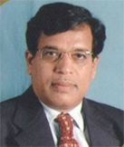

13/06/2020
COVID-19 –
Challenges & Opportunities
in Higher Education
Dr. A. D. Sawant
Pro Vice-Chancellor, University of Mumbai,
Vice-Chancellor,
University of Rajasthan, Jaipur.
Speakers
Topic Speaker
Dr. Sanjay Jagtap, Dr. A. D. Sawant
Dr. D. John Chelladurai, Shri. Rajnikant Shroff, Dr. Deepak D.Shelar
Topic:
Accepting the challenges & providing opportunities in Higher Education

Slide 2
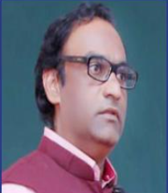
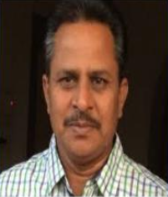
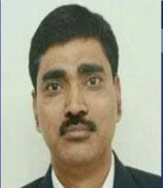
13/06/2020
An Overview of Qualitative & Quantitative Metrics Of SSR and Forthcoming AQAR
Dr. Ayub Shaikh
Prof. Bharat Kangude
Dr. Ramdas Pawar
Resource Admin
IQAC Cluster India
Resource Admin
IQAC Cluster India
Co Founder
IQAC Cluster India

