Slide 1
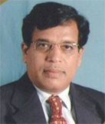

13/06/2020
COVID-19 –
Challenges & Opportunities
in Higher Education
Dr. A. D. Sawant
Pro Vice-Chancellor, University of Mumbai,
Vice-Chancellor,
University of Rajasthan, Jaipur.
Speakers
Topic Speaker
Dr. Sanjay Jagtap, Dr. A. D. Sawant
Dr. D. John Chelladurai, Shri. Rajnikant Shroff, Dr. Deepak D.Shelar
Topic:
Accepting the challenges & providing opportunities in Higher Education

