Slide 1
PROJECT TITLE
Predicting Building Damage After the Nepal Earthquake
Application of Machine Learning Methods to Predict the Level of Building Damage in the Nepal Earthquake
Implementation: Random Forest Classifier
Dataset: DrivenData Richter’s Predictor • 2015 Nepal earthquake
Team Members:
Shamanth Shekar K (PES1UG24AM258) • Sujan S Masaguppi (PES1UG24AM292)
Machine Learning Mini-Project • Nepal Earthquake Damage Prediction
1

Slide 2
INTRODUCTION
Problem Statement & Objective
Earthquake-related structural damage varies between buildings.
Manual assessment across large areas is time-consuming.
Predict one of three damage grades from building characteristics.
Support preliminary damage assessment and reconstruction planning.
Scope: damage classification from survey data — not earthquake forecasting.
Machine Learning Mini-Project • Nepal Earthquake Damage Prediction
2

Slide 3
DATA
Dataset and Target Classes
260,601
38
Labeled buildings
Input features
3
0
Damage grades
Missing values
Grade 1: Low damage • Grade 2: Moderate damage • Grade 3: Severe damage
Source: DrivenData Richter’s Predictor; train_values.csv + train_labels.csv
Machine Learning Mini-Project • Nepal Earthquake Damage Prediction
3

Slide 4
METHODOLOGY
Preprocessing and Model Workflow
1
Load & merge
Join CSV files using building_id
2
Prepare data
Remove ID/label from inputs; one-hot encode
3
Split
80% training / 20% testing; stratified
4
Train
Random Forest with 100 decision trees
5
Evaluate
Accuracy, F1, confusion matrix
Machine Learning Mini-Project • Nepal Earthquake Damage Prediction
4

Slide 5
ALGORITHM
Why Random Forest?
A supervised classification algorithm made up of decision trees.
Each tree votes for a damage grade; the forest selects the most-voted grade.
Works well with mixed numerical and encoded categorical inputs.
Model setting: n_estimators = 100; random_state = 42.
We use only one ML algorithm in this implementation.
Machine Learning Mini-Project • Nepal Earthquake Damage Prediction
5

Slide 6
EVALUATION
Test Results
71.60%
0.66
Accuracy / Micro F1
Macro F1
52,121
37,321
Test buildings
Correct predictions
Per-class F1 scores: Grade 1 = 0.55 • Grade 2 = 0.77 • Grade 3 = 0.65
Observed in the project’s held-out 20% split; not directly comparable to the paper’s separate test score.
Machine Learning Mini-Project • Nepal Earthquake Damage Prediction
6

Slide 7
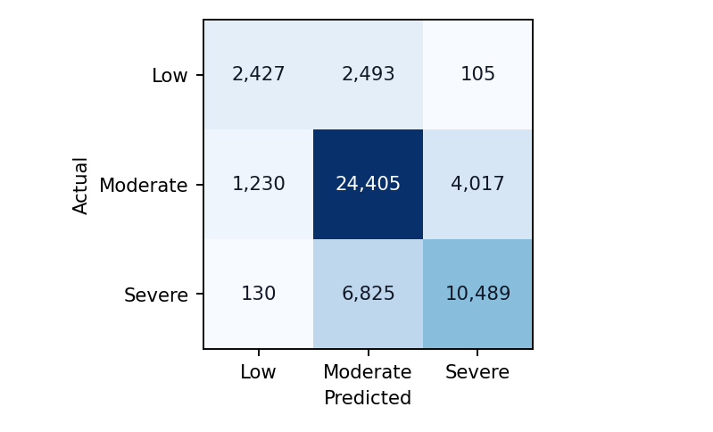
EVALUATION
Model Errors: Confusion Matrix
Main finding
The model identifies moderate damage most reliably.
6,825 severely damaged buildings were classified as moderate.
Machine Learning Mini-Project • Nepal Earthquake Damage Prediction
7

Slide 8
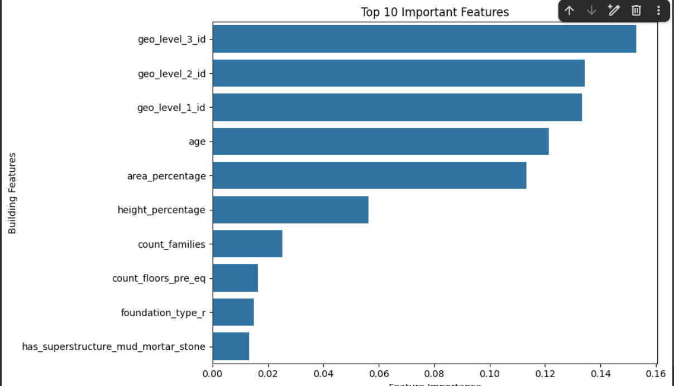
FEATURE IMPORTANCE
Which Inputs Matter Most?
Notable features
Location codes
Building age
Area and height
Construction factors
Importance is predictive, not causal.
Machine Learning Mini-Project • Nepal Earthquake Damage Prediction
8

Slide 9
DEMONSTRATION
Sample Prediction & Limitations
Held-out test building #10
Limitations
Floors: 2 • Age: 5 • Area %: 8 • Height %: 5
Less reliable for low and severe damage.
Damage labels depend on the dataset’s survey context.
Predicted: Severe (Grade 3)
Actual: Severe (Grade 3)
Predictions do not replace engineering inspections.
Estimated probability: 61.15%
Machine Learning Mini-Project • Nepal Earthquake Damage Prediction
9

Slide 10
WRAP-UP
Conclusion & References
A single Random Forest model predicts three building damage classes.
The model achieved 71.60% held-out test accuracy.
Location, age and structure-related inputs were influential.
Future work could focus on improving minority-class recall.
References
Y. Liang, “Application of Machine Learning Methods to Predict the Level of Buildings Damage in the Nepal Earthquake,” Stanford CS229, 2021.
DrivenData: Richter’s Predictor — Modeling Earthquake Damage (drivendata.org/competitions/57/nepal-earthquake/)
Machine Learning Mini-Project • Nepal Earthquake Damage Prediction
10

