Slide 1

CEIS110 Final Project
Programming in Python
Shane Keel
DeVry University
Engineering Technology

Slide 2

Introduction
With data growing exponentially, this project leverages a cloud-based system to capture real-time temperature and humidity readings, then uses Python's data analytics capabilities to reveal hidden patterns.

Slide 3
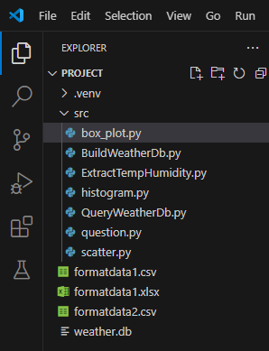
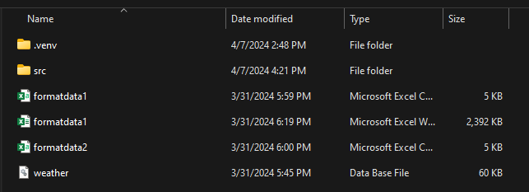
Software Inventory
To ensure a smooth development process, all necessary software, including Excel and Visual Studio Code, was installed and verified beforehand.

Slide 4
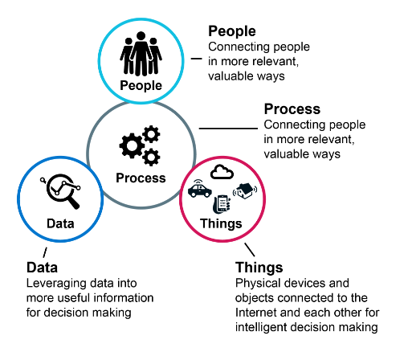
Agenda
Discuss the various project activities throughout the course session.

Slide 5
What are Flowcharts?
A flowchart is a visual diagram that shows the steps and decisions involved in a process. It uses simple shapes like boxes, diamonds, and arrows to represent actions, choices, and the flow of the process.

Slide 6
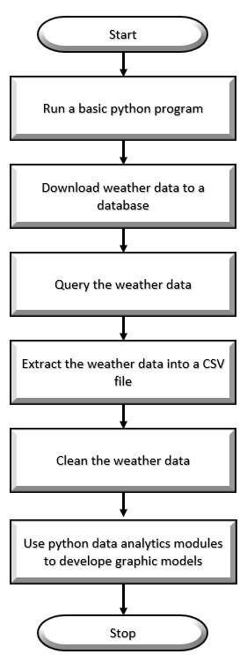
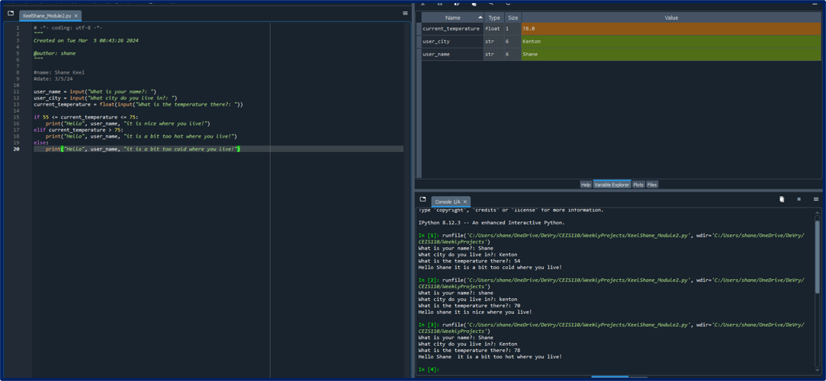
Project Flow
Week 2: Preparation
This week was dedicated to planning. I created a detailed flowchart to ensure I stay focused on task.

Slide 7
Introduction to Python Programming
Python 3 is a popular programming language known for its beginner-friendly syntax and versatility.
It can be used for various projects like web development, data analysis, and automation tasks.
Python's clear readability, extensive libraries, and the fact that it's an interpreted language contribute to its popularity and make it an excellent choice for those starting to learn programming as well as experienced developers.

Slide 8
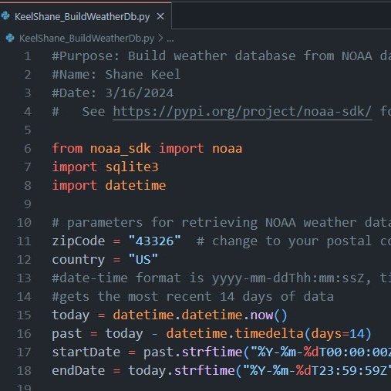
Week 3: Harnessing Weather Data
This week marked a significant step forward as I began collecting and organizing weather data. Here's a breakdown of the key tools I employed:
noaa_sdk: This library provided a seamless way to access and download weather data from NOAA (National Oceanic and Atmospheric Administration), ensuring I'm working with reliable, real-world information.
sqlite3: I used this database library to structure and store the downloaded weather data. This will be crucial for efficient analysis later in the project.
datetime: Manipulating dates and times is essential when working with weather data. The datetime library helped me manage timestamps and organize the data chronologically.

Slide 9
Asking Questions About the Data
Querying databases means using a specialized language like SQL to ask specific questions about the stored data.
This allows you to extract only the information you need, filter results based on specific criteria, and organize the data to uncover insights.
Querying is a powerful tool for analyzing databases and making data-driven decisions.

Slide 10
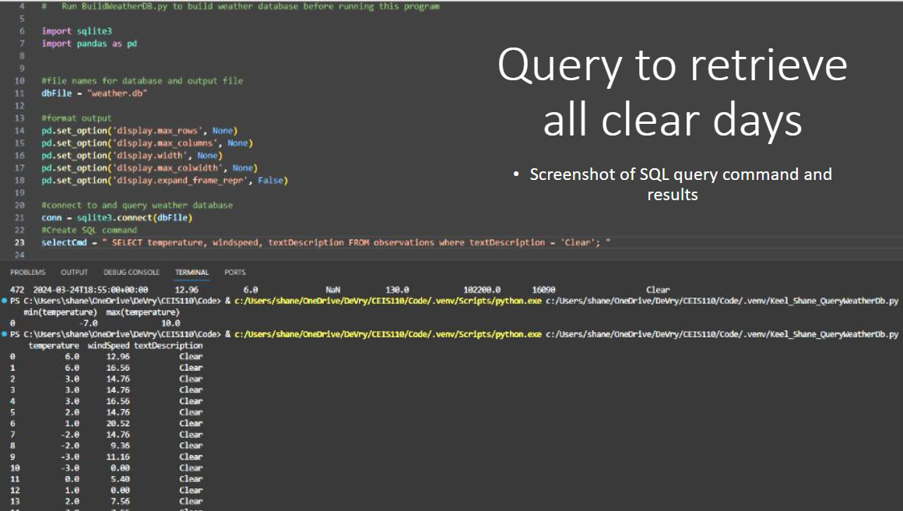
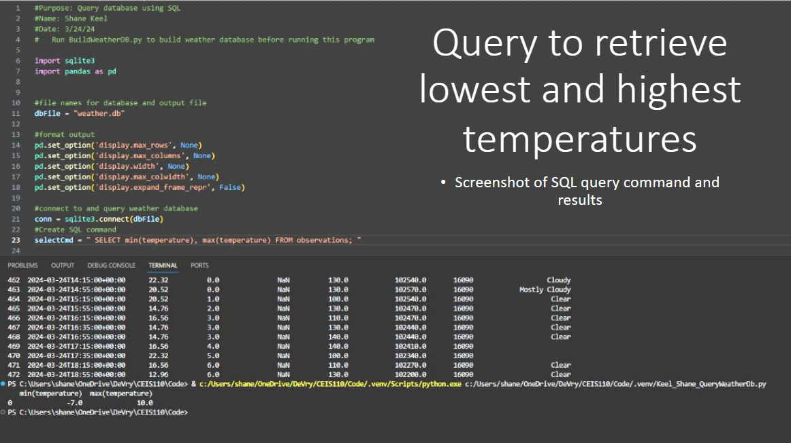
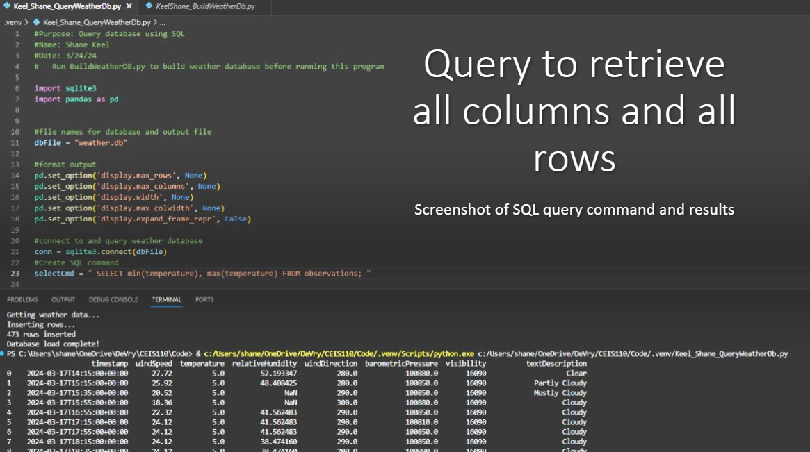
Week 4: Unlocking Insights from Weather Data
This week, I got into the art of querying the weather database. Here are some highlights of my exploration:
Understanding the Structure: I began by querying all columns and rows for a comprehensive overview of the database, giving me a deeper understanding of the data I've collected.
Temperature Extremes: Finding the highest and lowest temperature records helped me identify potential patterns and anomalies in the weather data.
Focusing on Weather Conditions: By specifically querying for 'clear' days, I started to segment the data for further analysis. This could help isolate factors that influence clear weather patterns.

Slide 11
Python Libraries
NumPy (Numerical Python)
Matplotlib
The Core of Scientific Computing: NumPy is the foundation for numerical and scientific work in Python. It introduces powerful array and matrix structures that make complex mathematical operations efficient.
Key Capabilities:
N-dimensional arrays: Multidimensional arrays for storing and manipulating large datasets efficiently.
Mathematical functions: A wide range of functions for linear algebra, Fourier transforms, random number generation, and more.
Optimized for speed: Highly optimized for computational speed, especially when handling large datasets.
Python's Visualization Powerhouse: Matplotlib is a comprehensive plotting library that enables the creation of various visualizations. Think of it as a way to translate your data into visual stories.
Key Capabilities:
Wide range of plots: Line charts, scatter plots, bar charts, histograms, heatmaps, 3D plots, etc.
Customization: Extensive control over every element of a plot (lines, markers, colors, axes, labels, legends).
Interactivity: Ability to create plots that users can pan, zoom, and interact with.

Slide 12
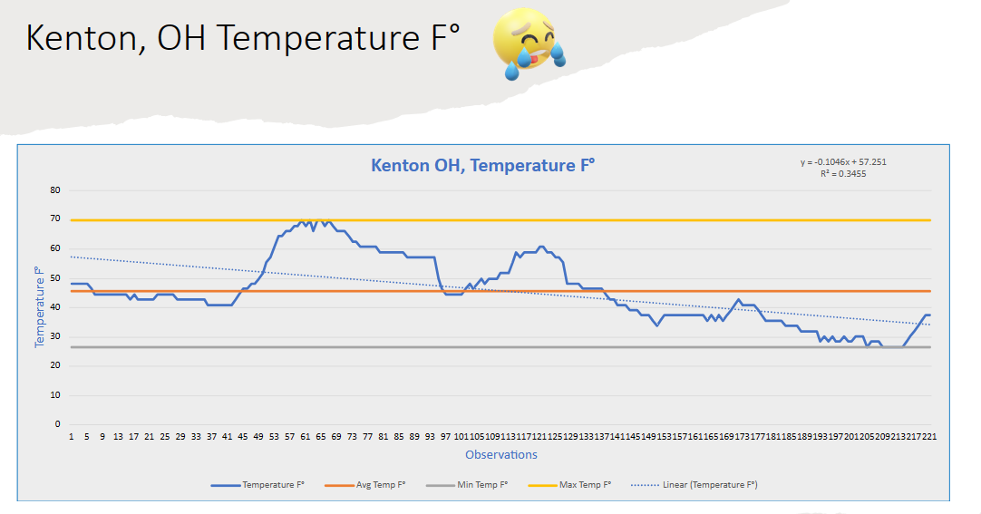
Week 5: Visualizing Weather Patterns with Matplotlib
This week was all about bringing my weather data to life! Matplotlib proved to be an incredible tool for creating insightful visualizations. Here's a glimpse of what I achieved:
Temperature Trends: Line plots helped me visualize temperature fluctuations over time, revealing interesting daily and seasonal patterns.
Distribution of Weather Conditions: Histograms, powered by NumPy's data manipulation, showed me the distribution of different weather conditions (clear, cloudy, rainy, etc.)
Geographic Comparisons: (If applicable) Mapping temperature data onto geographic regions uncovered spatial differences and potential correlations.

Slide 13
Data Analytics with Python
Data analytics with Python involves using specialized libraries like NumPy, Pandas, and Matplotlib to collect, clean, transform, analyze, and visualize data.
Python provides a powerful and flexible environment for extracting insights from raw data. NumPy enables numerical computations, Pandas offers tools for manipulating tabular data, and Matplotlib lets you create informative visualizations.
Using these tools, Python empowers you to identify patterns, trends, and anomalies, enabling data-driven decision-making in a variety of fields

Slide 14
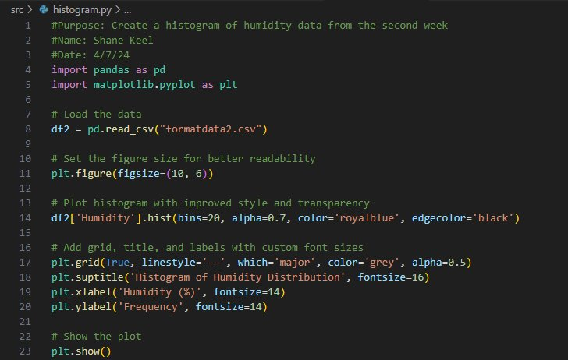
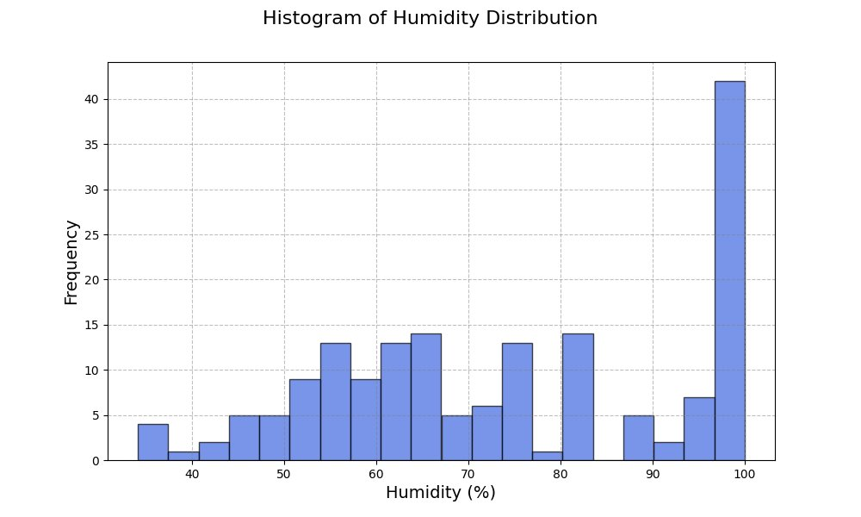

Week 6: Diving into Data-Driven Insights
Week 6: Final Analysis
We were asked to develop a question and apply it to our data.

Slide 15
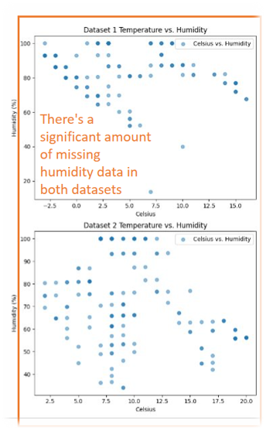
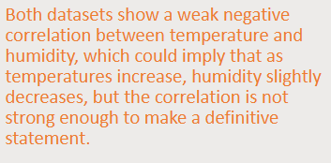
Week 6: Continued…
Unveiling the Answer:

Slide 16
Challenges
The biggest challenge was managing my excitement! The tools in this course are so powerful that I found myself constantly applying them to work projects or experimenting for personal curiosity – it was hard to stay focused on the course material at times.

Slide 17
Career Skills
Key Skills Demonstrated:
Problem-Solving: Defined the project scope, broke down the problem into smaller components, and designed a programmatic solution.
Logical Thinking & Decision-Making: Implemented conditional logic and iteration (loops) to control program flow.
Modular Design: Created well-structured code using functions or modules for reusability and readability.
Debugging & Validation: Utilized testing strategies, input validation, and code walkthroughs to ensure code accuracy.
Data Analysis and Interpretation: Analyzed gathered data to draw insights and support findings.
Career Connections:
Software Development: These skills translate to creating maintainable and efficient code in professional software projects.
Data Analytics: The project showcases the ability to collect, process, and extract valuable insights from data.
Problem-solving & Adaptability: Demonstrated the capacity to tackle complex problems and quickly learn new technologies, which are essential in the evolving job market.

Slide 18
Conclusion
This project solidified my understanding of core programming concepts by applying them directly to real-world data. Gathering data from a cloud service and performing analytics offered a hands-on learning experience that has significantly advanced my skillset.

