Slide 1
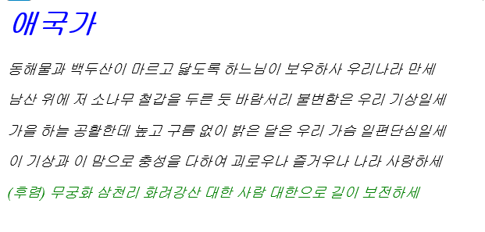
1주 과제
https://sskimking97.github.io/koreaAthem

Slide 2
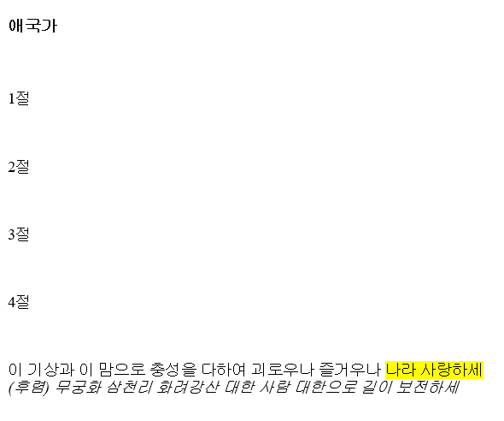
2주 과제
https://sskimking97.github.io/koreaAnthem4

Slide 3
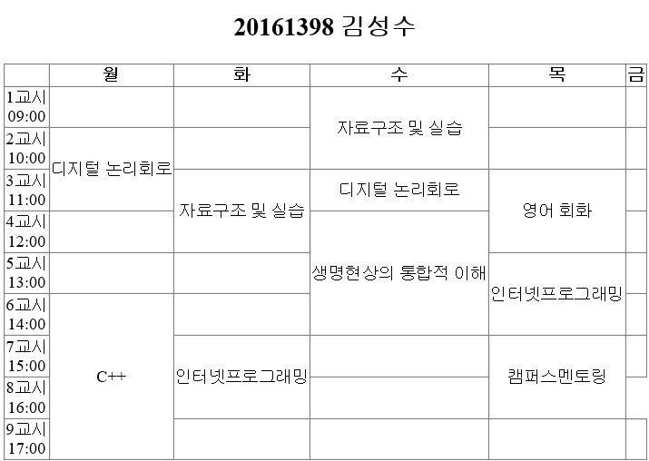
3주 과제
https://sskimking97.github.io/timeTable

Slide 4
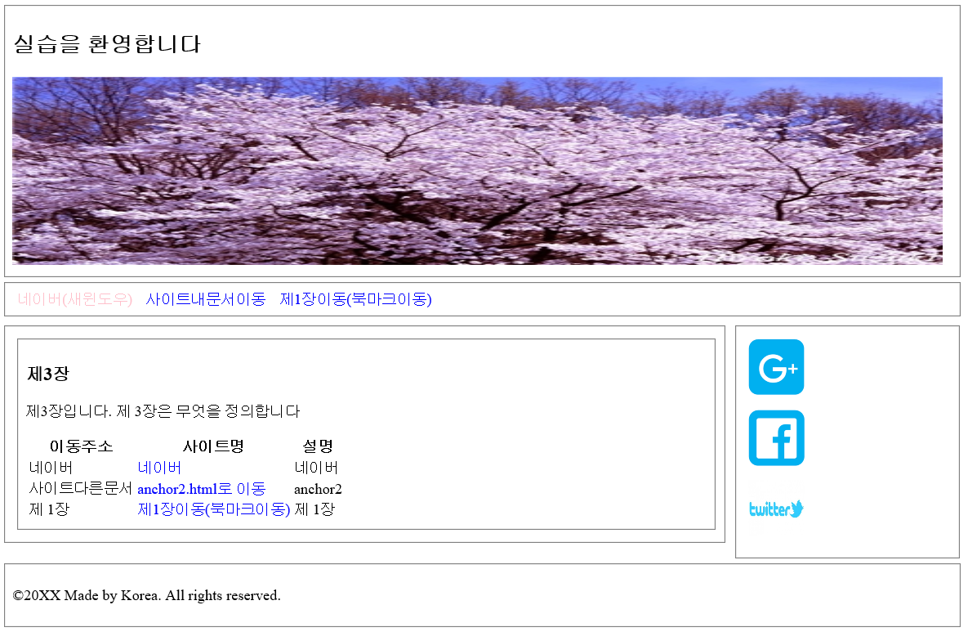
4주 과제
https://sskimking97.github.io/Sementic1.html

Slide 5
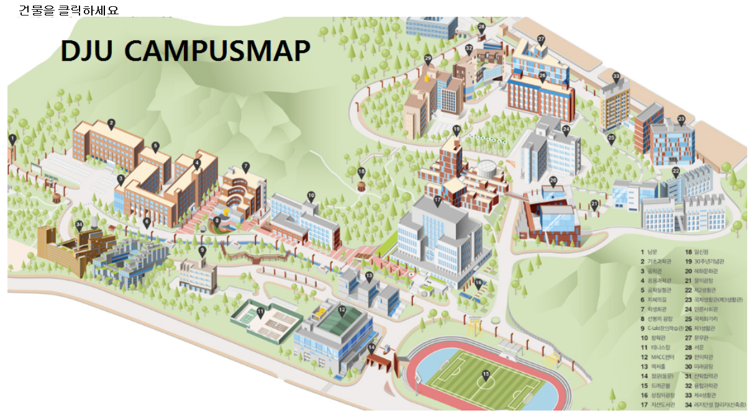

5주 과제
https://sskimking97.github.io/djumap.html

Slide 6
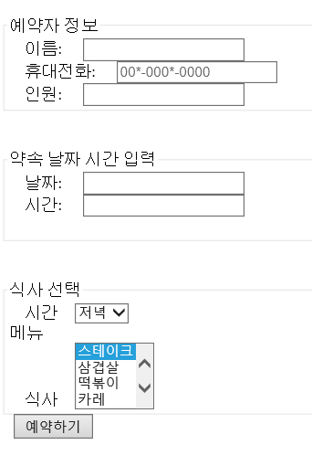
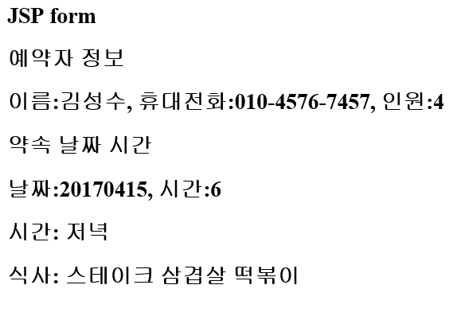
6주 과제
https://sskimking97.github.io/reservation.html

