Slide 1
KNOWLEDGE BUILDER FRAMEWORK
Executive Brief
One knowledge layer for every AI agent in FAaaS
For: product/engineering leadership · executive sponsors · persona team leads
Draft v1 · 2026-05-05
Read in 10 minutes · 14 slides

Slide 2
Agenda
1
The problem
8
Cost & quality discipline
Every AI agent re-builds context from scratch
Citations, eval, telemetry from day one
2
The vision
9
What changes
One layer ingests; many consumers query
Before / after
3
Architecture
10
The asks
Five layers, bottom-up
What we need from leadership
4
Polyglot per persona
11
Risk & mitigation
Match shape to the kind of knowledge
5
Personas
12
Success criteria
v1 narrows to PM, TPM, Aira
12-month outcome
6
Tech stack
13
References
Oracle 23ai + OpenAI + LangGraph
Deeper-dive documents
7
Phase plan
14
Decision
Four phases, each shippable on its own
Approve to unblock Phase 1

Slide 3
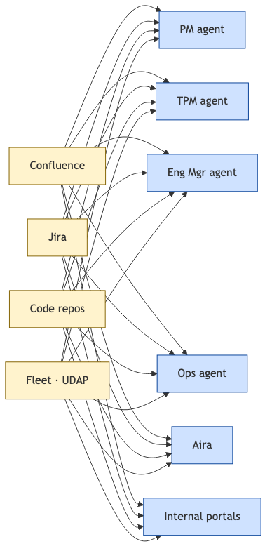
1. The problem
Every AI agent in FAaaS is re-building context from scratch.
Slow answers — every query re-pays the ingestion cost
Duplicated infra cost across consumers
Inconsistent answers — each agent has its own outdated snapshot
No citations, no eval gates, no cost visibility
Each new persona-agent triples the integration tax

Slide 4
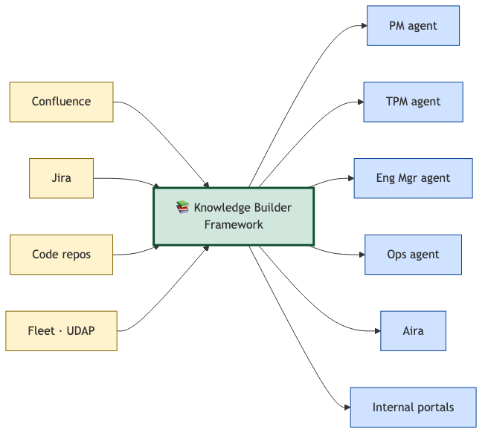
2. The vision
One layer ingests. Many consumers query.
Citations on every answer · eval gates on every change · cost per query reported daily

Slide 5
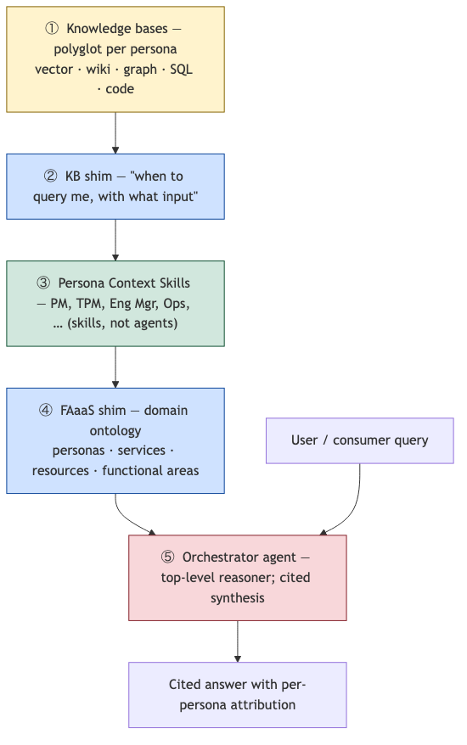
3. Five-layer architecture (bottom → top)
Layer | What it does | Owner
① Knowledge bases | Each persona's data, in the right shape | Persona teams
② KB shim | Each KB self-describes its capabilities | Auto-generated
③ Persona skills | One skill per persona; fans out across that persona's KBs | Framework + persona prompts
④ FAaaS shim | The domain ontology that lets the orchestrator route | Framework + curated
⑤ Orchestrator | Picks skills, merges results, cites sources | Framework

Slide 6
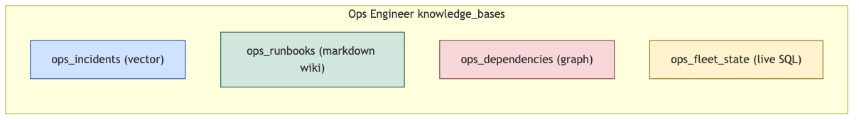
4. Polyglot per persona
A single persona's knowledge needs multiple shapes.
Match shape to the kind of knowledge:
Wiki
curated narrative — designs, runbooks, decisions
Vector
high-volume observations — incidents, tickets
Graph
relationships — resource hierarchy, service deps
SQL
enumerable state — live fleet, structured fields
One persona's knowledge_bases are heterogeneous by design.

Slide 7
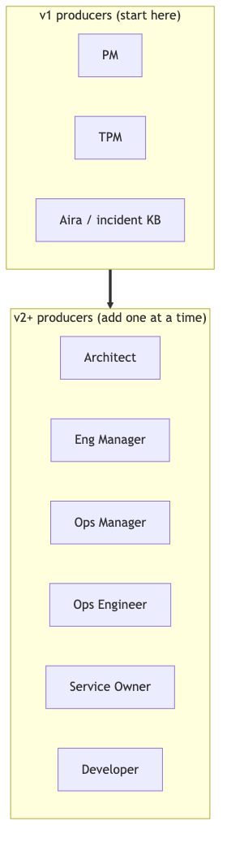
5. Personas
v1 starts narrow on purpose. Adding personas later is config-only.
v1 producers validate the contract end-to-end. Adding Eng Mgr, Ops Mgr, Service Owner, … afterwards is one YAML + one JSON-Schema — no framework changes.

Slide 8
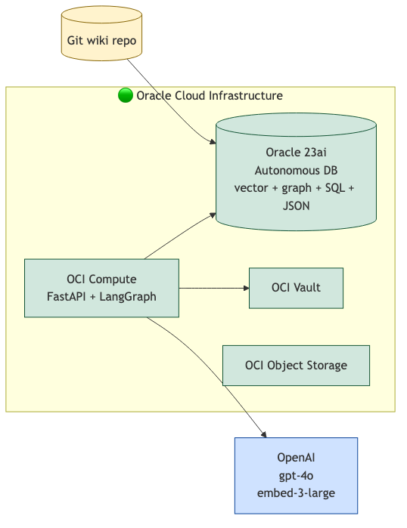
6. Tech stack
Decided (DECISION-001/002/003):
Oracle 23ai Autonomous DB
one converged engine — vector + SQL + graph + JSON
OpenAI
gpt-4o + text-embedding-3-large (Oracle-certified)
LangGraph on OCI
orchestration with control + debuggability
Git wikis
diff/PR/blame for free; bodies in git, metadata in DB
OCI Vault, Object Storage, Streaming
secrets + raw + events
Lock-in posture: framework code stays provider-agnostic at two seams (Store, LLMClient) — a future swap is bounded.

Slide 9
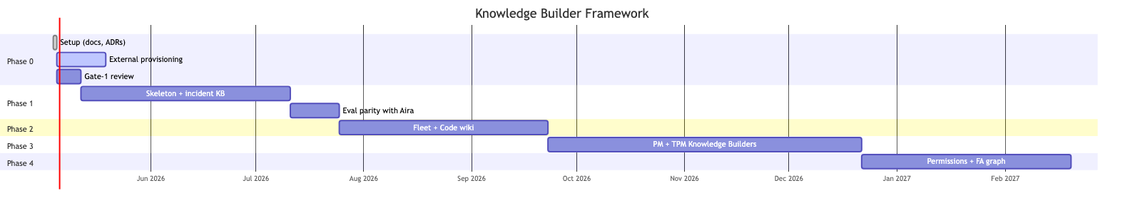
7. Phase plan
Each phase ships its own slice end-to-end. No "build the whole framework first."
Phase | What ships | Outcome
0 | Docs + ADRs + persona-builder contract | Approval to start
1 | Incident KB end-to-end | Aira parity with citations
2 | Fleet read-through + Code wiki | Mixed-source queries work
3 | PM + TPM Knowledge Builders | First non-incident persona KBs
4 | Permissions + FA semantic graph + dashboards | v2 ops posture
Phase 1 hard exit gate
Aira matches/beats current incident KB on a 25-question gold set · ≥80% recall · retrieval p95 <500ms with citations · idempotency verified · eval CI green.

Slide 10
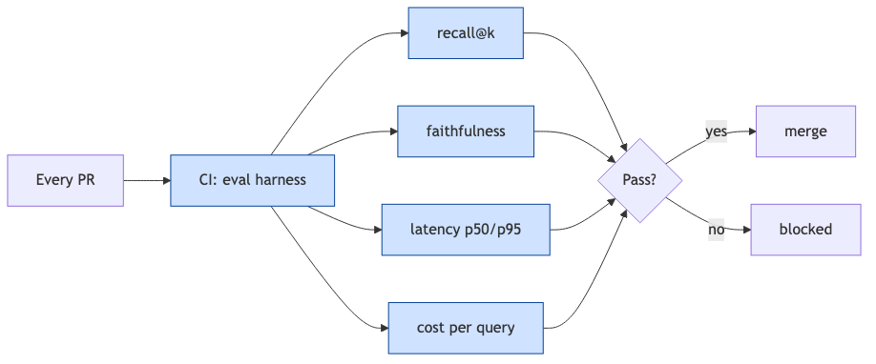
8. Cost & quality discipline
Mandatory from v1 — what makes the layer trustworthy.
CITATIONS
every answer cites sources; no citation = bug
EVAL GATES
every PR runs the gold-set; regressions block merge
COST TELEMETRY
tokens-per-query, $/day, per persona
IDEMPOTENCY
re-ingesting unchanged content does nothing
ACL PLACEHOLDERS
persona_visibility on every record (Phase 4 enforces)

Slide 11
9. What changes for FAaaS

Slide 12
10. The asks
Six items unblock everything.
# | What | From whom | When | Why
1 | Approval of the PDD (Gate 1) | Leadership | Now | Unblocks Phase 1
2 | Oracle 23ai Autonomous DB (dev tier) | Cloud ops | This week | Phase 1 cannot start without it
3 | OpenAI API access (Vault-stored) | Vendor mgmt + cloud ops | This week | Every parser/synthesis call
4 | OCI Vault + secrets (Confluence/Jira tokens) | IT + cloud ops | 1–2 weeks | Phase 1 ingestion sources
5 | Persona team owners (PM, TPM) | Product / engineering leads | Before Phase 3 | Persona schemas need authors
6 | OpenAI spend cap ($200 dev / $1K Phase 1) | Finance | Phase 0 close | Cost ceiling before scale-up

Slide 13
11. Risk & mitigation
Risk | Mitigation
Oracle Autonomous DB single-point-of-failure | HA defaults (Data Guard) + per-schema metrics for granular restore
OpenAI as external dependency | LLMClient shim swaps to OCI Generative AI without rewriting call sites
Persona team velocity | v1 narrows to 3 producers; each new persona is config-only afterward
Cost surprises | Per-call telemetry + per-PR eval cost cap ($0.50 default); hard CI cap ($5)
Eval drift | Baseline pinned on main; baseline updates require justified PR
Vendor lock-in | Two clean seams (Store, LLMClient); persona configs are storage-agnostic

Slide 14
12. What success looks like (12 months)
By Phase 4 exit:
✓
3+ persona Knowledge Builders
PM, TPM, Aira in production; expanding to Eng Mgr / Ops Mgr / Service Owner one at a time
✓
One MCP layer queried by multiple consumers
Aira + ≥2 internal consumers (portals or coding assistants)
✓
>90% recall · >0.9 faithfulness
On every persona's gold set
✓
<$0.10 average cost per query
Daily $/query dashboard live (excl. ingestion)
✓
Aira incident response time -30%
Via cached, cited context
✓
<2 weeks to onboard a new persona-agent
One YAML + one schema + gold set
✓
ACL enforcement at retrieval
Sensitive content invisible to unauthorized consumers

Slide 15
13. Deeper-dive references
For the curious.
Topic | Document
Comprehensive product definition | PDD — Knowledge Builder Framework (.docx)
Persona-builder contract | persona-knowledge-builder.md · ADR-004
Tech stack rationale | ADR-001
Storage shape per data type | ADR-002
Core interfaces (developer-facing) | ADR-003
Eval discipline | ADR-005
Phase 0 setup details | pmo/phase-briefs/PHASE-0-kickoff.md
Source spec | docs/raw/knowledge-builder-framework-spec.md

Slide 16
14
DECISION
Reply
EXEC-APPROVED
and we unblock Phase 1.
Questions · feedback · amendments — happy to deep-dive any slide.

