Slide 1
FACULTY OF ENGINEERING AND NATURAL SCIENCES
Department of Bioengineering
In Silico Analysis of the Effects of Bennu Asteroid-Derived Non-Canonical Amino Acids on the Structural Stability and Allosteric Function of the DnaK Chaperone Protein
Pelinsu Eda Şentürk · 22120509009
Advisor: Asst. Prof. Dr. Saliha Ece Acuner
Undergraduate Thesis · June 2026

Slide 2
Presentation Outline
01
Research Question & Hypotheses
Asteroid Bennu, the DnaK protein, and the astrobiological context
02
Methodology
PDB: 4B9Q, PyRosetta ΔΔG, Boltz-2 structure prediction, PyMOL visualization
03
Linker Region Findings (L390–L391)
Energy profiles of NVA, VAL, ILE, and AIB mutations
04
SBD Region Findings (A429–A435)
Effects of NVA and ILE mutations on the SBD
05
Discussion & Astrobiological Interpretation
Findings, limitations, and future work
06
Conclusion
Key takeaways

Slide 3
Research Question & Context
Research Question: How do non-canonical amino acids derived from asteroid Bennu affect the structural stability and allosteric mechanism of the DnaK chaperone?
Asteroid Bennu
DnaK (HSP70)
In Silico Approach
Non-canonical amino acids such as NVA, NLE, AIB, and ABA were detected in samples from JAXA’s Hayabusa2 mission (2023).
An E. coli molecular chaperone; plays a critical role in proteostasis via the NBD-SBD allosteric mechanism.
PyRosetta (ΔΔG calculation) + Boltz-2 (structure prediction) + PyMOL (visualization).
H1
NVA and NLE may be tolerated in the linker region due to structural similarity to leucine.
H2
β-branched ILE and α,α-dialkyl AIB conflict with linker geometry, causing destabilization.
H3
SBD alanine positions are highly sensitive to increases in side-chain volume.
H4
β-Alanine (B3A) cannot be calculated due to backbone incompatibility.

Slide 4
Methodology
1
→
2
→
3
→
4
Protein Structure
PyRosetta ΔΔG
Boltz-2 Structure Prediction
PyMOL Visualization
E. coli DnaK
PDB: 4B9Q (2.0 Å)
Chain A: 587 aa
Target: L390–L391 (Linker)
A429–A435 (SBD β-sandwich)
ref2015 energy function
ΔΔG = E_mutant − E_WT
Rigid-backbone approach
NVL CCD code for NVA
11 mutant structures
tamarind.bio platform
Mutant–WT superposition
CCD code + position input
11 structure predictions completed
3 angles/mutant (close, mid, wide)
Blue=WT, Green=NVA
Orange=ILE, Cyan=VAL
Magenta=AIB

Slide 5
Linker Region (L390–L391) — ΔΔG Results
Amino Acid | Position | ΔΔG (REU) | Effect
NVA | L390 | −3.951 | ✅ Stabilizing
NVA | L391 | −3.751 | ✅ Stabilizing
NVA | L390+L391 | −6.090 | ✅ Stabilizing
VAL | L390 | −4.905 | ✅ Stabilizing
VAL | L391 | +2.418 | ⚠️ Mildly destabilizing
VAL | L390+L391 | −2.403 | ✅ Stabilizing
ILE | L390 | +65.519 | ❌ Severe destabilization
ILE | L391 | +7.318 | ❌ Destabilizing
ILE | L390+L391 | +72.800 | ❌ Severe destabilization
AIB | L390 | +5.700 | ❌ Destabilizing
AIB | L391 | +18.573 | ❌ Destabilizing
AIB | L390+L391 | +25.364 | ❌ Destabilizing
NLE / ABA / B3A | — | ERROR | Rotamer/backbone incompatibility

Slide 6
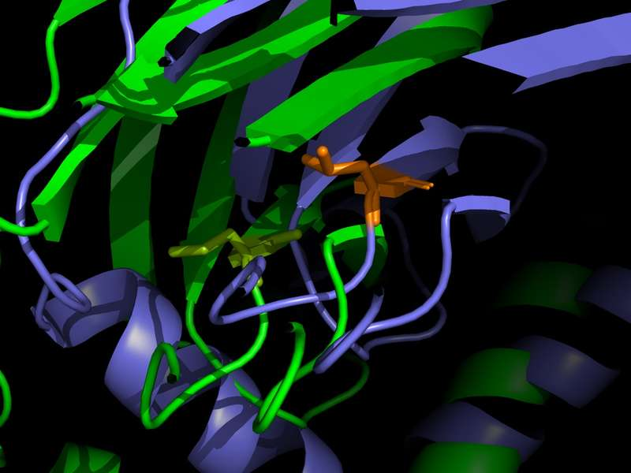
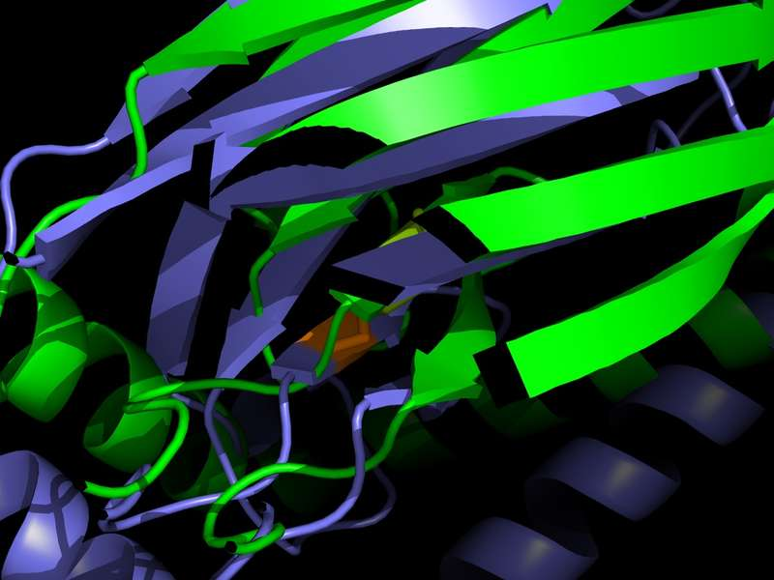
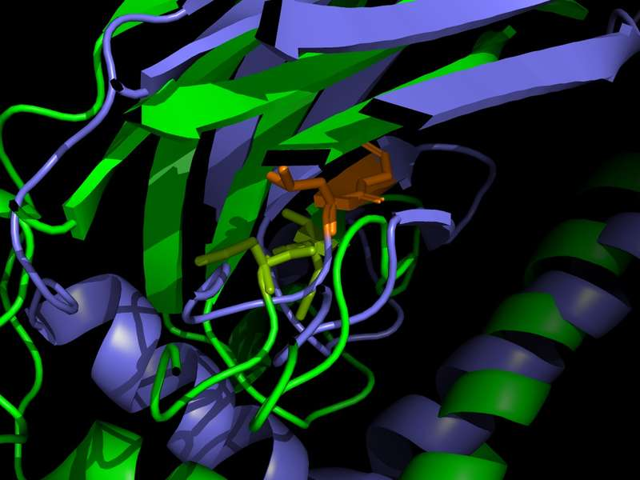
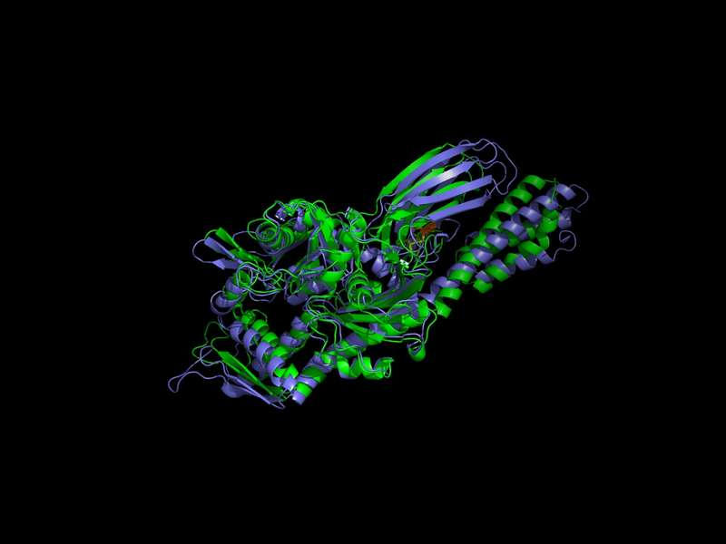
Norvaline (NVA) — Linker Region (L390–L391)
L390NVA
L391NVA
L390+L391NVA
−3.951 REU
−3.751 REU
−6.090 REU
Figure 1: L390NVA close-up view
Figure 4: L391NVA close-up view
Figure 7: L390+L391NVA close-up
Figure 9: L390+L391NVA wide view
Key Finding: NVA produced marked stabilization at both leucine positions in the linker region. Its straight-chain structure achieves more optimal packing within the linker’s hydrophobic pocket compared to leucine’s branched structure. The near-additive value of the double mutation (−6.090 REU) suggests the two positions contribute independently. Boltz-2 backbone analyses confirm that overall structural integrity is preserved.

Slide 7
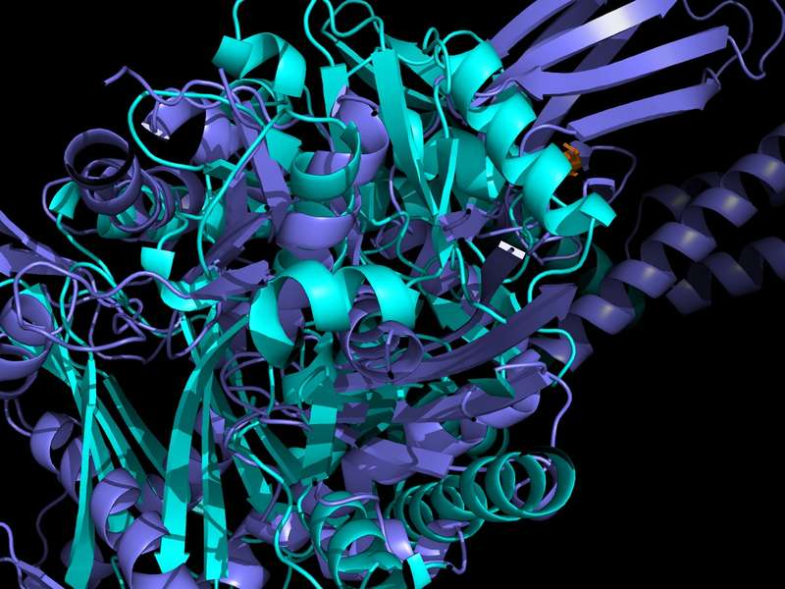
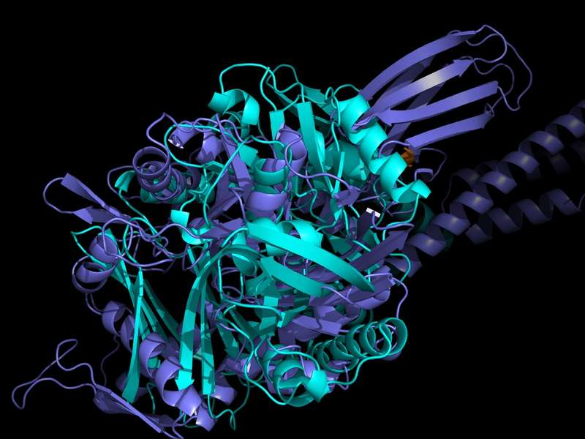
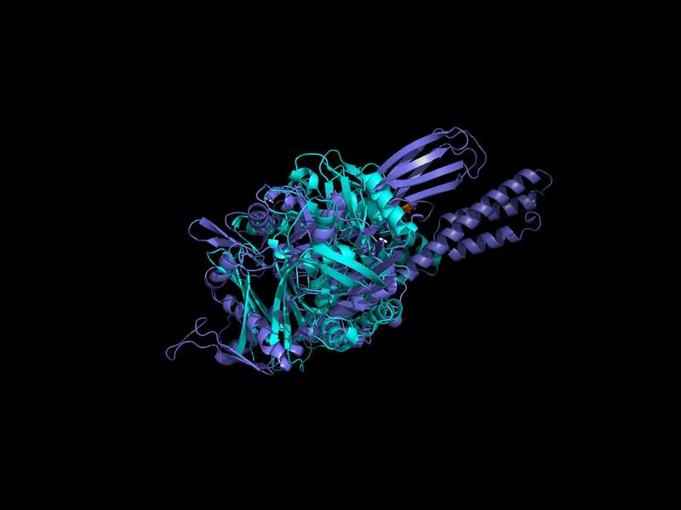
Valine (VAL) — Linker Region (L390–L391)
L390VAL
L391VAL
L390+L391VAL
−4.905 REU
+2.418 REU
−2.403 REU
Figure 10: L390+L391VAL close-up view
Figure 11: L390+L391VAL mid view
Figure 12: L390+L391VAL wide view
Position-Dependent Effect: VAL provides strong stabilization at L390 (−4.905 REU) while causing mild destabilization at L391 (+2.418 REU). In the double mutant, the L390 contribution dominates, yielding net stabilization (−2.403 REU).

Slide 8
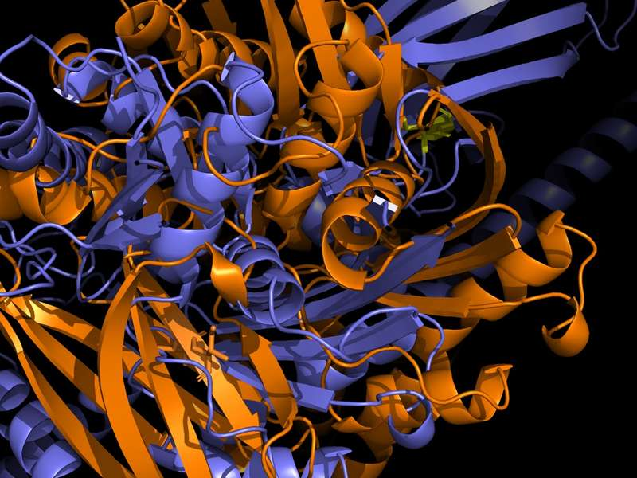
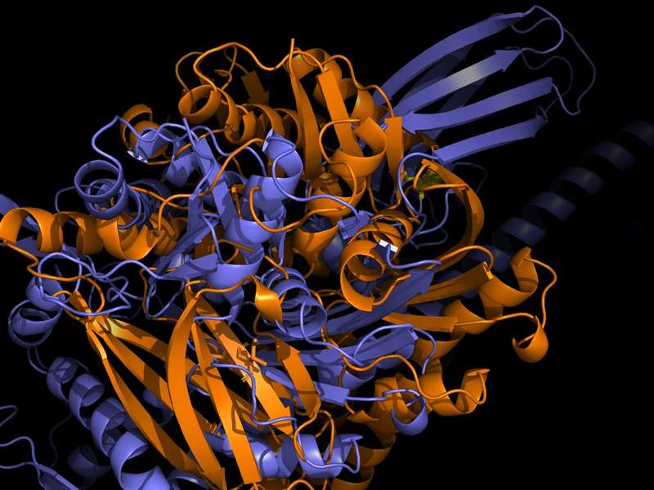
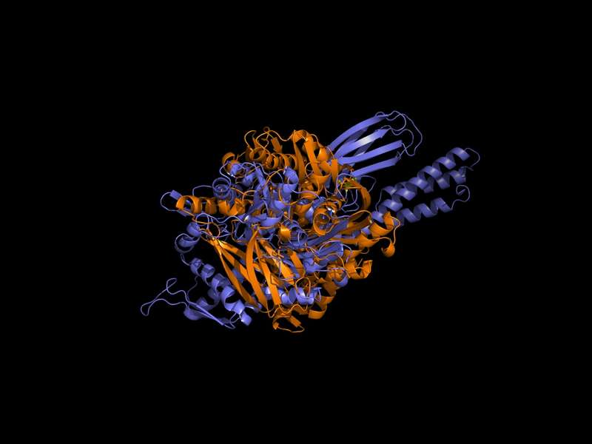
Isoleucine (ILE) — Linker Region (L390–L391)
L390ILE
L391ILE
L390+L391ILE
+65.519 REU
+7.318 REU
+72.800 REU
Figure 13: L390+L391ILE close-up — steric clashes
Figure 14: L390+L391ILE mid view — backbone deviation
Figure 15: L390+L391ILE wide view
Severe Destabilization: ILE’s β-branched structure (γ-methyl group) creates severe steric clashes with the linker’s narrow hydrophobic geometry. The absence of backbone minimization may have contributed to the unusually high REU values.

Slide 9
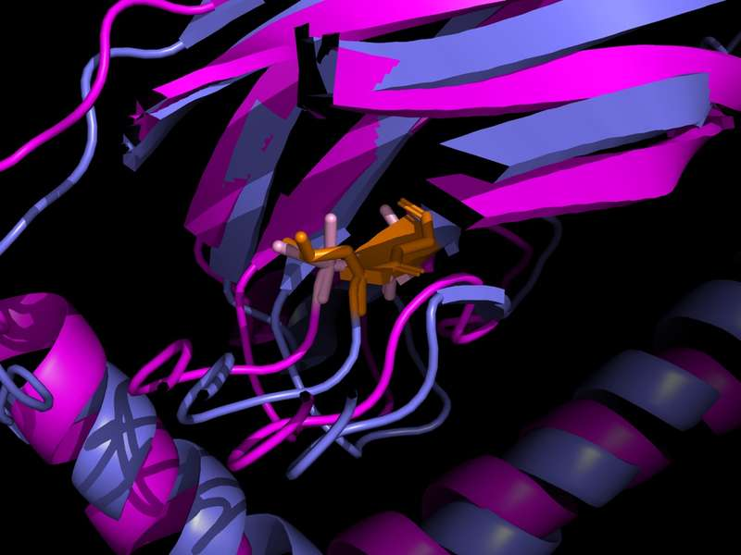
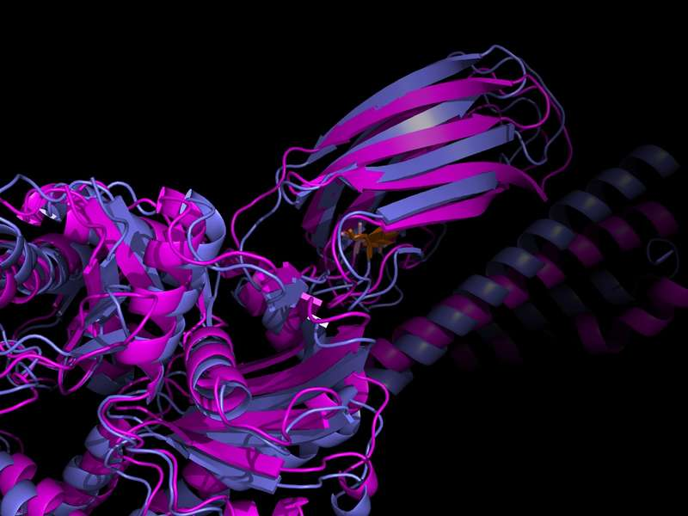
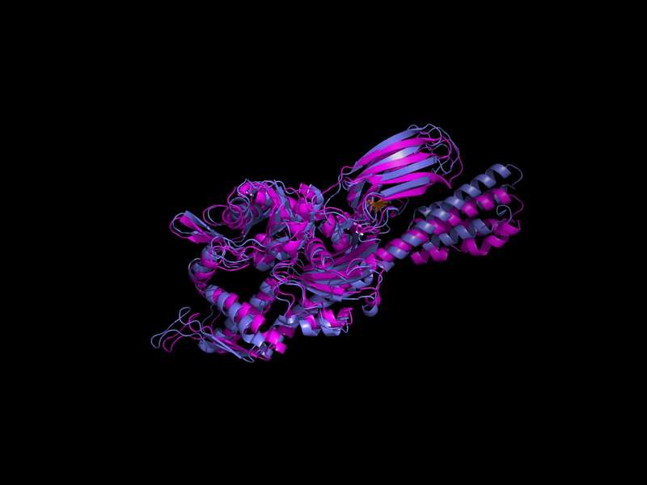
α-Aminoisobutyric Acid (AIB) — Linker Region (L390–L391)
L390AIB
L391AIB
L390+L391AIB
+5.700 REU
+18.573 REU
+25.364 REU
Figure 16: L390+L391AIB close-up — steric incompatibility
Figure 17: L390+L391AIB mid view — backbone deviation
Figure 18: L390+L391AIB wide view
Helical Incompatibility: Because AIB’s α,α-dialkyl structure strongly favors α-helical conformation, it is biophysically incompatible with the flexible linker region. Boltz-2 analyses show that β-strand elements are rearranged as a result.

Slide 10
SBD Region (A429–A435) — ΔΔG Results
Amino Acid | Position | ΔΔG (REU) | Effect
NVA | A429 | −2.578 | ✅ Stabilizing
NVA | A435 | +5.354 | ❌ Destabilizing
NVA | A429+A435 | +2.776 | ⚠️ Mildly destabilizing
VAL | A429 | +52.115 | ❌ Severe destabilization
VAL | A435 | +27.256 | ❌ Severe destabilization
VAL | A429+A435 | +79.372 | ❌ Severe destabilization
ILE | A429 | +108.675 | ❌ Extreme destabilization
ILE | A435 | +409.291 | ❌ Extreme destabilization
ILE | A429+A435 | +517.966 | ❌ Highest value
AIB | A429 | +7.899 | ❌ Destabilizing
AIB | A435 | +113.746 | ❌ Severe destabilization
AIB | A429+A435 | +121.645 | ❌ Severe destabilization
NLE / ABA / B3A | — | ERROR | Rotamer/backbone incompatibility

Slide 11
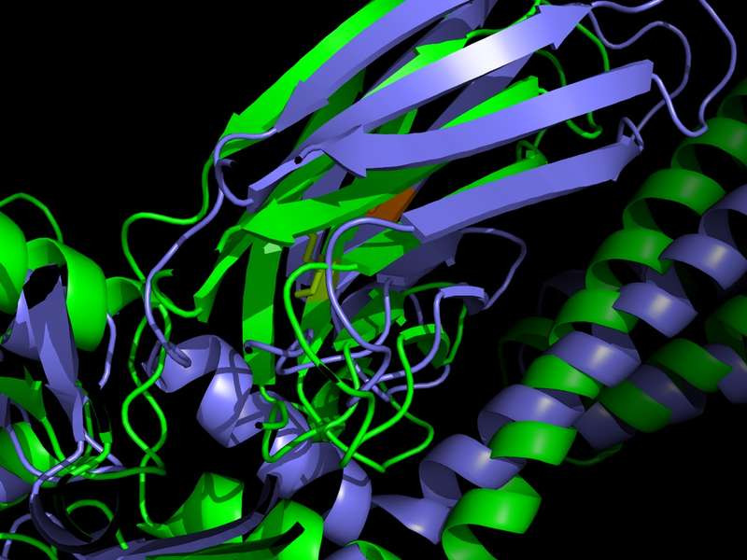
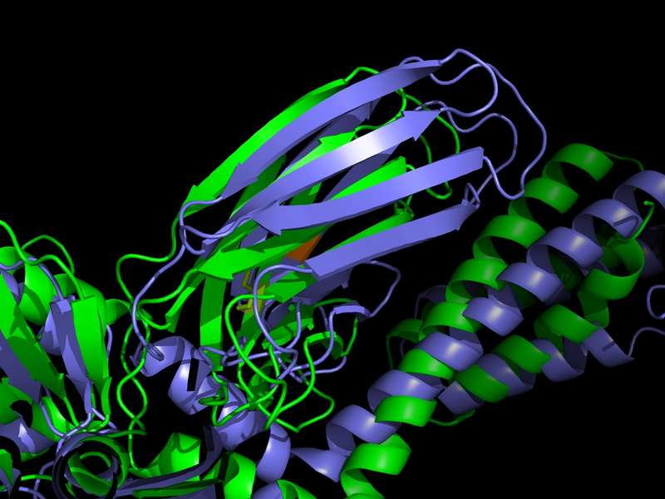
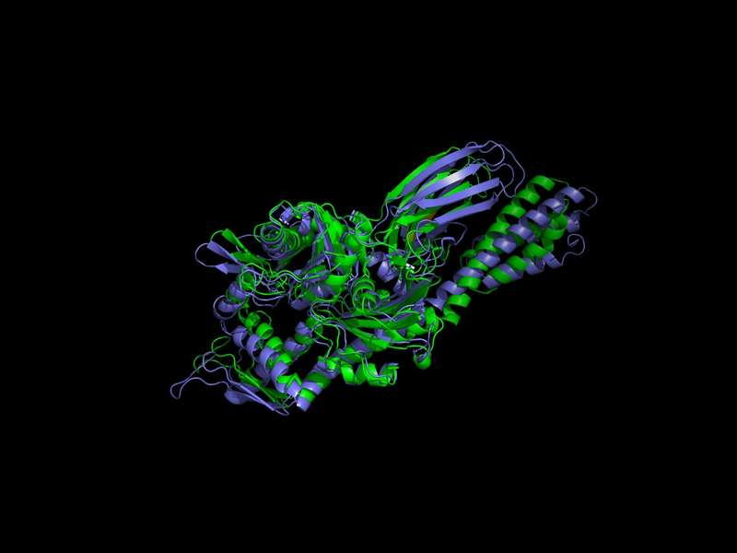
Norvaline (NVA) — SBD Region (A429–A435)
A429NVA
A435NVA
A429+A435NVA
−2.578 REU
+5.354 REU
+2.776 REU
Figure 19: A429NVA close-up — hydrophobic pocket
Figure 20: A429NVA mid view — backbone conservation
Figure 21: A429NVA wide view
Position-Dependent Asymmetry: NVA provides stabilization at A429 (−2.578 REU) while causing destabilization at A435 (+5.354 REU). This indicates that the two positions occupy markedly different steric microenvironments around the SBD substrate-binding pocket.

Slide 12
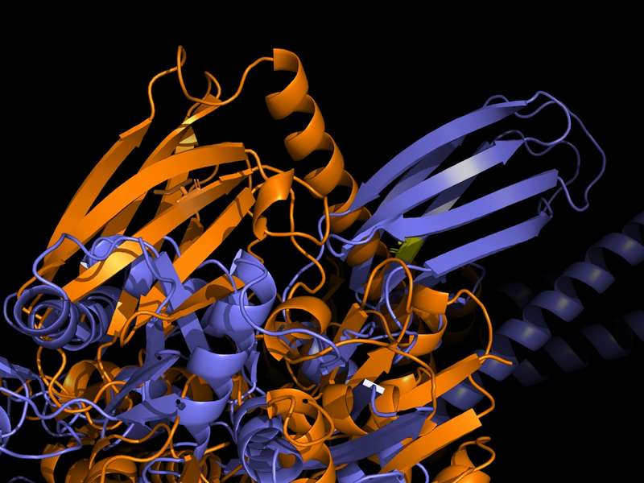
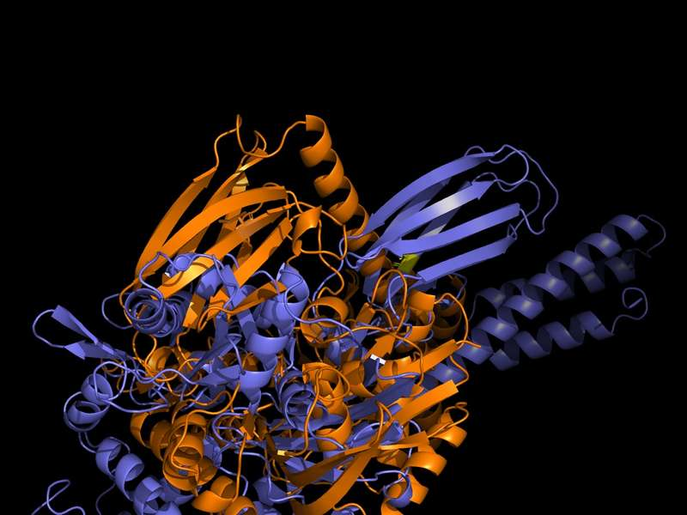
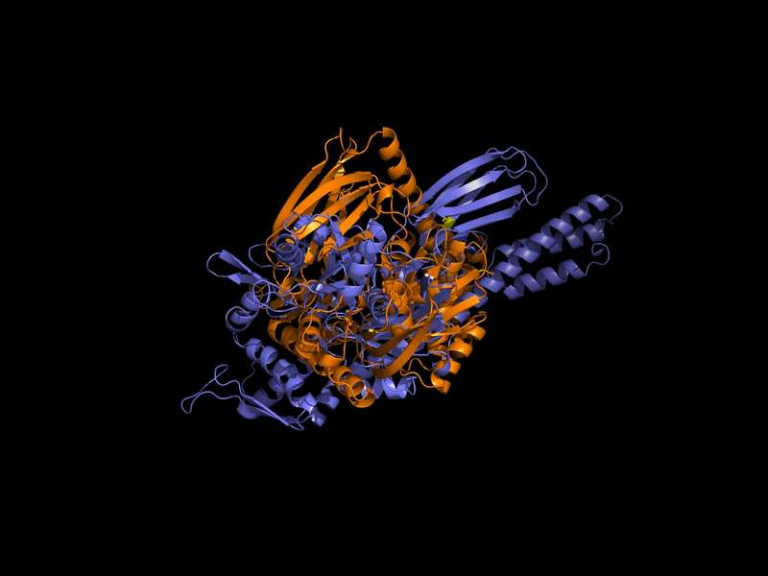
Isoleucine (ILE) — SBD Region I: A429
A429ILE
A435ILE
A429+A435ILE
+108.675 REU
+409.291 REU
+517.966 REU
Figure 22: A429ILE close-up — steric clashes
Figure 23: A429ILE mid view — backbone distortion
Figure 24: A429ILE wide view
Evolutionary Constraint: The alanine residues in the SBD β-sandwich appear evolutionarily selected for substrate-binding geometry and are highly sensitive to volume increases. Even at A429, a substantial destabilization of +108.675 REU is observed.

Slide 13
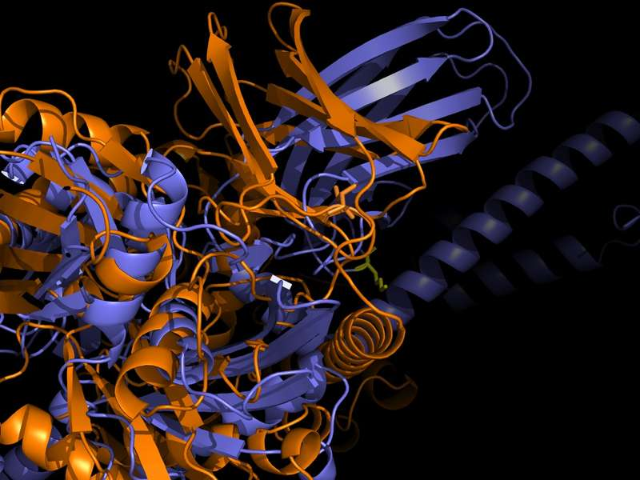
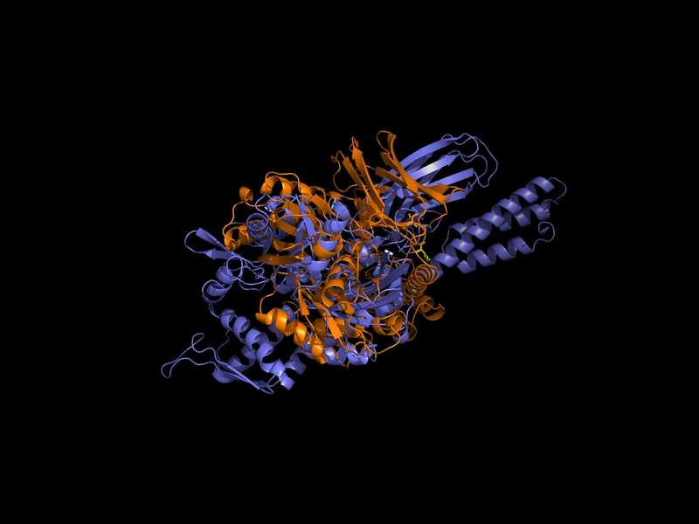
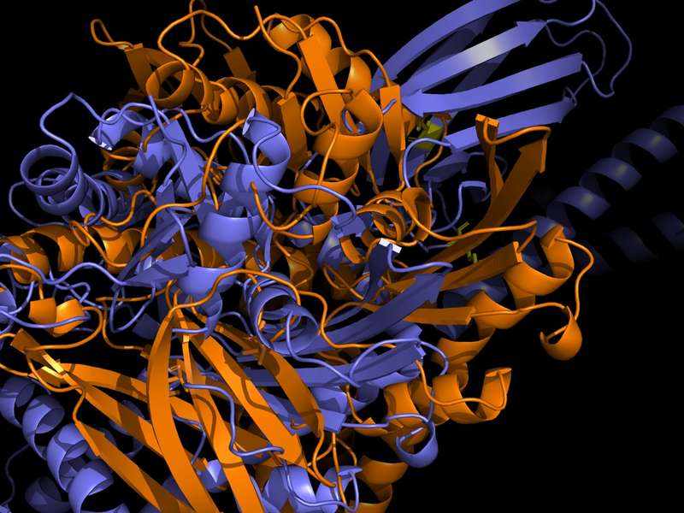
Isoleucine (ILE) — SBD Region II: A435 and Double Mutation
A435ILE
A429+A435ILE
+409.291 REU
+517.966 REU
Figure 25: A435ILE close-up — steric incompatibility
Figure 27: A435ILE wide view
Figure 28: A429+A435ILE close-up — cumulative clash
Highest ΔΔG: Position A435 is even more sensitive to ILE’s volume than A429 (+409.291 REU). The combined double mutation produced the highest total ΔΔG value of the study (+517.966 REU), demonstrating that the SBD β-sandwich region has extremely limited tolerance for bulky amino acids.

Slide 14
Discussion & Astrobiological Interpretation
NVA’s Linker Stability
SBD Position-Dependent Asymmetry
NVA’s straight-chain structure enables optimal packing within the linker’s hydrophobic pocket. The backbone conservation observed in Boltz-2 indicates that the linker conformational dynamics required for allosteric signaling are largely preserved.
The differing NVA results at A429 and A435 show that these positions occupy markedly different steric microenvironments. The extremely high SBD values for VAL and ILE indicate that this region has been evolutionarily optimized.
Astrobiological Inference
Methodological Limitations
NVA’s compatibility with the linker region and its stabilizing effect support the possibility that, if delivered to early Earth via asteroid impact, this amino acid could have been incorporated into primordial chaperone precursors.
The absence of backbone minimization may lead to overestimated REU values. Missing rotamer libraries for NLE, ABA, and B3A prevented their calculation. Boltz-2’s static predictions do not capture allosteric dynamics.

Slide 15
Conclusion
NVA
NVA exhibited a strong stabilizing effect in the linker region (ΔΔG = −6.090 REU, double mutation). The overall backbone geometry was preserved — supporting continuity of allosteric signaling.
VAL
VAL provided stabilization at linker L390 but produced position-dependent differences elsewhere — the steric effect of β-branching is decisive.
ILE
ILE and AIB produced marked destabilization at all linker and SBD positions. The ILE SBD double mutant reached the study’s maximum value of +517.966 REU.
SBD
The SBD β-sandwich region shows extremely limited tolerance for bulky amino acids — evidence of evolutionary optimization.
★ NVA’s compatibility with the linker and its stabilizing effect support the astrobiological hypothesis that this amino acid may have been incorporated into primordial chaperone precursors.

Slide 16
References
[1] Bertelsen et al. (2009). Solution conformation of wild-type E. coli Hsp70 (DnaK). PNAS, 106(20), 8471–8476.
[7] Park et al. (2016). Simultaneous optimization of biomolecular energy functions. J. Chem. Theory Comput., 12(12), 6201–6212.
[2] Bukau & Horwich (1998). The Hsp70 and Hsp60 chaperone machines. Cell, 92(3), 351–366.
[8] Pizzarello & Shock (2010). The organic composition of carbonaceous meteorites. Cold Spring Harb. Perspect. Biol., 2(3).
[3] Glavin et al. (2023). The significance of meteoritic amino acids. Chemical Reviews, 123(21), 12478–12528.
[9] Swain et al. (2007). Hsp70 chaperone ligands control domain association via an allosteric mechanism. Mol. Cell, 26(1), 27–39.
[4] Hartl et al. (2011). Molecular chaperones in protein folding and proteostasis. Nature, 475(7356), 324–332.
[10] Toniolo & Benedetti (1991). The polypeptide 3(10)-helix. Trends in Biochemical Sciences, 16, 350–353.
[5] Laufen et al. (1999). Mechanism of regulation of Hsp70 chaperones by DnaJ. PNAS, 96(10), 5452–5457.
[11] Zhu et al. (1996). Structural analysis of substrate binding by the molecular chaperone DnaK. Science, 272(5268), 1606–1614.
[6] Mayer (2010). Gymnastics of molecular chaperones. Molecular Cell, 39(3), 321–331.

Slide 17
Thank You
For Your Attention
Pelinsu Eda Şentürk · Bioengineering · June 2026
Advisor: Asst. Prof. Dr. Saliha Ece Acuner

