Slide 1
Happy Jump
http://www.youtube.com/watch?v=rxlLs9MEZSY

Slide 2
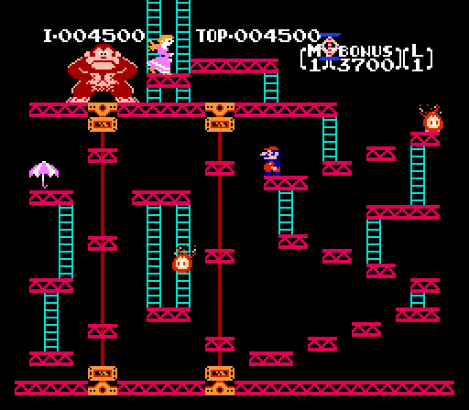
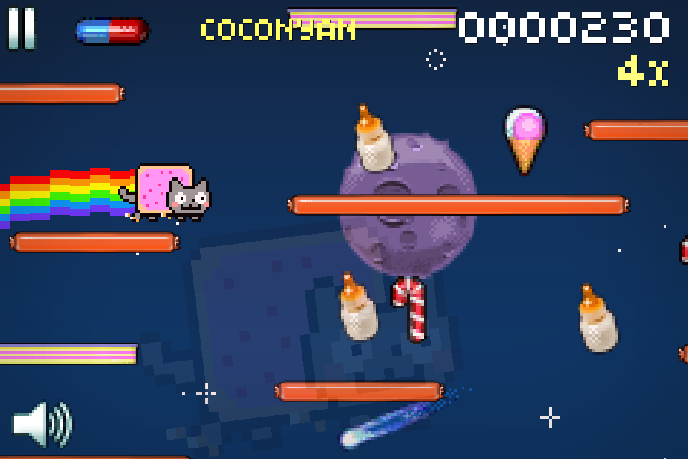
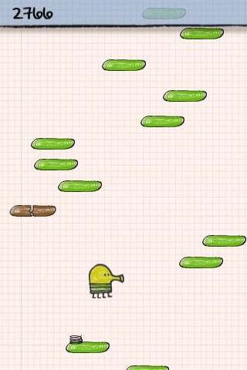
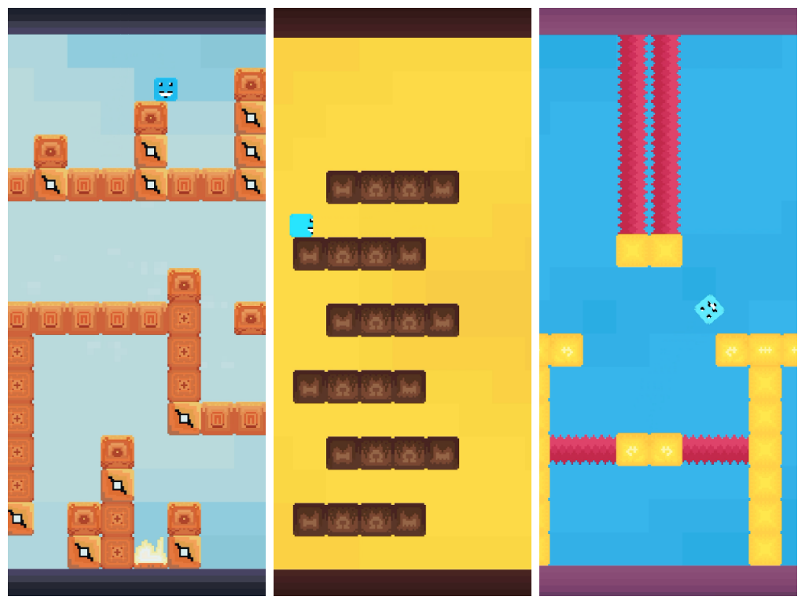
Mechanics
Vertically scrolling platforming game
Sprite jumps, moves horizontally and vertically, and can shoot
Platforms generate in random places and in random sizes
Platform game examples: Nyan Cat, Donkey Kong, Super Pixalo, Doodle Jump

Slide 3
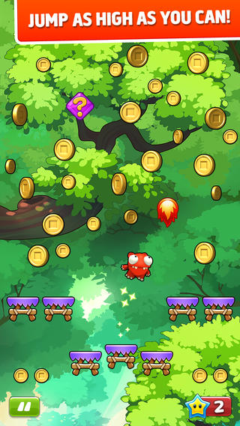
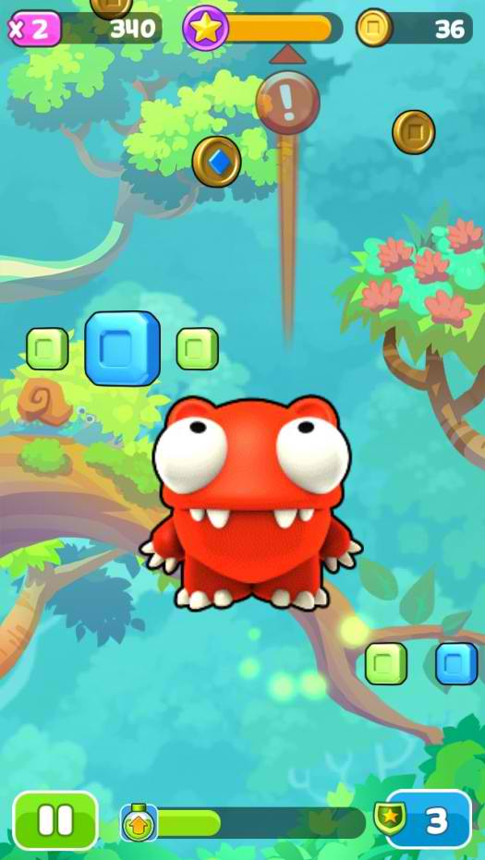
Controls
Sprite jumps automatically, users control by tilting and tapping obstacles to destroy them
Simple, intuitive user controls
No swiping or buttons necessary; successful jumps depend on momentum, proximity, and accurate angles
Mega Jump

Slide 4
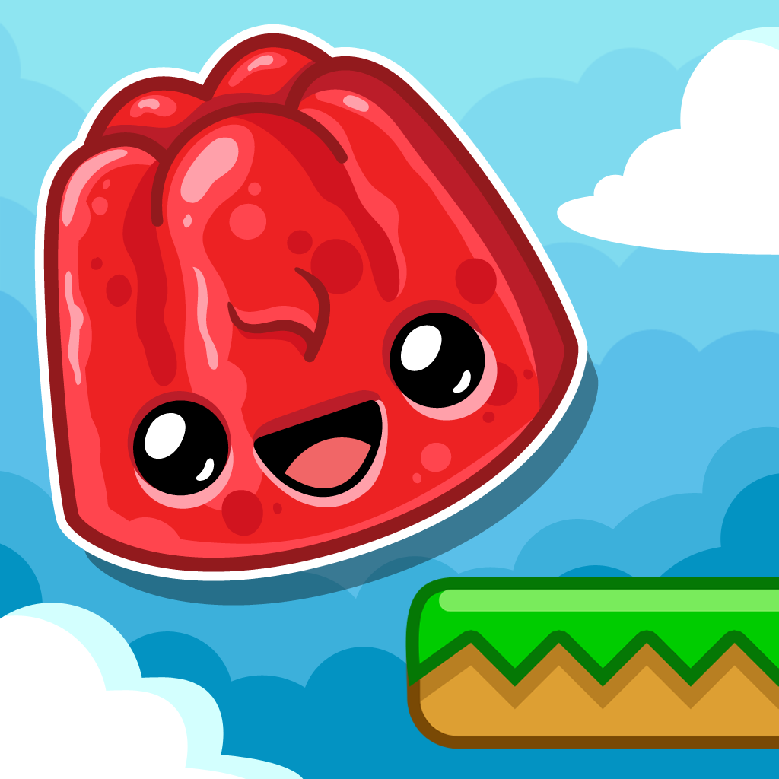

Environment and design
Ascending game environment
Colorful and cartoon-y; round and bubble-like
Bright, solid colors
Happy Jump

Slide 5
Our take
Design is in a candy land-type environment
Main jumper: gumdrop
Special platforms: some gives boosts, others slow down the gumdrop
Gumdrop can also shoot
Chocolate sauce begins to form at top of screen. If the gumdrop “shoots” it with sugar dust before it fully forms, the sauce is destroyed. If not, the sauce falls onto the gumdrop. Too many sauce drops sticks the gumdrop to the platform before it can drop, causing the player to lose the game.

