Slide 1

BON22162 - OVERVIEW
FINANCIAL REPORTING AND ANALYSIS PLATFORM
FINANCIAL REPORTING AND ANALYSIS SERVICE PROVIDER
VMO ACTIVITIES
ADDED VALUE
ABOUT
VMO designed and developed a robust web-based financial reporting platform using agile practices, ensuring iterative progress and adaptability to evolving requirements. The team integrated Morningstar’s financial data warehouse, enabling the efficient handling of billions of records and applying ETL best practices to streamline data flow. VMO also implemented a microservices architecture, providing scalability and efficient operations, while facilitating modular development and simplified maintenance.
SCOPE OF WORK:
Requirements Analysis (SRS)
Solution Detail Design (SDD)
Development and Integration
Testing (Manual and Automation)
Deployment and Support
32 members
Our client: A fast-growing start-up specializing in financial reporting and analysis services. The company provides real-time insights into fund performance and financial data to help investors make informed decisions. Their business model focuses on subscription-based services for strategic data analysis and portfolio tracking. The company primarily serves institutional investors, fund managers, and financial advisors, helping them optimize portfolio strategies and achieve better investment outcomes.
Challenge: The client faced challenges in managing and processing large volumes of financial data efficiently while also meeting the need to deliver faster updates. For example, the inability to process data in real time led to delays in providing actionable insights to investors, which risked losing their interest. Therefore, the client needed seamless integration with financial data warehouses, along with a platform to enhance product features and support weekly updates, ensuring competitiveness and sustained investor interest.
Business Impact:
Improved data processing capabilities with faster analysis.
Increased investor engagement through real-time updates.
Enhanced portfolio management for better decision-making.
Financial Value:
Accelerated time-to-market for new features, increasing customer retention.
Created a scalable platform, ready for growth and expansion.
Key Capabilities:
Real-time financial data analysis.
Portfolio performance tracking and visualization.
Enhanced reporting for subscribed users.
10 months
Japan
STANDARDS AND TOOLS
Planning & Scheduling: Jira + Excel
Resource Management: Excel
Documentation Repository: Google Drive
Timesheet Management: Jira
Task Management: Jira
Source Code Management: Git
Fixed price

Slide 2
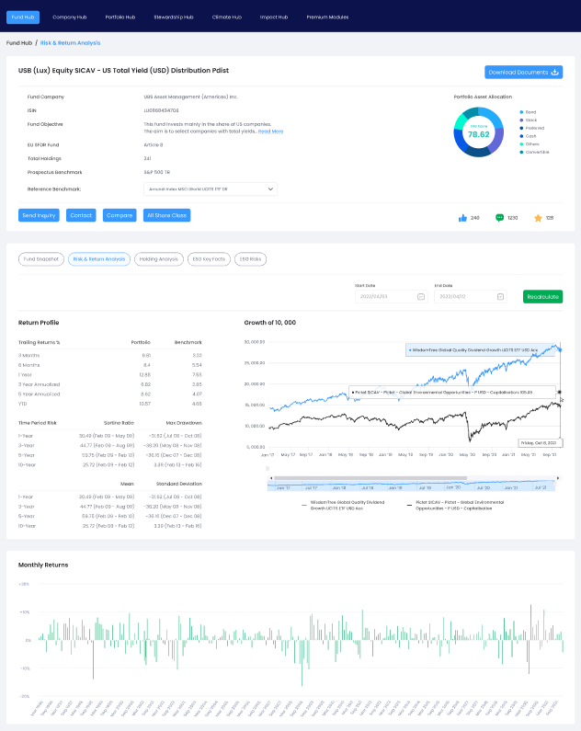
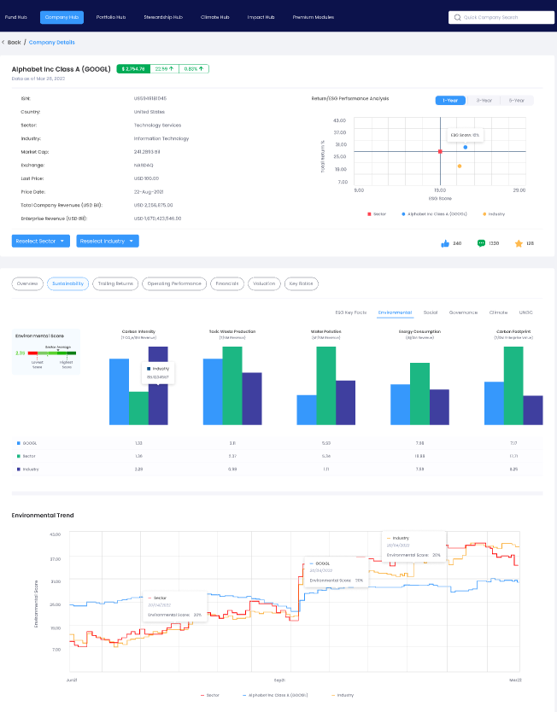
BON22162 - DEMO/KEY FEATURES/RESOURCE RAMP-UP & DOWN
FINANCIAL REPORTING AND ANALYSIS PLATFORM
FINANCIAL HUBS
KEY FEATURES
User Portal:
Authentication
Financial analysis reports
ESG data analysis
Portfolio management
Search, screen, and filter funds and companies
Admin Platform:
User and role management
Company management
Dashboard management
RESOURCE RAMP-UP & DOWN
The project team consisted of 32 members at its peak, including 1 Project Manager, 2 Business Analysts, 1 UI/UX Designer, 2 Technical Leaders, 9 Back-End Developers, 5 Front-End Developers, 6 Manual Testers, and 1 DevOps Engineer.
The team maintained a balanced allocation throughout the project to meet the demanding requirements effectively.

Slide 3
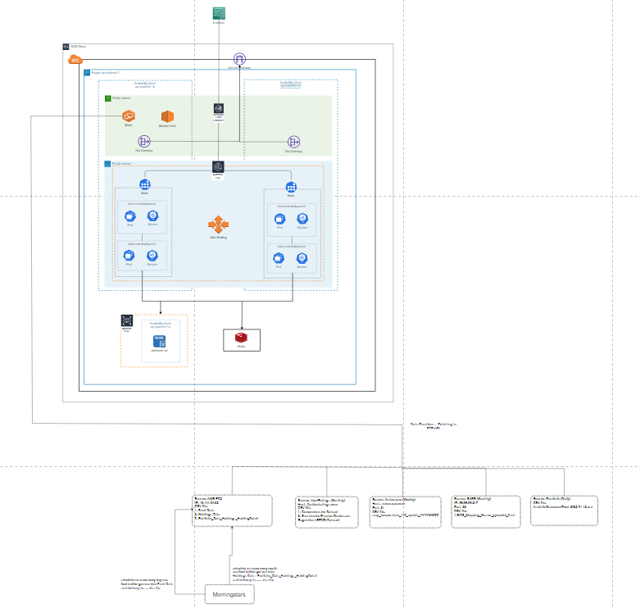
BON22162 - TECHNICAL SOLUTION/TECH STACK
FINANCIAL REPORTING AND ANALYSIS PLATFORM
ARCHITECTURE OVERVIEW
TECH STACK
Platform: Web Application
Languages: React.js (v17.0.2), Node.js (v14.0)
Frameworks: Nest.js, Next.js
Database: MySQL v8.0.23, Redis, Elasticsearch
Third-Party Tools: Mixpanel, Google Analytics, Stripe, Twilio, HubSpot
Cloud: AWS services (EKS, ECS, Lambda, S3, etc.)
OS: Ubuntu
Operations: Kubernetes (K8s), CloudWatch
Architecture: Microservices

