Slide 1
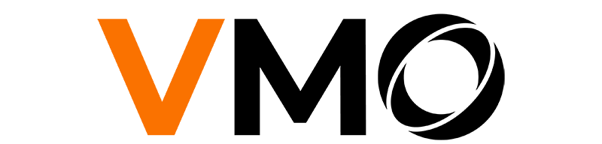
EN - ISG23223 – ERP Modernization & Cloud Migration – Migration
Overview
Gas provider company
VMO ACTIVITIES
ABOUT
VMO Solution:
VMO provided end-to-end ERP modernization services including legacy system analysis, business logic extraction, feasibility assessment, and data migration to a cloud-based platform. The team also supported system integration design to ensure seamless connectivity between NetSuite and existing subsystems.
SCOPE OF WORK:
Legacy system analysis and business logic extraction from AS400 source code
Feasibility study and solution design for NetSuite and Boomi integration
Data migration from AS400 to NetSuite with data validation and integrity assurance
System architecture documentation including data flow, table definition, and integration mapping
Integration design to connect NetSuite with existing subsystems (C/S Bridge, DBMoto, EDI, etc.)
Our client:
The client is a Japan-based energy and utility provider specializing in LP gas and electricity services, with additional business in housing renovation. The company operates a legacy AS400-based ERP system to manage core business processes and serves customers primarily in the domestic market.
Product Overview:
An integrated cloud-based ERP platform designed to centralize and manage core business operations such as finance, inventory, and data integration across multiple subsystems. The solution enables seamless data synchronization and supports business process continuity for energy and utility service providers.
Client Pain Points:
Legacy AS400-based ERP system with outdated technologies (RPG, COBOL), making maintenance and troubleshooting difficult
Lack of proper development and debugging environment for existing source code
Challenges in ensuring functional equivalence when migrating to a modern cloud-based ERP (NetSuite)
Complexity in migrating and preserving over 15 years of historical ERP data while maintaining data integrity
Team size:
5 Members
Successfully migrated 15+ years of ERP data to NetSuite with high data accuracy and integrity
Enabled 100% visibility of legacy business logic through comprehensive documentation (system flow, table definitions, integration mapping)
Reduced dependency on legacy technologies (RPG/COBOL), improving maintainability and future scalability
Ensured seamless integration between NetSuite and multiple subsystems, supporting stable business operations post-migration
Duration:
4 months
STANDARDS
Location:
Japan
ISO 27001, ISO 9001
ITIL, PMBOK, BABOK, Agile/Scrum
RESOURCES RAMP UP & DOWN
Fixed team size of 5 members (PM, BA, Developer, Data Engineer)
Contract Type: T&M

Slide 2
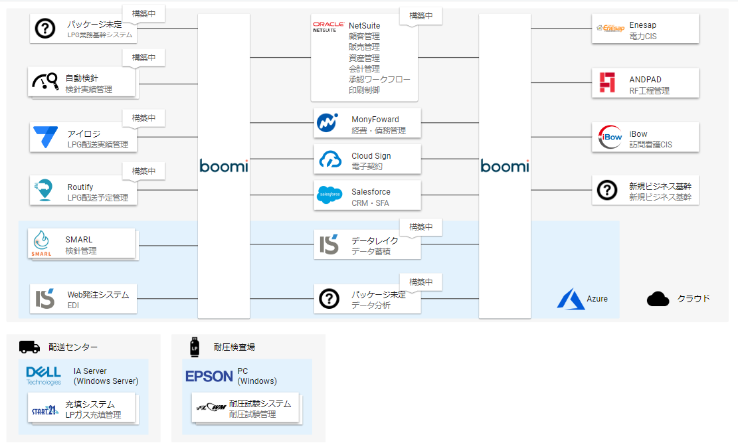
EN - ISG23223 – ERP Modernization & Cloud Migration – Migration
Technology Detail
System Architecture
KEY FEATURES
Financial Management: Manage accounting, billing, and financial reporting in a centralized system
Inventory & Order Management: Track inventory, manage orders, and support operational workflows
ERP Data Centralization: Single source of truth for all business data across departments
Reporting & Analytics: Generate reports and insights to support business decision-making
TECH STACK
Development Language:
RPG
Java
Database: IBM DB2, SQL Server
Platform: Boomi, Netsuite
Cloud: Azure

Slide 3
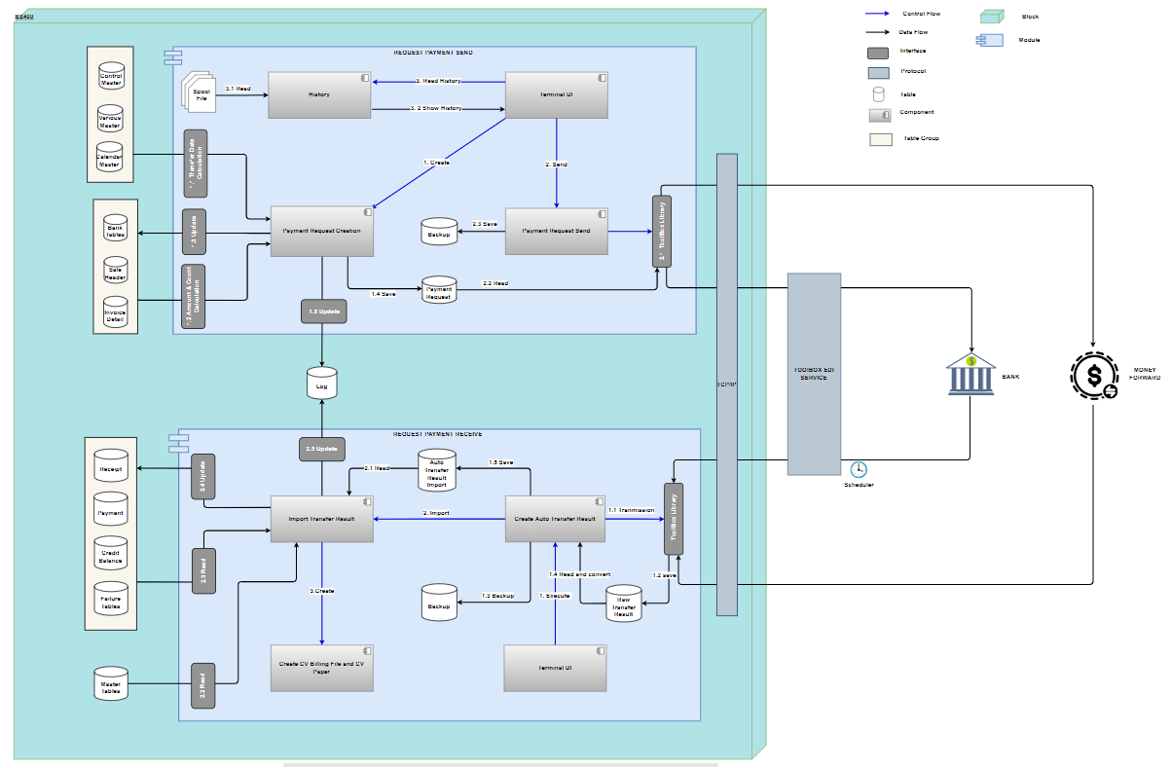
EN - ISG23223 – ERP Modernization & Cloud Migration – Migration
Technology Detail
System design

Slide 4
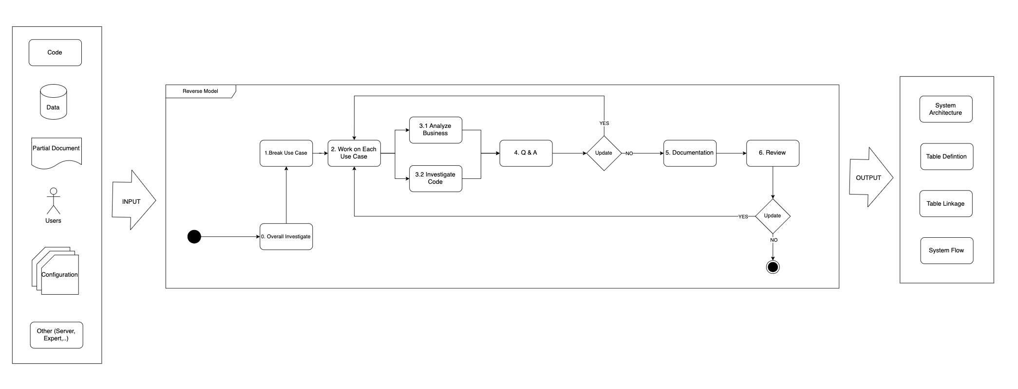
EN - ISG23223 – ERP Modernization & Cloud Migration – Migration
Business flow - Function Transition Chart

