Slide 1
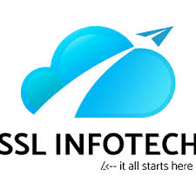

Slide 2
Cloud Computing:
Cloud computing is the delivery of computing services—servers, storage, databases, networking, software, analytics and more—over the Internet (“the cloud”). Companies offering these computing services are called cloud providers and typically charge for cloud computing services based on usage, similar to how you are billed for water or electricity at home.
Top benefits of cloud computing:
Cloud computing is a big shift from the traditional way businesses think about IT resources. What is it about cloud computing? Why is cloud computing so popular? Here are 6 common reasons organizations are turning to cloud computing services:
1. Cost
Cloud computing eliminates the capital expense of buying hardware and software and setting up and running on-site datacenters—the racks of servers, the round-the-clock electricity for power and cooling, the IT experts for managing the infrastructure. It adds up fast.
2. Speed
Most cloud computing services are provided self service and on demand, so even vast amounts of computing resources can be provisioned in minutes, typically with just a few mouse clicks, giving businesses a lot of flexibility and taking the pressure off capacity planning.

Slide 3
3. Global scale
The benefits of cloud computing services include the ability to scale elastically. In cloud speak, that means delivering the right amount of IT resources—for example, more or less computing power, storage, bandwidth—right when its needed and from the right geographic location.
4. Productivity
On-site datacenters typically require a lot of “racking and stacking”—hardware set up, software patching and other time-consuming IT management chores. Cloud computing removes the need for many of these tasks, so IT teams can spend time on achieving more important business goals.
5. Performance
The biggest cloud computing services run on a worldwide network of secure datacenters, which are regularly upgraded to the latest generation of fast and efficient computing hardware. This offers several benefits over a single corporate datacenter, including reduced network latency for applications and greater economies of scale.
6. Reliability
Cloud computing makes data backup, disaster recovery and business continuity easier and less expensive, because data can be mirrored at multiple redundant sites on the cloud provider’s network.

Slide 4
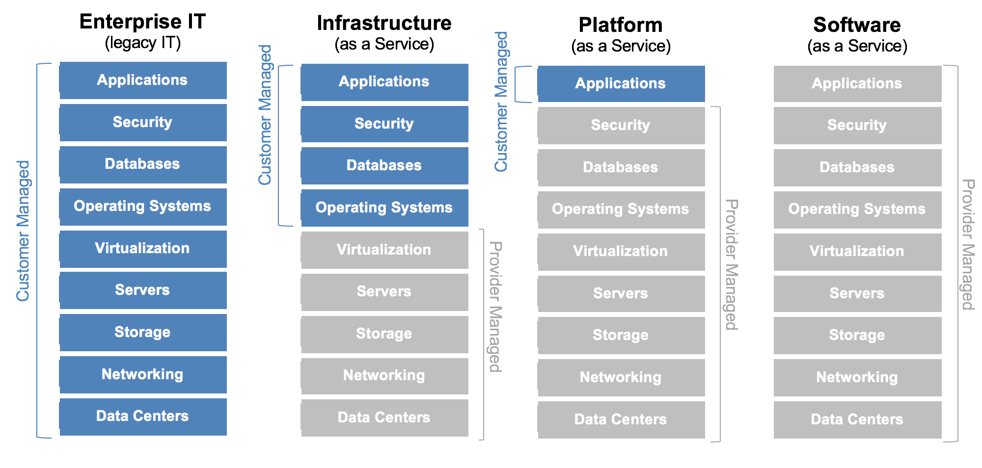
Types of Cloud Services: IaaS, PaaS, SaaS

Slide 5
Deployment models
1) Private cloud model
In this system, the cloud infrastructure is set up on the premise for the exclusive use of an organization and its customers. In terms of cost efficiency, this deployment model doesn’t bring many benefits. However, many large enterprises choose it because of the security it offers.
2) Public cloud model
Public cloud is hosted on the premise of the service provider. The service provider than provides cloud services to all of its customers. This deployment is generally adopted by many small to mid-sized organizations for their non-core and some of their core functions.
3) Hybrid cloud model
Hybrid cloud is a combination of two or more models, private cloud, public cloud or community cloud. Though these models maintain their separate entities they are amalgamated through a standard technology that enables the portability of data and applications.
4) Community cloud
Community cloud model is a cloud infrastructure shared by a group of organizations of similar industries and backgrounds with similar requirements i.e. mission, security, compliance and IT policies. It may exist on or off premise and can be managed by a community of these organizations.

Slide 6
Hypervisor
A hypervisor or virtual machine monitor (VMM) is computer software, firmware or hardware that creates and runs virtual machines. A computer on which a hypervisor runs one or more virtual machines is called a host machine, and each virtual machine is called a guest machine. The hypervisor presents the guest operating systems with a virtual operating platform and manages the execution of the guest operating systems. Multiple instances of a variety of operating systems may share the virtualized hardware resources: for example, Linux, Windows, and macOS instances can all run on a single physical x86 machine. This contrasts with operating-system-level virtualization, where all instances (usually called containers) must share a single kernel, though the guest operating systems can differ in user space, such as different Linux distributions with the same kernel.
Type-1, native or bare-metal hypervisors
These hypervisors run directly on the host's hardware to control the hardware and to manage guest operating systems. For this reason, they are sometimes called bare metal hypervisors. The first hypervisors, which IBM developed in the 1960s, were native hypervisors.^{[4]} Modern equivalents include Xen, Oracle VM Server for SPARC, Oracle VM Server for x86, Microsoft Hyper-V and VMware ESX/ESXi.
Type-2 or hosted hypervisors
These hypervisors run on a conventional operating system (OS) just as other computer programs do. A guest operating system runs as a process on the host. Type-2 hypervisors abstract guest operating systems from the host operating system. VMware Workstation, VMware Player, VirtualBox, Parallels Desktop for Macand QEMU are examples of type-2 hypervisors.

Slide 7
Virtualization
virtualization refers to the act of creating a virtual (rather than actual) version of something, including virtual computer hardware platforms, storage devices, and computer network resources.
Hardware virtualization :
Hardware virtualization or platform virtualization refers to the creation of a virtual machine that acts like a real computer with an operating system. Software executed on these virtual machines is separated from the underlying hardware resources. For example, a computer that is running Microsoft Windows may host a virtual machine that looks like a computer with the Ubuntu Linux operating system; Ubuntu-based software can be run on the virtual machine.
Different types of hardware virtualization include:
Full virtualization – almost complete simulation of the actual hardware to allow software, which typically consists of a guest operating system, to run unmodified.
Paravirtualization – a hardware environment is not simulated; however, the guest programs are executed in their own isolated domains, as if they are running on a separate system. Guest programs need to be specifically modified to run in this environment.

