Slide 1
Memory tracer
Supervisor: Cruz lzu
Group members: Changchang Liu
Tianxu Xi

Slide 2
Summary
Background
Introduction of this project
Current tools
Advantage
Future improvement
Conclusion

Slide 3
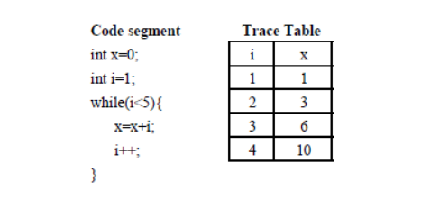
Background
Learning programming is hard, especially for beginners
The core of memory tracer: trace table
Example
Function of trace table
Advantages of trace table (obvious, easy to identify errors and check code)

Slide 4
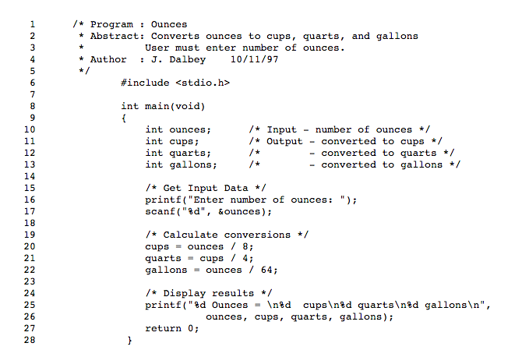
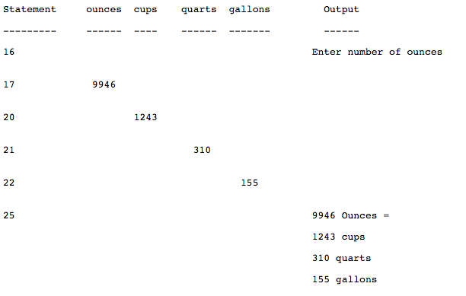

Slide 5
Introduction of this project
Memory tracer
Teacher mode
Student mode
Upload new code
Select code
Input variable’s value
Get feedback and hints after submit
Collect common error
Two modes
Student mode
Example
Teacher mode
Example

Slide 6
Teacher mode
Choose from computer
Upload
Upload New Code
 | Student number1 | Student number2
a.c | 100 | 90
b.c | 80 | 70
Student Marks
Common Errors
a.c | b.c | c.c
Line 3 | Line 1 | line10
Line 6 | Line 2 | Line 20

Slide 7
Current Tools
Automatically generate trace table for java code
Allow students fill into trace table
Auto-grades the submission to students

Slide 8
Advantage
Automatically generate trace table for C code
Allow students fill into trace table
Auto-grades the submission and provide feedback to student
Allow teachers upload new codes
Can provide statistic information to teachers
Common errors that need revision

Slide 9
Future improvement
Automatically generate trace table for both C and Python
Work with other language, ie Python, C++
Provide some more difficult code for students
This tool can show teachers the students’ progress on programming

Slide 10
Conclusion
Trace table is good tool
Help students revise and identify error
Easy to use and get feedback automatically
Current tools are not good enough
It will give both students and teachers more help

Slide 11
Questions

