Slide 1
Memory tracer
Supervisor: Cruz lzu
Group members: Changchang Liu
Tianxu Xi

Slide 2
SUMMARY
Background
What is this project?
Advantage
Interface
Ending

Slide 3


BACKGROUND
INCREASING STUDENTS
LACK OF EFFECTIVE PRACTICE
INCRASING LOAD FOR TEACHERS
HARD TO MAKE PLAN FOR SO MUCH STUDENTS

Slide 4
What is this project
Web-based tool(login)
Form
Web submission
Practice tool

Slide 5
ADVANTAGE
EFFECTIVE PRACTICE
COLLECT DATA FOR TEACHERS

Slide 6
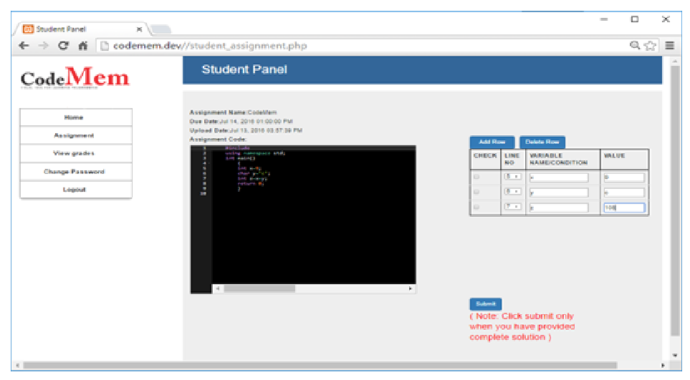
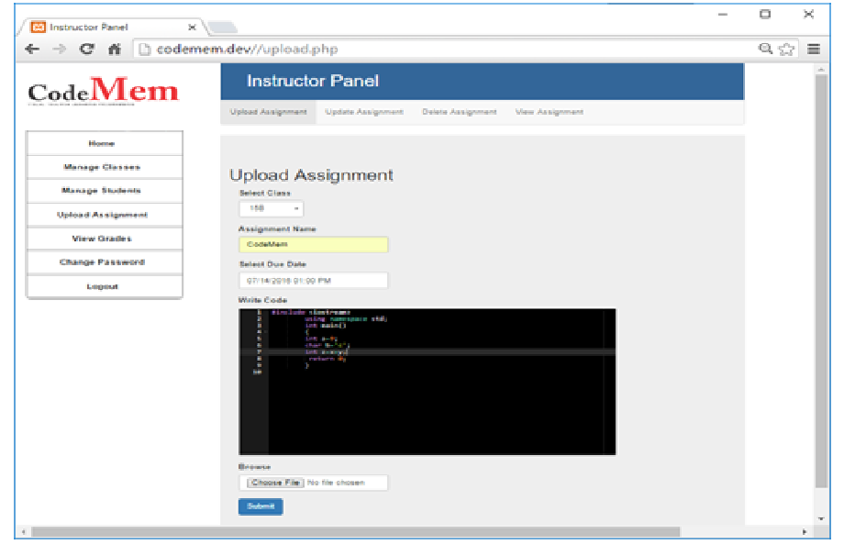
INTERFACE

Slide 7
ENDING
Wish this tool can help students

