Slide 1
Memory Trace In C
Supervisor : Cruz Izu
Team member:
Tianxu Xi a1674472
Changchang Liu a1692335

Slide 2
01
Introduction
02
Project Aims
CONTENT
03
Approach
04
Achievement
05
Future Improvement
06
Conclusion

Slide 3
INTRODUCTION About Memory C Tracer
01. Web-based Tool
02. Fill – in Trace Table
03. Generate Solution Automatically
04. Auto - grades

Slide 4
INTRODUCTION Background
1
2
3
Trace table
Perform Exercise
Mark Trace Table
(time-consuming)
Has been regarded as an effective exercise to learn how to analyze written C code
Teachers are required to generate solutions and mark students’ results manually
Students are asked to draw and fill trace tables manually

Slide 5
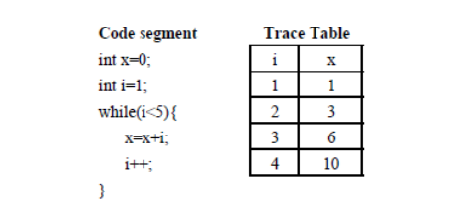
INTRODUCTION Trace Table

Slide 6
AIMS
Solution Trace Table
Submit Results
Auto - Grades
Feed
back
Automatically generates solution for error free C code
Automatically generates empty and allow students to fill in the trace table
Automatically grades students’ submission
provide feedback and hints for students

Slide 7
APPROACH DEVELOPMENT TOOLS
HTML
Shell
CSS
PHP
Back
end
Front
End
PHP
MYSQL
JAVASCRIPT

Slide 8
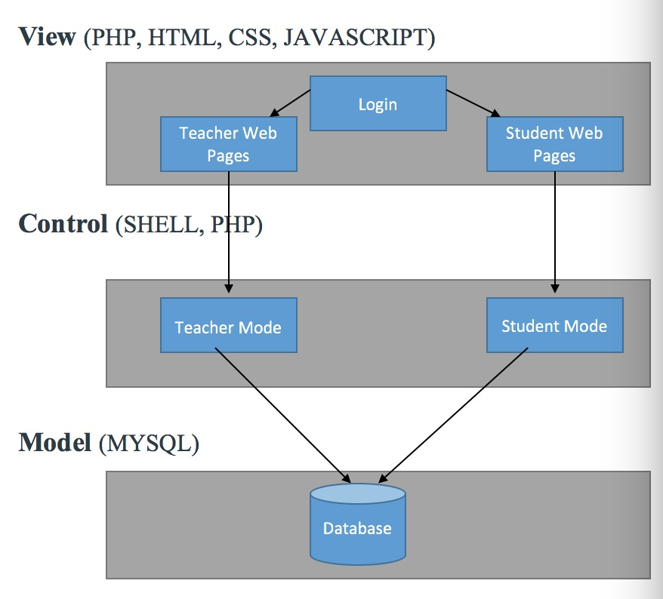
Achievement Architectural Details

Slide 9
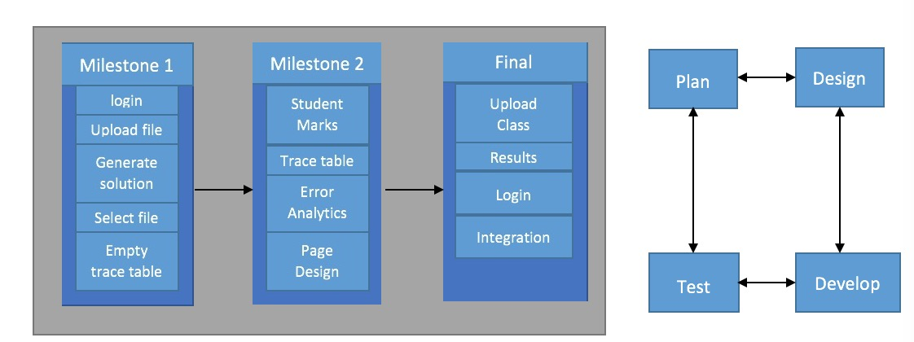
APPROACH Process Model
Backend
Front
End

Slide 10
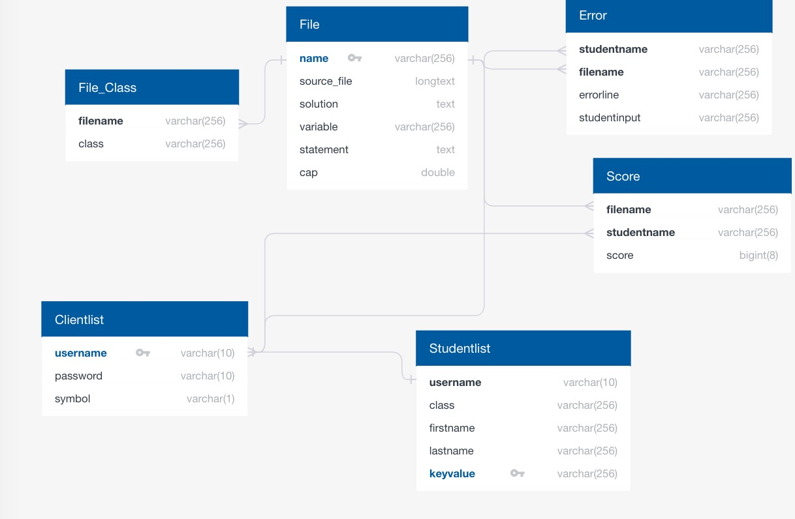
Database Structure

Slide 11
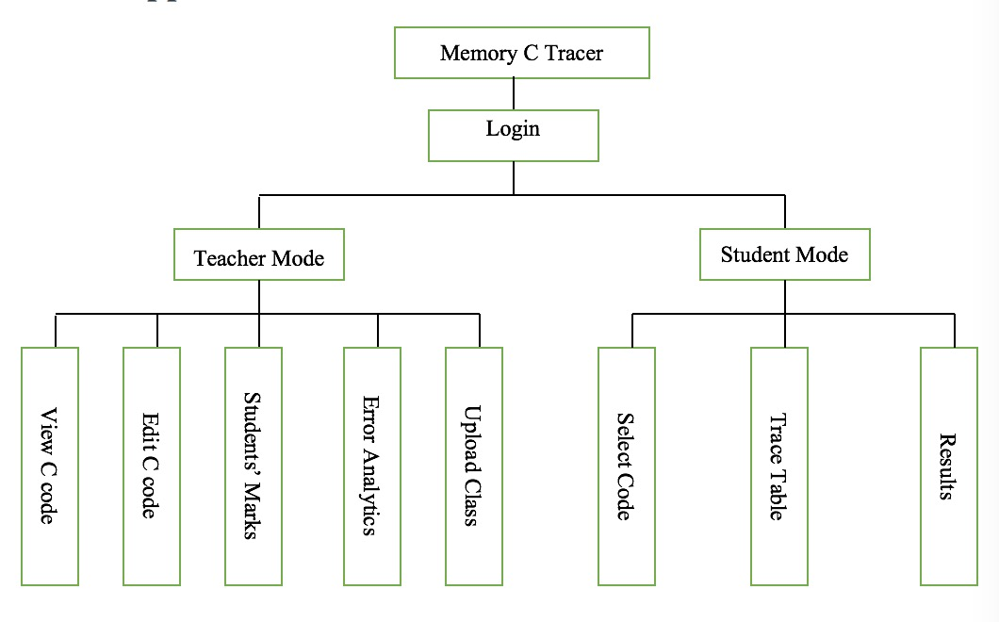
Achievement Function Details

Slide 12
Achievement Student Mode
Login
Student mode
Code selection
Trace table
Results’ display
Display of codes’ content
Display of codes’ content
Colored background
Class option
Dynamic trace table
Tick and cross
More notices
Second chance
Cap scores

Slide 13
Integration
Integration:
XAMPP for local server (easy to use , free)
Database
Login part
Files’ upload and selection
Statements in the trace table.
Scores

Slide 14
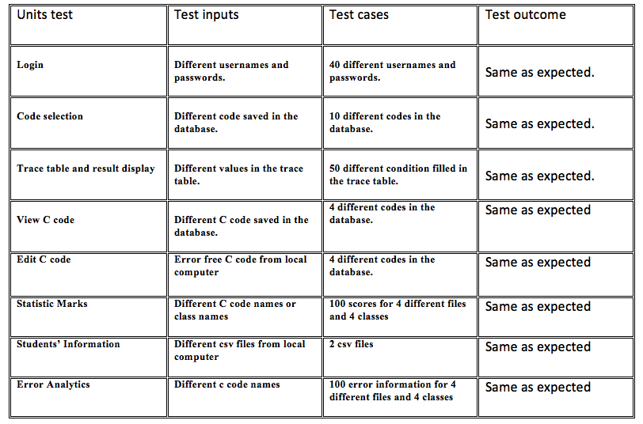
Test

Slide 15
Test
Integration test:
Connection between login page and two modes.
Code upload and code selection
Statements’ change
Scores’ check and Scores’ mark
Acceptance test:
20 people are invited to test our tool.

Slide 16
What do we learn?
Programming language:
HTML
Javascript (ajax)
PHP
The cooperation of teamwork (process and codes)
The approach of trouble shooting
The advantages of iterative project management

Slide 17


Future improvement
Support more codes’ structures
Support more programming language
Support more devices
Multiple loops
Multiple condition
Array
Function
Android app
IPhone app
C++
PHP
Python

Slide 18
Conclusion
01
02
Teacher mode
03
View C Code
Edit C Code
Student Marks
Error Analytics
Upload Class
Student mode
Code selection
Trace table (first chance)
Trace table (second chance)
Display of reuslts
Login part
Connection with two modes

Slide 19
THANKS FOR YOUR WATCHING

Slide 20
Demo display

