Slide 1
Memory tracer
Supervisor: Cruz lzu
Group members: Changchang Liu
Tianxu Xi

Slide 2
SUMMARY
Background
What is this project?
Current tools
Advantage
Future improvement
Ending

Slide 3


BACKGROUND
LACK OF EFFECTIVE PRACTICE
INCREASING NUMBER OF STUDENTS
INCRASING LOAD FOR TEACHERS
HARD TO MAKE PLAN FOR SO MUCH STUDENTS

Slide 4
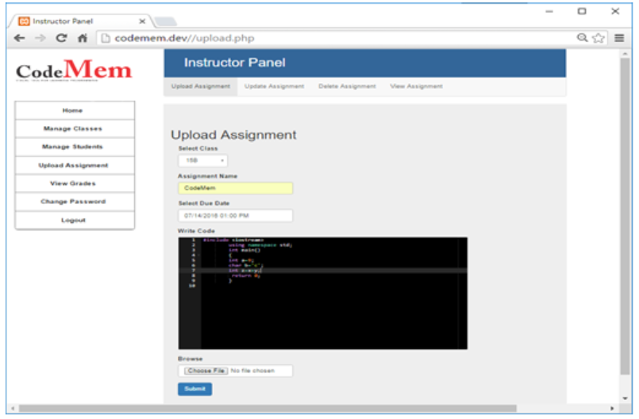
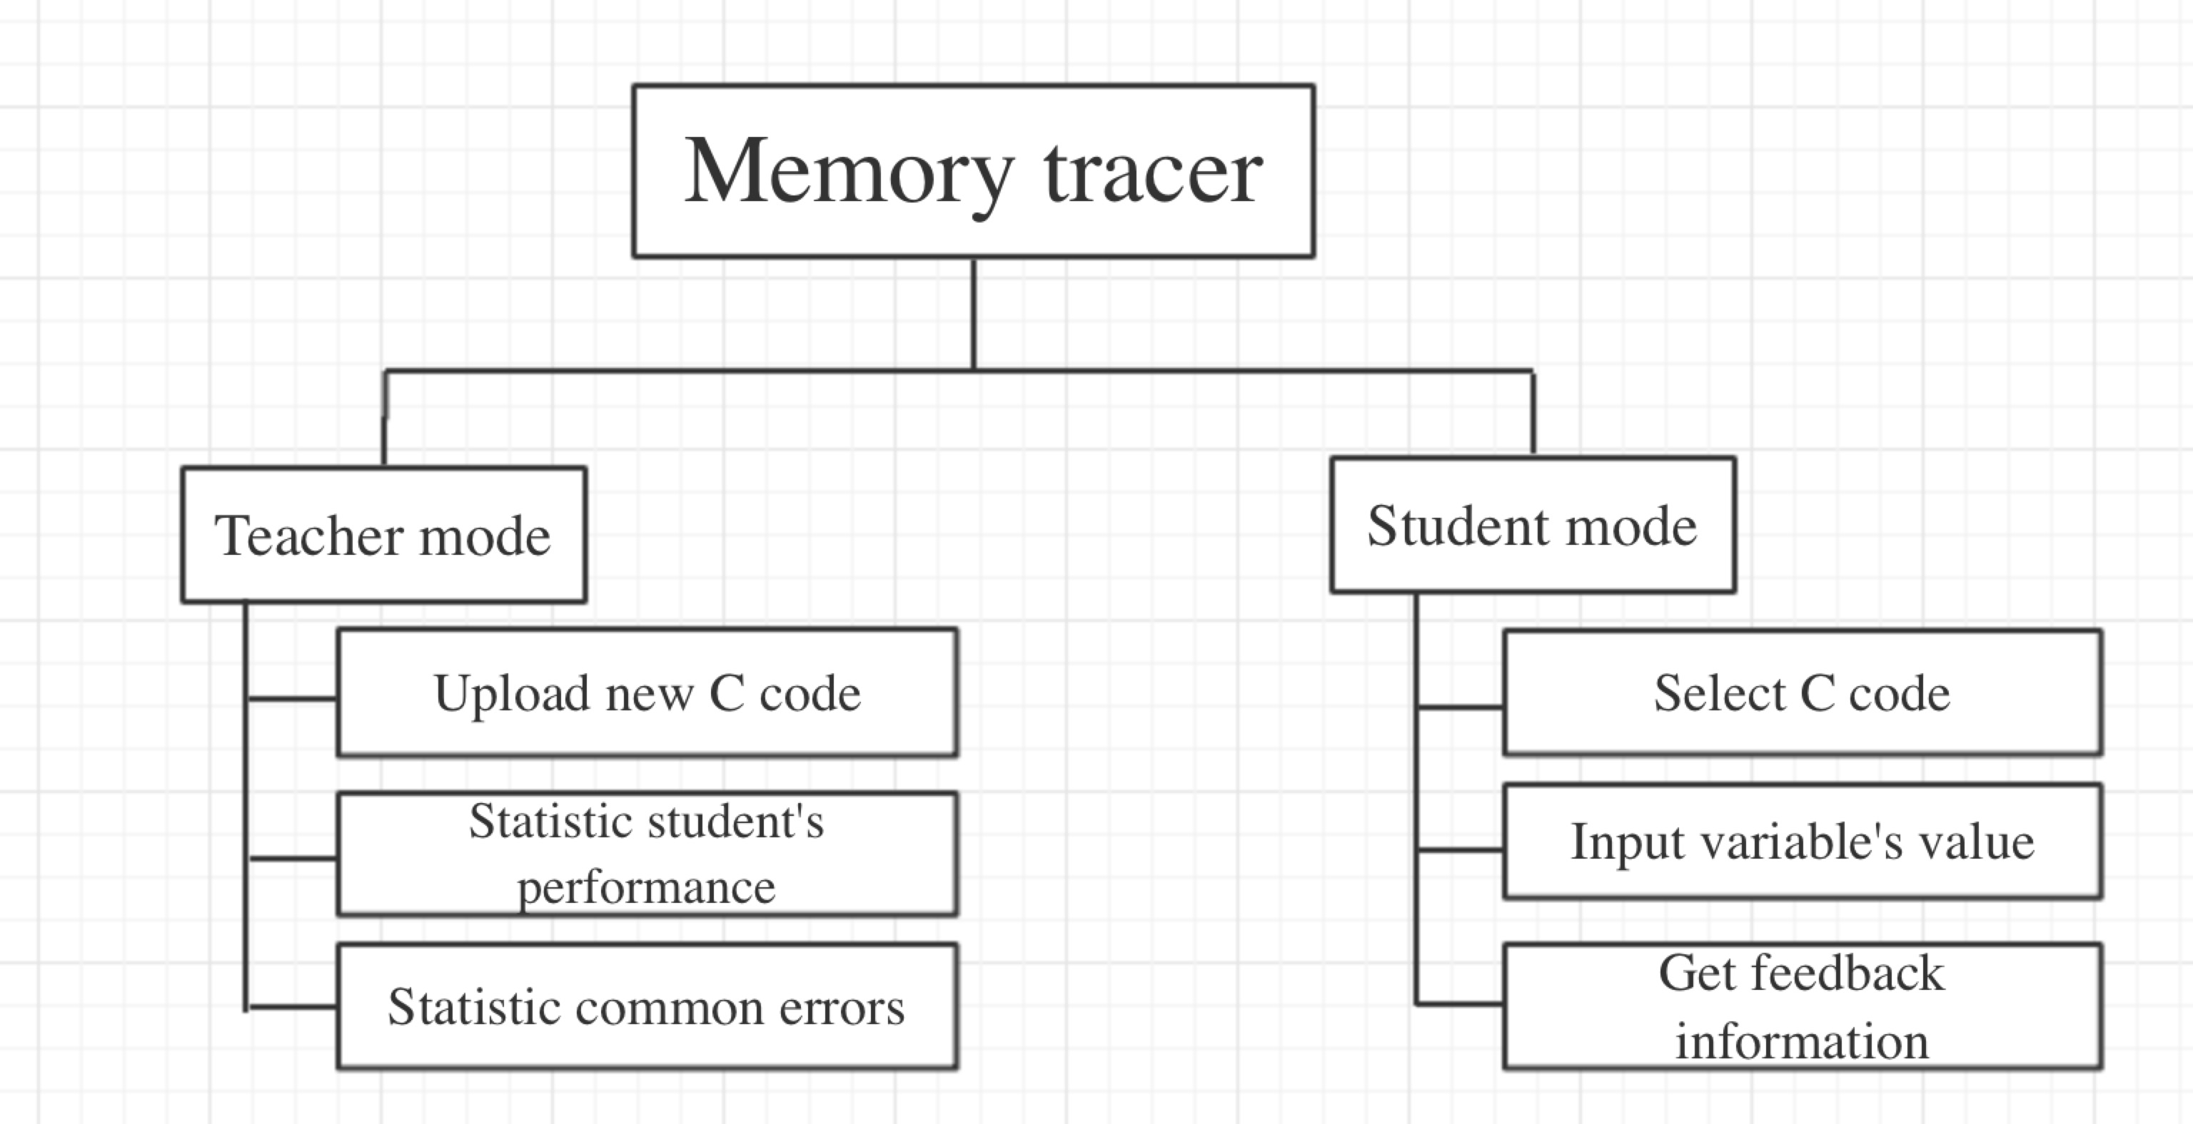
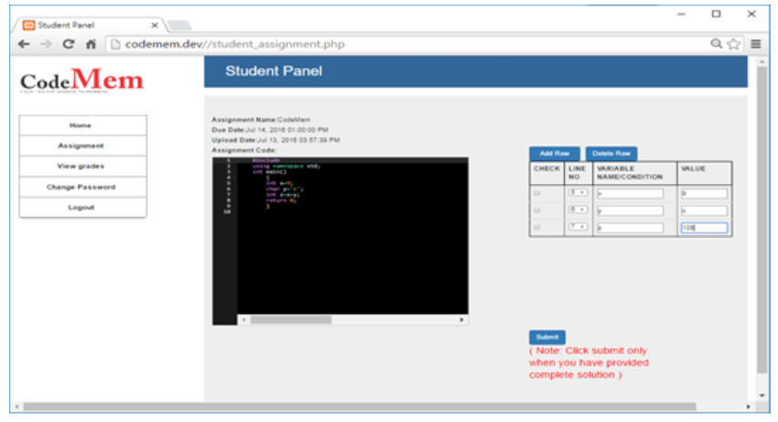
What is this project
Web-based tool(login)
Form
Web submission
Practice tool

