Slide 1
Memory tracer
Supervisor: Cruz lzu
Group members: Changchang Liu
Tianxu Xi

Slide 2
SUMMARY
Background
What is this project?
Advantage
Interface
Ending

Slide 3
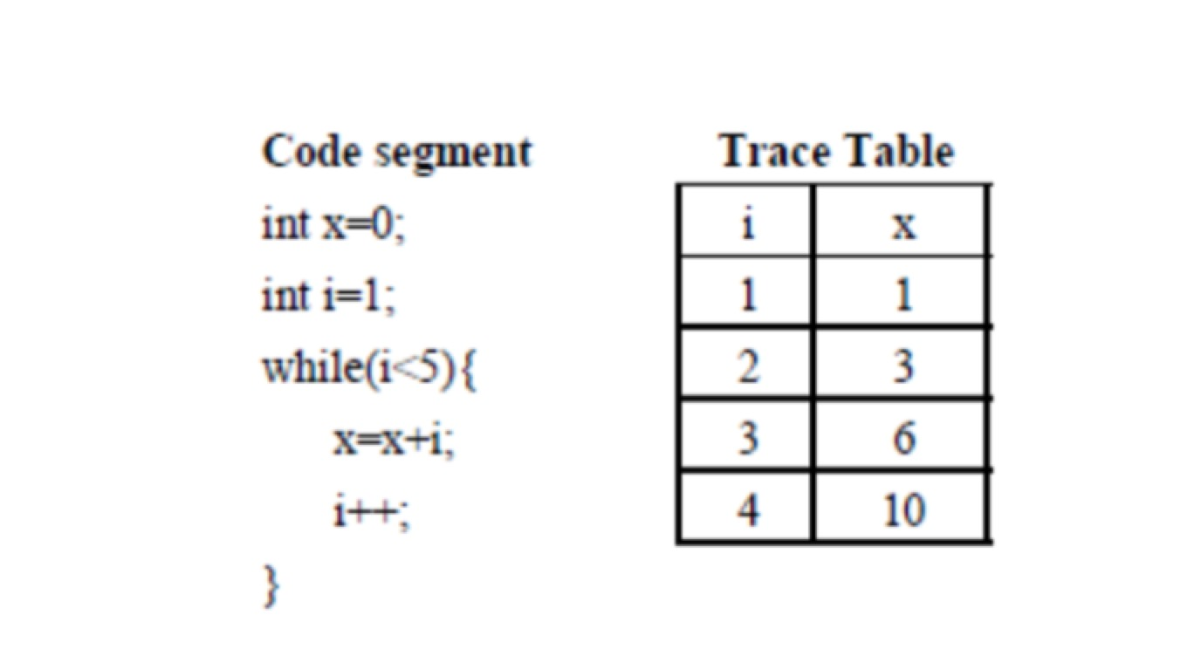


BACKGROUND
INCREASING STUDENTS
LACK OF EFFECTIVE PRACTICE
INCRASING LOAD FOR TEACHERS
HARD TO MAKE PLAN FOR SO MUCH STUDENTS

Slide 4
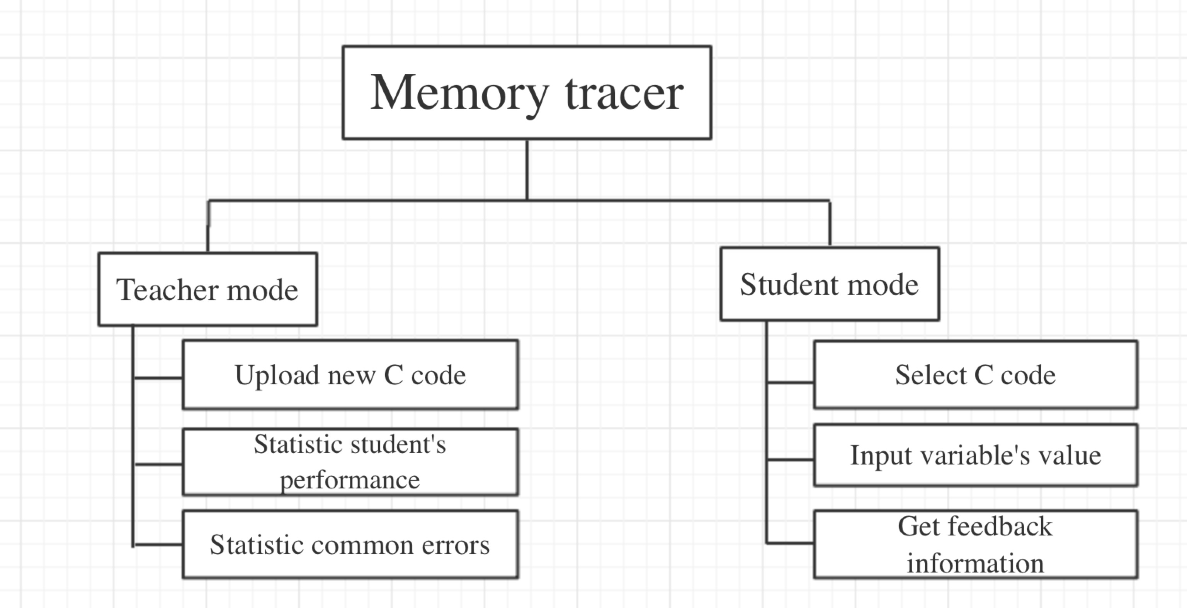
What is this project
Web-based tool(login)
Form
Web submission
Practice tool

Slide 5
ADVANTAGE
Automatically generate trace table for C code
Allow students fill into trace table
Auto-grades the submission and provide feedback to student
Allow teachers upload new codes
Can provide statistic information to teachers

Slide 6
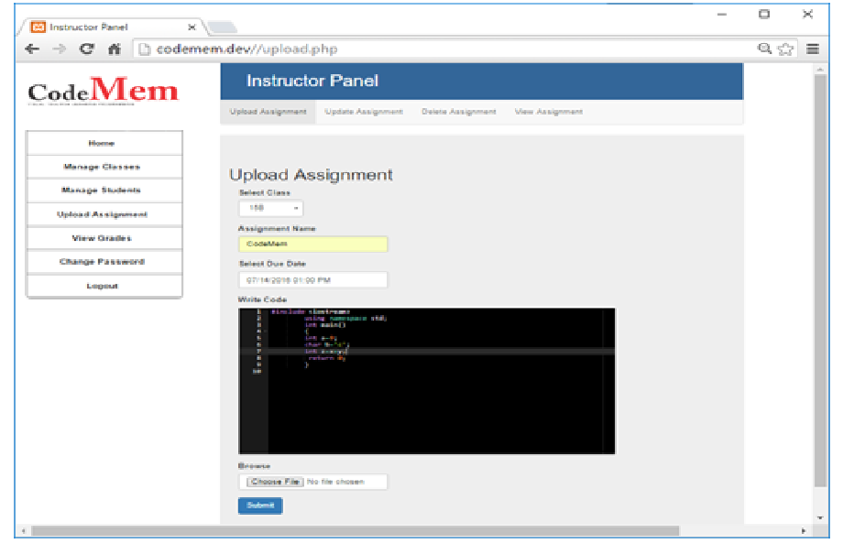
INTERFACE

Slide 7
improvement
Automatically generate trace table for both C and PHP code
Allow students to correct their errors and provide feedback again
Help teachers make future teaching plans

Slide 8
ENDING
Wish this tool can help students

