Slide 1
Help to help

Slide 2
Where do I go out ?
Alone In a foreign country !
With who ?
Which restaurant to choose ?

Slide 3
We got you !
Help to Help

Slide 4
Find people :
Who know where the best place are
Who have the same interest as you
Create your own event
Chat with knew people
All of this in security

Slide 5
Project management
Wished Features:
Passport verification
Creation of event
Chat room
Reasonable matching algorithm

Slide 6
Project management
Final Feature:
Authentication using OAuth-Kakao
Creation of event
Chat room Using Kakao Open Chat
Reasonable matching algorithm

Slide 7
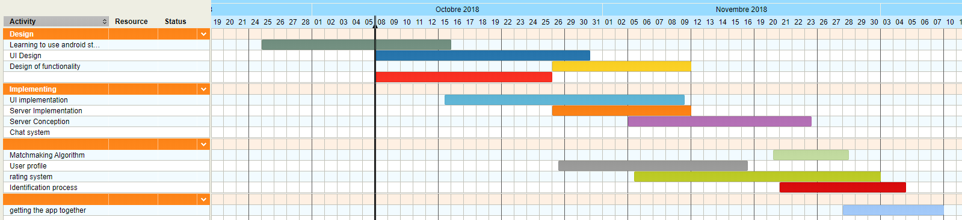
timeline

Slide 8
Team Members: JaeWon, Katrina, Tristan
For now :
Learning to use android studio | Tristan, JaeWon
UI Design | Ekaterina
Server Conception | JaeWon
Chat system | JaeWon
User profile | JaeWon
Rating System | JaeWon
Matching Algorithm | Tristan
Identification process | Ekaterina,JaeWon
Getting things together | Ekaterina,JaeWon

Slide 9
Lessons learnt
JaeWon
What I learned in web programming is applicable to app development
Usefulness of README files
Technical Issues are usually solved past 4AM
Tristan
Ekatrina

Slide 10
Live demonstration

Slide 11
Technical details

Slide 12
Miscellaneous backend feautures
Automated notification generation
Search keyword in tags/titles/descriptions
Match users with other users (location, experience, language, gender, rating, age, common tags)
CRUD events/profiles
Event request, accept, bookmark / User follow, review
Future/past events based on hosted time
Kakao user authentication

Slide 13
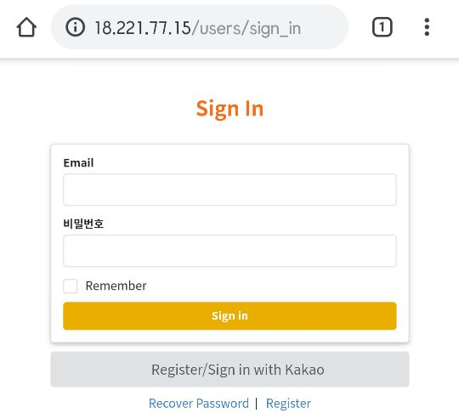
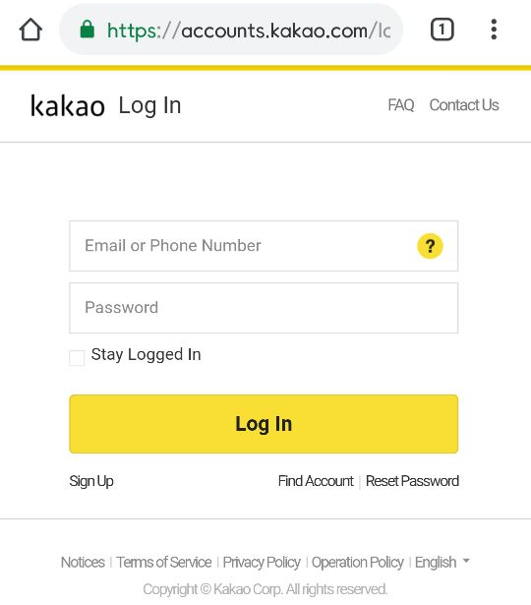
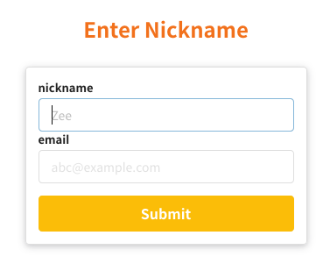
User Authentication

Slide 14
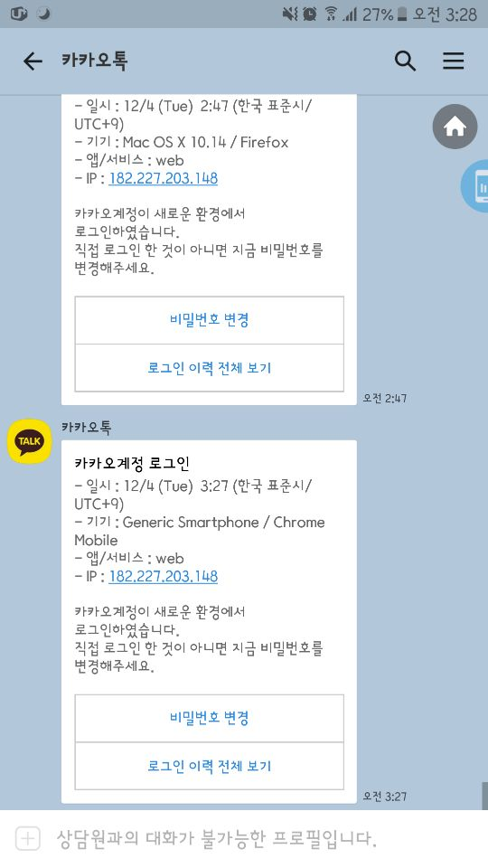
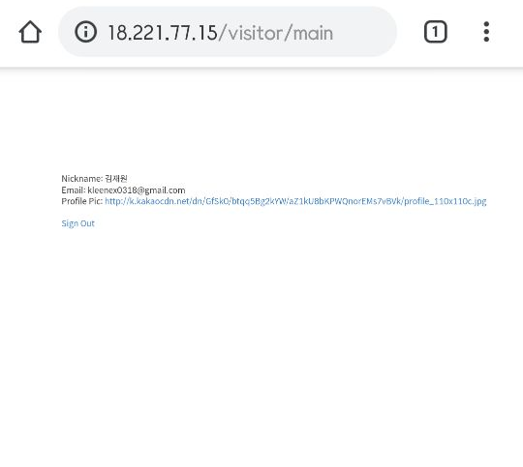

User Authentication

Slide 15
Matching algorithm

Slide 16
Libraries and tools
Backend
Ruby on Rails
Turbolinks, Figaro, omniauth, omniauth-kako, semantic UI, faker, Geokit, Carrierwave, Devise, mini_magick, sqlite, jbuilder
EC2

Slide 17
DB Design update
Added profile pictures to profiles
Added gender and language
Added nickname (username) to users
Added tags for both events and profiles
Added experience to profiles
Added (temporary) match scores to profiles
Removed chats & event waiting

Slide 18
Challenges we have faced
Backend:
Implementing Kakao authentication
Implementing location based search
Implementing matching algorithm
Sending data and testing via json format
Connecting with frontend (i.e. user sign in)
Deploying (Heroku & EC2!)

