Slide 1
Help to help

Slide 2
Where do I go out ?
Alone In a foreign country !
With who ?
Which restaurant to choose ?

Slide 3
We got you !
Help to Help

Slide 4
Find people :
Who know where the best place are
Who have the same interest as you
Create your own event
Chat with knew people
All of this in security

Slide 5
Project management
Initial Features:
Passport verification
Creation of event
Chat room
Reasonable matching algorithm

Slide 6
Project management
Final Feature:
Authentication using OAuth-Kakao
Creation of event
Chat room Using Kakao Open Chat
Reasonable matching algorithm

Slide 7
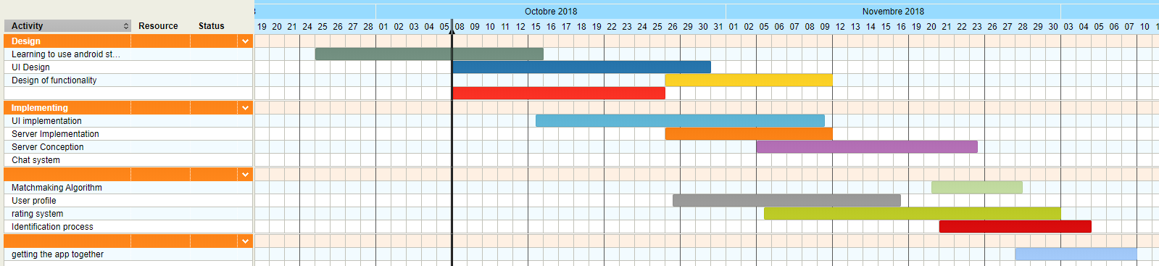
timeline

Slide 8
Team Members: Ekatrina, JaeWon, Tristan
For now :
Learning to use android studio | Tristan
UI Design | Ekatrina
UI Implementation | Ekatrina
Server Conception | JaeWon
Rating System | JaeWon
Matching Algorithm | Tristan
Search and Matching Implementation | Jaewon
User Authentication | JaeWon
Getting things together | Ekatrina, JaeWon

Slide 9
Lessons learnt
JaeWon
What I learned in web programming is applicable to app development
Usefulness of README files
Technical Issues are usually solved past 4AM
Tristan
Ekatrina

Slide 10
Live demonstration

Slide 11
Technical details

Slide 12
Miscellaneous backend feautures
Automated notification generation
Search keyword in tags/titles/descriptions
Match users with other users (location, experience, language, gender, rating, age, common tags)
CRUD events/profiles
Event request, accept, bookmark / User follow, review
Future/past events based on hosted time
Kakao user authentication

Slide 13
DB Design update
Added profile pictures to profiles
Added gender and language
Added nickname (username) to users
Added tags for both events and profiles
Added experience to profiles
Added (temporary) match scores to profiles
Removed chats & event waiting

Slide 14
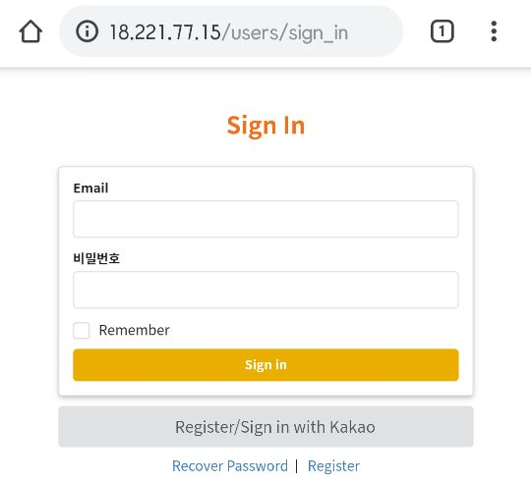
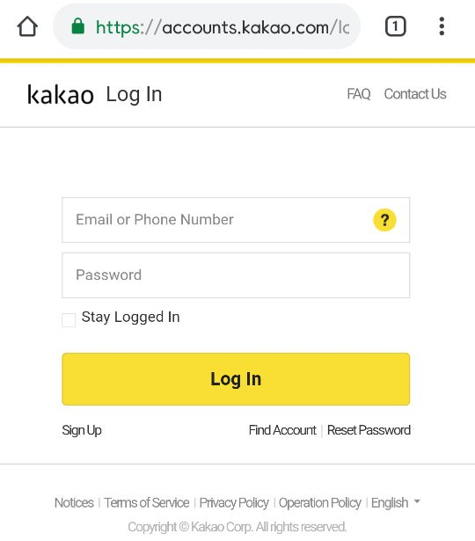
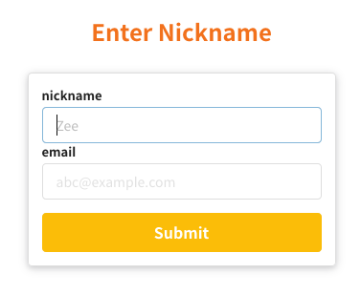
User Authentication

Slide 15
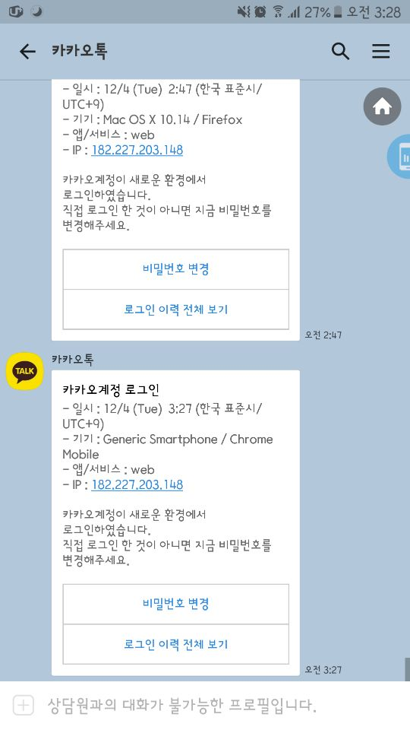


User Authentication

Slide 16
Matching algorithm

Slide 17
Challenges we have faced
Solved
Implementing Kakao authentication
Geocoding and location based search
Implementing matching algorithm
Sending data and testing via json format
Client-server connection
Deploying (Heroku & EC2)
Not solved
User Authentication on App environment
Time management; some features not available on frontend yet

Slide 18
Libraries and tools
Frontend
Android Studio
Retrofit 2, okhttp, glide, flexbox
Backend
Ruby on Rails
Gems: Turbolinks, Figaro, omniauth, omniauth-kako, semantic UI, faker, Geokit, Carrierwave, Devise, mini_magick, sqlite, jbuilder
Heroku, EC2

