Slide 1
The PMRC and Its Effect on Music Popularity

Slide 2
Outline
Hypothesis
The Data
Cool Graphs
Conclusion

Slide 3
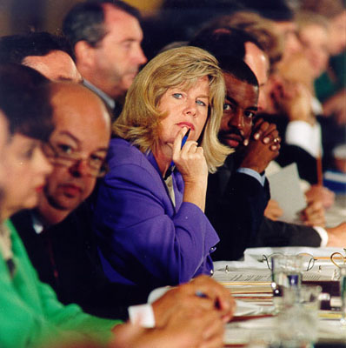
Hypothesis
Hypothesis
In the 1985, the Parents Music Resource Center (PMRC) pushed to put a warning label on 'explicit' music
This was supposed to help parents monitor the music their children were buying
I propose it had the opposite effect that was intended
Notes:
In the mid to late 1980's, there was a big push to put a warning label on records and CD's that were deemed 'explicit' and had suggestive or 'satanic' lyrics. This was supposed to help parents monitor the music their children were buying. I propose it had the opposite effect. Albums and music with explicit lyrics and images were more popular after the mid to late 1980's.

Slide 4
The Data
Weekly Hot 100 singles chart between 1958 and 2019, over 300,000 records
Spotify, including genres and an ‘explicit’ indicator, over 25,000 records
Raw data available here

Slide 5
Assumptions
The music genre list by Spotify is accurate
Notes:
My determination of a single genre for each song is accurate

Slide 6
Cool Graphs

Slide 7
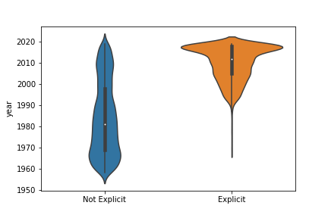
There were very few 'explicit' songs before 1985

Slide 8
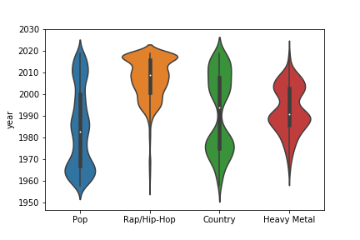
Rap and hip-hop became popular right after the PMRC was formed in 1985

Slide 9
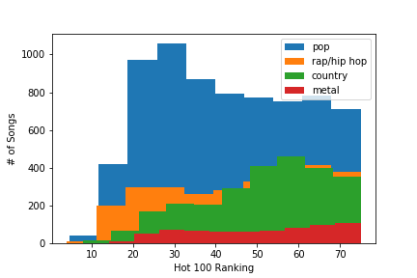
No difference in Hot 100 ranking between genres

Slide 10
Conclusions
Explicit music became significantly more popular after the PMRC was formed in 1985
Rap and Hip-Hop are more explicit on average than other types of music
Because explicit music is more popular now, sales of explicit music have significantly increased in recent years

Slide 11
Questions?

