Slide 1
The PMRC Its Effect on Music Popularity

Slide 2
Outline
Hypothesis
The Data
Cool Graphs
Conclusion

Slide 3
Hypothesis
In the 1980’s, the Parents Music Resource Center (PMRC) pushed to put a warning label on records and CD's that were deemed 'explicit'.
This was supposed to help parents monitor the music their children were buying.
I propose it had the opposite effect. Albums and music with explicit lyrics and images were more popular after the mid 1980's.

Slide 4
The Data

Slide 5
Solution description
Now that you’ve justified your attention to the problem, summarize your solution in one or two sentences.

Slide 6
Assumptions
The music genre list by Spotify is accurate
My determination of a single genre for each song is accurate

Slide 7
Cool Graphs

Slide 8
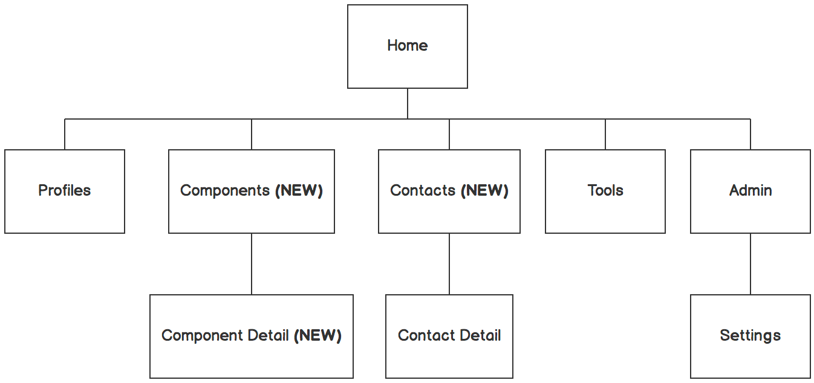

Information architecture
Balsamiq Tip | Information architecture is the flow of content across the site or application (more info).

Slide 9
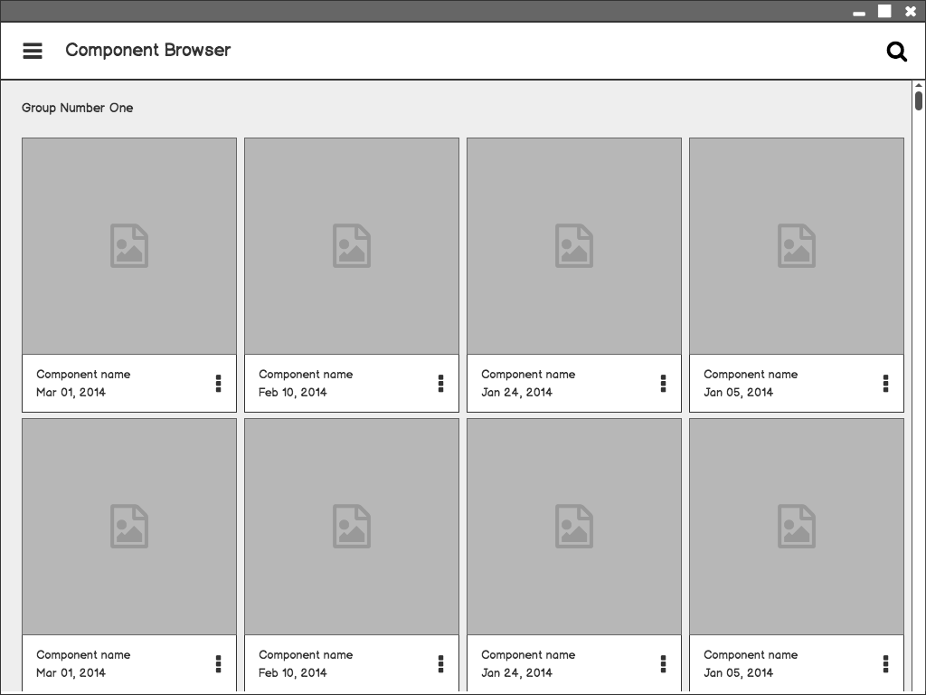
Component Browser
Call out key parts of the UI
Balsamiq Tip | Use the Balsamiq add-on to make your own wireframe.

Slide 10
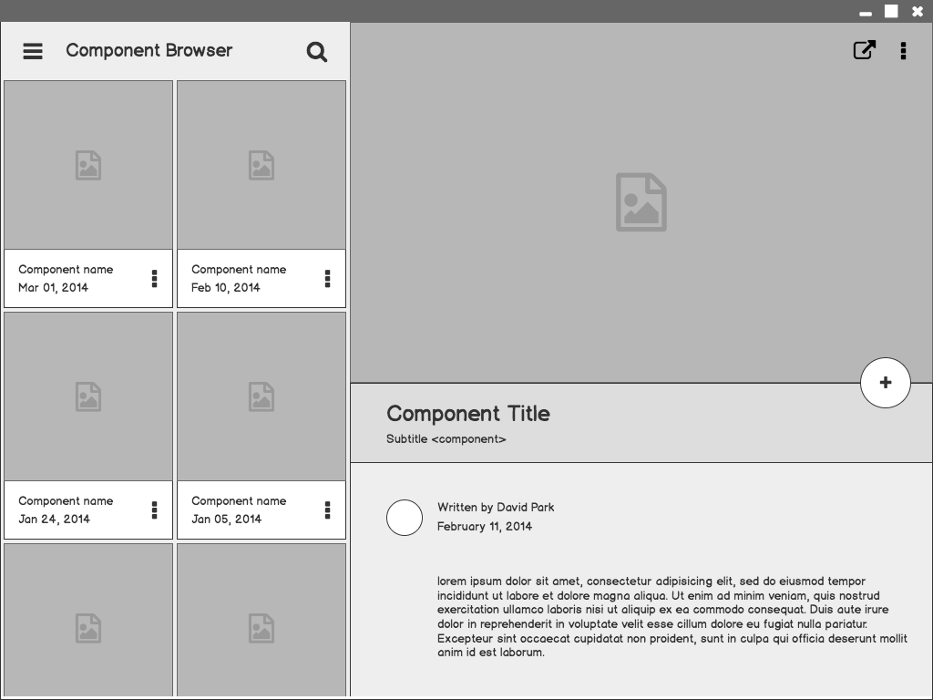
Component Detail

Slide 11
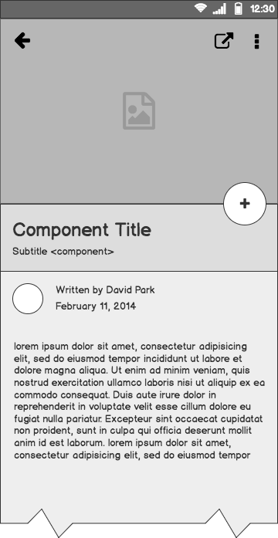
Component Detail (Mobile)
Articulate your design decisions by adding justifications

Slide 12
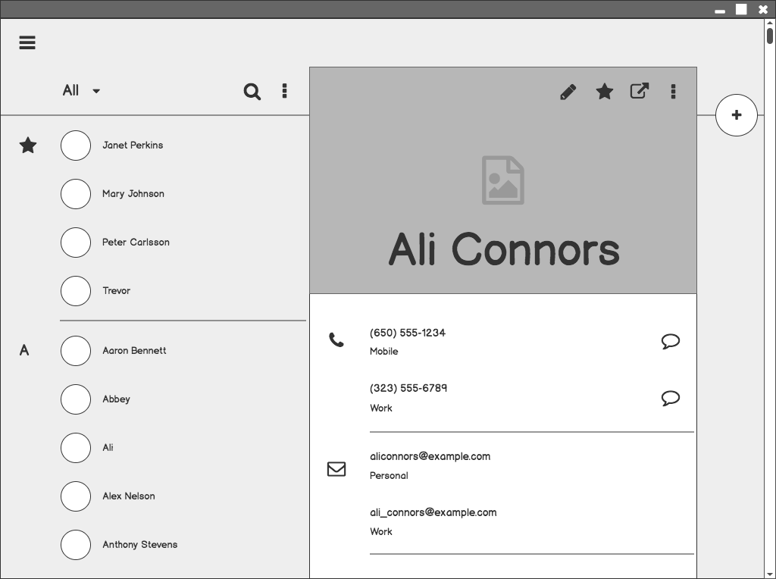
Contacts

Slide 13
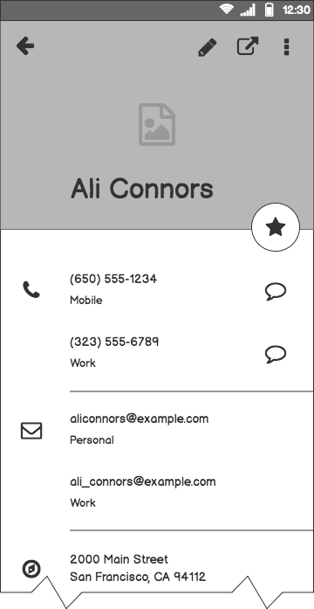
Contacts (Mobile)

Slide 14
Conclusion

Slide 15
What next?
Present the timeline.
Solicit comments on these slides or reviews on these wireframes in the Balsamiq add-on.
User testing plan.

Slide 16
Timeline
MAY
JUN
TODAY
AUG
SEPT
OCT
NOV
Requirements gathering
User research
Wireframes
Review
Prototype
User testing
Dev hand-off

Slide 17
Questions?

Slide 18
References
Tips for Presenting Your Wireframes
3 Steps to Better UI Wireframes
Wireframing for Beginners

