Slide 1
Spotify Music Cluster Analysis

Slide 2
Outline
Summary
The Data
The Clustering Process
Cool Graphs
Interpret Cluster Membership
Limitations
Next Steps

Slide 3
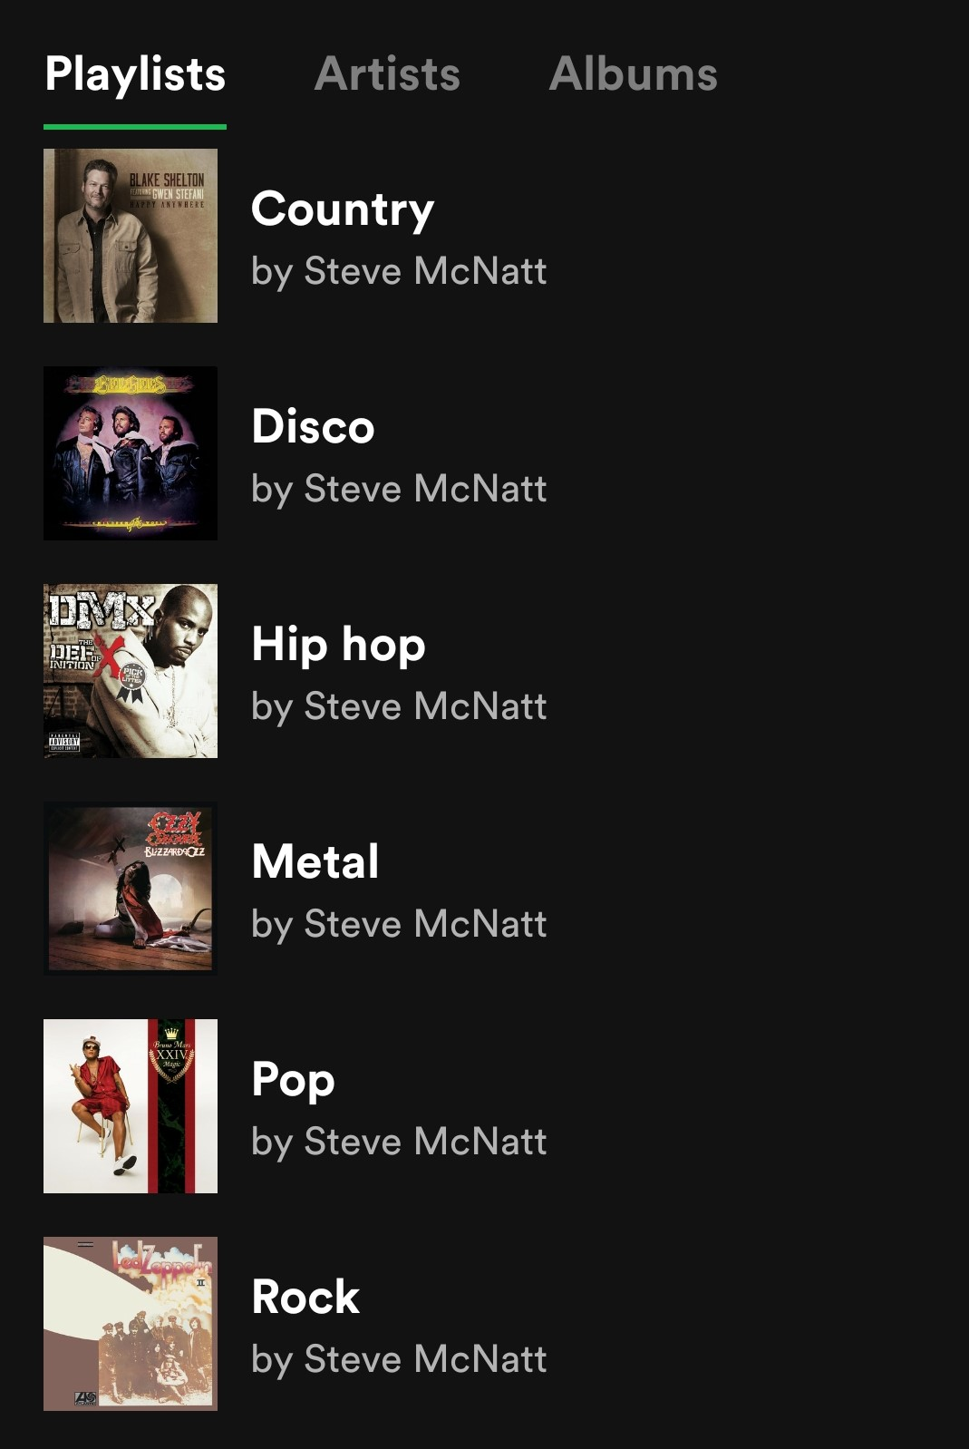
Summary
Question: Is there a way to cluster music and performers into groups by using the music genre or the musical audio features of a song as defined by Spotify?
Music genres analyzed:
Pop
Country
Hip Hop
Rock
Metal
Blues
Disco
Jazz
Classical
Musical audio features analyzed:
Danceability – how suitable a track is for dancing based on a combination of musical elements including tempo, etc.
Energy - a perceptual measure of intensity and activity.
Mode - modality (major or minor) of a track, the type of scale from which its melodic content is derived.
Instrumentalness - predicts whether a track contains no vocals
Speechiness - detects the presence of spoken words in a track

Slide 4
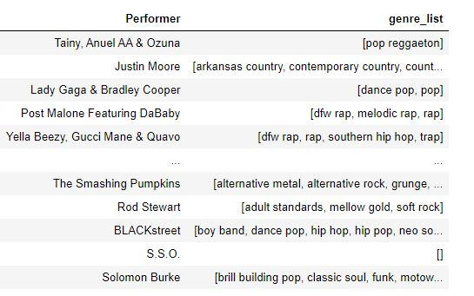
The Data
Weekly Hot 100 singles chart between 1958 and 2019, over 300,000 records
This file includes a list of music genres for each song as determined by Spotify:
This file also contains information about the individual songs such as the levels of certain musical traits (danceability, speechiness, etc). These levels are also defined by Spotify.
Raw data available here

Slide 5
The Clustering Process
A sample of 10000 records were used for the clustering models and analysis
I determined a single genre for each of the song records based on the genre list for each song using an algorythm that I defined
I used several data clustering techniques to group the data using the musical audio features described earlier. All of the features values in the data file ranged from 0.0 to 1.0
Audio Features
Danceability
Energy
Mode
Instrumentalness
Speechiness
Clustering Techniques
Kmeans
Hierarchical
UMAP

Slide 6
Cool Graphs

Slide 7
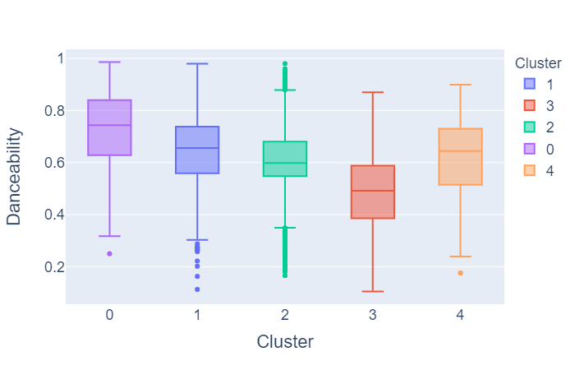
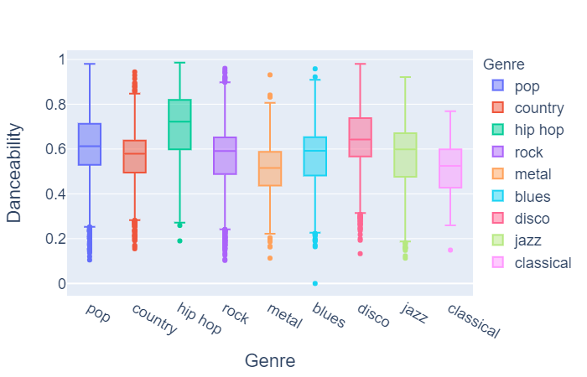
Grouping by danceability
Cluster 0 appears to have the highest danceability
Cluster 3 appears to have the lowest danceability
Hip hop, disco and pop have high danceability. I observed a large number of hip hop songs in cluster 0.
Metal, classical and jazz have low danceability. I observed a large number of metal and jazz songs in cluster 3.

Slide 8
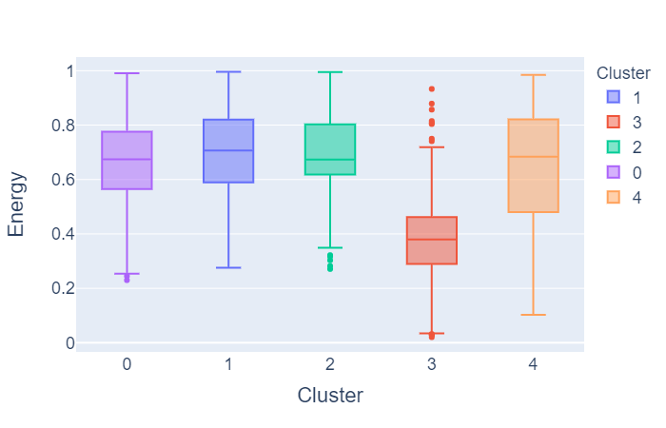
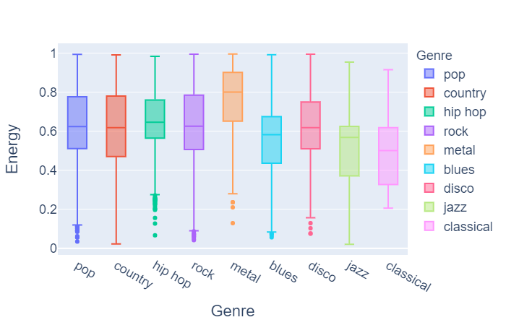
Grouping by energy
Cluster 3 appears to have the lowest energy
Metal and rock have high energy. I observed a large number metal, pop and rock songs in clusters 0 and 2
Classical, jazz and blues have low energy. I observed a large number of classical and jazz songs in cluster 3

Slide 9
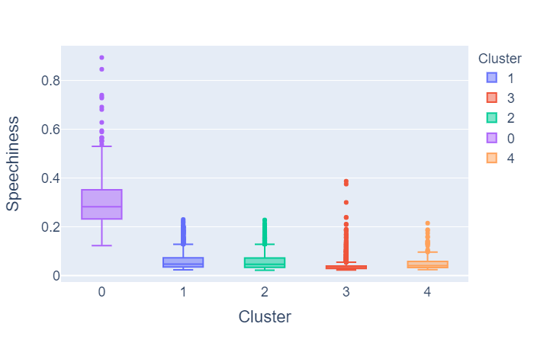
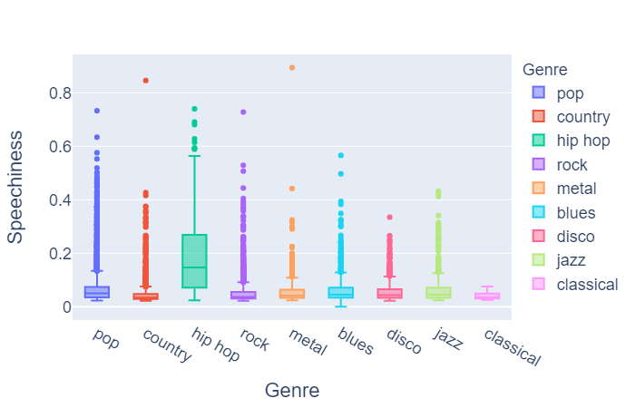
Grouping by speechiness
Cluster 0 appears to have the highest speechiness
Hip hop has high speechiness. I observed a large number of hip hop songs in cluster 0.
The rest of the genres have low speechiness. Not many of those songs were in cluster 0.

Slide 10
Interpret Cluster Membership
Many of the clusters had a very diverse population of all of the genres
Only one of the clusters for each audio feature had a high percentage of one or two of the genres.
Audio features are the best way to group musical performers
It is difficult to group musical performers by genre given the audio features.

Slide 11
Limitations
The genre list for each of the songs was determined by Spotify, so it is very subjective
The determination of the single genre selected for each of the songs is done with an algorithm that I created

Slide 12
Next Steps
This data can be used by music festival promoters, such as Bonaroo and other diverse music festivals
These festivals usually have many different stages. The promoters can ‘cluster’ the performers by the grouping data so that people don’t have to walk between the different tents to see the type of music that they prefer. For example, high enery music can be on one stage, while high danceability and speechiness music can be on another stage.
It doesn’t matter what genre is on what stage

Slide 13
Questions?

