Slide 1
Java Collection
Raghu G B
Notes:
This template can be used as a starter file for presenting training materials in a group setting.
Sections
Right-click on a slide to add sections. Sections can help to organize your slides or facilitate collaboration between multiple authors.
Notes
Use the Notes section for delivery notes or to provide additional details for the audience. View these notes in Presentation View during your presentation.
Keep in mind the font size (important for accessibility, visibility, videotaping, and online production)
Coordinated colors
Pay particular attention to the graphs, charts, and text boxes.
Consider that attendees will print in black and white or grayscale. Run a test print to make sure your colors work when printed in pure black and white and grayscale.
Graphics, tables, and graphs
Keep it simple: If possible, use consistent, non-distracting styles and colors.
Label all graphs and tables.

Slide 2
Collection in java
Collections in java is a framework that provides an architecture to store and manipulate the group of objects.
All the operations that you perform on a data such as
Searching
Sorting
Manipulation
Insertion
Deletion
Cont……
Notes:
Give a brief overview of the presentation. Describe the major focus of the presentation and why it is important.
Introduce each of the major topics.
To provide a road map for the audience, you can repeat this Overview slide throughout the presentation, highlighting the particular topic you will discuss next.

Slide 3
Collection in java
Java collection is simple mean collection of Objects.
Java collection provide many Interfaces such as
List
Queue
Dqueue
Set
SortedSet
Notes:
Give a brief overview of the presentation. Describe the major focus of the presentation and why it is important.
Introduce each of the major topics.
To provide a road map for the audience, you can repeat this Overview slide throughout the presentation, highlighting the particular topic you will discuss next.

Slide 4
Collection in java
Java collection provide many Abstract Classes such as
Abstract Collection
Abstract List
Abstract Sequential List
Abstract Set
Notes:
Give a brief overview of the presentation. Describe the major focus of the presentation and why it is important.
Introduce each of the major topics.
To provide a road map for the audience, you can repeat this Overview slide throughout the presentation, highlighting the particular topic you will discuss next.

Slide 5
Collection in java
Java collection provide many Concrete Classes such as
ArrayList
LinkedList
Vector
Stack
PriorityQueue
ArrayDqueue
Hashset
LinkedHashset
Treeset
Notes:
Give a brief overview of the presentation. Describe the major focus of the presentation and why it is important.
Introduce each of the major topics.
To provide a road map for the audience, you can repeat this Overview slide throughout the presentation, highlighting the particular topic you will discuss next.

Slide 6
Hierarchy of Collection Framework
<<Collection>>
<<Queue>>
<Abstract Collection>
<<List>>
<<Set>>
<Abstract List>
<Abstract Set>
<ArrayList>
<PriorityQueue>
<AbstractSequentialListList>
<<Dqueue>>
<<SortedSet>>
<HashSet>
<LinkedList>
<TreeSet>
<ArrayDqueue>
<LinkedHashSet>
<Vector>
The java.util package contains all the classes and interfaces for Collection framework.
Notes:
This is another option for an Overview slides using transitions.

Slide 7
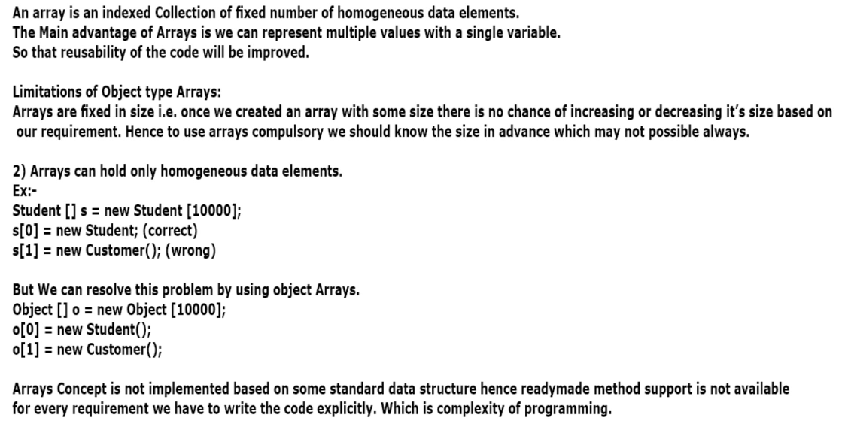
Need of Collection in java
Notes:
Give a brief overview of the presentation. Describe the major focus of the presentation and why it is important.
Introduce each of the major topics.
To provide a road map for the audience, you can repeat this Overview slide throughout the presentation, highlighting the particular topic you will discuss next.

Slide 8
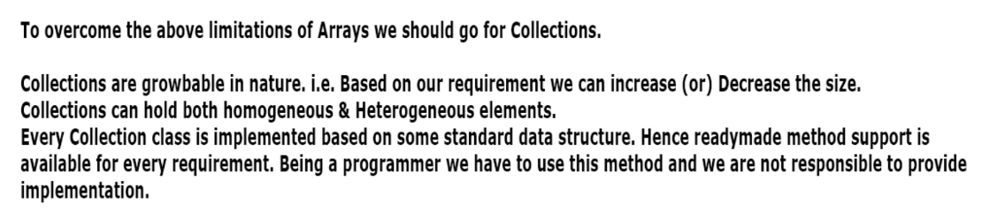
Need of Collection in java
Notes:
Give a brief overview of the presentation. Describe the major focus of the presentation and why it is important.
Introduce each of the major topics.
To provide a road map for the audience, you can repeat this Overview slide throughout the presentation, highlighting the particular topic you will discuss next.

Slide 9
Difference between Collection And Collections
Collection: Collection is an Interface which can be used to represent a group of individual objects as a single Entity
Collections: Collections is an utility class present in java.util package to define several utility methods (like Sorting , searching…)for collection Objects.
Notes:
Give a brief overview of the presentation. Describe the major focus of the presentation and why it is important.
Introduce each of the major topics.
To provide a road map for the audience, you can repeat this Overview slide throughout the presentation, highlighting the particular topic you will discuss next.

Slide 10

1.Collection
If you want to represent group of individual object as a single entity then we
should go for a collection .
Collection interface defines the most common methods which are applicable
for any collection objects
In general collection interface is considered as root interface of Collection interface
There is concrete class which implements collection interface directly
Notes:
This is another option for an Overview slides using transitions.

Slide 11
Methods of Collection interface
1 public boolean add(Object element)
is used to insert an element in this
collection.
2 public boolean addAll(collection c)
is used to insert the specified
collection elements in the invoking
collection.
Notes:
Give a brief overview of the presentation. Describe the major focus of the presentation and why it is important.
Introduce each of the major topics.
To provide a road map for the audience, you can repeat this Overview slide throughout the presentation, highlighting the particular topic you will discuss next.

Slide 12
Methods of Collection interface
3 public boolean remove(Object element)
is used to delete an element from
this collection.
4 public boolean removeAll(Collection c)
is used to delete all the elements of
specified collection from the
invoking collection.
Notes:
Give a brief overview of the presentation. Describe the major focus of the presentation and why it is important.
Introduce each of the major topics.
To provide a road map for the audience, you can repeat this Overview slide throughout the presentation, highlighting the particular topic you will discuss next.

Slide 13
Methods of Collection interface
5 public boolean retainAll(Collection c)
is used to delete all the elements of
invoking collection except the specified collection.
6 public int size()
return the total number of elements
in the collection.
7 public void clear()
removes the total no of element
from the collection.
Notes:
Give a brief overview of the presentation. Describe the major focus of the presentation and why it is important.
Introduce each of the major topics.
To provide a road map for the audience, you can repeat this Overview slide throughout the presentation, highlighting the particular topic you will discuss next.

Slide 14
Methods of Collection interface
8 public boolean contains(object element)
is used to search an element.
9 public boolean containsAll(Collection c)
is used to search the specified collection in this collection.
10 public Iterator iterator()
returns an iterator.
11 public Object[] toArray()
converts collection into array.
Notes:
Give a brief overview of the presentation. Describe the major focus of the presentation and why it is important.
Introduce each of the major topics.
To provide a road map for the audience, you can repeat this Overview slide throughout the presentation, highlighting the particular topic you will discuss next.

Slide 15
Methods of Collection interface
12 public boolean isEmpty()
checks if collection is empty.
13 public boolean equals(Object element)
matches two collection.
14 public int hashCode()
returns the hashcode number for collection.
Notes:
Give a brief overview of the presentation. Describe the major focus of the presentation and why it is important.
Introduce each of the major topics.
To provide a road map for the audience, you can repeat this Overview slide throughout the presentation, highlighting the particular topic you will discuss next.

Slide 16
Iterator interface
Iterator interface provides the facility of iterating the elements in forward direction only.
Notes:
Give a brief overview of the presentation. Describe the major focus of the presentation and why it is important.
Introduce each of the major topics.
To provide a road map for the audience, you can repeat this Overview slide throughout the presentation, highlighting the particular topic you will discuss next.

Slide 17
Methods of Iterator interface
There are only three methods in the Iterator interface. They are:
1. public boolean hasNext()
it returns true if iterator has more elements.
2. public object next()
it returns the element and moves the cursor pointer to the next element.
3. public void remove()
it removes the last elements returned by the iterator. It is rarely used.
Notes:
Give a brief overview of the presentation. Describe the major focus of the presentation and why it is important.
Introduce each of the major topics.
To provide a road map for the audience, you can repeat this Overview slide throughout the presentation, highlighting the particular topic you will discuss next.

Slide 18
2.List
List is a child interface of Collection
If you want to represent group of individual object as a single entity where duplicates are allowed and insertion ordered preserved then we should go for List .
We can differentiates the duplicates using index
We can preserve insertion order by using index .hence index play important Role in List interface

Slide 19
List iterator Specific methods
Void add(int index , Object obj);
boolean addAll(int index Collection c);
Object get(int index);
Object remove(int index);
Object set(int index, Object new);
Int indeOf(Object obj);
Int lastIndexof(Object obj);
ListIterator listIterator();

Slide 20
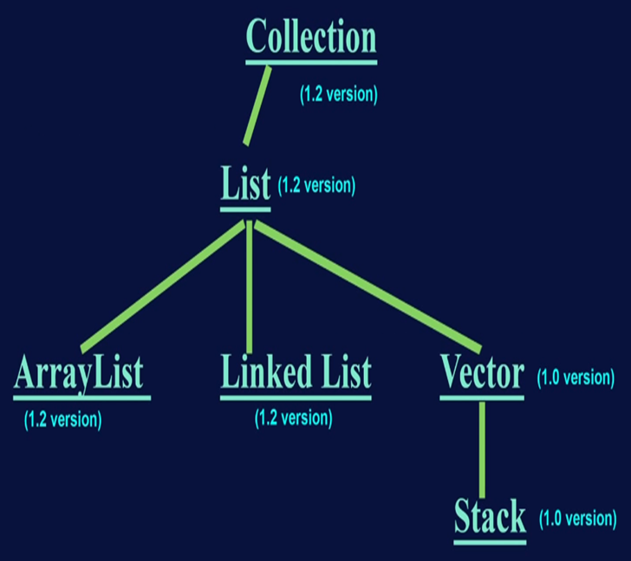


Slide 21


ArrayList

Slide 22
Array List
The underlined data structure is resizable array and grow able array.
Duplicates are allowed.
Insertion order is preserved
Heterogeneous elements are allowed[except tree set and tree map every where heterogeneous elements are allowed]
Null insertion is possible.
Notes:
This is another option for an Overview slide.

Slide 23
Constructor in ArrayList
1. ArrayList al= new ArrayList();
Creates an empty arraylist object with default initial capacity 10.
Once its reaches its map capacity new arraylist will be created with the new Capacity.
New capacity=(cc*3/2)+1.
2. ArrayList al=new ArrayList( int initialCapacity );
3. ArrayList al= new ArrayList (Collection c);
Notes:
What will the audience be able to do after this training is complete? Briefly describe each objective how the audience will benefit from this presentation.

Slide 24
Usually we can use collection objects to hold and transfer the objects from one place to another place To provide support for this requirement every collection already implements Serializable and Clonable interface
Notes:
Use a section header for each of the topics, so there is a clear transition to the audience.

Slide 25
ArrayList and Vector classes implements RandomAcess interface so that we can access any random element with the same speed.
Hence if your frequent operation is retrieval
Operation then we go for ArrayList
RandomAcess interface present in java.util package and it is a Marker Interface.
Notes:
Use a section header for each of the topics, so there is a clear transition to the audience.

Slide 26
ArrayList is the best choice for frequent retrieval operation because its implements
RandomAcess interface
ArrayList is worst choice if frequent insertion or deletion operations because lot of shifting is needed .
Notes:
Use a section header for each of the topics, so there is a clear transition to the audience.

Slide 27
LinkedList

Slide 28
Linked List
The underlined data structure is Doubly Linked List.
Duplicates are allowed.
Insertion order is preserved
Heterogeneous elements are allowed
Null insertion is possible.
Linked List is implements Serializable and Clonable interface but not RandomAcess interface
Notes:
This is another option for an Overview slide.

Slide 29
LinkedList is the best choice if our frequent operation is insertion or deletion in the middle
LinkedList is the worst choice if our frequent operation is retrieval operation
Notes:
Use a section header for each of the topics, so there is a clear transition to the audience.

Slide 30
LinkedList Specific methods
Usually we use LinkedList to implements the stack and queues to provide support for this requirements LinkedList class defines the Fallowing methods
Void addFirst(Object obj);
Void addLast(Object obj);
Object getFirst();
Object getLast();
Object removeFirst();
Object removeLast();
Notes:
This is another option for an Overview slide.

Slide 31
Constructor in LinkedList
1. LinkedList al= new LinkedList();
Creates an empty LinkedList object
Here no capacity
2. LinkedList al= new LinkedList (Collection c);
creates equivalent LinkedList object for passed Collection.
Notes:
What will the audience be able to do after this training is complete? Briefly describe each objective how the audience will benefit from this presentation.

Slide 32
ListIterator interface
Iterator interface provides the facility of iterating the elements in forward and backward direction also.
Hence ListIterator is Bidirectional Cursor
By using ListIterator we can perform replacement and addition of new objects
in addition to read and remove operations
Notes:
Give a brief overview of the presentation. Describe the major focus of the presentation and why it is important.
Introduce each of the major topics.
To provide a road map for the audience, you can repeat this Overview slide throughout the presentation, highlighting the particular topic you will discuss next.

Slide 33
We can create a ListIterator object using listiterator() method.
this method present in List interface.
public ListIterator listiterator();
Example :
ListIterator li=l. listiterator ();
l is the list type object.
Notes:
Give a brief overview of the presentation. Describe the major focus of the presentation and why it is important.
Introduce each of the major topics.
To provide a road map for the audience, you can repeat this Overview slide throughout the presentation, highlighting the particular topic you will discuss next.

Slide 34
ListIterator interface
ListIterator is a child interface of Iterator And hence all the method of Iterator by default available to ListIterator.
ListIterator defines fallowing methods
1.public boolean hasNext();
2.public Object next();
3.public int nextIndex();
4. public boolean hasPrevious();
5. public Object previous();
6. public int previousIndex();
Notes:
Give a brief overview of the presentation. Describe the major focus of the presentation and why it is important.
Introduce each of the major topics.
To provide a road map for the audience, you can repeat this Overview slide throughout the presentation, highlighting the particular topic you will discuss next.

Slide 35
ListIterator interface
7.public void remove();
8.public void set(Object new);
9.public void add(Object new);
Note: ListIterator is most power full cursor
But limitation is there it applicable only for List implemented Objects and it is not a Universal cursor
Notes:
Give a brief overview of the presentation. Describe the major focus of the presentation and why it is important.
Introduce each of the major topics.
To provide a road map for the audience, you can repeat this Overview slide throughout the presentation, highlighting the particular topic you will discuss next.

Slide 36
Vector

Slide 37
Vector
LinkedList Specific methods
The underlined data structure is resizable array and grow able array.
Duplicates are allowed.
Insertion order is preserved
Heterogeneous elements are allowed
Null insertion is possible.
Vector implemented by RandomAccess Serializable and Clonable interfaces
Most of the methods present in vector class are synchronized hence vector is Thread safe
best choice is frequently retrieval operation.
Notes:
This is another option for an Overview slide.

Slide 38
Vector Specific methods
For Adding Objects.
1. add(Object o) ->From Collection
2. add(int index ,Object o) -> From List
3. addElement(Object o) ->From vector
For removing Objects
1.remove(Object o) ->From Collection
2.removeElement(Object o) ->From vector
3.remove(int index) ->From List
4.clear() -> From collection
5.removeAll() ->From vector
Notes:
This is another option for an Overview slide.

Slide 39
Vector Specific methods
Object get(int index); ->collection
Object elementAt(int index); ->vector
Object firstElement(); ->vector
Object lastElement(); ->vector
Other methods:-
int capacity();
int size();
Enumeration elements();
Notes:
This is another option for an Overview slide.

Slide 40

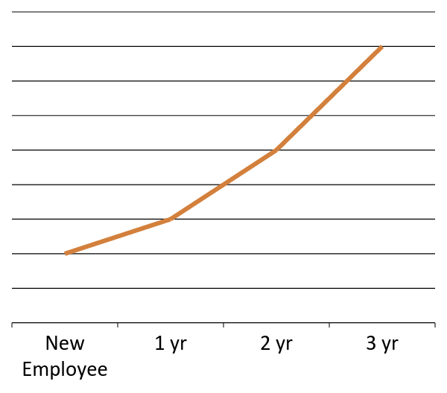
New Work
The technology learning curve
Notes:
Add slides to each topic section as necessary, including slides with tables, graphs, and images.
See next section for sample table, graph, image, and video layouts.

Slide 41
Who’s Who
Lead | Contact information
Jim | Jim@company.com
Dee | Dee@gcompany.com
Mavis | Mavis@company.com
Doug | Doug@company.com
Notes:
Keep it brief. Make your text as brief as possible to maintain a larger font size.

Slide 42
Working Toward Mastery
Achieve Mastery
Get Experienced
Projects Worked On
Get Familiar
Time Spent

Slide 43

Doing Your Best Work
Working from home
Working offsite
Technology requirements
Notes:
If there is relevant video content, such as a case study video, demo of a product, or other training materials, include it in the presentation as well.

Slide 44

Case Study
Jeremy
His first day
Mistakes made
Successes achieved
The moral of the story
Notes:
Add a case study or class simulation to encourage discussion and apply lessons.

Slide 45
Discussion
What we can learn from Jeremy
Best practices
Take-aways
Notes:
Discuss outcomes of the case study or class simulation.
Cover best practices.

Slide 46
Summary
Define your challenges
Technological as well as personal
Set realistic expectation
Mastery is not achieved overnight
Keep your eye on the goal
Mentorship programs
Notes:
Summarize presentation content by restating the important points from the lessons.
What do you want the audience to remember when they leave your presentation?
Save your presentation to a video for easy distribution (To create a video, click the File tab, and then click Share. Under File Types, click Create a Video.)

Slide 47
Resources
<Intranet site text here> <hyperlink here>
<Additional reading material text here> <hyperlink here>
This slide deck and related resources: <hyperlink here>

Slide 48
Questions?

Slide 49
Appendix
Notes:
Is your presentation as crisp as possible? Consider moving extra content to the appendix.
Use appendix slides to store content that you might want to refer to during the Question slide or that may be useful for attendees to investigate deeper in the future.

