Slide 1

Module 1: Introducing Siebel Applications
0/5
Siebel 8.0 Essentials
Notes:
Time: Lecture: <n – n> minutes; Labs: <n – n> minutes
Intent: <What is the instructional goal of the module>
Flow: < Describe at a high level the overall flow of the module>.
Key Terms: <List terms the instructor should be familiar with in order to teach this module>
<Term>
<Term>
<Term>
<Term>

Slide 2
Module Objectives
After completing this module you should be able to:
  Describe Siebel Customer Relationship Management (CRM) applications and how they are classified
  Identify the common business entities found in Siebel CRM applications
Why you need to know:
  You need to be familiar with Siebel applications to understand the context of this course

Slide 3
Siebel Customer Relationship Management (CRM)
Enables you to manage interactions with customers, partners, and employees
  Typically deployed as a single application with broad functionality
  Supports multiple communication channels
    Web and email
    Call center
    Field service
Uses a single database to:
  Allow all users access to the same set of data
    Example: The correct customer order status is seen by all relevant users
  Ensure changes to data are made once and only once
    Example: An address needs to be updated in only one place
Is a packaged application with built-in best practices

Slide 4
Siebel CRM Applications
Are available tailored for:
  Different types of customer, partner, or employee interactions and channels (horizontal applications)
  Different industries (industry applications)
Examples:
  Horizontal applications
    Siebel Sales
    Siebel Call Center
    Siebel Partner Portal
    Siebel Remote
  Industry applications
    Siebel Finance
    Siebel Consumer Goods

Slide 5
Types of Siebel Enterprise Applications
Employee applications
  Are used by internal employees
  Examples include:
    Siebel Call Center
    Siebel Sales
Customer and partner applications
  Are used by customers and partners
  Examples include:
    Siebel eSales
    Siebel Partner Portal

Slide 6
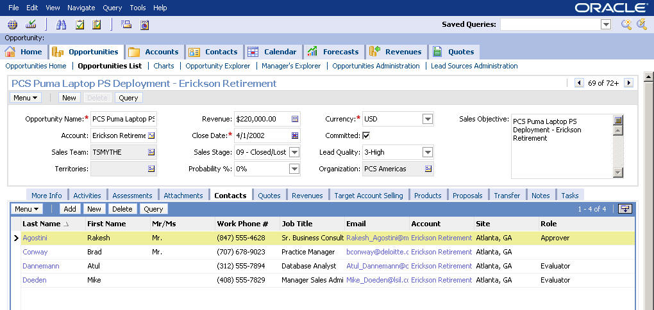
Employee Application: Siebel Sales
Siebel Sales may be used by a company’s sales representatives and managers to manage accounts, sales opportunities, and contacts
Siebel Sales Opportunities screen

Slide 7
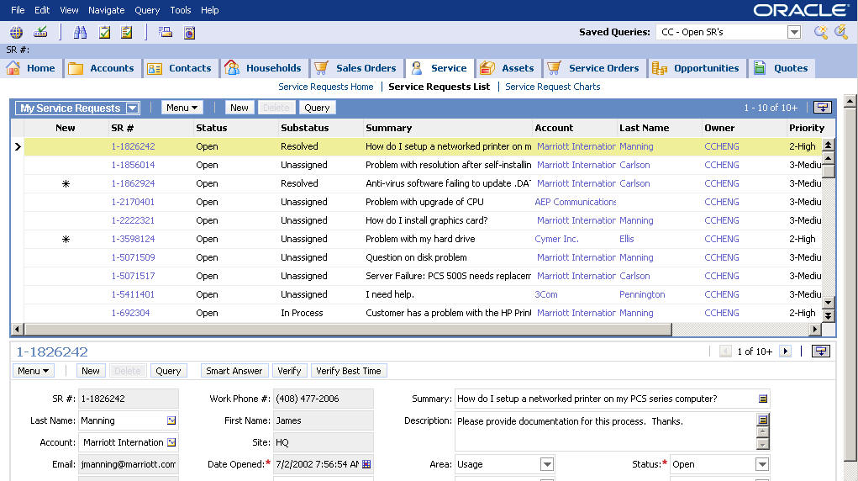
Employee Application: Siebel Call Center
Siebel Call Center may be used by a company’s telesales and service representatives
Siebel Call Center service screen

Slide 8
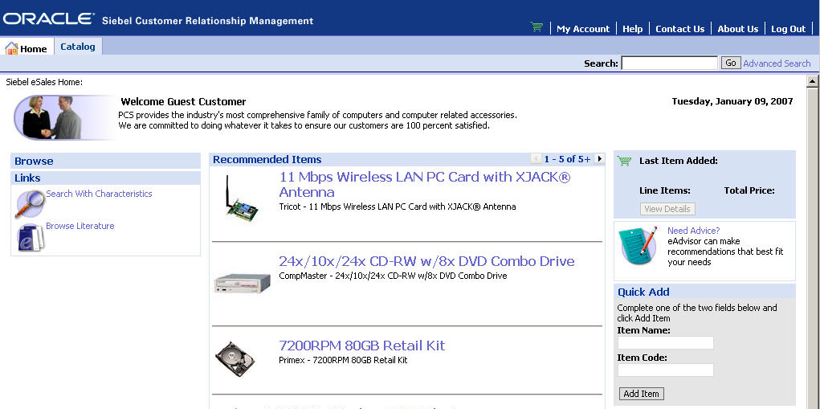
Customer Application: Siebel eSales
May be used by customers to purchase products over the Web
Includes an interactive product catalog, search and product comparison mechanisms, and online ordering capabilities
Product catalog
Shopping cart

Slide 9
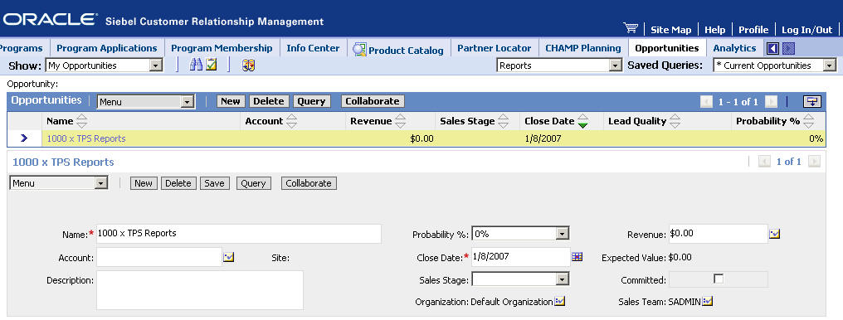
Partner Application: Siebel Partner Portal
May be used by a company’s partners to communicate, collaborate, and conduct business with a Web-based interface
Partner Portal opportunities screen

Slide 10
Comparison of Siebel CRM Applications
Siebel functionality is delivered as separate horizontal or vertical applications that:
  Have the same user interface and navigation
  Are based on the same underlying application architecture
  Use the same underlying technologies for automation, integration, and so on
  Share many of the same application screens
Applications use the same executable, but use different configuration and input files
  Configuration files are used to specify application parameters
  Use Siebel Tools to generate input files that control behavior
This course will teach you how to modify these files to meet the specific requirements of your business

Slide 11
Siebel User Interface (UI) Modes
0/2
The Siebel UI is rendered in one of two modes:
High Interactivity Mode
Standard Interactivity Mode

Slide 12
High Interactivity Mode
1/2
Is available for employee applications, supporting highly interactive users
Uses additional code, such as Active X controls, to provide extra functionality
  Drag-and-drop for setting column widths
  Explorer-like hierarchy views
  Menu bar and tool bars
  Saving records by moving off the current line
Requires Internet Explorer (check documentation for versions)

Slide 13
Standard Interactivity Mode
2/2
Is available for customer and employee applications
Designed to be less browser-dependent
  Behaves like a typical HTML-based Web application
Available on a wide variety of browsers (check documentation for supported browsers)

Slide 14
Common Siebel Application Business Entities
Siebel applications use common business entities
  A business entity is something of business interest in the real world
Siebel applications refer to these entities as business components
Examples:
  Accounts
  Contacts
  Opportunities
  Service requests
  Assets

Slide 15
Common Siebel Business Components
0/7
0/5
Accounts
Contacts
Opportunities
Service Requests
Assets

Slide 16
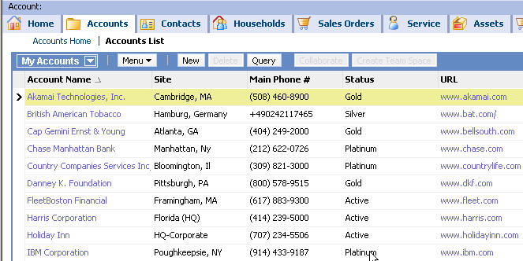
Accounts
1/5
Are businesses external to your company
Represent a current or potential client, a business partner, or a competitor
Are associated with a team

Slide 17
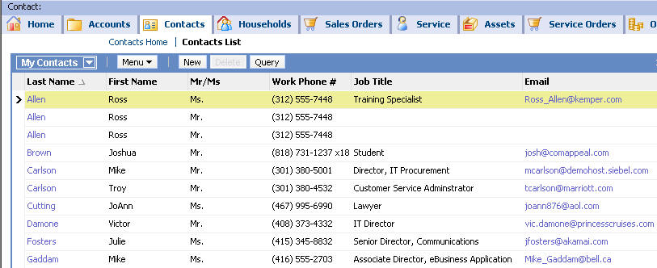
Contacts
2/5
Are people with whom you do business
Can be public or marked as personal
Are associated with a team (public contacts) or a user (personal contacts)

Slide 18
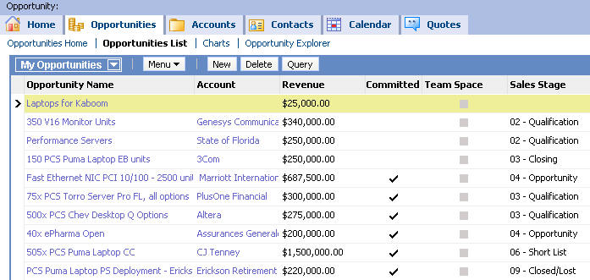
Opportunities
3/5
Are potential revenue-generating events
Have the following characteristics:
  A possible association with an account
  A probability of completion
  A close date
Are associated with a team

Slide 19
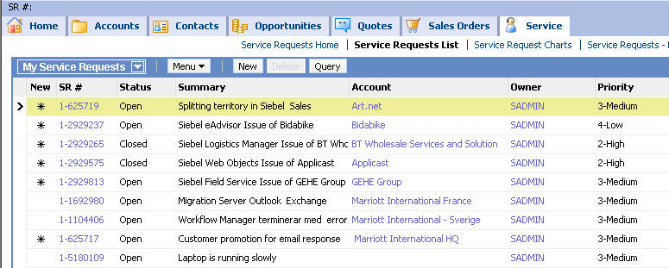
Service Requests
4/5
Are requests from customers or prospects for information or assistance with your products or services
Have the following characteristics:
  A status
  A severity level
  A priority level
Are associated with a single owner

Slide 20
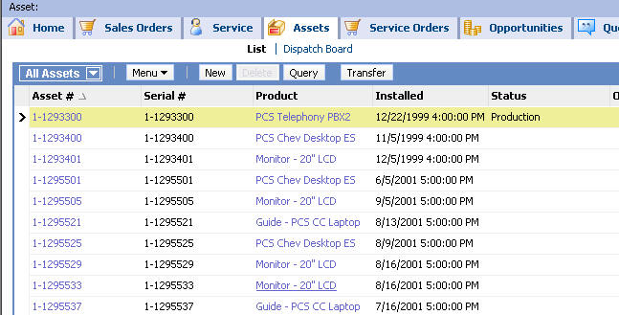
Assets
5/5
Are instances of purchased products
Have the following characteristics:
  An asset number
  A product and part number
  A status level

Slide 21
Module Highlights
Siebel CRM applications allow you to manage all customer points of contact
Types of Siebel CRM enterprise applications are:
  Employee applications: Siebel Call Center, Siebel Sales, and so on
  Customer applications: Siebel eSales, Siebel Partner Portal, and so on
Common Siebel business components include:
  Accounts
  Contacts
  Opportunities
  Service requests
  Assets

