Slide 1

Module 2: Using the Siebel Web Client
0/5
Siebel 8.0 Essentials
Notes:
Time: Lecture: <n – n> minutes; Labs: <n – n> minutes
Intent: <What is the instructional goal of the module>
Flow: < Describe at a high level the overall flow of the module>.
Key Terms: <List terms the instructor should be familiar with in order to teach this module>
<Term>
<Term>
<Term>
<Term>

Slide 2
Module Objectives
After completing this module you should be able to:
  Start and log in to a Siebel application
  Navigate screens and views in the application
  Identify major user interface (UI) features in a Siebel CRM application
Why you need to know:
  Understanding the UI enables you to effectively use and configure Siebel applications

Slide 3
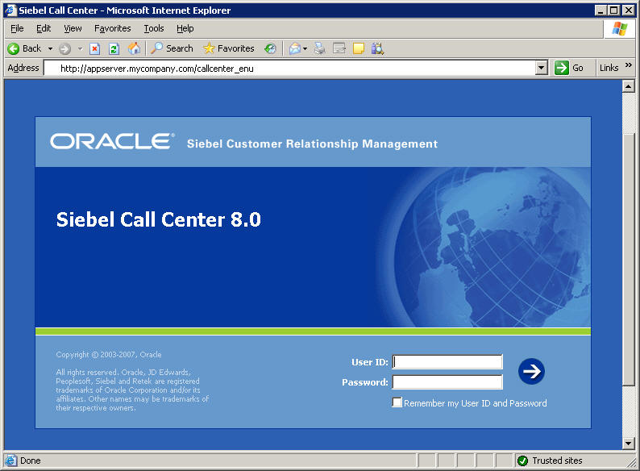
Logging In to a Siebel Application
Start a Siebel application in a Web browser by entering the application’s URL
Log in using assigned user ID and password
Application URL
User ID and password

Slide 4
Application URLs
A Siebel application’s URL is formed from :
  Application’s Web server name
  Application name
  Suffix identifying the application language
Examples:
  http://AppServer0.MyCompany.com/callcenter_enu
  Web server name: Appserver0.MyCompany.com
  Application name: callcenter (Siebel Call Center)
  Language suffix: _enu (American English)
  http://public.MyCompany.com/esales_fra
  Web server name: public.MyCompany.com
  Application name: esales (Siebel eSales)
  Language suffix: _fra (French)

Slide 5
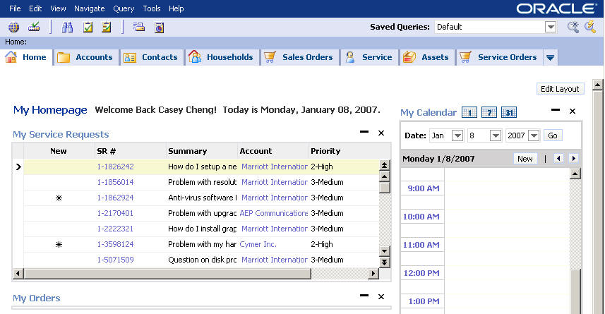
Application Home Page
Displayed after log-in to a Siebel application
Personalize home page by clicking Edit Layout
Personalized data provides direct links to common tasks

Slide 6
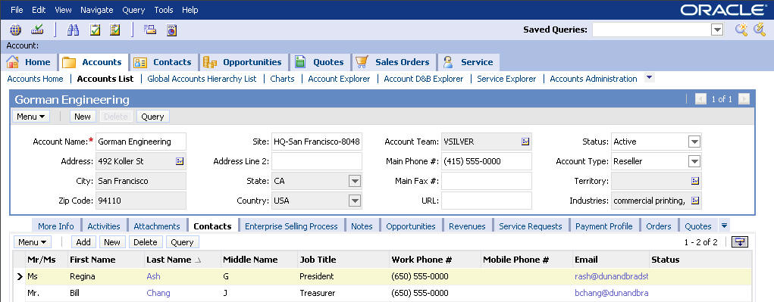
Siebel Application User Interface
Siebel applications consist of Web pages
Each page displays Siebel data surrounded by tabs, toolbars and a top-level menu
Application-level menu helps navigation and manipulating data
Global toolbar provides quick access to common tasks
Tabs provide easy navigation to related data

Slide 7
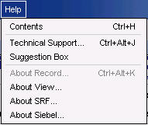
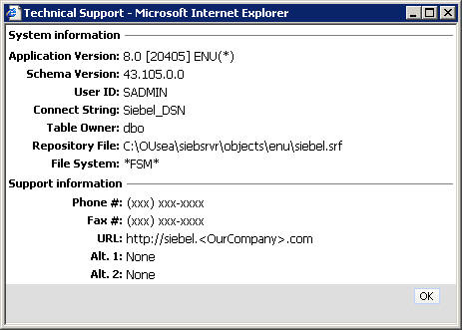
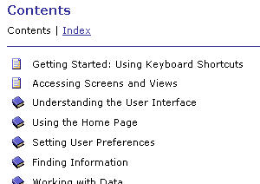
Help Menu: Online Help and Technical Support
The application-level Help menu offers Online Help
  Documents common end-user tasks
Technical Support… in the Help menu identifies useful technical information
  Includes current user ID and support contact information

Slide 8

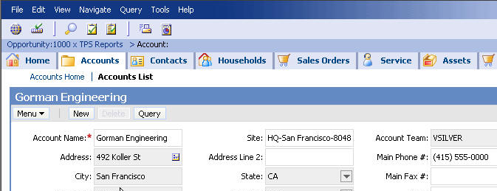
Global Toolbar: iHelp and Reports
Access context-sensitive tasks and reports associated with the current screen
Click the How Do I button to access iHelp, which provides guidance with tasks
Click the Reports button to access reports for the screen you are working in

Slide 9
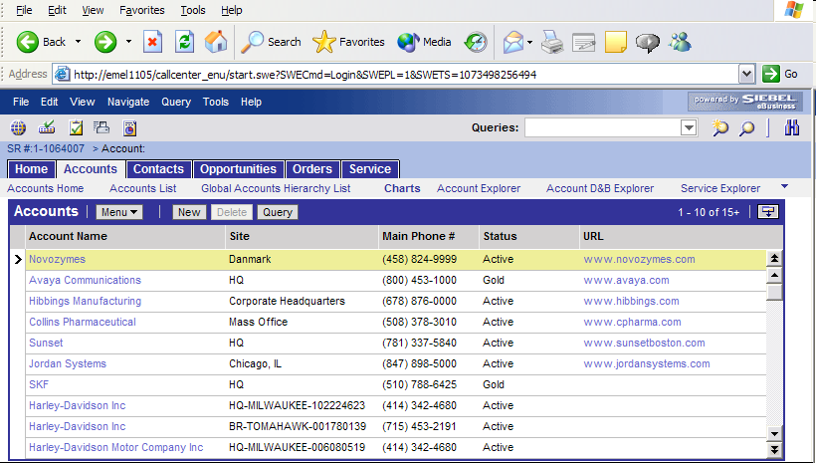
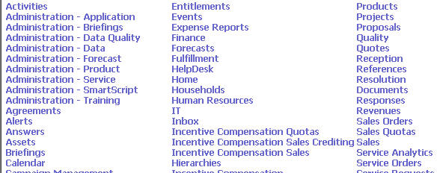
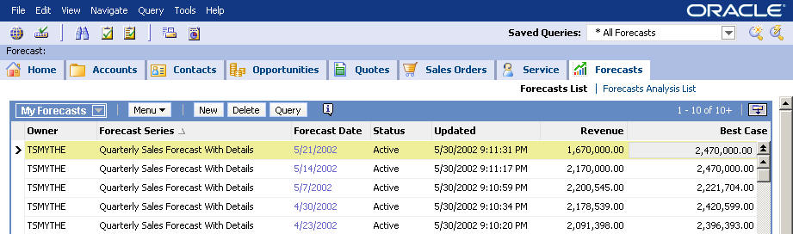
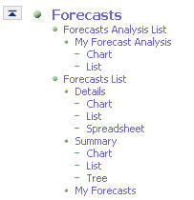
Global Toolbar: Site Map
Access a list of all application areas available to the user
Site Map button
Site Map lists application areas
Drilling down on an area shows detailed navigation

Slide 10
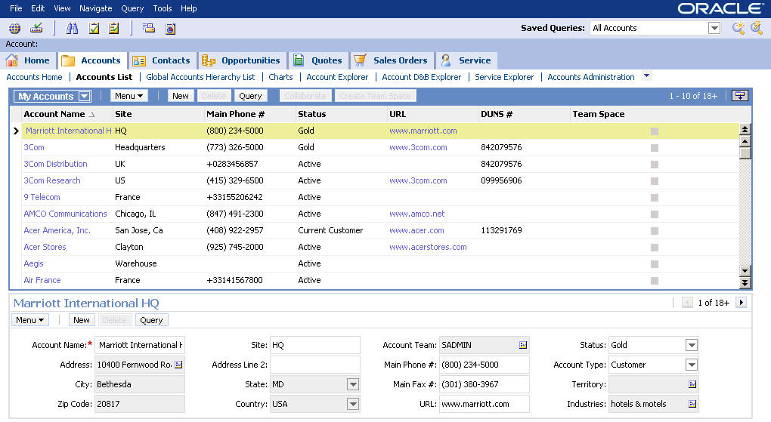
Screens
Represent groups of related data for a functional business area, such as accounts, contacts, or opportunities
Screen tab
Link bar has links to other account-related data

Slide 11
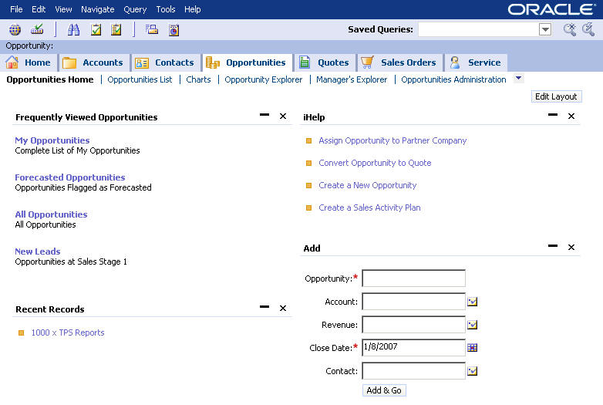
Screen Home Pages
Some screens have home pages that provide quick access to common end-user tasks and data
Guided help with common tasks
Links to different sets of records
Links to recent records

Slide 12
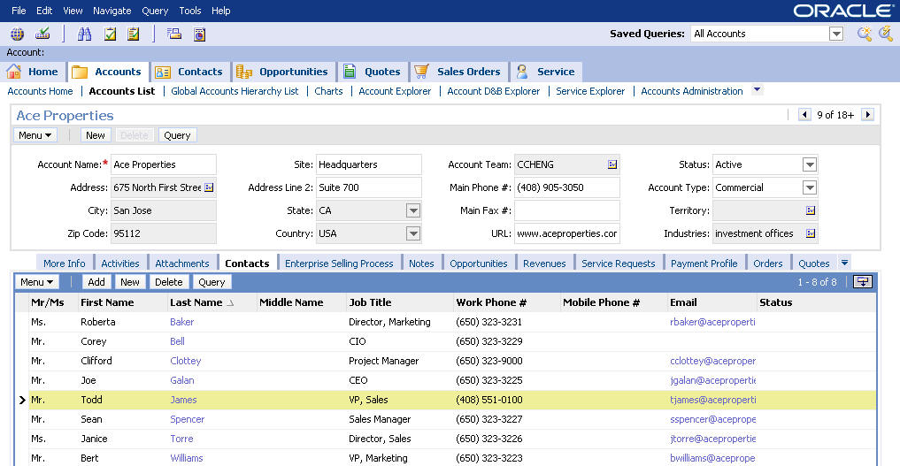
Navigating
Click the different UI elements to navigate to different data
Screen tabs
Link bar
View tabs
Row indicator
Selected record

Slide 13
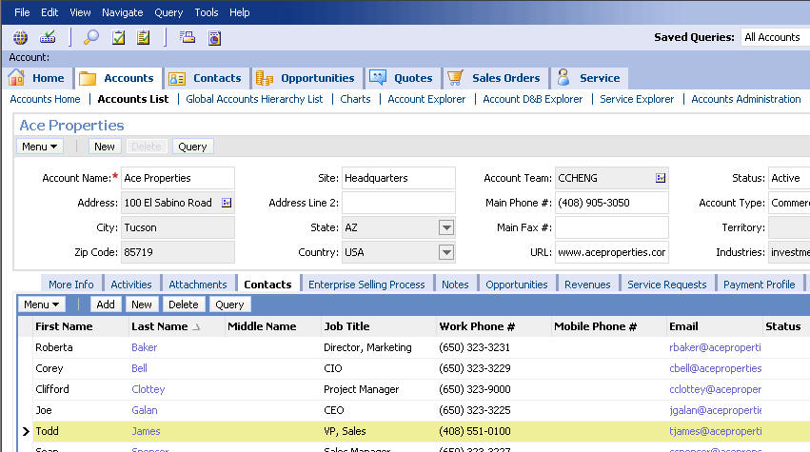
Views
A view consists of one or more applets displaying records
View
View tab

Slide 14
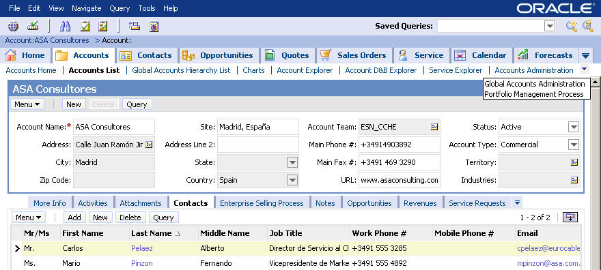
Drop-Down Menu Screen and View Navigation
Access additional tabs and links using drop-down arrows
  Available if needed for screen tabs, link bar, and view tabs
Click drop-down to display more choices

Slide 15
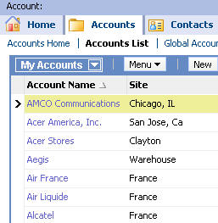
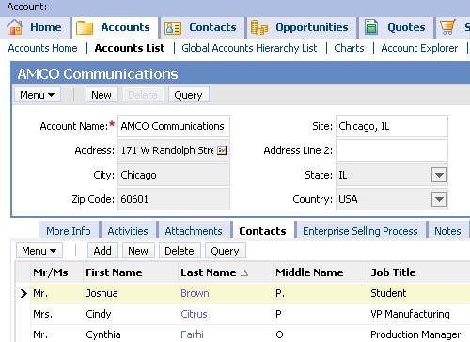
Hyperlinks
Drill down on a hyperlink to see more information
Clicking account hyperlink…
...navigates you to the Account Detail - Contacts view

Slide 16
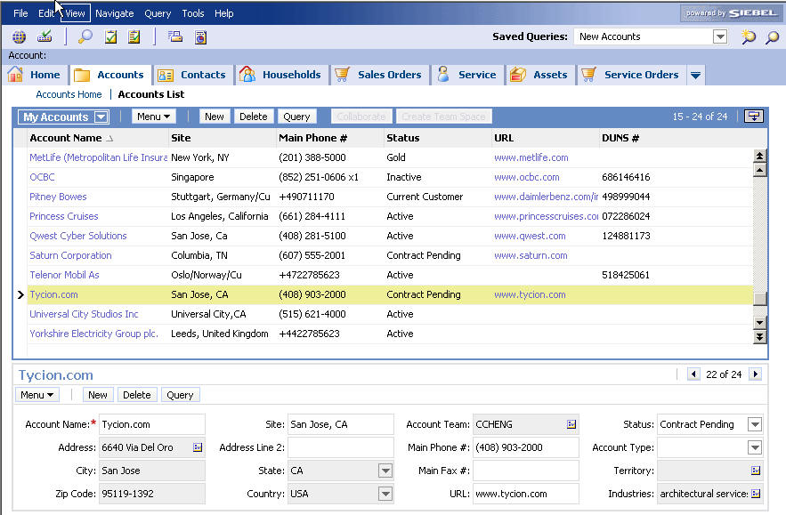
List Applets and Form Applets
Views are made up of one or more applets
  List applet displays records in rows
  Form applet displays a single record in a two-dimensional layout
List applet
Selected record
Form
applet

Slide 17
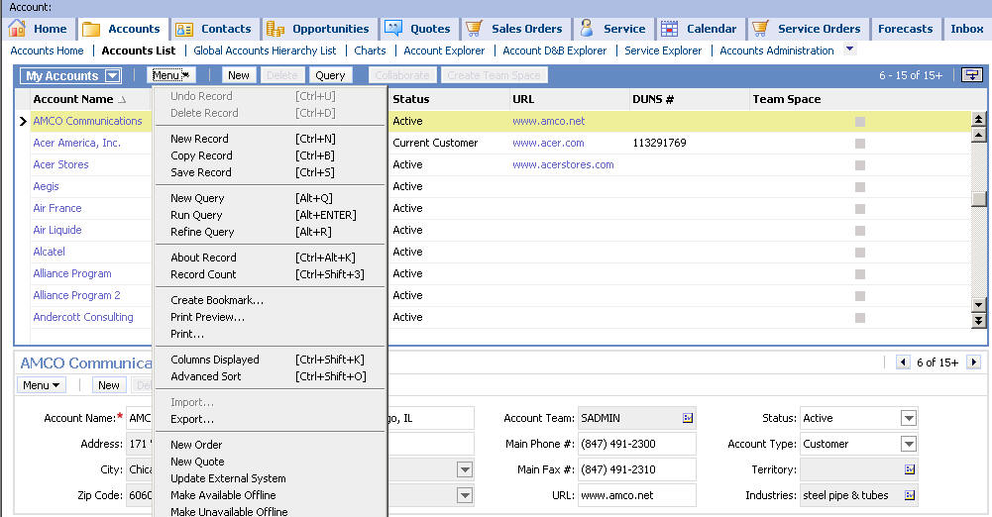
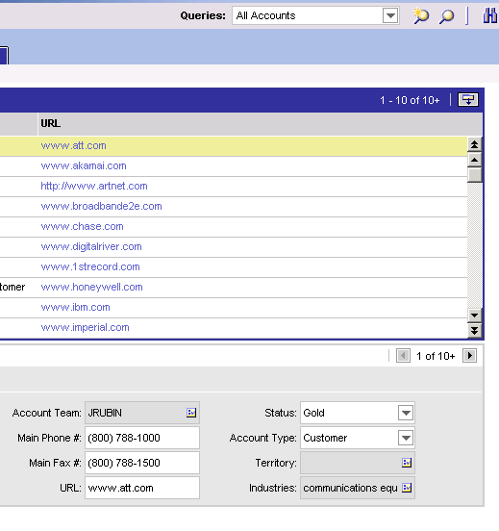
Navigating List Applets and Form Applets
Use the Menu button or scroll bars and arrows
Standard applet buttons
Right-click for context menu
Form applet navigation arrows
Applet-specific menu items

Slide 18
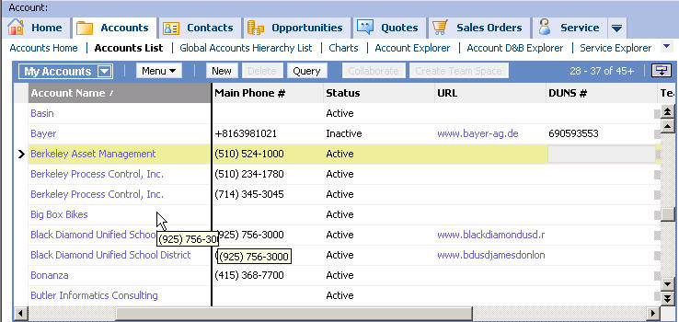
Freezing List Columns
0/5
Freeze position in list columns
  Freeze columns by double-clicking column headers within list applets
    Enhances ability to work effectively with lists that contain many columns of data
  Drag and drop columns in and out of the frozen area
Double-click column header to freeze (or unfreeze) columns
Scrolling horizontally through columns leaves frozen columns in place

Slide 19
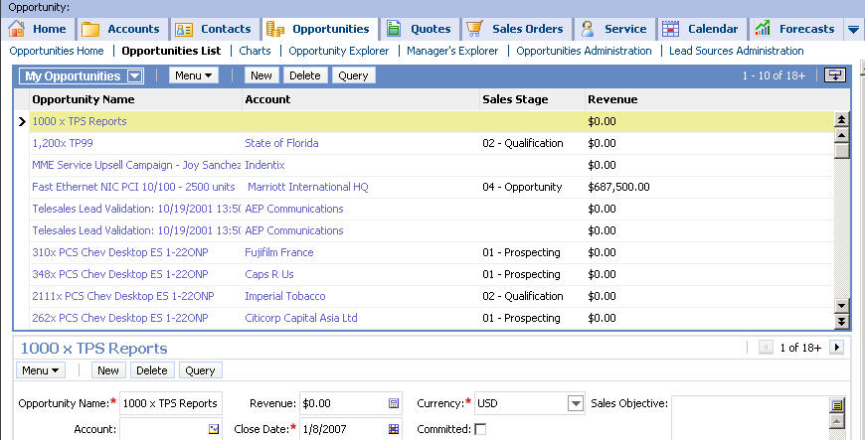
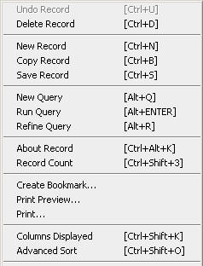
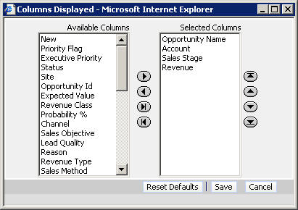
Changing Columns Displayed
Click the Menu button, or right-click and select Columns Displayed
Columns available to be used in the applet
Columns visible in the applet
Right-click and select Columns Displayed
Click to add or remove columns from applet
Click buttons to sequence columns

Slide 20
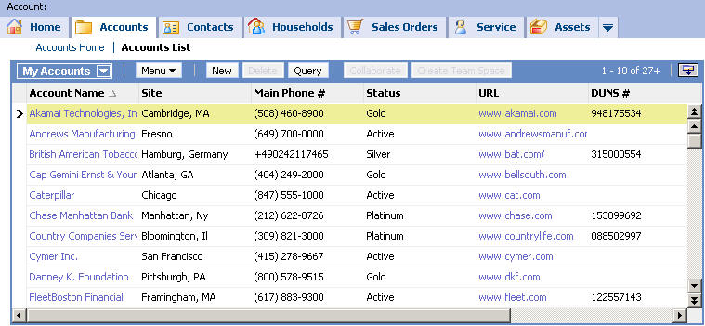
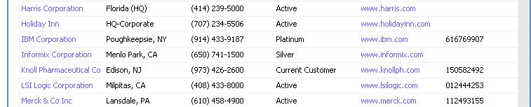
Displaying More Records
Click the Show More button in the top-right corner of a list applet to toggle display of more records
Click Show More ...
… to see more records

Slide 21
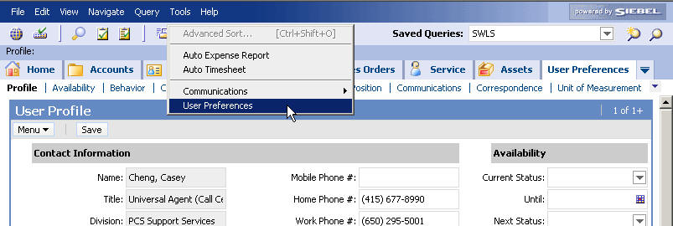
Setting User Preferences
Allows users to set individual preferences for some application features
  Set time zone preferences
  Set a startup view
  Change default spell check options
  Customize aspects of the calendar
Select User Preferences from the application-level Tools menu
Link bar categorizes preferences
New screen tab appears

Slide 22
Module Highlights
A Siebel application consists of Web pages that display data
A screen is a grouping of views in a major application functional area
A view consists of one or more applets as well as links and tabs used to navigate within the view
A list applet displays multiple records in table form
A form applet displays a single record

Slide 23
Lab
In the lab you will:
  Practice navigating in Siebel Call Center

