Slide 1

Module 3: Working With Siebel Data
0/5
Siebel 8.0 Essentials
Notes:
Time: Lecture: <n – n> minutes; Labs: <n – n> minutes
Intent: <What is the instructional goal of the module>
Flow: < Describe at a high level the overall flow of the module>.
Key Terms: <List terms the instructor should be familiar with in order to teach this module>
<Term>
<Term>
<Term>
<Term>

Slide 2
Module Objectives
After completing this module you should be able to:
  Create, modify, and delete records
  Query for records in a Siebel CRM application
Why you need to know:
  Knowing these skills is important for understanding and configuring Siebel applications

Slide 3
Working with Data in the Siebel User Interface (UI)
0/5
Creating Data
Modifying and Saving Data
Using Picklists and Multi-Value Groups
Sorting Data
Deleting Data

Slide 4
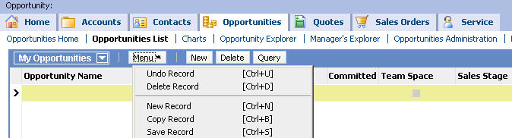
Creating Data
1/5
Select Menu > New Record or click the New button to create a new record

Slide 5
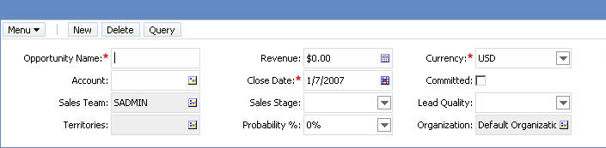
Creating Data Continued
1/5
Enter data in list or form applet
Some fields are required:
  Marked with a red asterisk in a form applet
  Default value may be provided automatically
Required field indicated by red asterisk
Required field populated with default value

Slide 6
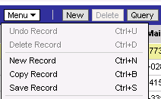
Modifying and Saving Data
2/5
Modify data
  Select field in the list or form and change it
Save data implicitly
  Step off the record in a list or a form to commit it to the database
  Available in High Interactivity interface
Save data explicitly
  Click Menu and select Save Record
  Keyboard: CTRL+S
Explicit save

Slide 7
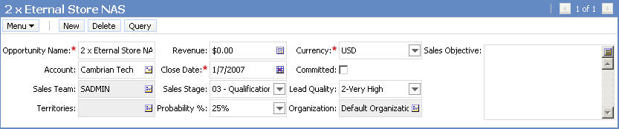
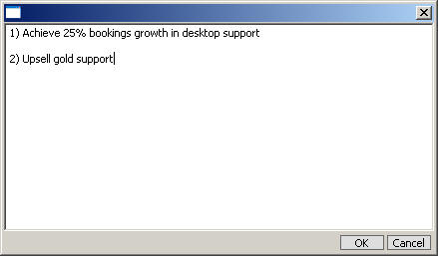

Text Editor
2/5
Is an editable text area used to create, edit, or view large amounts of text
Is accessed by clicking the Text Editor button in the top-right corner of a text field
Enter text and click OK
Text Editor button

Slide 8
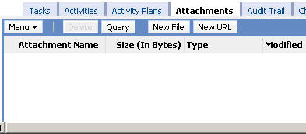
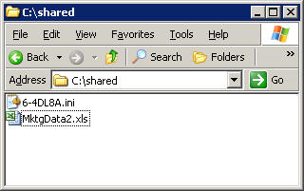

Attachments
2/5
Are files created in other applications that can be associated to records in Siebel applications
Can be related to records wherever the Attachments view is available within a screen
  Drag and drop a file into the Attachments list view, or
  Use the New File or New URL button
Use New File or New URL to create an attachment
Drag and drop file to create an attachment

Slide 9
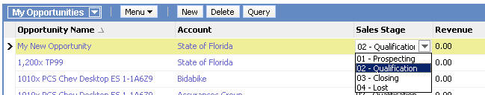

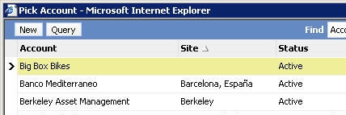
Using Picklists
3/5
Picklists allow user to select a field value from a list
Two types of picklist:
  Static: User selects a value from a fixed drop-down list
  Dynamic: User selects a value from list of changing values
    Examples: Accounts, Opportunities, Contacts
Static picklist uses drop-down list
Dynamic picklist
Select button opens pick applet

Slide 10
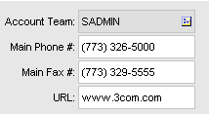
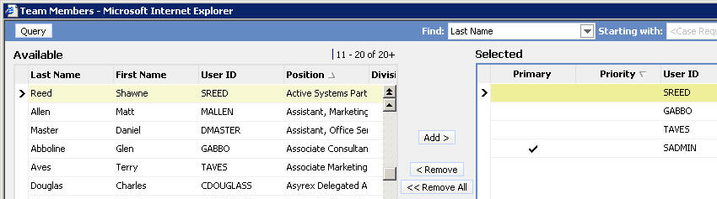
Using Multi-Value Groups
3/5
Multi-value groups (MVGs) assign one or more values to a field in a record
Only the primary value will be displayed in a list or form
MVG Select button
Associate members to the account team
Primary

Slide 11
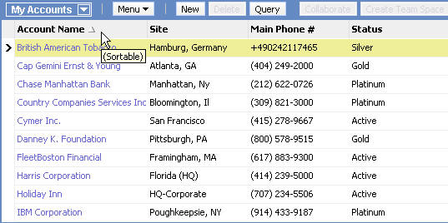
Sorting Data
4/5
Click a column header to sort data in ascending or descending order
Click the column header for ascending (A – Z) or descending (Z – A) order

Slide 12
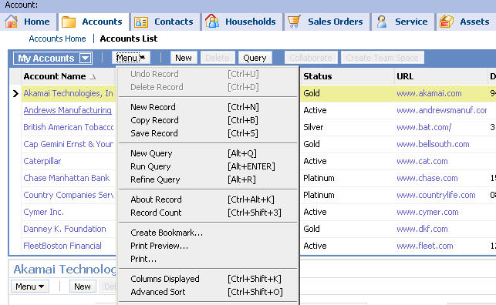
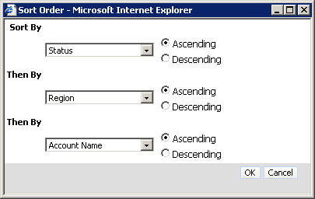
Sorting Data Continued
4/5
Select Menu > Advanced Sort to sort using values of up to three columns at once
Select sort columns and order

Slide 13
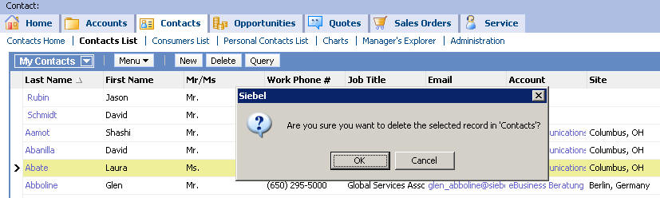
Deleting Data
5/5
Delete a record by:
  Select Menu > Delete Record
  Click Delete button
  CTRL+D
Some records may be read-only
Confirm delete

Slide 14
Querying for Data in the Siebel UI
0/6
Running and Executing a Query
Using the Query Assistant
Querying an MVG Field
Refining a Query
Saving a Query
Executing Predefined and Saved Queries

Slide 15
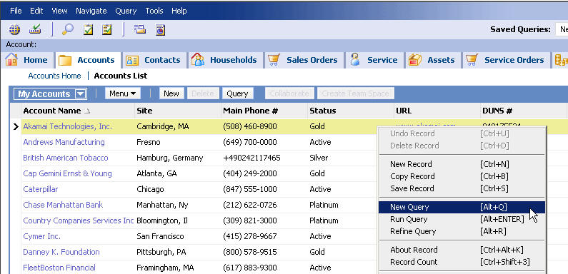
Running and Executing a Query
1/6
Query for records inline within a form or list applet using one of the following methods:
  Query button on an applet
  Query from applet-level and application-level menus
  Run Query item in context menu (accessed by right-click)
Right-click for context menu

Slide 16
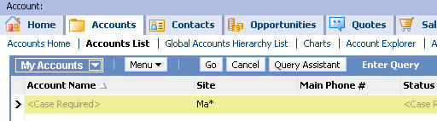
Wildcards
1/6
Wildcards can be used to search for matching characters
* is a substitute for zero or more characters in a string query
  * cannot be used in date or numeric fields
  Examples:
    Ma* matches “Madrid”, but not “San Mateo”
    *Ma* matches “Madrid” and “San Mateo”
? Is a substitute for exactly one character in a string query
  ? cannot be used in date or numeric fields
  Examples:
    st?r matches star and stir, but not stair
    *st?r matches monster and rock star, but not tastier

Slide 17
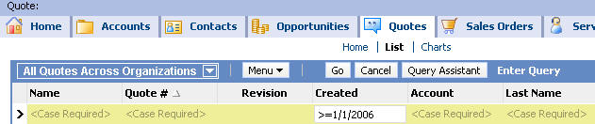
Query Operators
1/6
Relational operators can be used on numeric or date fields
  < (less than)
  > (greater than)
  = (equal to)
  <= (less than or equal to)
  >= (greater than or equal to)
<> (not equal to) can be used on all fields
Example:
  Find dates on or after 1/1/2006
    Date field in query is set to: >= 1/1/2006

Slide 18
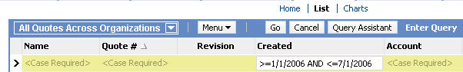
Query Operators Continued
1/6
OR allows match on any one of multiple values for a field
AND allows match on all of multiple values for a field
Other operators include
  NOT
  “ ”
  IS NULL
  IS NOT NULL
Examples:
  Find service requests with no description entered
    Use IS NULL in Description field of service request
  Find dates on or between 1/1/2006 and 1/7/2006
    In date field of query: >=1/1/2006 AND <= 1/7/2006

Slide 19
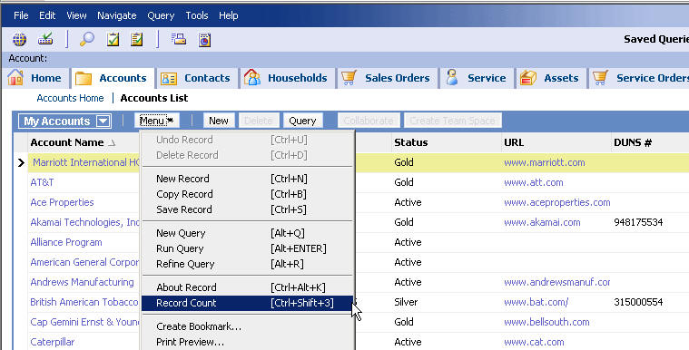
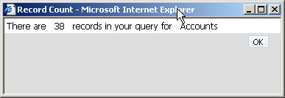
Record Count
1/6
Provides the total number of matching records in the query
Select Record Count for count of records in current query

Slide 20
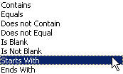
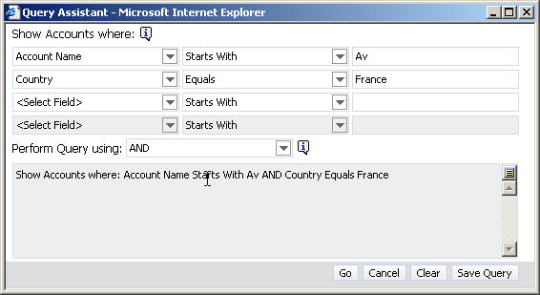
Using the Query Assistant
2/6
Provides a simplified way for users to execute queries from anywhere in a Siebel application
  Guides users through creating a query
  Users do not have to be familiar with query syntax or operators
Click Query Assistant button after clicking Query in a form or list
Select fields and operators using drop-down lists
Select any field from the current screen
Two expressions combined with AND to form the query

Slide 21
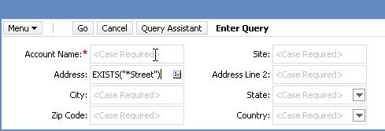
Querying an MVG Field
3/6
Use EXISTS() to search for matches in multi-value groups (MVGs)
  Only way to query all child records in an MVG
  Example: Searching for the string “*Street” in the address of an account
    An account can have multiple addresses
    Query matches all accounts with one or more addresses ending with the sub-string “Street”
MVG indicator
Search criterion

Slide 22
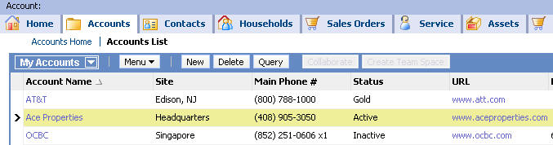
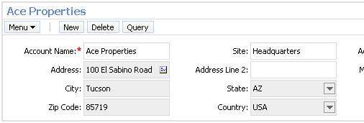
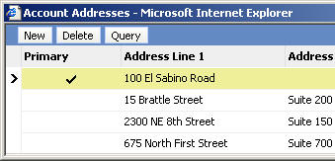
Querying an MVG Field Continued
3/6
Search results show records where at least one value in an MVG matches the search criteria
  Example:
    Search results include accounts with string “*Street” in at least one address
These accounts all have addresses that match the query
Record detail for Ace Properties

Slide 23
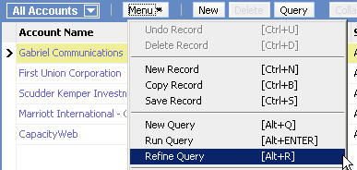


Refining a Query
4/6
Use Refine Query to modify an existing query
1. Select Refine Query
2. Enter additional or modified criteria
Original criterion
3. Query results reflect original and modified criteria

Slide 24
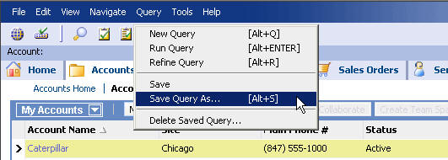
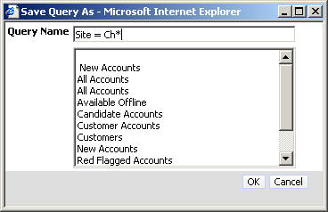
Saving a Query
5/6
Use the application-level Query menu to save a query
1. Select Query > Save Query As
2. Name the query and click OK

Slide 25
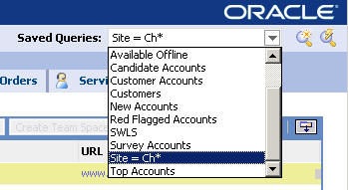
Executing Predefined and Saved Queries
6/6
Predefined queries are provided by an application administrator
  Cannot be deleted by an end user
Additional saved queries are created and saved by the user
All saved and predefined queries appear in the Saved Queries drop-down list
Predefined and saved queries in alphabetical order
Created and saved by user

Slide 26
Module Highlights
Creating and editing data may involve using:
  Required and optional fields
  Drop-down lists
  MVG fields
  Attachments
Siebel applications support complex queries on data with:
  Wildcards
  Logical and numerical operators
  Support for searching multi-value group (MVG) fields
The Query Assistant helps end users form complex queries
Commonly-executed queries may be saved

Slide 27
Lab
In the lab you will:
  Create, modify, and delete records
  Use basic querying skills

