Slide 1

Module 4: Responsibilities and Views
0/5
Siebel 8.0 Essentials
Notes:
Time: Lecture: <n – n> minutes; Labs: <n – n> minutes
Intent: <What is the instructional goal of the module>
Flow: < Describe at a high level the overall flow of the module>.
Key Terms: <List terms the instructor should be familiar with in order to teach this module>
<Term>
<Term>
<Term>
<Term>

Slide 2
Module Objectives
After completing this module you should be able to:
  Describe the purpose of a responsibility
  Create a new responsibility
  Modify an existing responsibility
Why you need to know:
  Access to views within the application is controlled by responsibilities
  Understanding responsibilities is required to properly configure users within the application
Notes:
Each objective and “why you need to know” should be stated aloud.

Slide 3
Business Challenge
Large-scale enterprise applications should not grant all users access to the entire application, for example:
  Most users should not have access to system administration views
  Most users should not have access to all data in the application, for example:
    Employee salaries, sales contracts, and other sensitive data
    Data not related to the employee’s job function
Application administrators require a mechanism to restrict access to views and data
  Ideally, the restriction mechanisms should be independent of one another:
    One mechanism to restrict access to views
    A separate mechanism to restrict access to data

Slide 4
Business Solution: Access Control
Siebel applications provide mechanisms known as Access Control to restrict views and data seen by users
  Responsibilities control access to views
    Subject of this module
  Positions control access to data
    Subject of subsequent module
  These Access Control mechanisms are independent of one another

Slide 5
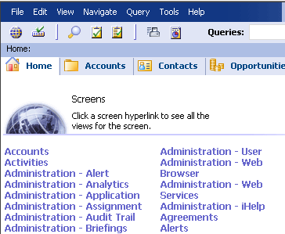
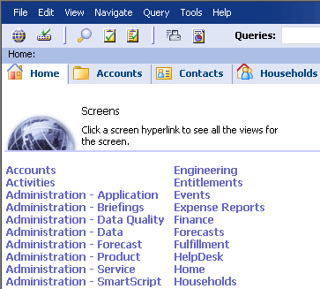
Views and Job Functions
Users should see only those views required to perform their job functions
  Improves efficiency for the user
  Improves business security by preventing unauthorized access to sensitive or administrative views
The System Administrator has many more administrative views than a Call Center Agent. Notice that even the set of screen tabs is different
System Administrator
Call Center Agent

Slide 6
Responsibilities
Are collections of views associated with a job function
  All of the views necessary to perform that particular job function
Are assigned to users according to their job functions
Users may have more than one job function, hence may have more than one responsibility
Views
Responsibilities
Users
Responsibilities contain one or more views
Assign users one or more responsibilities

Slide 7
Properties of Responsibilities
A view may be contained in multiple responsibilities
  For example, the Home Page View of an application should be included in every responsibility used to access that application
Multiple users may share the same responsibility
  For example, Call Center agents
Views
Responsibilities
Users
The same view may be contained by multiple responsibilities
Multiple users may share the same responsibility

Slide 8
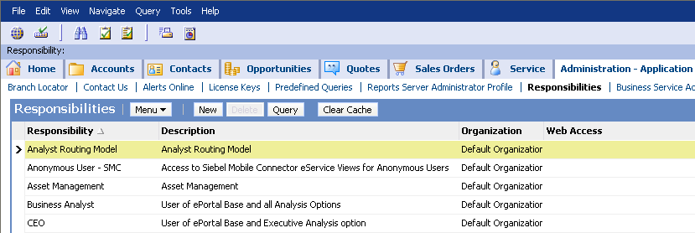
Seed Responsibilities
Are a set of responsibilities provided with the Siebel application
  Automatically created during application installation
Cannot be modified or deleted
May be copied to create new, editable responsibilities
Seed responsibilities are created when the application is installed

Slide 9
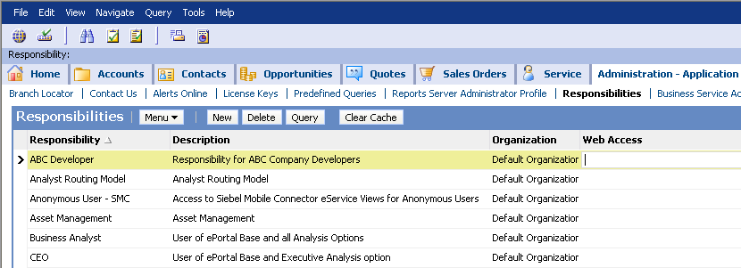
Creating New Responsibilities
If the existing seed responsibilities are not sufficient for your business requirements, create new responsibilities as required
  New responsibilities may be edited or deleted
Create new responsibilities for customized, editable responsibilities

Slide 10
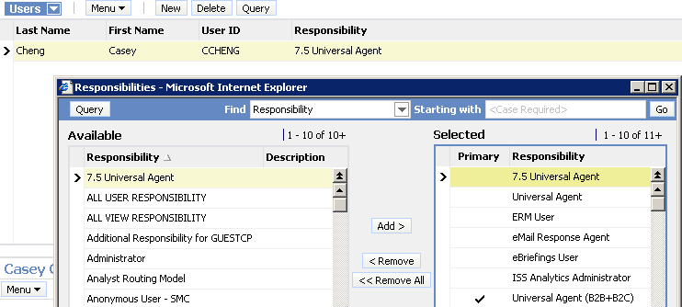
Assigning Responsibilities to Users
Assign responsibilities to users according to their job role(s)
  Users with multiple responsibilities see the union of the views
  Users with no responsibilities see nothing
    Critical to remember to assign responsibilities to partners and Web customers
Click the Select button to bring up the Responsibilities list
CCHENG has many responsibilities, and is able to see all of the views in all of them

Slide 11
Primary Responsibilities
Assign each user a primary responsibility
  Determines the initial tab layout when the user logs in
    Administrator determines the initial layout
    User can edit personal preferences to create a different layout
CCHENG’s primary responsibility is Universal Agent (B2B+B2C), so she initially sees the tab layout for that responsibility

Slide 12
Creating a Responsibility
0/3
1. Copy or Create a Responsibility
2. Add or Remove Views
3. Test the Responsibility
Notes:
This is a structuring slide for <insert what will be discussed>. Do not teach the steps or concepts here because the following slides cover them in detail. Provide a high level description of what will be discussed.

Slide 13
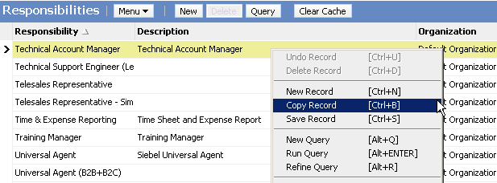
1. Copy or Create a Responsibility
1/3
Navigate to the Administration – Application > Responsibilities view
Copy an existing responsibility with a set of views similar to your requirements
Alternatively, create a new responsibility to start without any views
Right-click and select Copy Record to create a duplicate responsibility

Slide 14
1. Copying or Creating Responsibilities
1/3
Copying seed responsibilities:
  Provides a “quick start” in creating responsibilities with large numbers of views
  May provide far more views than your business logic requires
    Seed responsibilities frequently contain hundreds of views
    Inefficient for inexperienced users
    May include inappropriate administrative views
Creating new responsibilities:
  Allows fine-tuning of application logic to exactly match business requirements
    Users see only those views that your company has decided they require to perform their job functions
  Requires determining exactly which views a user may require and adding those views to the responsibility

Slide 15
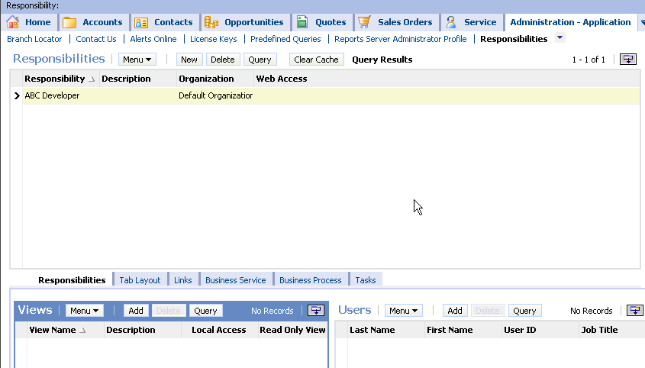
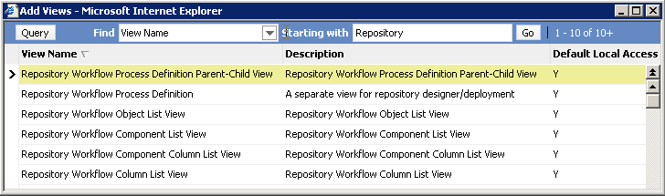
2. Add or Remove Views
2/3
Add or remove views from the responsibility as necessary
A pick applet provides querying functionality and improves efficiency when selecting views
1. Click Add to add views to a responsibility
2. Pick applet supports querying for and adding multiple views at once

Slide 16
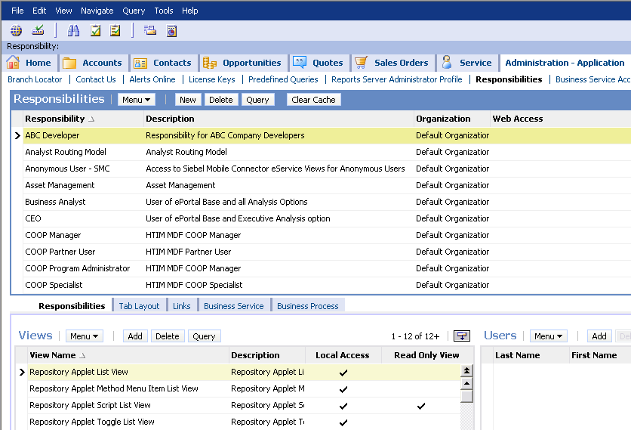
2. Read-Only Views
2/3
After editing the set of views for the responsibility, mark views as read-only for that responsibility if desired
  Allows different responsibilities to have different levels of access to the same view
Mark views as Read Only Views to prevent editing

Slide 17
2. Clear the Cache
2/3
Clear the responsibility cache to ensure that users will see their updated responsibilities the next time they log in
Click Clear Cache to clear the responsibility cache after creating or modifying responsibilities

Slide 18
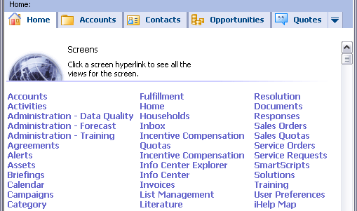
3. Test the Responsibility
3/3
Assign the responsibility to a sample user
  Use the Administration – User > Users view
Log in as that user and verify the available views from the Site Map
  Users only see references to views that are contained in their responsibilities
Examine the Site Map to confirm that only views associated with the responsibility are shown

Slide 19
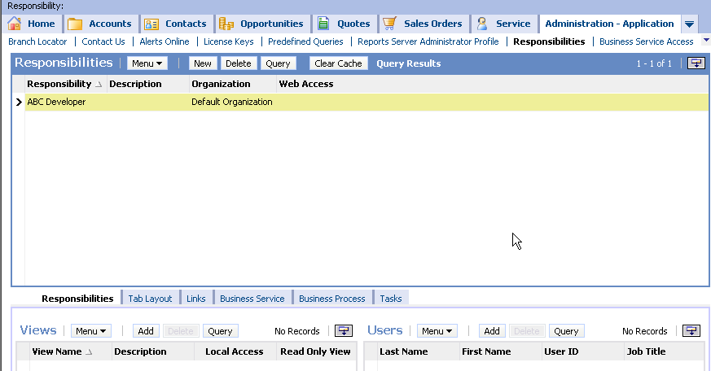
Additional Features
Use responsibilities to restrict access to business services, business processes, and tasks
  This prevents unauthorized users from invoking them

Slide 20
Module Highlights
Responsibilities are collections of views used to limit the views visible to a user
Responsibilities have a M:M relationship with views and users
Create responsibilities by copying and editing seed responsibilities or by creating new responsibilities
Assign responsibilities to a user and clear the responsibility cache before testing a responsibility
Notes:
Review Question: <Question>
Answer: <Answer>

Slide 21
Lab
In the lab you will:
  Explore seed responsibilities
  Create and test a new responsibility
Notes:
Labs and Troubleshooting:
<Summarize the tasks the students will perform in this lab. Suggest specific guidance the instructor may provide if necessary to help the students complete the lab and avoid trouble spots.>

