Slide 1

Module 5: Users, Positions, and Organizations
0/5
Siebel 8.0 Essentials
Notes:
Time: Lecture: <n – n> minutes; Labs: <n – n> minutes
Intent: <What is the instructional goal of the module>
Flow: < Describe at a high level the overall flow of the module>.
Key Terms: <List terms the instructor should be familiar with in order to teach this module>
<Term>
<Term>
<Term>
<Term>

Slide 2
Module Objectives
After completing this module you should be able to:
  Describe how data access is controlled by users, positions, and organizations
  Implement the company structure using divisions, organizations, positions, users, and employees
Why you need to know:
  Access to some data within the application is controlled by users, positions, and organizations
  Implementing your company's structure enables role- and organization-specific functionality in Siebel CRM
Notes:
Each objective and “why you need to know” should be stated aloud.

Slide 3
Business Challenge
Large-scale enterprise applications should not grant all users access to all of the data within the application
  For example, sales representatives should see their own sales quota attainment, but no one else’s
  On the other hand, sales managers should see all of their reports’ quota attainments
System administrators require a mechanism to restrict access to data within the application
  This mechanism should be independent of the mechanism to restrict access to views

Slide 4
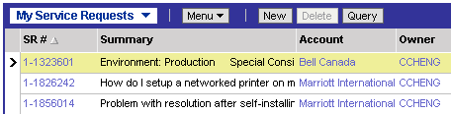
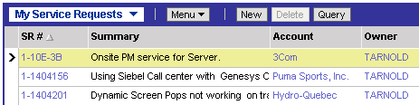
Business Solution: Access Control
Siebel applications allow different users to see different data based on their user ID, position, or organization within the company
  Data access control is independent of responsibilities and views
  Example: Ted Arnold and Casey Cheng can access the same view based on their responsibilities, but see different data in the view

Slide 5
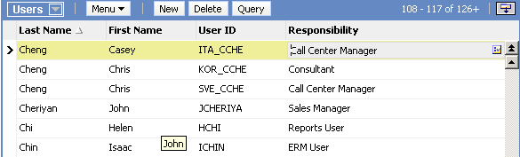
Users
Are individuals who use the Siebel application
  May be employees, customers, or partners
Require unique user IDs
Require at least one responsibility to see views in the application
Note that multiple users can have the same name as long as their user ID is different
Users must have at least one responsibility or they will see no views

Slide 6
Employees
Are a special type of user representing employees of the company
  Employees have one or more positions within the company
  Each position belongs to an organization within the company
Employees are users who have positions that belong to organizations
Users
Employees
Positions
Organizations
Responsibilities
All users have responsibilities, whether or not they are employees

Slide 7
Positions
Positions are used to control access to data within the application
  For example, a sales representative’s accounts are only visible to members of his or her sales team
Employees may have one or more positions
  One position is designated as the primary position, and is the position employees occupy when they log in
  Employees only see data for their current position
  Employees may change positions once they have logged in

Slide 8
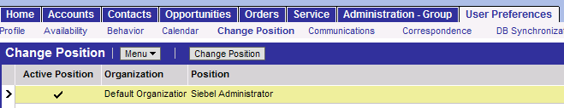
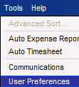
Changing Positions
If an employee has more than one position, he or she can change position during a session
  From the application-level Tools menu, select User Preferences > Change Position
  Becomes the Active Position for that session
Changing the default login (primary) position for an employee is an administrator function

Slide 9
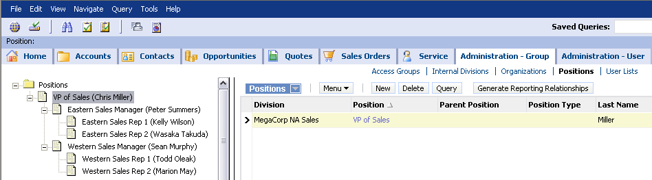
Position Hierarchy
Positions are arranged in a hierarchy
  Defines a reporting structure that allows managers to see data from their direct and indirect reports
  The Administration – Group > Positions view shows this hierarchy
    Also shows the primary for each position
The VP of Sales position can see data for the Eastern Sales Manager and Eastern Sales Rep positions

Slide 10
Divisions and Organizations
A company is divided into divisions representing lines of business, regions, or departments
Divisions are arranged in a hierarchy
Organizations are a special type of division used to restrict data access within that division
  Data is shared among divisions within an organization

Slide 11
Example: MegaCorp Organizational Structure
Here is a sample organizational structure of a sample company, MegaCorp
Default Organization
Default Organization is the root of the hierarchy
All divisions belonging to Default Organization share the same data access
MegaCorp HQ
MegaCorp Sales
MegaCorp
Training
MegaCorp Consulting
NA Sales
EMEA Sales
Partner Sales
Customer Training
Internal Training
Financial Services
Public Sector
Telecoms & Media
Partner organizations created to segregate data
LEGEND
European Partners
ASIA/PAC Partners
Division
Organization

Slide 12
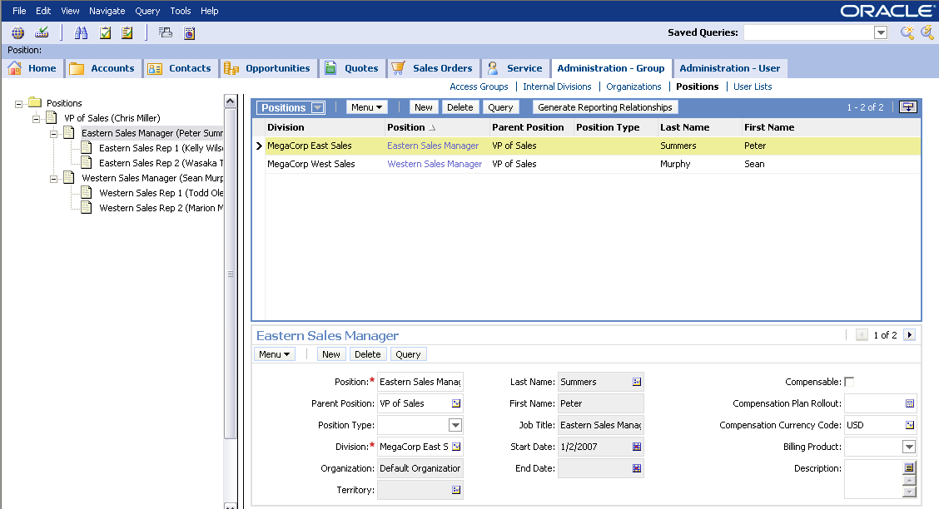
Positions and Divisions
A position is assigned to one, and only one, division
A position is associated with one, and only one, organization:
  The organization to which the division belongs
The Eastern Sales Manager position is assigned to the MegaCorp East Sales division
This position is associated with the MegaCorp East Sales division, which belongs to the Default Organization

Slide 13
Example: NA Sales with Positions and Users
The NA Sales division (part of Default Organization) might have users and positions that look something like this:
MegaCorp NA Sales
LEGEND
VP of Sales
Chris Miller
Division
Organization
Position
MegaCorp West Sales
MegaCorp East Sales
MegaCorp West Sales
MegaCorp East Sales
Western Sales Manager
Sean Murphy
Eastern Sales Manager
Peter Summers
Western Sales Rep 1
Todd Oleak
Western Sales Rep 2
Marion May
Eastern Sales Rep 1
Kelly Wilson
Eastern Sales Rep 2
Wasaka Takuda

Slide 14
Implementing the Company Structure
0/5
1. Create Divisions and Division Hierarchy
2. Label Some Divisions as Organizations
3. Create Positions
4. Create Employees
5. Create Users
Notes:
This is a structuring slide for <insert what will be discussed>. Do not teach the steps or concepts here because the following slides cover them in detail. Provide a high level description of what will be discussed.

Slide 15
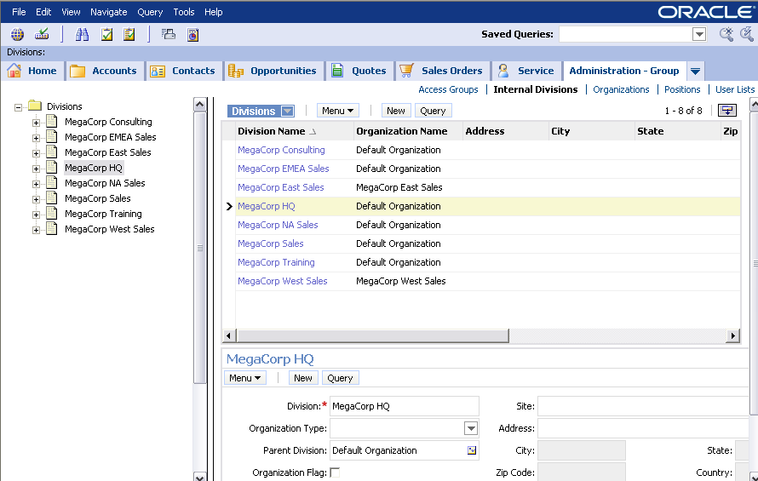
1. Create Divisions and Division Hierarchy
1/5
Create divisions in the Administration – Group > Internal Divisions view
  Required fields are division name and currency
  Be careful: Once divisions are created they cannot be deleted

Slide 16
2. Label Some Divisions as Organizations
2/5
Label divisions as organizations by clicking the Organization Flag check box
  Be careful: This cannot be undone
Organization Flag check box

Slide 17
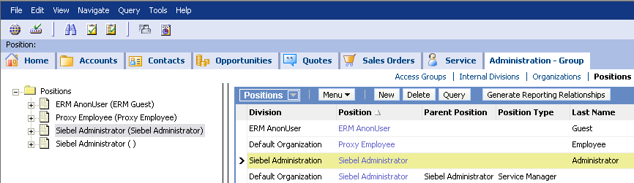
3. Create Positions
3/5
Create Positions on the Administration – Group > Positions view
  Positions require a name and a division
Siebel applications provide some seed positions such as Siebel Administrator
Recommended practice: Do not delete positions, as they are related to data
The Siebel application has four seed positions, including Siebel Administrator

Slide 18
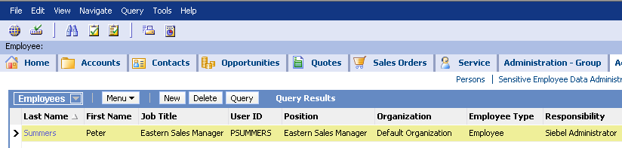
4. Create Employees
4/5
Use the Administration – User > Employees view to create employees
  Employee will also appear as a user
Required fields are First Name, Last Name, User ID, Position, and Organization
By default, new employee records are in the same organization as the person creating the record
  Used for access control of visibility of employee records
  Can be changed to reflect appropriate access control

Slide 19
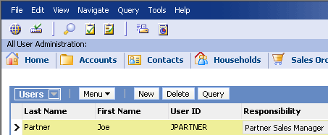
5. Create Users
5/5
Some users will not be employees
  For examples, customers and partners
Create them in the Administration – Users > Users view
  Customers and partners require responsibilities, but not positions

Slide 20
Module Highlights
Users are individuals who log in to the application
  Require responsibilities
Employees are special users representing employees of the company
  Hold at least one position
  Belong to at least one organization
Positions are similar to job titles, and are used to determine what data an employee can see
Divisions represent divisions within the company
Organizations are specialized divisions used to limit data visibility
Notes:
Review Question: <Question>
Answer: <Answer>

Slide 21
Lab
In the lab you will:
  Implement a company structure, including divisions, organizations, positions, and employees
Notes:
Labs and Troubleshooting:
<Summarize the tasks the students will perform in this lab. Suggest specific guidance the instructor may provide if necessary to help the students complete the lab and avoid trouble spots.>

