Slide 1

Module 6: Controlling Access to Customer Data
0/5
Siebel 8.0 Essentials
Notes:
Time: Lecture: <n – n> minutes; Labs: <n – n> minutes
Intent: <What is the instructional goal of the module>
Flow: < Describe at a high level the overall flow of the module>.
Key Terms: <List terms the instructor should be familiar with in order to teach this module>
<Term>
<Term>
<Term>
<Term>

Slide 2
Module Objectives
After completing this module you should be able to:
  Describe the difference between customer and master data in Siebel applications
  Describe the different Access Control mechanisms used to restrict access to data in Siebel applications
  Identify the different view types used for different types of users
Why you need to know:
  To effectively use and administer Siebel applications, you need to understand how access to data is controlled
  Understanding view types is essential to properly assigning them to responsibilities
Notes:
Each objective and “why you need to know” should be stated aloud.

Slide 3
Business Challenge
Users often perform the same job functions but on different sets of data
  For example, sales representatives need access to the records for their own accounts, but not each others’
Access to some data in the enterprise needs to be restricted
  Users should only see records they need to do their job
  Users should easily locate records of interest

Slide 4
Business Solution: Access Control for Data
Siebel applications provide mechanisms to restrict access to certain records based on:
  The employee
  The employee's position
  The position’s organization
Limited access to data:
  Increases business security
  Increases user productivity

Slide 5
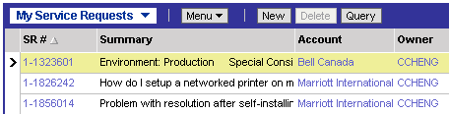
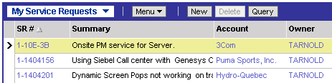
Relationship Between Views and Data
Access to views is independent of access to data
  But the view defines the Access Control mechanism that will be used to access data
Data displayed within a view is based on the Access Control mechanism for the view
  Example: Ted Arnold and Casey Cheng can access the same view based on their responsibilities, but see different data in the view
Casey Cheng (CCHENG) sees only her own service requests
Ted Arnold (TARNOLD) can access the same view but sees only his own service requests there

Slide 6
Data Classification
Data in a Siebel Enterprise is classified as either customer data or master data
Customer data:
  Consists of dynamic, transactional data such as service requests and opportunities
  Is typically created and managed by users of the application
  Has access controlled at the record level according to employee, position, organization, or a combination thereof
Master data:
  Includes static, referential data such as products and literature
  Is created and maintained by administrators
  Can be grouped into categories and catalogs
  Has access controlled according to catalog and category

Slide 7
Accessing Customer Data
Individual records may be restricted by employee, position, organization, or a combination thereof
  Data visibility is determined by Siebel-set properties of the underlying business component (BC)
  Visibility may be restricted to an individual employee, position, or organization, or multiple employees, positions, or organizations
Organization
Employees are assigned to positions. Each position is assigned to one and only one organization
Position
Records
Employee
Record visibility is restricted by a combination of employee, position, and organization, depending on the underlying BC

Slide 8
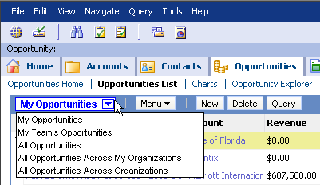
Viewing Customer Data
For customer data that is access controlled, visibility is determined using the following drop-down visibility filters:
  My views
  My Team’s views
  All views
  All Across My Organizations views
  All Across Organizations views
Assigning the appropriate views to the appropriate responsibilities is critical for data access control
The visibility filter drop-down list shows the views available according to the user’s responsibilities

Slide 9

My Views
My views show records where you or your position is directly associated with the record
  For example, My Accounts or My Contacts
For some records such as Accounts or Opportunities there is a team of positions associated with each record
  The record appears in My View if your position is on the team
A sales agent only sees accounts for which the sales agent’s position is on the account team

Slide 10
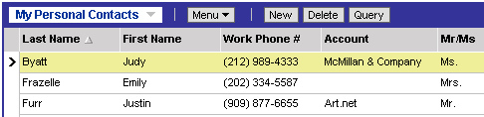
My Personal Views
Are used to display records directly owned by you or your position
Are special-case views that are rarely used (for example, with Contacts)
A sales agent only sees contacts for which he or she is the direct owner

Slide 11
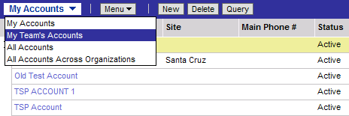
My Team’s Views
Are an additional view for managers that allow them to see records assigned to their direct and indirect reports
  For records with teams of positions, only records where the primary is the direct or indirect report are displayed
  Manager does not have to be assigned to the record
Are typically assigned only to manager responsibilities
Are implemented using the position hierarchy
Manager sees only the accounts for which the manager’s direct or indirect reports are the primary position on the account

Slide 12
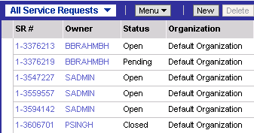
All Views
Are used to show all records belonging to your current organization
  The organization of your current position
  Not related to My or My Team’s views, which are person or position oriented
A service agent sees all the service requests assigned to his or her organization, regardless of the owner

Slide 13
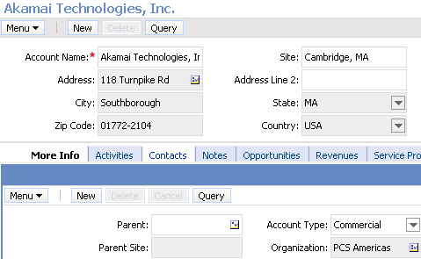
Customer Data and Organizations
By default, when a record is created it is associated with the organization of the creator’s current position
To change the organization associated with a record, use the More Info view
  Records may be associated with multiple organizations
A record’s Organization is usually shown under the More Info tab in the detail view

Slide 14
All Across My Organizations Views
Are used to display all data from an organization and its child organizations
  Based on the relationships specified by the organizational hierarchy
Are typically restricted to users who need to access records at the enterprise level
  Mid-level executives
  Partners
Are typically used for only a few types of records
  For example, opportunities
  In the All Opportunities Across My Organizations view, a sales manager sees all opportunities in his or her organization and all of its child organizations

Slide 15
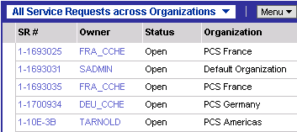
All Across Organizations Views
Are used to show all records in the enterprise that are assigned an organization
Are typically restricted to only those users who need to access records across the whole company
  Top-level executives
A vice president of sales can see all service requests that have been assigned

Slide 16
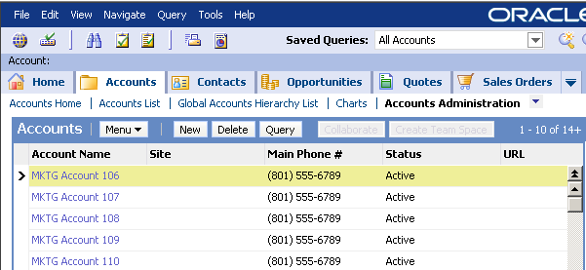
Administration Views
Are used to display all database records, even those without a valid owner
  For example, records that have just been imported but not yet assigned or records where the primary position has been deleted
Are accessed from the Administration views for each major entity
Should be restricted to a few users in the enterprise as they display all records in the database
Administration views are separate from the visibility filter drop-down list

Slide 17
Summary: Types of Views
Views | Description
My View | Displays records directly assigned to you based on user ID or active position
My Personal View | Only displays records you directly own
My Team’s View (Manager’s View) | Allows managers to see records assigned to their direct and indirect reports that are the primary owner based on reporting structure
All View | Displays all records associated with the user’s organization
All Across My Organizations View | Displays records that are assigned to the user’s organization and its child organizations
All Across Organizations View | Displays all records in the enterprise with a valid organization
Administration Views | Display all records in the database, even those without a valid organization

Slide 18
Best Practices for Views
My Views:
  Individual contributors should always have access
    Allows them to see records directly associated with them or their position
  Managers and executives may or may not require access
    Require access if they might be on a team associated with a record
    Do not require access if they will never be associated with a record
My Team’s Views:
  Individual contributors should not have access unless they have people who report to them
  Managers should have access
    Allows them to see records associated with their reports
  Executives may or may not require access

Slide 19
Best Practices for Views Continued
All Views:
  Individual contributors may or may not need access
    Call center agents should be able to see all of a company’s service requests, hence should have an All Service Requests view
    Sales representatives may or may not need to see all opportunities within their organization, depending on the business model
  All views are typically restricted to users who need to access records at the organization level
    Executives, administrators
    Service agents who need to access all service requests
All Across Organizations Views:
  These views are usually reserved for upper managers and executives
    Exception: Call center agents may need to see all service requests filed by a customer worldwide, hence may need access to these views

Slide 20
Review: Access to Customer Data
Can be restricted by assigning individual records to:
  Employees (specified by employee’s user ID)
  Positions
  Organizations

Slide 21
Using Multiple Access Control Mechanisms
A record can be restricted by more than one Access Control mechanism
  Mechanisms are not mutually exclusive
Each view is preconfigured to use only one mechanism at a time
  If you want to use another mechanism, you create and configure another view

Slide 22



Examples
An employee’s position may be assigned to an account that is not assigned to that employee’s organization
  Employee sees the account in the My View
  Employee does not see the account in the All View
Contacts have multiple access mechanisms: public (team-based), private (position- or employee-based), and manager
  Employee sees public contacts in the My View
  Employee sees private contacts in the My Personal View
  Manager sees contacts for self and subordinates in the My Team’s View

Slide 23
Summary of Record Assignment
Standard Siebel business entities can be assigned to single or multiple employees, positions, or organizations
Access Method | Single-Valued Access | Multi-Valued Access
Employees | Service requests Expense reports Contacts | Assets Activities
Positions | Forecasts Quotes | Accounts Contacts Opportunities
Organizations | Assets Consumers Forecasts | Accounts Opportunities Quotes
Team Access Control

Slide 24
Module Highlights
Access to records may be restricted by employee, position, organization, or a combination thereof
Which records are shown depends on the view selected from the visibility filter drop-down list
Multiple Access Control mechanisms may be in place for a single record
  For example, both position-based and organization-based Access Control
Notes:
Review Question: <Question>
Answer: <Answer>

Slide 25
Lab
In the lab you will:
  Explore record visibility in the application
  Add a position to a user an examine how it affects the various visibility filters
Notes:
Labs and Troubleshooting:
<Summarize the tasks the students will perform in this lab. Suggest specific guidance the instructor may provide if necessary to help the students complete the lab and avoid trouble spots.>

