Slide 1

Module 7: Catalogs and Master Data
0/5
Siebel 8.0 Essentials
Notes:
Time: Lecture: <n – n> minutes; Labs: <n – n> minutes
Intent: <What is the instructional goal of the module>
Flow: < Describe at a high level the overall flow of the module>.
Key Terms: <List terms the instructor should be familiar with in order to teach this module>
<Term>
<Term>
<Term>
<Term>

Slide 2
Module Objectives
After completing this module you should be able to:
  Identify how master data is organized into catalogs and categories
  Identify how users are organized into access groups
Why you need to know:
  Administering master data requires an understanding of catalogs, categories, and access groups
Notes:
Each objective and “why you need to know” should be stated aloud.

Slide 3
Business Challenge
Companies have large amounts of data that must be:
  Classified, so that it is easy to organize, administer, navigate, and search
  Controlled, so that users only have access to appropriate data
Example: Companies want different sales divisions to have access to different product lists

Slide 4
Business Solution
Siebel applications provide mechanisms for:
  Organizing and classifying large amounts of static, referential data
  Organizing users into groups for appropriate access to data

Slide 5
Master Data
Is static, referential data managed by administrators
  Products
  Solutions
  Literature
  Resolution items
  Auction items
  Events
  Decision issues
  Competitors
  Training courses
Has its visibility controlled by:
  Catalogs
  Categories
  Access groups

Slide 6
Catalogs
Are containers for hierarchies of categories
  Do not contain master data themselves
Are created to contain a specific subset of the master data
  For example, customer documentation for credit card accounts
Catalog A
Category A
Category B
Category C
Product 1
Product 2
Product 3
Literature Item 1
Product 4
Product 5
Subcategory A
Product 3
Product 6
Subcategory A
Product 2
Literature Item 2
Subcategory B
Literature Item 1

Slide 7
Catalogs Continued
May be declared public or private
  Public catalogs are visible to all users
    Categories within public catalogs may still be marked private
  Private catalogs have their visibility limited to privileged groups known as access groups
For example, a credit card documentation catalog might be public to allow users to see the service agreements and benefits
However, a customer service documentation catalog might be private to restrict visibility to those with service agreements
Catalog A (Public)
Catalog B (Private)
A public catalog is visible to all users; individual categories within that catalog may still be marked private
Categories within private catalogs are private

Slide 8
Catalog Types
Are assigned to catalogs
  Catalogs should have a catalog type
  Seed catalog types include:
    Infocenter
    Buying
    Partner
    eService FAQ
    Customer
    Multiselect Checkbox
    Training
    Partner Program
    Training Curriculum
Are used when querying for master data

Slide 9
Categories
Are nodes in a catalog that contain:
  Master data
  Other categories
Are not shared between catalogs
  However, multiple catalogs may contain categories with the same name
May be declared public or private
  If a category is declared private, all of its subcategories are also private
  Private categories also have their visibility limited to specified access groups

Slide 10
Categories: Example
Even though Category B and Category C both contain subcategories named Subcategory A, these two subcategories are distinct
Since Category B is private, its Subcategory A is also private
Category B has been marked as private
Catalog A
Category A
Category B
Category C
Product 1
Product 2
Product 3
Literature Item 1
Product 4
Product 5
Subcategory A
Product 3
Product 6
Subcategory A
Product 2
Literature Item 2
Subcategory B
Literature Item 1

Slide 11
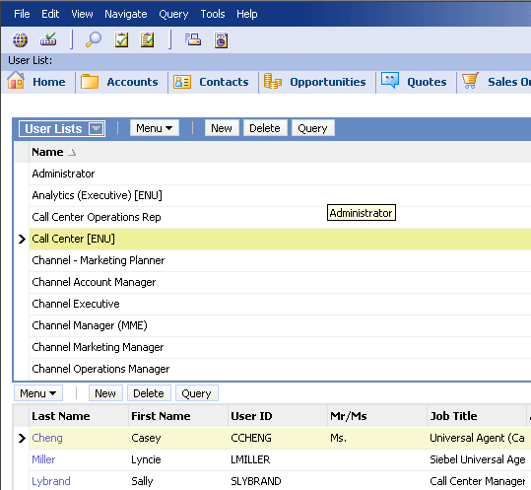
Access Groups
Are collections of positions, organizations, user lists, and households used to access private catalogs and categories
Cannot contain individuals such as employees and users
  To add an individual, create a user list with that individual as the only member
Create User Lists in the Administration – Group > User Lists screen and add them to access groups

Slide 12
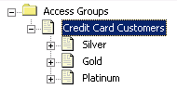
Access Group Hierarchies
Access groups can be organized into a hierarchy
  Child access groups inherit all of the access granted to their parents, hence have more privileges than their parents
  Useful for giving more privileged users greater access
Parent access group
Child access groups

Slide 13
Access Control
Assign access groups to catalogs or categories
  Unlike customer data, individual records are not controlled
Access groups must be assigned to every catalog or category to which they need access
  Access is not inherited along the category hierarchy
Catalog A
Assign Access Group X to Category B
Category A
Category B
Category C
Product 1
Product 2
Product 3
Literature Item 1
Product 4
Product 5
Subcategory A
Product 3
Product 6
Subcategory A
Product 2
Literature Item 2
Subcategory B
Literature Item 1
Also assign Access Group X to subcategory A if access is required

Slide 14
Access Control Continued
An access group can only be added to a category if:
  The access group is also assigned to the category’s parent, or
  The access group is a child of an access group assigned to the parent
Catalog A
Assign any access group to Category B because its parent (Catalog A) is public
Category A
Category B
Category C
Product 1
Product 2
Product 3
Literature Item 1
Product 4
Product 5
Subcategory A
Product 3
Product 6
Subcategory A
Product 2
Literature Item 2
Subcategory B
Literature Item 1
Cannot assign Access Group Y to Subcategory A unless…
… Access Group Y is assigned to Category B, or…
… Access Group Y is the child of an access group assigned to Category B

Slide 15
Access Control Continued
Removing a parent access group from a category also removes all child access groups from all subcategories
Example: Suppose Access Group Y is a child of Access
Group X
Catalog A
Removing Access Group X from Category B…
Category A
Category B
Category C
Product 1
Product 2
Product 3
Literature Item 1
Product 4
Product 5
Subcategory A
Product 3
Product 6
Subcategory A
Product 2
Literature Item 2
Subcategory B
Literature Item 1
… removes Access Group Y from Subcategory A

Slide 16
Building a Catalog
0/6
1. Create the Catalog
2. Add Categories to the Catalog
3. Associate Master Data with Categories
4. Declare Catalogs or Categories Private
5. Create Access Groups
6. Assign Access Groups
Notes:
This is a structuring slide for <insert what will be discussed>. Do not teach the steps or concepts here because the following slides cover them in detail. Provide a high level description of what will be discussed.

Slide 17
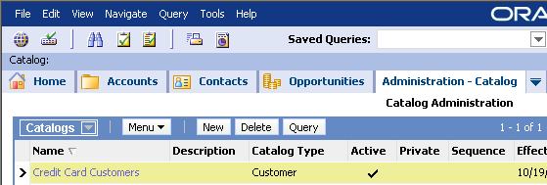
1. Create the Catalog
1/6
Navigate to Administration – Catalog > Catalogs
Create a new catalog
  Specify a name
  Specify a catalog type
  Specify other options
By default, the catalog is active; mark it as inactive to make it unavailable, for example, during updates
Specify sequence numbers to change the order in which catalogs appear

Slide 18
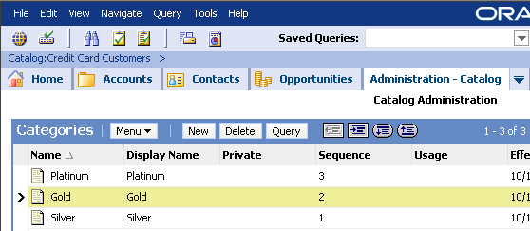
2. Add Categories to the Catalog
2/6
Drill down on the catalog name in the Catalog view to navigate to the Categories view
Add categories to the catalog
Use buttons to promote and demote subcategories
Drill down on a catalog to see its categories

Slide 19
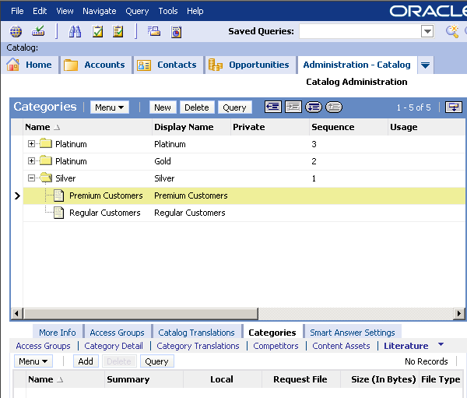
3. Associate Master Data with Categories
3/6
Select the appropriate tab in the Categories view to add master data to a category
For example, select the Literature tab to add product literature

Slide 20
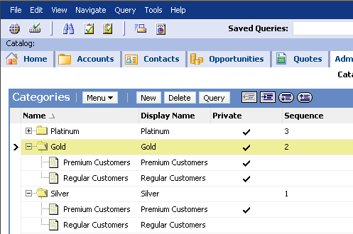
4. Declare Catalogs or Categories Private
4/6
Set the Private flag at the catalog or category level to restrict data access
  Subcategories are automatically marked as private
Marking the Gold category as private automatically causes the Premium and Regular Customers categories to be marked as Private

Slide 21
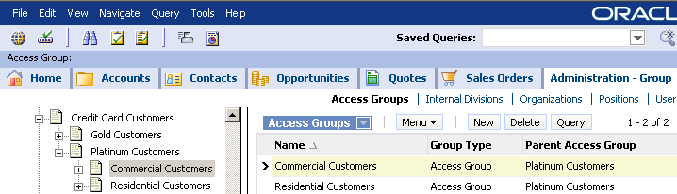
5. Create Access Groups
5/6
Navigate to Administration – Group > Access Groups
Create the access group hierarchy as required
  Create parents, then children
  Specify parents for child records
Specify the parent access group when creating the child access group; this requires creating the parent first

Slide 22
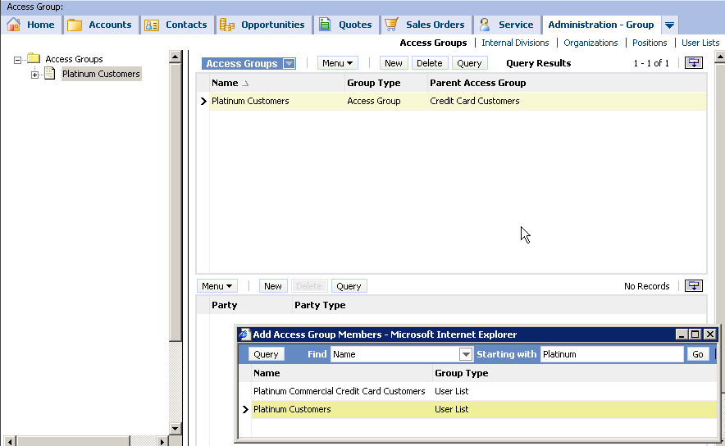
5. Create Access Groups Continued
5/6
Add positions, organizations, or user lists to access groups
Click New to add parties to an access group
Group type can be Position, Organization, User List, or Household

Slide 23
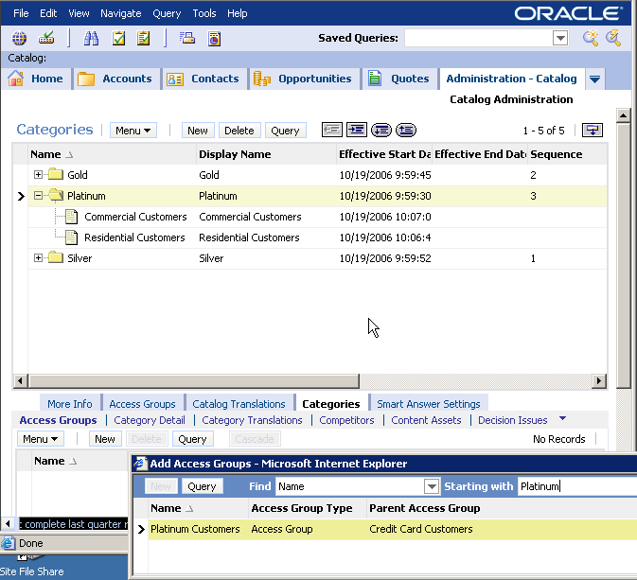
6. Assign Access Groups
6/6
Assign access groups to catalogs or categories
  Use the Cascade button to automatically assign an access group to all child categories
Add access groups using the Access Group tab under Categories or Catalogs
Select an Access Group and click Cascade to assign that access group to all child categories

Slide 24
Access Control Summary
Access Control
Controls access to
Views
Determined by Responsibility
Data
Customer Data
Master Data
Determined by
Access Groups
Catalogs &
Categories
Examples:
Products
Literature
Competitors
etc.
Personal Ownership
Determined by
UserID
Examples:
Service Requests
Product Defects
Activities
Positions
Determined by
Position
Examples:
Accounts
Opportunities
Contacts
Campaigns
Organizations
Determined by
Organization
Examples:
Accounts
Opportunities
Contacts
Campaigns
Customer Data
Is dynamic and transactional (can be updated)
Is created and managed by users of the application
Access is controlled at the record level
Master Data
Is static, read-only material to the end user
Is created and maintained by company administrators
Access is controlled at the Catalog and Category level

Slide 25
Module Highlights
Master data is static, referential data such as product catalogs or product documentation
Catalogs are containers for categories
  Mark catalogs as private to restrict access to specific access groups
Categories contain master data
  Arranged in a hierarchy within the catalog
  Mark categories as private to restrict access to specific access groups
Notes:
Review Question: <Question>
Answer: <Answer>

Slide 26
Lab
In the lab you will:
  Navigate catalogs, categories, and access groups
  Restrict access to master data contained in categories
Notes:
Labs and Troubleshooting:
<Summarize the tasks the students will perform in this lab. Suggest specific guidance the instructor may provide if necessary to help the students complete the lab and avoid trouble spots.>

