Slide 1

Module 8: The Siebel Web Architecture
0/5
Siebel 8.0 Essentials
Notes:
Time: Lecture: <n – n> minutes; Labs: <n – n> minutes
Intent: <What is the instructional goal of the module>
Flow: < Describe at a high level the overall flow of the module>.
Key Terms: <List terms the instructor should be familiar with in order to teach this module>
<Term>
<Term>
<Term>
<Term>

Slide 2
Module Objectives
After completing this module you should be able to:
  Identify the pieces that make up the Siebel Web architecture
  Identify the role of each piece of the architecture
  Describe how Siebel requests are processed
Why you need to know:
  Provides a foundation for understanding the relationship between the Siebel software components
Notes:
Each objective and “why you need to know” should be stated aloud.

Slide 3
Siebel Web Architecture Overview
At a high level, the Siebel Web architecture consists of:
  Siebel Web Clients that access and display the business data
  A Gateway Name Server that stores configuration information
  A Web server that handles interactions with the Web Clients and distributes requests to the Siebel Servers
  Servers that manage the business data and provide batch and interactive services for clients
  A relational database and file system that store business data
Siebel Web Client
Web Server
Enterprise
Siebel Gateway Name Server
Siebel Server(s)
Database Server
Siebel File System

Slide 4




Siebel Web Client
Displays the interactive Siebel application used to manage the Siebel data
Runs in a variety of environments
  Web browsers, Wireless Markup Language (WML) devices such as mobile phones, and personal digital assistants (PDAs)
Siebel Web Client
Web Server
Enterprise
Siebel Gateway Name Server
Siebel Server(s)
Database Server
Siebel File System

Slide 5
Web Server
Identifies and passes Siebel requests from Siebel Web Clients to the Siebel Servers
Passes completed HTML application pages back to Siebel Web Clients
Provides load balancing for multi-server installations
  Supports either built-in or third-party load balancing
Siebel Web Client
Web Server
Enterprise
Siebel Gateway Name Server
Siebel Server(s)
Database Server
Siebel File System

Slide 6
Siebel Gateway Name Server
Is a Windows service or UNIX daemon process
Stores component definitions and assignments, operational parameters, and connectivity information
  For example, connect strings to query servers for server/component availability
  Information stored in siebns.dat file on Gateway Name Server
Siebel Web Client
Web Server
Enterprise
Siebel Gateway Name Server
Siebel Server(s)
Database Server
Siebel File System

Slide 7
Siebel Enterprise
Is a logical collection of Siebel Servers that support users and access a single database server and the Siebel file system
Logically groups Siebel Servers for common administration via Siebel Server Manager
Supports sharing of common configuration information
Siebel Web Client
Web Server
Enterprise
Siebel Gateway Name Server
Siebel Server(s)
Database Server
Siebel File System

Slide 8
Siebel Servers
Execute tasks to manage the business data
  Programs known as server components perform specific functions or jobs for the server
  For example:
    Importing and exporting data
    Configuring the database to monitor for user-defined conditions
    Processing of client requests
  Tasks may run interactively, in the background, or as batch jobs
Siebel Web Client
Web Server
Enterprise
Siebel Gateway Name Server
Siebel Server(s)
Database Server
Siebel File System

Slide 9
Examples of Server Components
The application object manager (OM) is a server component that provides the environment in which Siebel user sessions run
  Users interact with an application-specific OM; for example, the Siebel Call Center Object Manager (SCCObjMgr)
  Runs in interactive mode
The Workflow Monitor Agent periodically checks the system to determine whether workflows or assignments need to be run
  Runs in background mode
Enterprise Integration Manager performs data imports and exports
  Runs in batch mode

Slide 10
Siebel File System
Is one or more shared directories that store files used by Siebel applications
  Files are compressed in a proprietary format to save space and provide security
  Examples: Product literature, sales tools, presentations, user profiles
Siebel Web Client
Web Server
Enterprise
Siebel Gateway Name Server
Siebel Server(s)
Database Server
Siebel File System

Slide 11
Database Server
Stores data used by Siebel applications in a predefined database schema
  Single database for Enterprise provides data consistency for users
  Data is accessed by components through a data manager layer
Supports a variety of third-party relational database management systems (RDBMS)
Siebel Web Client
Web Server
Enterprise
Siebel Gateway Name Server
Siebel Server(s)
Database Server
Siebel File System

Slide 12
Web Usage Login Scenario
Siebel Web Client (browser) sends the URL to the Web server
  URL specifies:
    Either HTTP or HTTPS protocol
    Web server machine name
    Application and language
URL initially connects to a Siebel-specific virtual directory on the Web server
  Virtual directories are created as part of the Siebel installation
Siebel Web Client <browser>
http://websrvr1/callcenter_enu
Web Server
<websrvr1>
Virtual Directory
[/callcenter_enu]
1. Browser sends URL to Web server
2. Connects to the virtual directory on the specified Web server

Slide 13
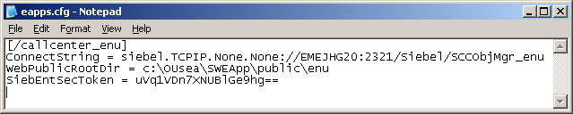
Web Usage Login Scenario Continued
Virtual directory forwards request to the Siebel Web Server Extension (SWSE) installed on the Web server
SWSE uses the eapps.cfg configuration file to obtain connection parameters
Siebel Web Client <browser>
3. Virtual directory specifies to use SWSE
Web Server
<websrvr1>
Virtual Directory
[/callcenter_enu]
SWSE
Eapps.cfg
4. SWSE locates the requested section in eapps.cfg

Slide 14
Web Usage Login Scenario Continued
Eapps.cfg specifies the location of the server, server connection broker port, Enterprise, and Object Manager information for initial connection
  For multi-server installations provides load balancing information
  Also provides generic login information for initial “anonymous” access to database
5. eapps.cfg specifies connect string values
Enterprise – <Siebel>
Web Server
<websrvr>
Siebel Server <EMEJHG20>
Object Manager
SCCObjMgr_enu

Slide 15
Web Usage Login Scenario Continued
Object Manager reads an application-specific configuration file and component parameters, which specify the application, the location of the Siebel Repository File (SRF), and so forth
  Siebel Repository File is a separate binary file that defines one or more Siebel applications
    Discussed in greater detail in subsequent modules
  Most configuration information is specified by component parameters rather than in the configuration file
Enterprise <Siebel>
Siebel Gateway Name Server
Siebel Server
Object Manager
SCCObjMgr_enu
Database Server
Database Server
6. Object Manager reads CFG file on server and component parameters from Gateway Name Server
CFG
SRF

Slide 16
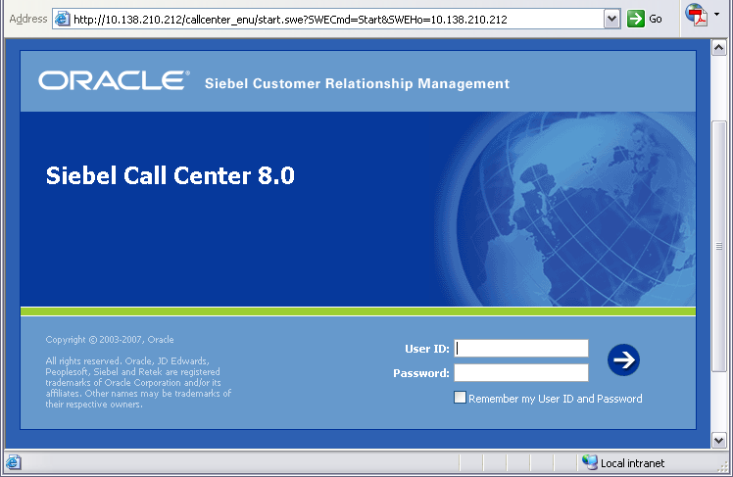
Web Usage Login Scenario Continued
Object Manager retrieves data through data manager
The Siebel Web Engine (SWE), part of the Object Manager, reads a set of Web templates that are stored on the Siebel Server and creates HTML pages for the data requested
  Siebel Web Templates (SWT) are a set of template files that specify how to render the UI in the user’s browser
    HTML files with embedded Siebel tags defining content
Enterprise <Siebel>
7. OM retrieves data through data manager layer
Siebel Server
Object Manager
Database Server
HTML login page
Database Server
SWE
8. SWE reads Web Templates and creates HTML pages
CFG
SRF
SWT

Slide 17
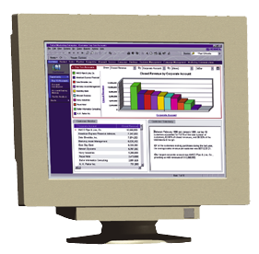
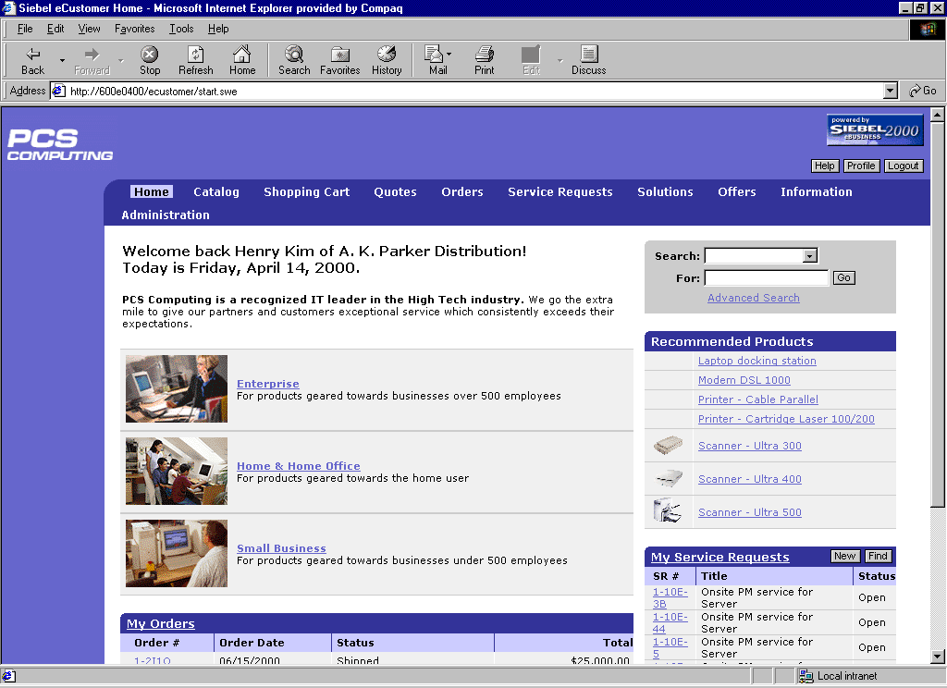
Web Usage Login Scenario Continued
The Object Manager sends the completed Web page to the Web server, which passes it back to the Siebel Web Client
Siebel Call Center
Enterprise – <Siebel>
Web Server
<websrvr1>
Siebel Server <SS1>
HTML login page
Object Manager
SCCObjMgr_enu

Slide 18
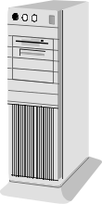
Physical Architecture
The Siebel Gateway Name Server, Siebel Server, database server, and File System can be implemented on one machine or spread across multiple machines
  SWSE can be on that machine for development or test environments
The Siebel Server(s) should have a high-speed LAN connection to the database server
High-speed LAN
Siebel Gateway Name Server
Web Server
SWSE
Enterprise Server
Siebel Server
Siebel File System
Firewall
Firewall
Siebel Server
Database Server

Slide 19
Module Highlights
A Siebel Web Client displays the Siebel application in a standard Web browser
A Siebel Web Server is a third-party Web server with the Siebel Web Server Extension (SWSE) installed and the Siebel application virtual directories created
A Siebel Gateway Name Server stores parameters and connection information for Siebel Servers
A Siebel Enterprise is a logical collection of Siebel Servers
A Siebel Server is a set of processes that manage processing for all Siebel clients
Notes:
Review Question: <Question>
Answer: <Answer>

Slide 20
Lab
In the lab you will:
  Examine the virtual directories and eapps.cfg
  Verify the information contained in the files against information retrieved from the application
Notes:
Labs and Troubleshooting:
<Summarize the tasks the students will perform in this lab. Suggest specific guidance the instructor may provide if necessary to help the students complete the lab and avoid trouble spots.>

