Slide 1

Module 9: Server Components and Parameters
0/5
Siebel 8.0 Essentials
Notes:
Time: Lecture: <n – n> minutes; Labs: <n – n> minutes
Intent: <What is the instructional goal of the module>
Flow: < Describe at a high level the overall flow of the module>.
Key Terms: <List terms the instructor should be familiar with in order to teach this module>
<Term>
<Term>
<Term>
<Term>

Slide 2
Module Objectives
After completing this module you should be able to:
  Define component groups
  Define components
  Describe parameters as inputs for components
  Describe the various levels at which you can set parameters and how to set them
  Describe named subsystems and job templates
Why you need to know:
  Server behavior is controlled by components and parameters, hence an understanding of how to find and configure them is essential
Notes:
Each objective and “why you need to know” should be stated aloud.

Slide 3
Review: Siebel Web Architecture
The Siebel Web architecture consists of a Web Client, Web server, Gateway Name Server, and Enterprise containing one or more Siebel Servers
  Each Siebel Server includes its own set of components: programs that run on the server to provide application functionality
Siebel Web Client
Web Server
Enterprise
Siebel Gateway Name Server
Siebel Server(s)
Database Server
Siebel File System

Slide 4
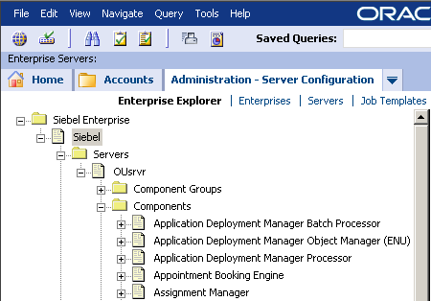
Examining the Siebel Enterprise
View the Siebel Enterprise hierarchy using the Enterprise Explorer View of the Server Administration – Configuration screen
1. This Siebel Enterprise is named Siebel
2. The first server listed in the enterprise is OUsrvr
3. OUsrvr has these components available

Slide 5
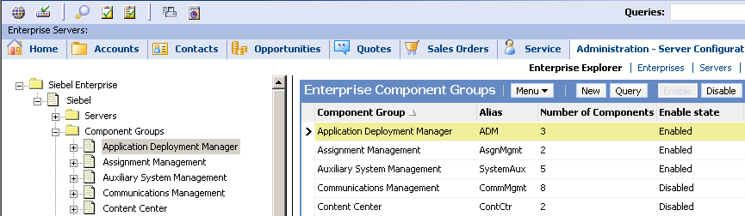
Component Groups
Are logical groupings of components
  Components are enabled or disabled in groups
Support major functional areas of the application
  For example, Siebel Call Center, Siebel Remote, or Assignment Management
The Enterprise Explorer lists the available component groups
The detail pane provides additional information such as the number of components in each group

Slide 6
Enabling and Assigning Component Groups
0/3
There are three steps to enable a component group on a server:
1. Enable the Component Group for the Enterprise
2. Assign the Component Group to the Server
3. Enable the Component Group on the Server
Notes:
This is a structuring slide for <insert what will be discussed>. Do not teach the steps or concepts here because the following slides cover them in detail. Provide a high level description of what will be discussed.

Slide 7
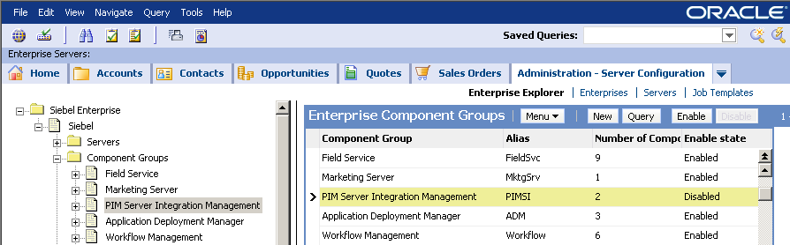
1. Enable the Component Group for the Enterprise
1/3
Click the Enable or Disable buttons in the detail pane of the Enterprise Explorer to enable or disable component groups
  By default, most component groups are enabled for the enterprise
  Components within disabled component groups are not available on any of the servers in the enterprise
Best Practice: Disable component groups which will never be used on any server
  Enabled component groups take a small amount of resources on the Siebel Gateway Name Server
Click the appropriate button to Enable or Disable a component group for the enterprise

Slide 8
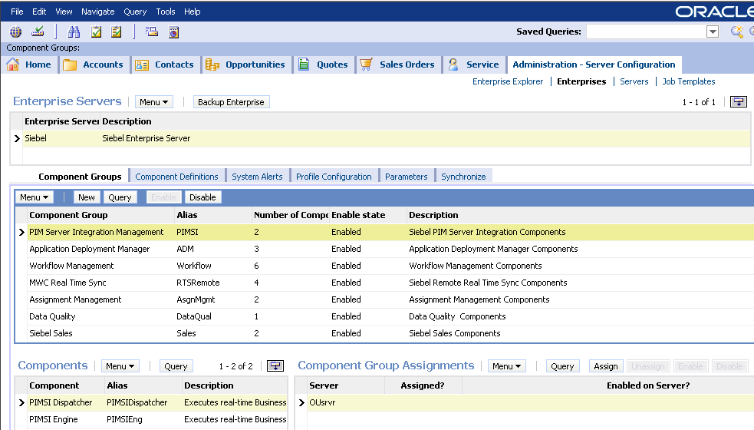
2. Assign the Component Group to the Server
2/3
In Administration – Server Configuration > Enterprises, select the component group and server and click Assign
  Stores component group information on the Siebel Gateway Name Server
  Allocates memory for the component group on the Siebel Gateway Name Server
1. Select component group to assign
2. Select server
3. Click Assign

Slide 9
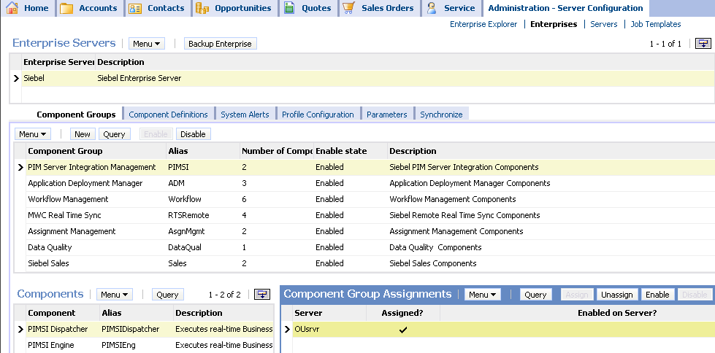
3. Enable the Component Group on the Server
3/3
Once you have assigned a component group to a server, enable or disable it on the server
  By default, assigning a component group automatically enables it
Best practice: Assign and disable component groups that you are not using now but may use in the future on that server
Select the desired server and click the Enable or Disable button
  Enabling allocates memory on the server for that component group
  The component group is now available to the server
Click Enable to enable the selected component group on the selected server

Slide 10
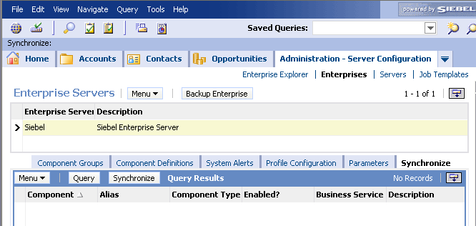
Synchronize Components
Synchronize components after enabling or disabling a component group that includes batch components
  Registers batch components with the Siebel Gateway Name Server
  Makes these components available to the Siebel Enterprise
Also possible to synchronize individual components
Synchronize every time a component group is enabled
Prior to initial synchronization, no components are available to run batch jobs

Slide 11
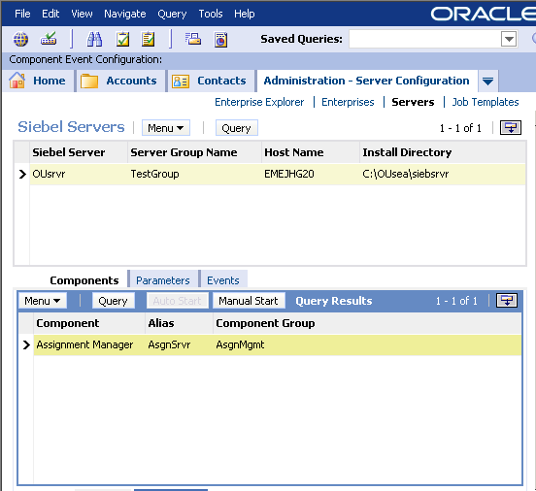
Manage Individual Components
Specify startup behavior for individual components
  Auto Start: The component automatically starts up when the Siebel Server service starts
  Manual Start: The component must be started manually
    Prevents component from consuming memory or processor time until it is needed
Click Manual Start under Administration – Server Configuration > Servers to set the component to manual startup

Slide 12
Executing Components
When a component executes, it is called a task
  Multiple instances of the same component may run simultaneously
Components execute in one of three modes:
  Batch components run once until completion
    Batch component executions are also called jobs
    Usually initiated by user action, event, or workflow
    For example, data loads or database extracts
  Background components run continuously in the background
    Periodically “wake up” and execute
    For example, transaction processor for tracking changes to the database
  Interactive components run in response to client requests
    For example, application object managers

Slide 13
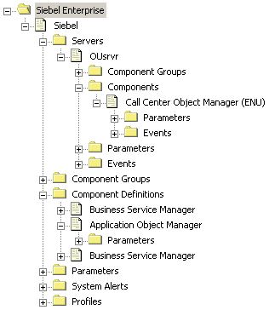
Component Parameters
Are input arguments for tasks
Are set at one of five levels:
  Enterprise parameters are set throughout the enterprise
  Server parameters are set at the individual server level
  Component Definition parameters are specific to a component, but enterprise-wide
  Server Component parameters allow a server to override a component definition
  Task parameters are for an individual component when it is run
Server Component parameters
Server parameters
Component Definition parameters
Enterprise parameters
Not shown: Task parameters are set when starting tasks, hence do not appear in the Enterprise Explorer

Slide 14
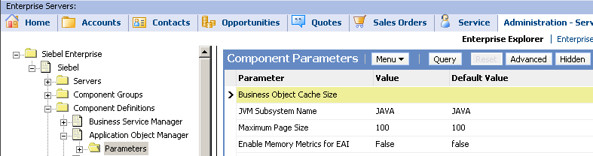
Hidden and Advanced Parameters
More advanced parameters are classified as hidden or advanced
Click the appropriate button to see these parameters
Click the Reset button to return to the normal set of parameters
Click Advanced or Hidden to see advanced or hidden parameters

Slide 15
Component Definitions
Are sets of parameters associated with a component to determine its behavior when it is run
  Set enterprise-wide, so that the component performs the same no matter which server it is run on
Reconfigure definitions to modify component behavior
Duplicate definitions to create new component definitions
  Creates a duplicate component with a new name and a different set of input parameters
Modify parameters or duplicate a definition to create a new component with different set of parameters

Slide 16
Parameter Inheritance
Parameters are set at any of five levels
  Parameters set at any level are inherited at all lower levels
    For example, parameters set at the enterprise level are inherited for the levels below it
  Parameters set at any level override parameters set at a higher level
    For example, parameters set when starting a task override those set at higher levels
Highest level
Enterprise
Server
Component Definition
Server Component
Lowest level
Task

Slide 17
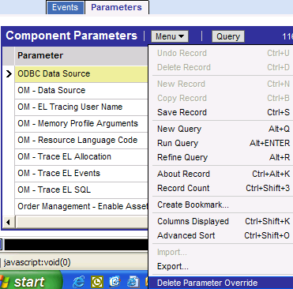
Removing Parameters
Do not attempt to delete parameters by setting their value to zero or null
  Causes zero or null value to be passed to component
Use Delete Parameter Override to remove parameter settings at a given level
Select Delete Parameter Override to remove parameter values

Slide 18
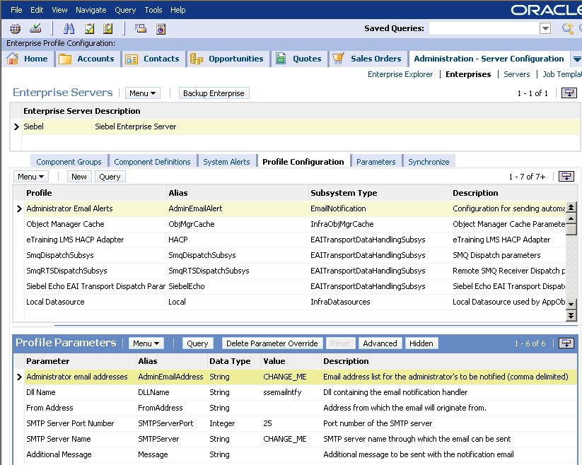
Profiles
Are sets of parameters that may be used by multiple components
  Also referred to as “named subsystems”
Are edited to modify behavior of multiple components
For example, the set of parameters used to send email alerts to administrators is used by multiple components
Modify the profile parameters to change the behavior of all components using this profile

Slide 19
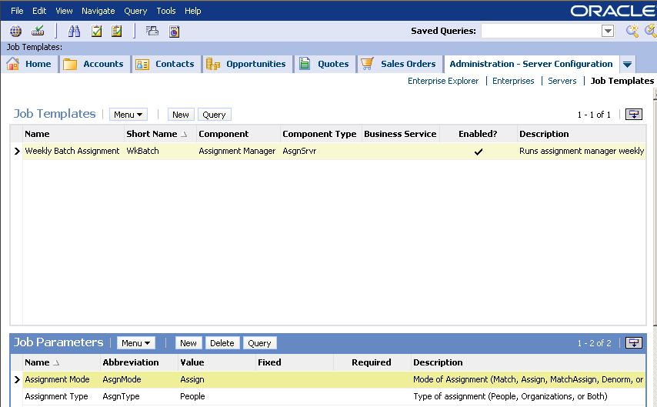
Job Templates
Job templates are predefined sets of parameters for use with batch components
  Recall: When a batch component is executed it is called a “job”
Multiple job templates can exist for the same component
  For example, weekly assignments versus daily assignments
    Both assignment jobs run the same component; only the set of input parameters is different
Unlike profiles, job templates are specific to a single component
For example, a job template containing parameters for a weekly batch assignment job
This job template is specific to the Assignment Manager component

Slide 20
Job Templates Continued
Create job templates by specifying the batch component to be used and entering the job-specific parameters
  Located under Administration – Server Configuration > Job Templates
1. Click New to create a new template
2. Select the component
3. Click New to create a new parameter; a select applet lists parameters for that component
4. Set parameter values

Slide 21
Module Highlights
Component Groups are logical groupings of server components
Enable component groups on the enterprise, assign them to a server, and enable them on that server
Set individual components to automatic or manual start up
Set component parameters at one of five levels: Enterprise, Server, Component Definition, Server Component, or Task
  Parameter values are inherited from higher levels
  Use Delete Parameter Override to restore inheritance
Profiles are sets of parameters used by multiple components
  Also known as “named subsystems”
Job templates are sets of parameters used to execute batch components
Notes:
Review Question: <Question>
Answer: <Answer>

Slide 22
Lab
In the lab you will:
  Use the Enterprise Explorer to examine component groups, components, and parameters
  Examine parameter inheritance
  Enable a component group on a server
Notes:
Labs and Troubleshooting:
<Summarize the tasks the students will perform in this lab. Suggest specific guidance the instructor may provide if necessary to help the students complete the lab and avoid trouble spots.>

