Slide 1

Module 10: Server Management
0/5
Siebel 8.0 Essentials
Notes:
Time: Lecture: <n – n> minutes; Labs: <n – n> minutes
Intent: <What is the instructional goal of the module>
Flow: < Describe at a high level the overall flow of the module>.
Key Terms: <List terms the instructor should be familiar with in order to teach this module>
<Term>
<Term>
<Term>
<Term>

Slide 2
Module Objectives
After completing this module you should be able to:
  Monitor the state of the enterprise, and individual servers and components within that enterprise
  Perform routine administrative tasks on the enterprise, including:
    Managing components
    Backing up and restoring the enterprise
    Setting logging options
    Submitting jobs
Why you need to know:
  These administrative tasks must frequently be performed while configuring and testing a deployment
Notes:
Each objective and “why you need to know” should be stated aloud.

Slide 3
Server Administration
Once components have been enabled and their parameters have been defined, perform common administration tasks:
  Monitor the system
  Change component parameters or component states, preferably without shutting down the server
  Back up the system after making these changes
  Submit batch jobs for processing
Perform these tasks using the Administration – Server Management screen
  A command-line interface is also available
    Useful for using scripts to interact with the enterprise

Slide 4
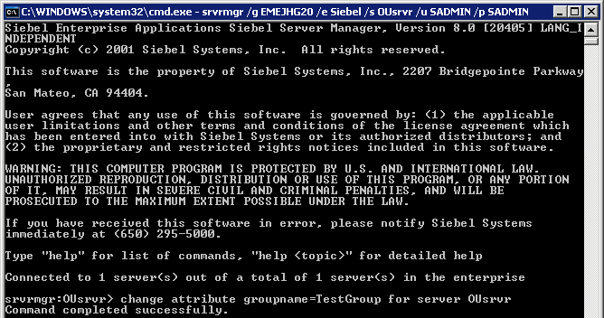
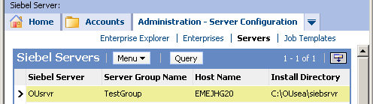
Server Groups
Add servers to a Server Group using the command-line tool:
change attribute groupname=<group name> for server <server name>
Connect to all servers in the group simultaneously:
srvrmgr /g <gateway> /e enterprise /z <group name> /u <user> /p <password>
Performing groupwide manipulations such as changing parameters:
change parameter NotifyHandler=newHandler
  Changes the parameter for all servers in the server group
Adding a server to a server group allows you to manipulate all servers in that group simultaneously from the command line interface

Slide 5
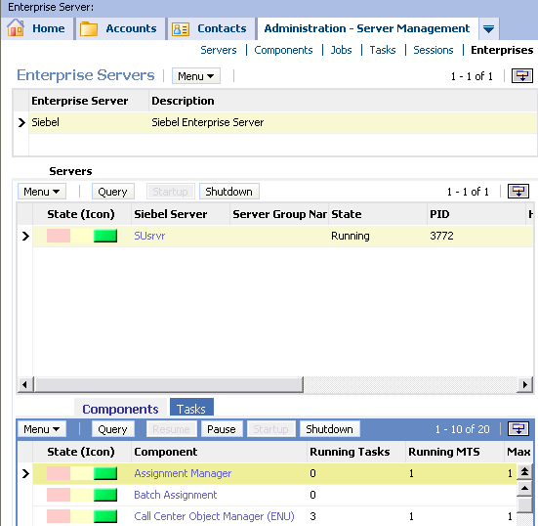
Monitor the Enterprise
Monitor the enterprise from the Administration – Server Management screen
  Provides status icons for servers, components, jobs, tasks, sessions, and the enterprise
Administration – Server Management > Enterprises shows the states of servers and their components within the enterprise

Slide 6
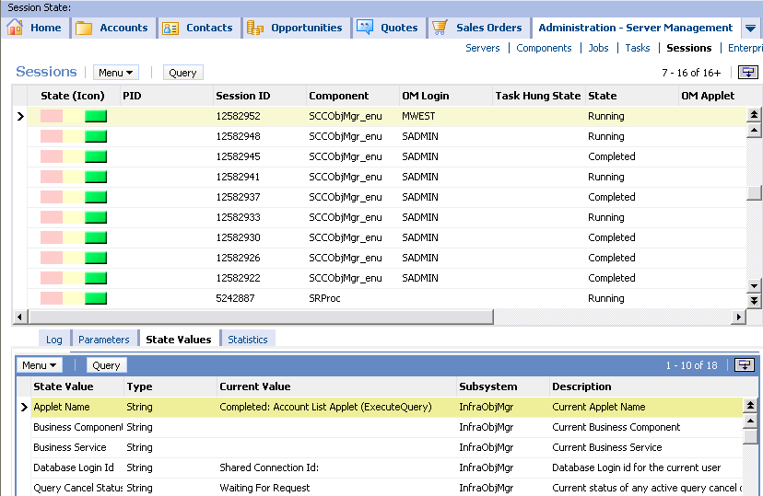
Monitor Sessions
Use the Session Monitor to monitor users logged in and their current activity
  Sessions are tasks running the associated Object Manager
Navigate to Administration – Server Management > Sessions
MWEST is currently logged in to Call Center (SCCObjMgr_enu) and is looking at the Account List Applet

Slide 7
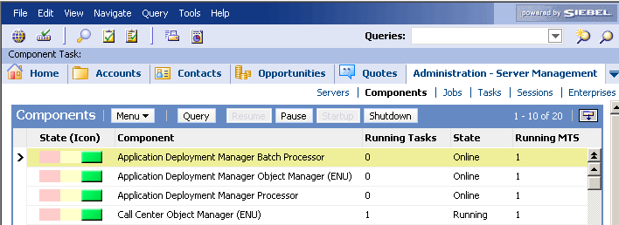
Manage Component States
Manage components across the entire enterprise from the Administration – Server Management > Components screen
Manage components on a particular server from the Administration – Server Management > Servers screen
In either case, components may be paused, resumed, started up, or shut down
Current component state in the enterprise

Slide 8
Component States
Running: The component is available and at least one component task is currently running
Online: The component is available but no component tasks are currently running
Unavailable: The component is unavailable and no component tasks are running
Paused: The component is online but is not accepting new tasks
Shutting Down: The server is shutting down; currently-running tasks will execute to completion, but no new tasks can be run
Shutdown: The server component is shut down

Slide 9
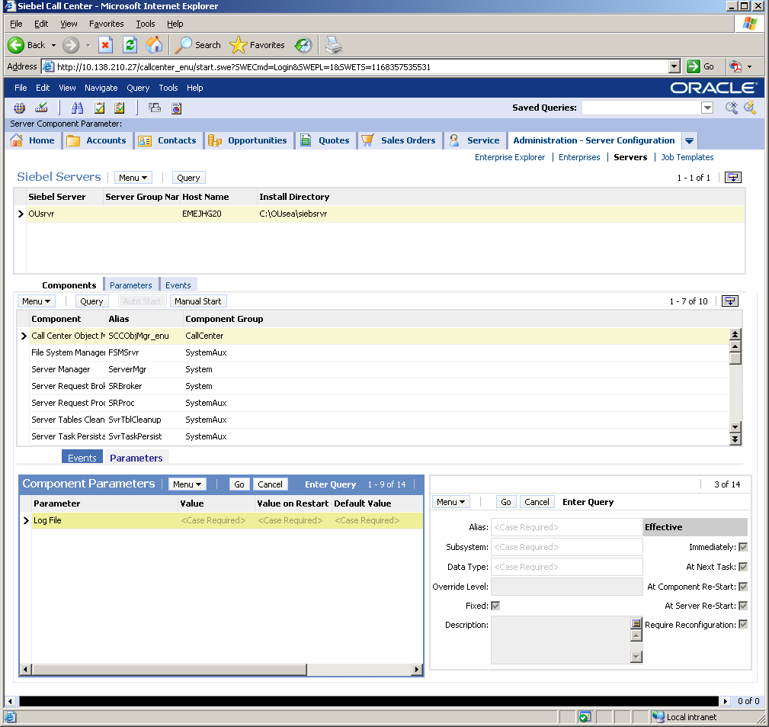
Change Component Parameters
Change component parameters by changing the Value or Value on Restart
Examine the Effective setting to see when the parameter change will become effective
Effective setting indicates when parameter change will become effective

Slide 10
Reconfigure Component Definitions
Modifies component parameters without shutting down the server(s)
  Useful during site migrations or application updates
  Useful when changing multiple parameters and changes should all be performed at once
    For example, when changing both a user name and a password parameter, changing one at a time would lead to authentication issues
During reconfiguration:
  Tasks started before and during reconfiguration continue to run with the old parameters
  Tasks started after the reconfiguration is committed run with the new parameters

Slide 11
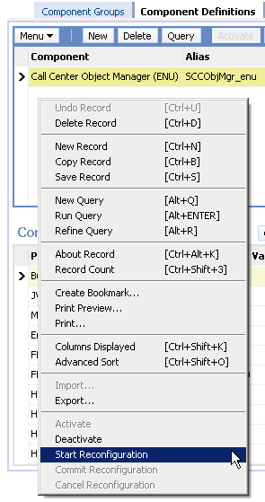
Reconfigure Component Definitions
Reconfigure Component Definitions Continued
From the Administration – Server Configuration > Enterprises screen
Start Reconfiguration:
  Opens existing component parameters for modification
Commit Reconfiguration:
  Commits the updated Component Definition
  All tasks started after the commit run with the new parameters
Cancel Reconfiguration:
  Cancels the current reconfiguration; component definition remains unaltered

Slide 12
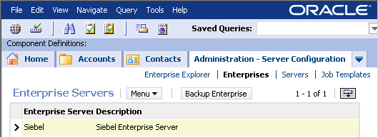
Back Up the Enterprise
Recommended practice: Back up the enterprise after making any configuration changes such as modifying component parameters
  Creates a backup copy of siebns.dat
    siebns.dat stores information about components, parameters, and servers
  May also be used for backup or migration purposes
  Do not try to manually duplicate this file
    File is in use as long as Siebel Gateway Name Server is running

Slide 13
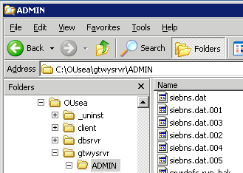
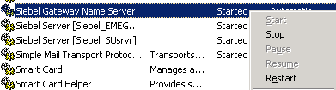
Restore the Enterprise
Restore a previous enterprise configuration with these steps:
  Shut down the Siebel Gateway Name Server and the Siebel Server
  Replace the existing siebns.dat file with a working backup
  Start the Siebel Gateway Name Server and the Siebel Server
1. For Windows, right-click each service and select Stop
2. Restore a backup of siebns.dat to <siebeldir>\gtwysrvr\ADMIN
3. Right-click each service and select Start

Slide 14
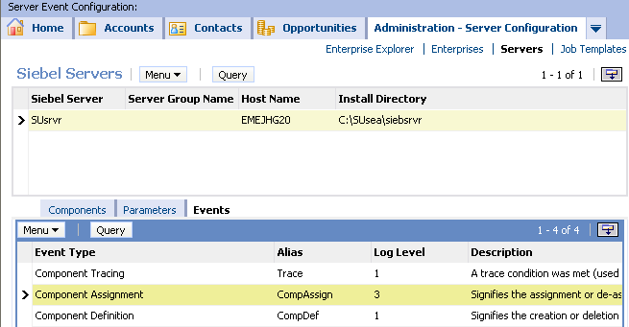
Server Event Logging
Monitor server events by setting their log levels
Navigate to Administration - Server Configuration > Servers > Server Event Configuration
  Set the log level for each Siebel Server event of interest
Select the Siebel Server for which you want to log events
Select the event type you want to
log and enter a logging level from 0 to 5 in the Log Level field

Slide 15
Log Levels
There are six available logging levels for server events:
  0: Fatal
  1: Errors
  2: Warnings
  3: Informational
  4: Details
  5: Diagnostic
Higher log levels generate larger log files and may affect system performance, hence the recommended practice is to only use these levels when troubleshooting

Slide 16
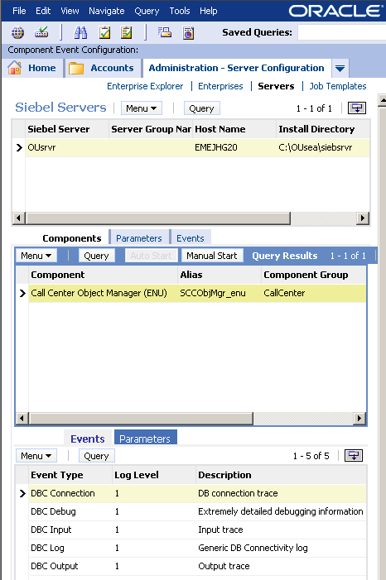
Component Event Logging
Use the Component Event Configuration view to set the log level of component event types
Select the component for which you want to log events
Select the event type you want to
log and enter a logging level in the Log Level field

Slide 17
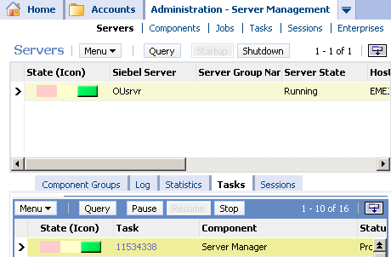
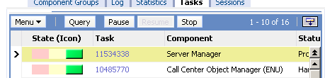
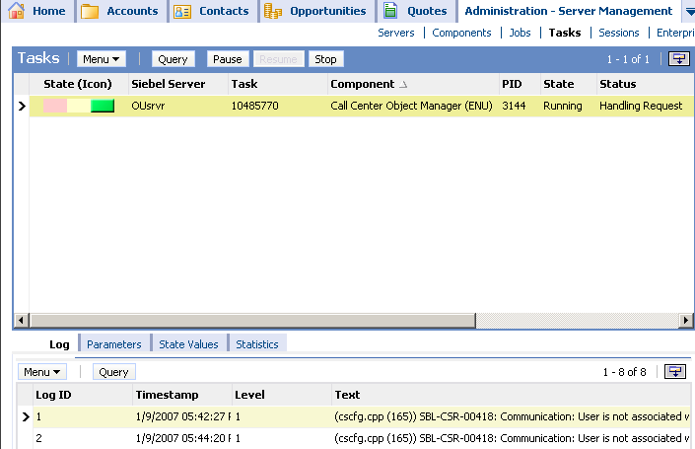
Examine Logs
Each task creates a log of its execution
Drill down on the task number …
… to view the Task Information Log

Slide 18

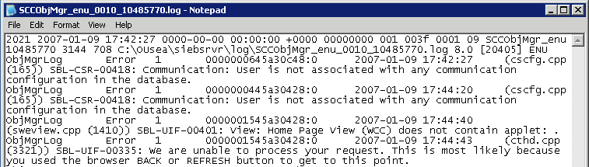
Examine Log Files
View the log file on the Siebel Server
View the log file on the Siebel Server
1. Note the task number
2. Locate the log file in the <Siebel>\siebsrvr\log directory
3. Examine the file

Slide 19
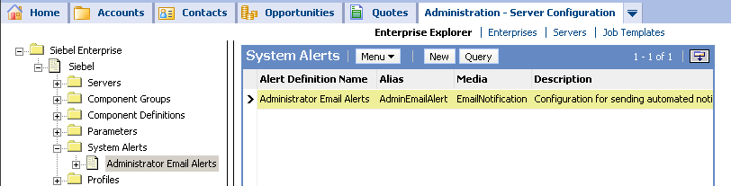
System Alerts
System alerts collect information about the failure of tasks or unavailability of components, and send email alerts to administrators
Examples:
  A component fails to restart
  Critical system throughput thresholds are achieved
Create additional alerts to notify additional individuals or to handle different types of alerts
1. Select System Alerts in Enterprise Explorer
2. Define new system alerts and alert parameters to notify additional individuals or to handle different types of alerts

Slide 20
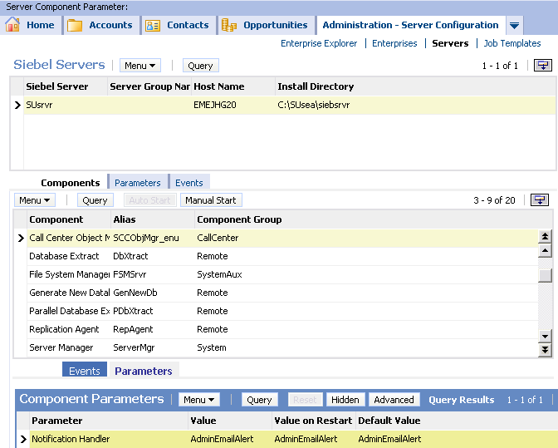
Using System Alerts
To configure a component to use these system alerts:
  Navigate to Administration – Server Configuration > Servers > Components
  Select the component of interest
  Specify the notification handler for that component
    One of the system alert profiles previously created
Notification handler is a parameter for every component that specifies which system alert to use

Slide 21
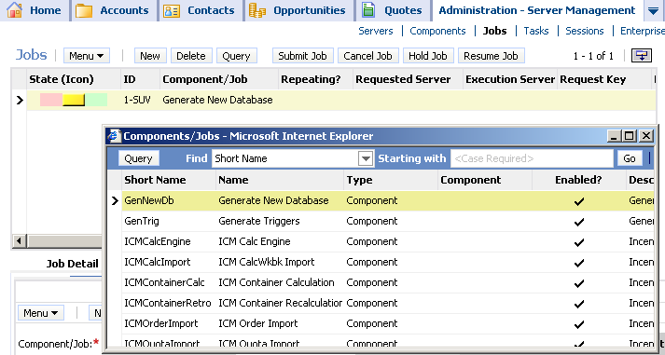

Submit Batch Jobs
Navigate to Administration – Server Management > Jobs
Create a new job or copy an existing job
  Job templates as well as components are listed for new jobs
Both job templates and batch components are listed in the pick applet

Slide 22
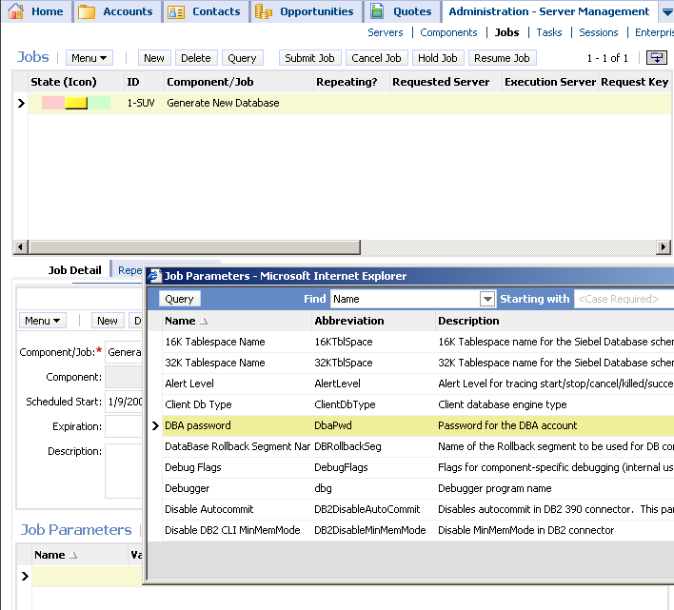

Submit Batch Jobs Continued
Specify job parameters
Optionally, schedule the job to repeat at regular intervals or to run on a preferred server if it is available
Submit the job
Submit the job once all options have been set
Jobs can be set to repeat periodically or to have a preferred server on which to run
Specific parameters depend on the job you are submitting
Create and define job parameters

Slide 23
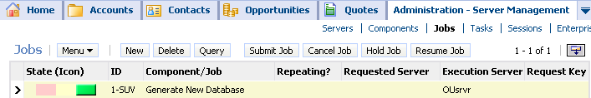
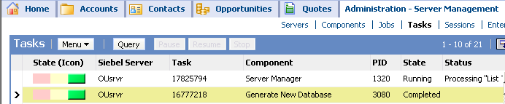
Manage Batch Jobs
Cancel, pause (hold), or resume jobs from the Administration – Server Management > Jobs screen
Monitor the progress of the job from the Administration – Server Management > Tasks screen
Cancel, hold, or resume jobs
Batch job appears as a task in the tasks list

Slide 24
Module Highlights
Monitor the state of the enterprise, servers, components, tasks, jobs, and sessions from the Administration - Server Management screen
Change component parameters
  May require reconfiguring component definitions
Back up the enterprise after changing configurations
Set logging options and system alerts to monitor the system
Submit and monitor batch jobs
Notes:
Review Question: <Question>
Answer: <Answer>

Slide 25
Lab
In the lab you will:
  Perform common administration tasks
Notes:
Labs and Troubleshooting:
<Summarize the tasks the students will perform in this lab. Suggest specific guidance the instructor may provide if necessary to help the students complete the lab and avoid trouble spots.>

