Slide 1

Module 11: Siebel Client Types
0/5
Siebel 8.0 Essentials
Notes:
Time: Lecture: <n – n> minutes; Labs: <n – n> minutes
Intent: <What is the instructional goal of the module>
Flow: < Describe at a high level the overall flow of the module>.
Key Terms: <List terms the instructor should be familiar with in order to teach this module>
<Term>
<Term>
<Term>
<Term>

Slide 2
Module Objectives
After completing this module you should be able to:
  Identify the various Siebel clients
  Describe files associated with each client, including configuration files and local databases
  Describe how each client accesses Siebel servers and data
Why you need to know:
  Not all users will be able to use the Siebel Web Client at all times, hence understanding other client types is essential
Notes:
Each objective and “why you need to know” should be stated aloud.

Slide 3
Business Challenge
Not all Siebel application users have access to the Web at all times
  Some users spend a great deal of time traveling
    Sales representatives
    Executives
    Instructors
Other users may want to access the application using their mobile phones or Personal Digital Assistants (PDAs)
Developers may need to access Siebel data when a Siebel Server or even the entire enterprise is down

Slide 4
Business Solution
Oracle provides five client types for use with the Siebel application:
  Siebel Web Client
  Siebel Wireless Web Client
  Siebel Mobile Web Client
  Siebel Handheld Client
  Siebel Developer Web Client

Slide 5
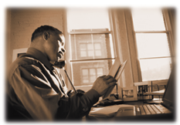
Siebel Web Client Scenario
Wayne is an employee working from home, and connected to his company’s network. He would like to frequently and quickly view and update the activities of his assigned accounts. Since his computer has a browser, but no Siebel software, he types the appropriate URL to access the account data.
Wayne is using the Siebel Web Client

Slide 6

Siebel Web Client
Is a “near zero footprint” client
  Uses only a Web browser and a network connection
  For High Interactivity (HI) clients, includes ActiveX controls so not truly zero-footprint in HI mode
Accesses Siebel Servers through the Web Server running the Siebel Web Server Extension (SWSE)
Accesses Siebel data through an Application Object Manager (OM)
Siebel Web Client
Web Server
Browser
SWSE
Siebel Gateway Name Server
Enterprise
Siebel File System
Siebel Server
Component Parameters
Object Manager
CFG
SRF
Database Server

Slide 7
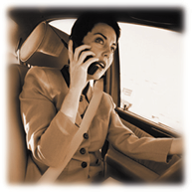
Siebel Wireless Web Client Scenario
Wendy is a salesperson. She has a meeting set up with one of her opportunities. Since she is running late, Wendy uses her Web-enabled phone to retrieve the meeting information from the Siebel database. As an outcome of the meeting, she updates the sales stage of the opportunity.
Wendy is using the Wireless Web Client

Slide 8

Siebel Wireless Web Client
Allows users to read from, write to, and search the Siebel database through a wireless connection between a mobile device and the Siebel Web Server
  Requires a wireless gateway to translate HTTP data generated by Siebel Wireless to Wireless Application Protocol (WAP)
Uses the same logical data model as the Siebel Web Client
  Same business objects, business components, and so forth
Uses wireless-specific applets, screens, and views
  Determined by the Wireless Object Manager
Siebel Wireless Web Client
Wireless Gateway
Web Server
SWSE
Siebel Gateway Name Server
Enterprise
Siebel File System
Siebel Server
Component Parameters
Wireless Object Manager
CFG
SRF
Database Server

Slide 9
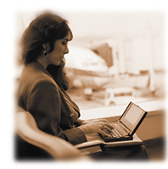
Siebel Mobile Web Client Scenario
Mary is a consultant. She is at the airport waiting for her flight and would like to access contact information for an active opportunity. Since she cannot access the server, she is retrieving this information from a local database on her laptop.
Mary is using the Mobile Web Client

Slide 10

Siebel Mobile Web Client
Is designed to provide full Siebel application functionality without requiring a network connection
  A local executable providing full application functionality must be installed on the client
  This local executable accesses local .cfg and .srf files, and stores its data in a local database and Siebel File System
Directly connects to a designated Siebel Server for synchronization of data and files
Enterprise
Siebel Server
Mobile Client
Synchronization Manager
CFG
SRF
Object Manager
Database Server
Siebel File System

Slide 11
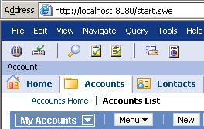
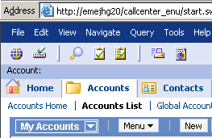
Siebel Mobile Web Client Caveats
Many users mistake the Mobile Web Client for the Web Client
  Application functionality is almost the same, so users forget which is which
To determine which application is running, check the URL
  The Mobile and Developer Web Clients have a port number in the URL, and no application name
  The Web Client usually does not have a port number in the URL, and includes the application name
Mobile Web Client URL has a port number and no application name
Web Client URL has no port number and includes the application name

Slide 12

Siebel Handheld Client
Architecture is similar to the Siebel Mobile Web Client:
  The handheld client includes local database, file system, and configuration files
  The handheld client synchronizes with a specific Siebel server
Architecture is not identical to Siebel Mobile Web Client:
  Only runs on Windows-based mobile devices
  Supports a focused subset of application functionality
    Screens, views, and applets customized for Siebel Handheld
    Applications customized for Siebel Handheld
Enterprise
Siebel Server
Handheld Client
Synchronization Manager
CFG
SRF
Object Manager

Slide 13
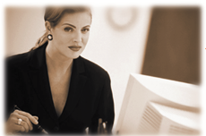
Siebel Developer Web Client Scenario
Dana is a system administrator. She has the client software installed locally because she requires access to the application even when the servers are not available.
Dana is using the Siebel Developer Web Client

Slide 14
Siebel Developer Web Client
Is used by developers and system administrators for direct access to the Siebel database
  Siebel servers do not have to be running
  Does not require a Web server
Is similar to the Siebel Mobile Web client in that:
  A local application must be installed on the client
  Local configuration files must be stored on the client
However, can access any Siebel database and file system, including a local one or the enterprise’s
Enterprise
Dedicated Web Client
CFG
SRF
Siebel Server
Object Manager
Server Components
Database Server
Siebel File System

Slide 15
The Big Picture
The Siebel application supports a mixture of clients, depending on your users’ business requirements
Siebel Wireless Web Client
Wireless
Gateway
Siebel Web Client
Browser
Web Server
SWSE
Enterprise
Dedicated Web Client
Siebel Server
Mobile/Handheld Client
Server Components
Object Manager
Object Manager
Object Manager
Component Parameters
CFG
CFG
SRF
CFG
Database Server
Siebel File System
SRF
SRF

Slide 16
Module Highlights
The Siebel Web Client accesses the Siebel Enterprise and Siebel Servers through a Web server running SWSE
The Siebel Wireless Web Client connects to a WAP-enabled Web server, and is otherwise similar to the Siebel Web Client
The Siebel Mobile Web Client is a local executable that connects to a local database and provides full Siebel application functionality
The Siebel Handheld Client is similar to the Siebel Mobile Web client, but runs on handheld devices
The Siebel Developer Web Client is used by developers and system administrators for direct access to the Siebel database and for development and administrative changes
Notes:
Review Question: <Question>
Answer: <Answer>

Slide 17
In-Class Discussion
Which client is best suited for:
  Disconnected remote users needing access to their data
  A user with a cell phone needing access to his or her data
  Users needing frequent and fast access to their data (easily scalable and maintained)
  Server administrator needing access (to shut down a server component)

Slide 18
Lab
In the lab you will:
  Answer questions about client types
  Use the Developer and Mobile Web Clients
Notes:
Labs and Troubleshooting:
<Summarize the tasks the students will perform in this lab. Suggest specific guidance the instructor may provide if necessary to help the students complete the lab and avoid trouble spots.>

