Slide 1

Module 13: Installing Siebel Applications
0/5
Siebel 8.0 Essentials
Notes:
Time: Lecture: <n – n> minutes; Labs: <n – n> minutes
Intent: <What is the instructional goal of the module>
Flow: < Describe at a high level the overall flow of the module>.
Key Terms: <List terms the instructor should be familiar with in order to teach this module>
<Term>
<Term>
<Term>
<Term>

Slide 2
Module Objectives
After completing this module you should be able to:
  Describe pre-installation steps necessary to prepare your environment for a Siebel installation
  Install the Siebel application
  Perform post-installation steps to verify your Siebel environment
  Describe how to use the multi-server update tool to automate installations
Why you need to know:
  Successful configuration of the Siebel environment requires successful installation
Notes:
Each objective and “why you need to know” should be stated aloud.

Slide 3
Business Challenge: Enterprise Installation
Installing enterprise-level software requires careful planning and preparation
  Hardware and software prerequisites must be met
  Multiple installers must be run in the correct sequence
  Configuration parameters must be properly set before, during, and after installation
  Installation may be required on many machines

Slide 4
Business Solution: Siebel Installation Tools
Siebel provides several tools to assist with the installation of Siebel environments:
  Bookshelf documentation:
    Deployment Planning Guide and System Requirements and Supported Platforms guide to prepare the system
    Installation Guide [Windows or UNIX] to perform the installation
  Step-by-step installers
    Guide you through the installation process itself
  Environment Verification Tool (EVT)
    Performs verification tests on system at any time during the installation to check:
      Prerequisites
      Configuration settings
      Installations
  Siebel Multi-Server Update Tool
    Upgrades multiple server instances from a central administration point

Slide 5
Performing a Successful Installation
Has three separate phases:
  Pre-installation
  Installation
  Verification

Slide 6
Pre-Installation Tasks
0/3
Plan the System Topology
Verify System Requirements
Create Prerequisite Objects
Notes:
This is a structuring slide for <insert what will be discussed>. Do not teach the steps or concepts here because the following slides cover them in detail. Provide a high level description of what will be discussed.

Slide 7

Plan the System Topology
1/3
Identify where software will be installed
  Which machine(s)
    Consider hardware and networking requirements
  What naming convention
  What directory structure
Use the Deployment Planning Guide as an aid
Example:
Siebel Gateway
GS
Enterprise Server
E1
Siebel Server(s)
Web Client
S1
S2
Siebel File System
C1
Web Server
D1
W1
Machine/Host Names/Addresses:
Database Server
C1, GS, S1, D1, W1

Slide 8
Verify System Requirements
2/3
Verify that hardware and software meets Siebel requirements
  Consult the System Requirements and Supported Platforms Guide
  Check the Release Notes for any updates to these requirements
Confirm that required third-party software is installed
  For example, a third-party RDBMS on the database server machine
    Installation Guide has recommendations for RDBMS configuration settings

Slide 9
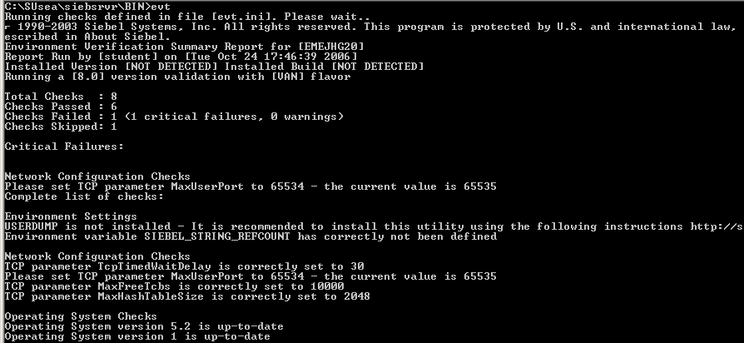
Verify System Requirements Continued
2/3
Optionally, run the Environment Verification Tool (EVT) to verify prerequisites
  Command-line tool for checking environment
  Installed as part of the Siebel Server installation, so it must be copied from another installation to be run prior to server installation
Run EVT with no flags to check the pre-installation environment
Checks system software, network settings, and recommended OS tools, but does not verify RDBMS

Slide 10
Create Prerequisite Objects
3/3
Create the Siebel database
  Install the proper version of your chosen supported RDBMS software
  Create an empty database/tablespace with appropriate space defined
  Consult the platform-appropriate Siebel Installation Guide for recommended database configuration parameter settings
Create the Siebel file system
  Create the Siebel file system as a directory on a disk with sufficient space
    Alternatively, partition the file system across multiple directories and servers
  Must be accessible from machines running Siebel Servers
  Must support long and case-sensitive file names

Slide 11
Create Prerequisite Objects Continued
3/3
Create a Siebel service owner account
  Used to run Enterprise processes and components
    Siebel Gateway Name service
    Siebel Server service
  Name must be consistent across all servers:
    Siebel Gateway Name Server
    Siebel Servers
    Server on which Siebel File System resides
  Recommended practice: On Windows use a domain account rather than separate accounts on each machine
Consult the platform-appropriate Siebel Installation Guide for exact steps and privileges

Slide 12
Installation Tasks
0/6
Create the Installation Image
Install the Enterprise
Configure the Server(s)
Install the Database
Install the Siebel Web Server Extensions
Install Additional Applications
Notes:
This is a structuring slide for <insert what will be discussed>. Do not teach the steps or concepts here because the following slides cover them in detail. Provide a high level description of what will be discussed.

Slide 13
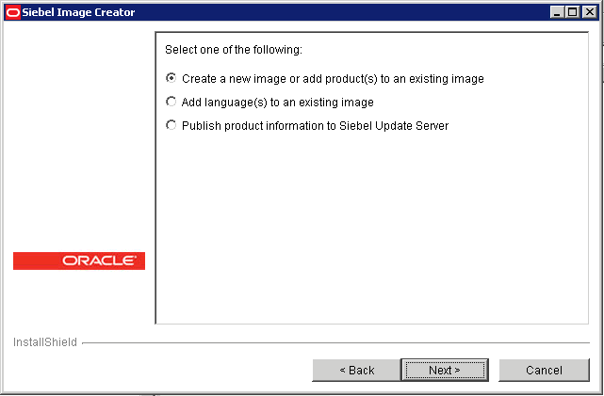
Create the Installation Image
1/6
Run the Siebel Image Creator utility provided on your media to generate an installation image
  Refer to the Siebel Installation Guide for detailed steps

Slide 14
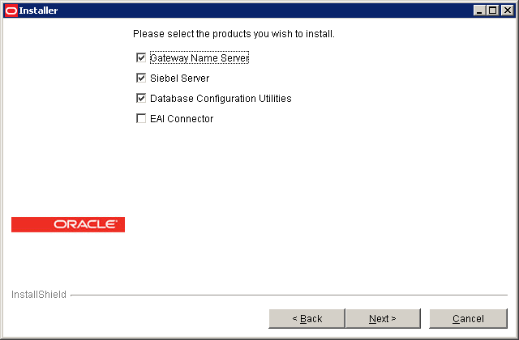
Install the Enterprise
2/6
Use the Siebel Enterprise Server installer to install the Gateway Name Server, Siebel Servers, Database Configuration Utilities, and EAI Connectors
  Each component may be installed separately
  Parameters include the directory name, setup type, and language

Slide 15
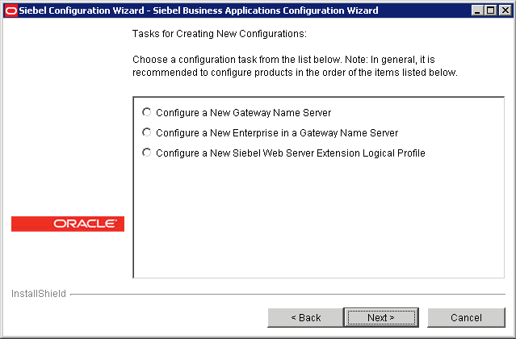
Run Siebel Enterprise Configuration Tool
2/6
Once installation completes, the enterprise configuration tool runs automatically to set system parameters
  Alternatively, run <InstallDir>/gtwysrvr/bin/ssincfgw.exe manually at a later time
Create Gateway Name Server, Enterprise, and Siebel Web Server Extension logical profile

Slide 16
Key Enterprise Configuration Parameters
2/6
To configure a new Gateway Name Server requires:
  Gateway Name Server port, language for server messages and logs, and service account
To configure a new Enterprise requires:
  An existing Siebel Gateway Name Server
  An Enterprise name, Siebel file system, database platform and login information, and security type (database/LDAP/ANSI/custom)
To configure a new Siebel Web Server Extension logical profile requires:
  An existing Siebel Gateway Name Server and Enterprise
  A directory in which to store the profile, network configuration parameters such as HTTP and HTTPS ports, High Interactivity and Standard Interactivity default login names, and an Enterprise security token

Slide 17
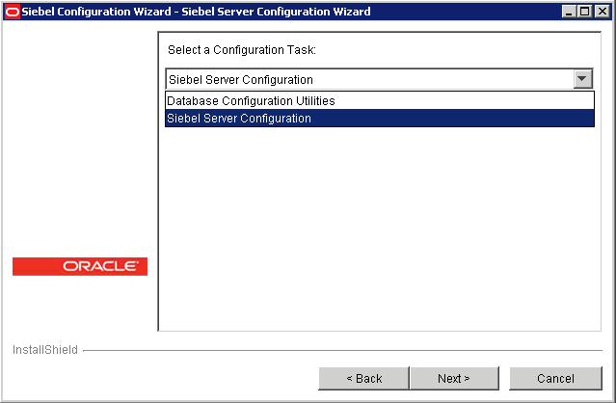
Configure the Server(s)
3/6
Once enterprise configuration completes, the server configuration tool runs automatically to set system parameters
  Alternatively, run <InstallDir>/siebsrvr/bin/ssincfgw.exe manually at a later time
Configure a Siebel Server

Slide 18
Key Server Configuration Parameters
3/6
Configuring a new Siebel Server requires:
  An existing Gateway Name Server and Enterprise
  The Siebel Server name
  Which component groups to enable on that server
  The language for server messages
  The languages to deploy
  Various port settings, including:
    The connection broker port, used by the Siebel Web Server Extensions and other server components for communication
    The Siebel Remote Synchronization Manager port
    The database connection port
  Server clustering information

Slide 19
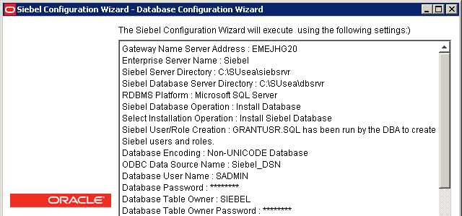
Install the Database
4/6
Run grantusr.sql in the dbsrvr/<RDBMS> directory on the database created during pre-installation
Manually run the database configuration utility and install a new database
  Creates appropriate schema and populates database with seed data
  Optionally, enter license key during database initialization

Slide 20
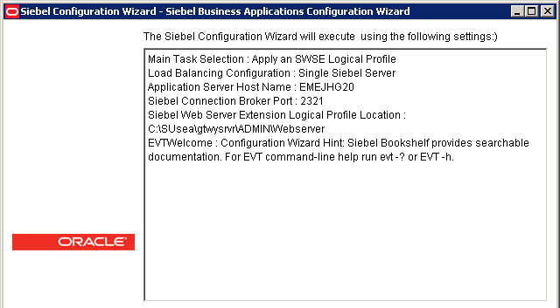
Install the Siebel Web Server Extensions
5/6
Use the SWSE installer to install the Siebel Web Server Extension on the machine hosting the Web server
  The Siebel Enterprise Server must already have been run to generate the Enterprise-specific SWSE profile
  Specify parameters, including load-balancing strategy for multi-server installations and connection broker port
Specify load balancing for multiple servers: Siebel native load balancing (supported by the SWSE) or third-party load balancing

Slide 21
Install Additional Applications
6/6
Install the Siebel Mobile or Siebel Developer Web clients on individual user machines
  Both applications use the Siebel Web Client installer
Install Siebel Tools on development machines
(Optional) Install the Sample database on development machines
  Pre-populated database allowing testing of configuration changes
(Optional) Install Siebel Management Server to support the Application Deployment Manager (ADM) or Diagnostic Console
(Optional) Install Siebel Update Server and clients to support multi-server updates

Slide 22
Verification Tasks
0/4
Check Installation Logs
Verify Services
Run EVT
Log In to Applications
Notes:
This is a structuring slide for <insert what will be discussed>. Do not teach the steps or concepts here because the following slides cover them in detail. Provide a high level description of what will be discussed.

Slide 23
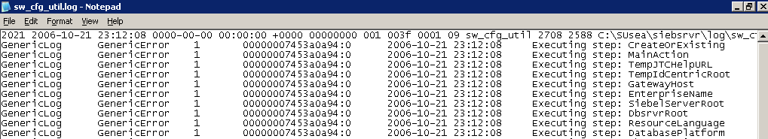
Check Installation Logs
1/4
Every step of configuration generates a log file:
  Siebel Gateway Name Server configuration log is /gtwysrvr/log/sw_cfg_util.log
  Siebel Server configuration log is /siebsrvr/log/sw_cfg_util.log
  Siebel Web Server Extention configuration log is /SWEApp/log/sw_cfg_util.log
Check these logs for severe or fatal errors
Informational messages are listed as GenericErrors with a severity level of 1

Slide 24
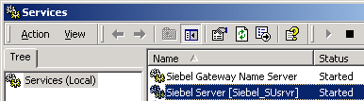
Verify Services
2/4
Verify that the Siebel Gateway Name Server service is running
Verify that the Siebel Server services are running on each machine hosting a server
In this instance the Siebel Gateway Name Server and Siebel Server are co-located

Slide 25
Run EVT
3/4
Use the Environment Verification Tool to check the status of your enterprise
  Tool reads evt.ini file to determine what checks to perform
  Tool supports checking Siebel Gateway Name Server, Siebel Server, Siebel Web Server Extension, third-party Web server, and third-party database
  Output can be text, text file, HTML, or HTML file
  For complete details on using the EVT, see your platform-specific Installation Guide

Slide 26

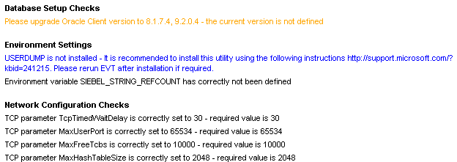
EVT Example
3/4
The following example runs the EVT with the default options and outputs the results to output.html
The –o flag specifies the output file format
The output is color-coded for readability

Slide 27
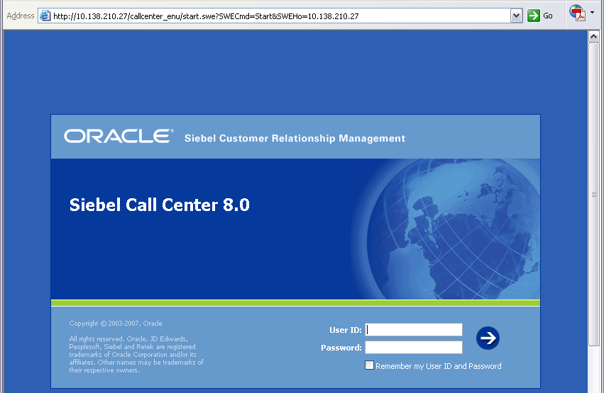
Log In to Applications
4/4
Log in to the Siebel application to confirm connectivity to the Web server and Siebel server
Web server address
Application
SWE command appended to the URL by the application’s default Web page

Slide 28
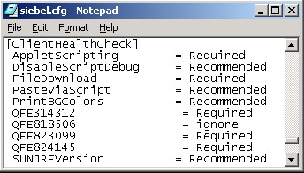
Browser Health Check
4/4
Is a utility that runs on the browser to verify that it is properly configured for High Interactivity
  Runs when the Web client is invoked if it is enabled in the [SWE] section of siebel.cfg
Checks the client environment on which the Siebel application is running
  Internet options
  Java setting
  Environment/registry settings
Performs checks using
values set in the application
configuration file
  Each check can have
  one of the following values
    Required
    Recommended
    Ignore
Set values in the [clientHealthCheck] section of the configuration file

Slide 29
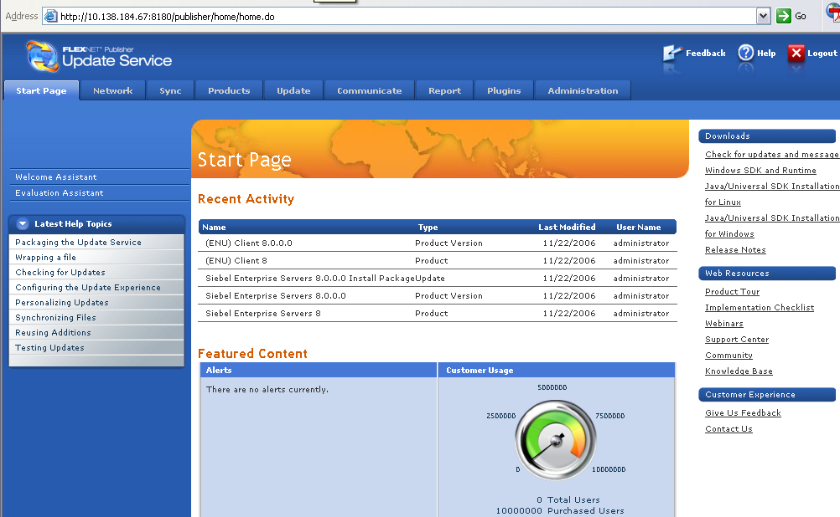
Multi-Server Updates
The Siebel Update Server provides a single administration point for patching and updating multiple Siebel servers
Allows quick monitoring of each server’s current patch level
Supports both push and pull models of software updates
  Administrator can send updates out to all servers (push)
  Servers can periodically query the update server for updates (pull)
Siebel Update Server provides a centralized administration point for managing updates on Siebel servers

Slide 30
Siebel Update Server
Is a Web-based installation tool based on Macrovision Installshield
  Uses a Tomcat/JSP Web server on the Update Server
  Includes a local database on the Update Server for storing all product information across an enterprise
Currently supports server updates and patches
  Gateway Name Server, Siebel Enterprise, Siebel Server, Siebel Web Server Extension, and so forth

Slide 31


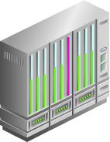
Siebel Update Server Architecture
A single update server provides a central access point to multiple clients
  Siebel Update Server software is installed on server
  Siebel Update Client software is installed on each client
    Clients have other Siebel software installed, such as Siebel Server or Siebel Web Server Extension
Clients are Siebel Servers or Siebel Web Servers
Cloudscape
Database
Update Server includes Tomcat Web server and local database
Siebel Update Server
Siebel Update Clients

Slide 32

Siebel Update Server Functionality
Clients register current software information on server
  Currently installed software and version information
  Stored in database on server
Administrator publishes product update information to server
  Location of update, version information, and so forth
Clients register current product information on server
Update server stores client and update information in database
Administrator publishes product information to server

Slide 33
Siebel Update Server Functionality Continued
Administrator may select client machines and schedule updates for them (push method)
Clients may check for updates and download them when it is convenient (pull method)
Administrator may choose which clients to update
Client may manually check for updates (pull)
As clients are updated, their information is updated in the database
Administrator may push updates to clients

Slide 34
Module Highlights
Installing Siebel applications is a three-step process:
  Perform pre-installation tasks
  Perform software installations
  Perform post-installation tasks
Pre-installation tasks include planning the topology, verifying prerequisites, and creating required objects such as the Siebel database
Software installations require multiple installers, which guide you through the installation process step-by-step and automatically run the appropriate configuration tools
Post-installation tasks include checking the installation logs, checking the services, running the EVT, and logging in to the application
Siebel Update Server supports multi-server updates
Notes:
Review Question: <Question>
Answer: <Answer>

