Slide 1

Module 14: Siebel Application Architecture
0/5
Siebel 8.0 Essentials
Notes:
Time: Lecture: 25 – 35 minutes; lab: 20 – 25 minutes
Intent: To introduce the major types of object definitions in the Siebel repository and the relationships between them.
Flow: The role of object definitions in specifying an application; object definitions that specify the data storage; object definitions that specify the business logic; and object definitions that specify the UI.
Key Terms:
Object Manager
SRF
Object definitions
Application Architecture
Data layer object definitions
Metadata
Business Component
Business Object
UI Object Definitions (application, screen, views, applets, list column/control)

Slide 2
Module Objectives
After completing this module you should be able to:
  Describe the major types of object definitions
  Describe the relationships between them
Why you need to know:
  Enables you to explore an existing application effectively
  Provides the foundation you need to configure the object definitions that form the basis of an application
Notes:
Each objective and “why you need to know” should be stated aloud.

Slide 3
The Siebel Application Architecture
Recall that the Siebel Application consists of:
  An execution engine that provides the application behavior
    The Siebel Server(s); more specifically, their components
  Configuration files and the Siebel Gateway Name Server that specify operating parameters for the execution engine
    Most configuration parameters are stored in the Gateway Name Server
  A relational database that stores user data
  A set of physical User Interface (UI) files that specify how to render the UI in the user’s
  A Siebel Repository File (SRF) containing compiled object definitions
Notes:
Object Definitions Within An Application
Siebel applications include UI files, configuration files and a repository file.
The object manager hosts a Siebel application, providing the central processing for HTTP transactions, database data, and metadata: object definitions in the repository that are relevant to the current state of the Siebel application.
These object definitions are stored in the SRF and will be discussed in this module.
Note On Reading Diagram: this diagram uses a “mind map” format. With this format you read the originating entity, the causal link, and then the receiving entity. For example:
SRF → supplies object definitions to → Object Manager.
The focus of this diagram is that applications draw their configuration information from three sources: UI files, cfg files and the SRF. In this module, and for most of the remainder of this course, we will be focusing on object definitions in the SRF.
Note: the primary point of this slide and the next slide is to provide a description of where objects are defined within the overall Siebel Application and where those definitions are inputs to the application. Objects are defined and stored in the SRF. They are not defined nor stored in the configuration file, the database, the UI files, or the user interface. The definitions do provide input to the object manager, which then uses them to organize data from the database and present them to the UI for display.

Slide 4
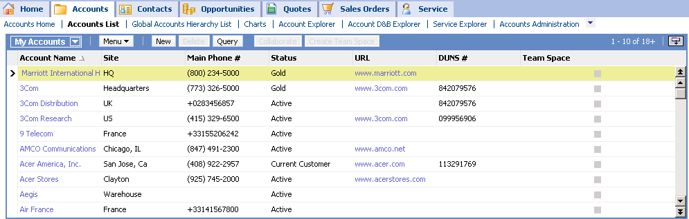
The Siebel Application Architecture Continued
Object definitions are created, modified, and stored in special tables in the database and compiled to the SRF
Siebel Application
User Interface
No object definitions here
  Siebel template files
  Cascading style sheets
  Image files
Generates
Shape the UI via
Supplies compiled object definitions to
UI files
Object Manager
Specifies parameters to
Object definitions compiled to here
Serves data to
SRF
.cfg
Object definitions stored here
Database Server
Siebel Repository File
Configuration File
Notes:
Object Definitions Within An Application
Siebel applications include UI files, configuration files and a repository file.
The object manager hosts a Siebel application, providing the central processing for HTTP transactions, database data, and metadata: object definitions in the repository that are relevant to the current state of the Siebel application.
These object definitions are stored in the SRF and will be discussed in this module.
Note On Reading Diagram: this diagram uses a “mind map” format. With this format you read the originating entity, the causal link, and then the receiving entity. For example:
SRF → supplies object definitions to → Object Manager.
The focus of this diagram is that applications draw their configuration information from three sources: UI files, cfg files and the SRF. In this module, and for most of the remainder of this course, we will be focusing on object definitions in the SRF.
Note: the primary point of this slide and the next slide is to provide a description of where objects are defined within the overall Siebel Application and where those definitions are inputs to the application. Objects are defined and stored in the SRF. They are not defined nor stored in the configuration file, the database, the UI files, or the user interface. The definitions do provide input to the object manager, which then uses them to organize data from the database and present them to the UI for display.

Slide 5
Siebel Repository File (SRF)
Contains compiled object definitions that specify:
  Presentation of data
  Business logic
  Physical table storage
UI layer definitions
Account
Account
Business layer definitions
Opportunity
Product
Contact
Data layer definitions
Notes:
Here we see a little more detailed picture of how object definitions provide input to the three layers of the application architecture, namely the data definition layer, business layer, and UI layer. In a moment we’ll take a closer look at these layers.
Right now, notice that the repository file contains the object definitions, and these object definitions are used to specify the presentation of data, the business logic, and how data is stored.
Recall that there are three distinct layers to a Siebel application. Now is the time to tie these layers to the idea of object definitions.
In a moment, we’ll see examples of the types of object definitions that reside in each of the layers.
Note that the SRF is the compiled version of repository objects. These objects are in an un-compiled state in the database.

Slide 6
Object Definitions
Provide the foundation for application execution
Are grouped in three layers with different purposes
Refer to definitions in the next lower layer
Siebel Application Architecture
UI
Layer
List Column
or Control
Applet
View
Screen
Application
Business
Layer
Field
Business
Component
Business
Object
1 or many
Column
Table
References
Data
Layer
Notes:
Siebel object definitions are metadata that define Siebel applications. Siebel object definitions implement the user interface, business entities, and database organization. You can see examples of these objects in the 10 box diagram: applets, views, business components, tables, etc.
The User Interface Layer consists of the UI object definitions for physical files, templates, style sheets, and other file-based metadata that render the UI. Definitions for these interface object definitions define the visual interface that the user sees and interacts with in a Web browser.
The Business Layer consists of object definitions that define business logic and organize data from underlying tables into logical units.
The Data Layer consists of object definitions that directly map the data structures from the underlying relational database into Siebel applications, providing access to those structures by object definitions in the Business Objects layer.
Object definitions for all three layers reside in the SRF.
In this diagram we see how objects in one layer reference objects in the layer below it. For example, a view references one, and only one, business object. An applet references one, and only one, business component, and that business component references one or more tables. And a list column or control references one and only one field. A field references one column in a table.
General Processing: Relational database management in Siebel applications is implemented through the layers of Siebel object definitions. The Siebel applications generate queries in response to user actions at the UI layer. The RDBMS holds the data, and processes the queries originating in the Siebel application. Query results that are returned from the RDBMS are processed up through the relevant object definitions in the Siebel applications architecture, through the business layer, and presented to the user at the UI layer.
(CONTINUED, NEXT PAGE)

Slide 7
Data Layer
Data layer object definitions specify the logical structure of the physical database
  Definitions are metadata, not data
In the Data layer, there are two principal data object definitions:
  Table definitions
  Column definitions
Table
S_ORDER
ORDER_NUM
DISCNT_PERCENT
STATUS_CD
Columns
Notes:
Now lets take a closer look at The data layer, which consists of tables and columns.
Tables
A table object definition is the direct representation of a database table in a DBMS. It has column and index object definitions that directly represent the table’s columns and indexes.
Columns
A column object definition represents one column in the database table. Each column in the physical table has a corresponding column object definition in the Siebel data layer (metadata) table.
Note: the 10 box diagram is included here and on subsequent slides as a learning tool to help you navigate the application architecture as its components are introduced. The white boxes indicate the topic currently under discussion.

Slide 8
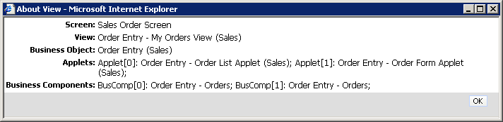
Business Layer
Business object definitions specify the business logic for the application
In the Business layer, there are two principal objects:
  Business component
  Business object
Business object
Business component
Notes:
The business layer is composed of business objects that reference multiple business components, and business components that reference multiple fields.
A business component provides a way to group data according to business logic, such as various product data (name, part #, product version), and is the data source for applets.
A business object groups related business components together. For example, the account business object might include business components that contain quote data, product data and contact information.
A field object definition typically associates a column with a business component. Fields are also referenced by controls and list columns in the Web interface.

Slide 9
Business Component (BC)
Represents one fundamental business entity in the enterprise
  For example: Service Request, Contact, Activity
Represents a logical grouping of data from one or more tables
Refers to a base table
Consists of multiple fields that characterize the business component
  Many fields within the business component reference columns in the base table
Order Entry - Orders
Business component
Order Number
Discount
Status
Field
Base table
S_ORDER
Column
ORDER_NUM
DISCNT_PERCENT
STATUS_CD
Notes:
How many of you have used the classic entity-relationship diagram (ERD)? In those diagrams the concept of entity is used to describe items that are usually recognizable concepts, either concrete or abstract, such as persons, places, things or events which have relevance to the database. For example, employees, projects, invoices, and opportunities. In Siebel, we call these business components.
Any given business component refers to a single base table. The Internal Product BC refers to the S_PROD_INT base table.
Any given field in a business component maps to one, and only one, column in a table.
Note
Exception to the rule: while this statement holds true in most cases, there are a few instances where some calculated fields map to zero columns or multiple columns. Therefore, strictly speaking, any non-calculated single value field in a business component that isn't virtual maps to one, and only one, column in a table. However, from a learning perspective, it is more important to focus on the rule rather than the exception when first exposed to a new concept. Exceptions are best presented later in the context in which they apply.

Slide 10
Business Component Continued
Can include data from additional related tables
  Some fields map to columns in these related tables
Order Entry - Orders
Business component
Order Number
Account
Opportunity
Field
Column
ORDER_NUM
LOC
NAME
S_ORDER
S_ORG_EXT
S_OPTY
Base table
Additional
tables
Notes:
A business component can be thought of as a virtual database table spanning multiple real tables. It organizes the data in the way the user chooses to view the data, rather than by how it is organized for effective data storage.
So, a business component can include data from other tables, allowing the business component to be a logical grouping of data from multiple tables. For example, when querying for a product, the user may need to know vendor location and cost information. The business component feature of Siebel addresses the user’s need to know this information by bringing data into the business component from other tables in the data model.
This is the key to understanding why business components are so powerful. They can be adjusted, adapted or created to meet a wide range of information display requirements.

Slide 11
Business Object (BO)
Is a collection of related Business components (BCs)
Represents a major functional area of the enterprise
  For example, order management
Contains specific details about the relationships between BCs
  One BC is the master or driving BC
  Organizes related business components
Order Entry
Order Entry
- Orders
Parent BC provides focus for BO
Business Object (BO)
Business Component (BC)
Action
Quote
Payments
Notes:
However, the business component doesn’t address the need for context. For example, if you’re viewing a record for a fireworks company called Kaboom, when you drill down on the contacts for that record you only want to see contacts associated with Kaboom, not all the records for all contacts in the database. Business objects provide a way to narrow the records displayed.
The business object is a collection of related business components in which one serves as the master or primary while the others are the related child components.
The relationship between the master and child component (indicated by the line connecting the grey boxes in the slide) is also an important part of the business object. It is called a link, and will be clarified later.
The name of the business object is, by convention, the name of the master or driving business component.
In this example, we can see the business object is Account, and the master business component is also Account. The master business component provides most of the data that is displayed via the business object. Other business components, called child business components, are also brought into the hierarchy, as needed.
DEMO: consider doing a very quick demo to show how data gets focused when drilling down, say on an Account.
Note
Exception to the rule: “Has one BC that’s the master or driving business component” does not address the fact that screen home pages have several unrelated BC's, with no links to each other. As noted earlier, from a learning perspective, it is more important to focus on the rule rather than the exception when first exposed to a new concept. Exceptions are best presented later in the context in which they apply.

Slide 12
Comparing Business Components and Business Objects
Business Objects provide focus to views and organize BCs
Business Components provide data to applets and control data manipulation in tables
Business Component
Business Object
Applet
View
Provide data
Provide focus
Field
Business
Component
Business
Object
Business
Component
Business
Object
Control data manipulation
Table
Details relationships between BCs
Organizes BCs
Notes:
To avoid confusion between business components and business objects, think about a business object as a container that is used to organize business components around a fundamental entity, such as an account, opportunity, or contact. Its also used to focus data display in the UI.
Think about business components as a way not only to control data manipulation at the physical layer, but also as a way to organize data for useful display in applets. For example, the Account business component organizes all the fields required to render a useful account applet, such as account name, address, the industry the account is in, what territories it covers, etc.
In summary, business components provide a way to organize data around an entity, such as Contacts (each contact record has a Name field, an address field, etc.). Business objects provide a way to focus that data around the context in which the data is being viewed, such as contact data for Kaboom Inc (each contact record displayed when viewed via Kaboom is specific to Kaboom Inc. The data is focused on Kaboom. Contacts for other companies that exist in the database are excluded from display).
Recall: meta-data is definitional data that provides information about other data.

Slide 13
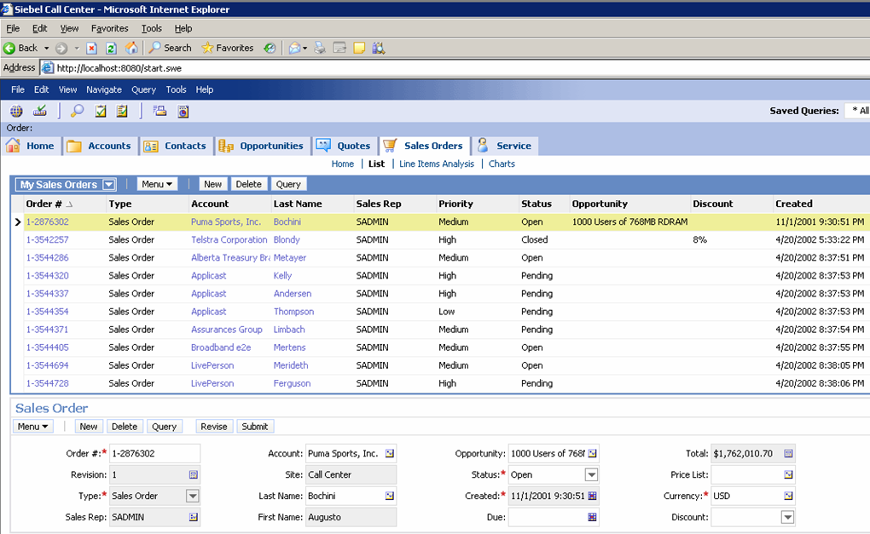
UI Object Definitions
There are five principal UI objects within the user interface
1. Application
2. Screen
4. Applet
3. View
5. List Column or Control
Notes:
The UI layer consists of physical files, such as templates, Siebel tags, style sheets, and other file-based metadata. These control the layout and look and feel of the user interface.
User interface objects expose data from the business layer and provide users with controls that allow them to navigate, view, and modify data. For example, there are five principal UI objects:
Application
Screen
View
Applet
List Column/Control
Note: this is a structuring slide. Do not teach what the various objects are at this point.

Slide 14
Control and List Column Object Definitions
Provide the ability to display and manipulate data
This column displays data in a columnar list
This control displays data in a field via a form
Notes:
Let’s take a closer look at each object definition type that exists at the UI layer.
Each applet contains, within it, multiple list columns and controls. Each column and control references a field in a business component.
Controls are child objects of Applets. They are user interface elements such as fields, text boxes, check boxes, and buttons. They allow users to interact with the application and with data.
In form applets, controls implement fields.
List columns are child objects of the List object type. List columns correspond to columns in a scrolling list table in a list applet, and to fields in the business component.

Slide 15
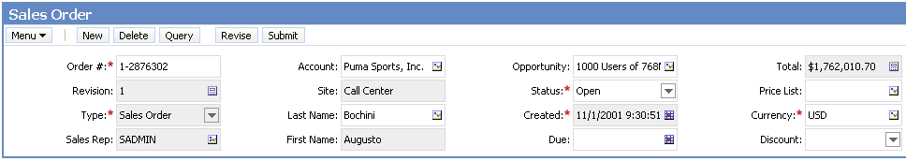
Applet Object Definition
A section of a view, such as a list or form
References one business component whose data can be viewed and edited through the list or form
Consists of list column or textbox control object definitions
  Refer to fields in the applet-referenced business component
  Specify how the data for the fields is displayed in the list or form
Order Entry - Orders
Business component
Order Number
Account
Opportunity
Notes:
Applets display business graphics, provide a navigation tree, or appear as pop-up windows. Applets are composed of controls, such as buttons and fields, that allow users to interact with data.
An applet contains controls and columns that, in turn, reference fields in the referenced business component. That means if you want to see some data in an applet, then there must be a field in the referenced business component.

Slide 16
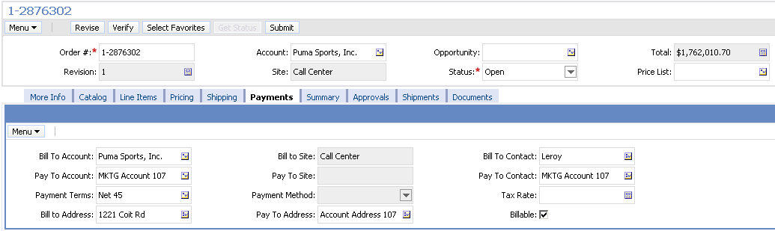
View Object Definition
Specifies a view in a Siebel application
Contains multiple applet object definitions
View
Order Entry – My Orders View (Sales)
View references one BO
Applet references one BC
BO
Order Entry
Order Entry
- Orders
Action
Quote
Payments
BC
Notes:
A view is associated with the data and relationships in a single business object. For example, the view in the slide references one, and only one, business object, called Account.
Each applet in the view references a business component that is referenced within the business object. The nature of the relationship between the parent and child BC determines the nature of the relationship between the applets. For example, the Payments BC in the slide will only display records related to the parent BC, Order Entry.

Slide 17
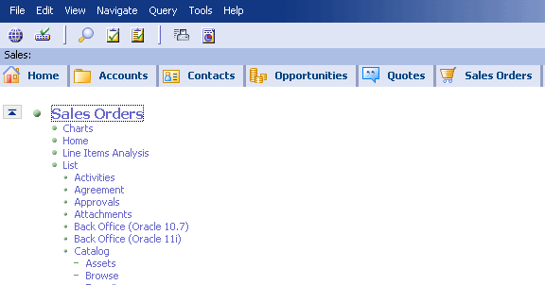
Screen Object Definition
Specifies a screen in a Siebel application
  Is associated with a major functional area of the enterprise
Contains multiple view object definitions that usually refer to the same business object
  Administration screens are an exception
Screens
Same screen
Views in that screen
Notes:
A screen is a collection of related views. Screens are associated with major functional areas of the enterprise, such as Accounts, Contacts, and Opportunities. In general, all views in a screen reference the same business object.
You access screens through Screen Tabs or Site Map.
Screen object definitions specify the default view that appears when a tab is clicked.
Screens are useful navigational tools. They group views together to enable users to quickly access the data they require by navigating to an area of functionality and be taken to the appropriate view.
Note: technically, the drilldown takes you to a view but the view may be in a different screen. Therefore, you can also navigate to a screen implicitly via drilldown. This is an exception to the rule.

Slide 18
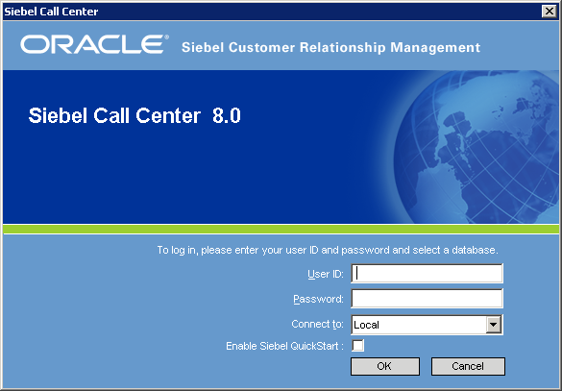
Application Object Definition
Specifies a particular collection of screens available in a Siebel application
Application
Notes:
An application is a collection of screens. In the lab, as an independent activity, you might experiment with starting different applications (Sales, Service, Call Center) as SADMIN and determine if the same sets of screens are displayed. (They will not, even though SADMIN has the same responsibility, because these are different applications, and the object definitions for the various applications differ.)
Applications are typically accessible from a URL specific to that application, e.g., Mobile Web Client applications are accessible from shortcuts in the Windows Start menu.
Any given organization may have licensed more than one Siebel application (for example, Siebel Sales and Siebel Call Center) to be used by different groups (for example, the sales team and the customer support team) within the organization. In that situation, one can install Siebel Sales and Siebel Call Center as separate applications, or as a single application in which different views are established for the relevant responsibilities of the two groups using them.

Slide 19
Configuring Siebel Applications
Is accomplished by using:
  An HTML editor to modify template and other physical UI files
  Siebel Tools to modify object definitions
Configurable Layers
Physical UI Files
Use an HTML editor to modify template
UI Object Definitions
Business Object Definitions
Use Siebel Tools to modify object definitions
Data Object Definitions
Notes:
Siebel applications are configured with two tools: an HTML editor and Siebel Tools.
The physical UI files are modified with an HTML editor of your choice.
Definitions for the metadata objects we studied in this module, at the UI, business logic and data layers, are all modified using Siebel Tools, an integrated development environment (IDE). In the next module, you’ll be introduced to Siebel Tools.

Slide 20
Module Highlights
Siebel architecture uses object definitions that specify application behavior
Use Siebel Tools to:
  Create, store, and modify object definitions in the database
  Compile object definitions into the SRF for more efficient run-time access
Object definitions are grouped into three layers:
  UI Layer
    Includes applications, screens, views, applets and list columns/controls
  Business Layer
    Includes business objects and business components
  Data Layer
    Includes tables and columns
Notes:
Review Question: What are the different layers of object definitions?
Review Question: What is the purpose of each of the layers?
Review Question: Is there a direct relationship between the UI and Data layers?
Answer: No, the relationship is indirect through business objects and business components.

Slide 21
Lab
In the lab you will:
  Examine how UI layer object definitions reference business layer object definitions
Notes:
See lab instructions for details.
If students encounter memory problems with their PCs during this or the following labs, advise them to stop the Gateway Server and Siebel Server. These servers are not needed for the labs related to the Exploring and Configuration sections.
However, remind the students to restart the servers after the Configuration section.

