Slide 1

Module 15: Using Siebel Tools to Examine Object Definitions
0/5
Siebel 8.0 Essentials
Notes:
Time: Lecture: 20 – 30 minutes; lab: 25 – 30 minutes
Intent: To use Siebel Tools to examine object definitions in the repository.
Flow: A definition of major concepts; the Siebel Tools user interface; viewing object definitions; navigation techniques; and search repository.
Key Terms:
Integrated Development Environment (IDE)
Declarative configuration tool
Object Explorer
Object List Editor
Object
Property
Object definition
Siebel Tools User Interface
Properties Window
Parent/Child Object Definitions
Flat Tab

Slide 2
Module Objectives
After completing this module you should be able to:
  Describe the differences between object types and object definitions
  Use Siebel Tools to examine parent and child object definitions
Why you need to know:
  Enables you to configure Siebel applications effectively
  Enables you to examine mappings that support bulk data transfer
Notes:
Each objective and “why you need to know” should be stated aloud.

Slide 3
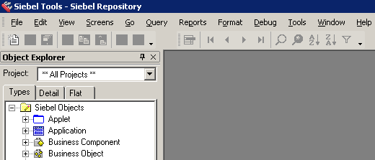
Siebel Tools
Is an Integrated Development Environment (IDE)
Is a declarative configuration tool
  Is used to create and modify object definitions (metadata) that define Siebel applications
    Set properties for objects that control behavior
    No need to modify source code or write SQL
Configure objects instead of writing code
Notes:
Siebel Tools is an integrated environment for configuring Siebel applications. Today, the term "IDE" is a contrast to unrelated command-line tools, such as vi, emacs, or make. While one could think of Unix as an IDE, most developers think of an IDE as being (or having the appearance of) a single program in which all development is done.
You use Siebel Tools to modify standard Siebel objects and create new objects to meet your organization’s business requirements. For example, you use Siebel Tools to extend the data model, modify business logic, and define the user interface.
Siebel Tools allows you to develop a single configuration that can be:
■ Deployed across multiple types of clients
■ Used to support multiple Siebel applications and languages
■ Easily maintained
■ Automatically upgraded to future Siebel product releases
Siebel Tools is a declarative configuration tool, not a programming environment. You use Siebel Tools to create and modify the object definitions (metadata) that define Siebel applications. You do not
modify the source code or directly write SQL. A declarative environment uses constraint programming and, to a lesser degree, logic programming, which focus on describing the properties of the desired solution (the what), leaving unspecified the actual algorithm that should be used to find that solution (the how).
NOTE: In the context of Siebel applications, the terms object and object definition are not equivalent to the terms “object,” “object class,” or “object instance” as they are used in the context of
programming languages such as C++.

Slide 4
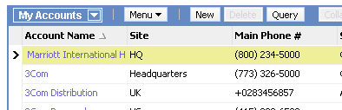
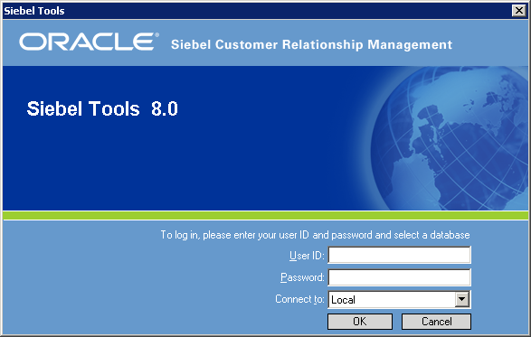
Object Definitions
Are metadata that define elements of the user interface, business logic, and data storage
Are stored in the Siebel Repository, a subset of tables in the Siebel database
Are examined, created, and edited using Siebel Tools
Are compiled into the repository file for a configured application
Configured application
Tools output is input for object manager
Object Manager
SRF
Repository Data
Siebel Repository File

Slide 5
Object Definition
Consists of a set of properties with assigned values
Is created from a template called an object type
Object Type
Object Definition
View
Name:
Title:
Inactive:
View
Name: Account List View
Title: My Accounts
Inactive: FALSE
Template with empty properties
Object with values in properties
Notes:
Object definitions consist of properties, which are characteristics of the software construct that the object implements. For example, the properties of a view include its name, title and whether its inactive or active.
This slide defines object definitions and object types. An object type is a construct with a set of properties and an object definition is an instance of the construct with specific values for one or more of the properties.
Some examples of object types are applets, views, and screens. An object definition example would be properties associated to an applet.
Refer to the student note for definitions of object terminology and object definition properties. Stress that property values are case-sensitive and that spaces do count.

Slide 6
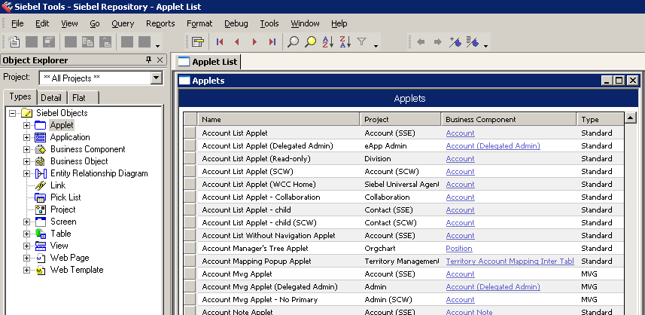
Examining Object Definitions
Use the Object List Editor (OBLE) to display object definitions
  Select an object type in the Object Explorer (OE)
  Object definitions appear in the Object List Editor
OBLE
OE
Object
property
Object definition
Notes:
This slide shows how to use Siebel Tools to examine definitions. Point out that Siebel Tools is similar to other Siebel applications (for instance it has applets that display records), but that the UI is very different. Siebel Tools is deployed only as a dedicated client. You can query and edit records as you do in a standard Siebel application.
You might consider demonstrating Tools before you start talking about this slide. You can show the class how the list editor works, bring up the Properties window, and show them how to navigate from parent to child object definitions. You can also demonstrate how to drill down on the business component on which the applet is based (although this is covered in more detail in a later slide).

Slide 7
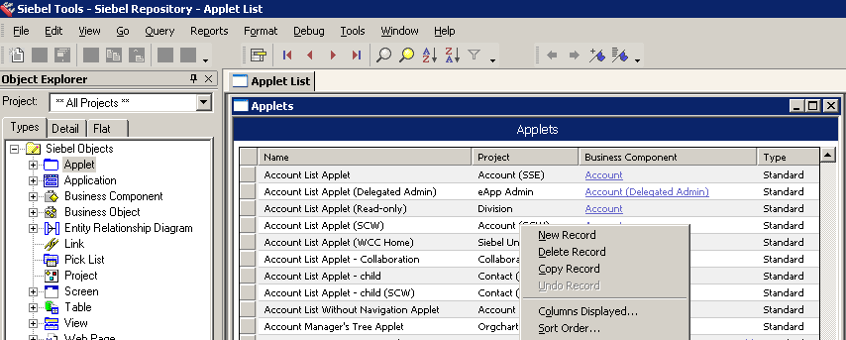
Siebel Tools User Interface
Differs from the client application
Has toolbar icons for common user operations
Record navigation
Query
Sort
Menu invoked by right-clicking object definition
Notes:
This slide highlights some of the major ways in which the Siebel Tools UI differs from the Web client UI. You might mention that the high-interactivity Web client does implement some of these features (such as implicit saves), but they are universally available in the Web clients.
Stress the fact that records are automatically saved when you step off the record, and there is no explicit save command for object definitions. Also stress that the record will not be saved until you step off the record.

Slide 8
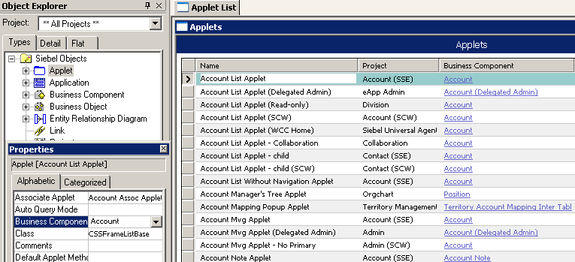
Properties Window
Displays the properties for the object definition selected in the OBLE
  Select View > Windows > Properties Window
  Properties are listed in alphabetical order
  The value is shown next to property name
OBLE
Properties window
Same value
Does not show Changed or Project properties
Notes:
The Properties window is an alternative to the Object List Editor (OBLE) to examine object definitions. Note that this window does not show either the Changed or Project properties.
The Properties window can either float freely on the screen or be docked in one of the corners. You can toggle between these modes by double-clicking the Properties window title bar. Consider demonstrating this.

Slide 9
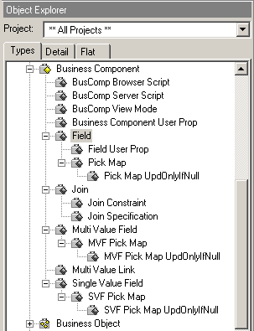
Hierarchy of Object Types
Some object types contain child object types
  For instance, Field is a child object type of the Business Component object type
Object explorer displays hierarchy
Multiple hierarchy levels
Notes:
Object types can have child object types. The Object Explorer behaves very much like a regular explorer applet in the way you navigate up and down the hierarchy.

Slide 10
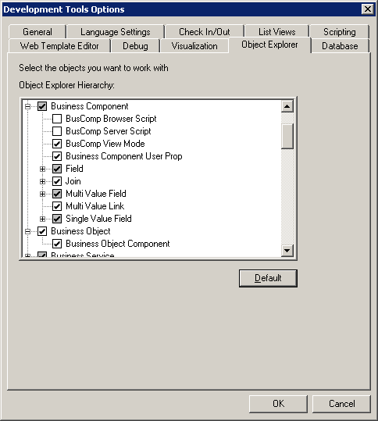
Object Explorer
Displays by default a small set of the most commonly used object types
  Select View > Options and click the Object Explorer tab to add or remove object types from the Object Explorer
Some options displayed
All options displayed
Notes:
Object definitions have hierarchical relationships called parent-child relationships. For example, when you expand an object, such as Business Component, in the Siebel Tools Object Explorer you see child objects, including, for example, Field, Join, and Multi Value Field.
The user can select the set of object types to be displayed in the object explorer. Mention that the default setting displays the most common object types, but that students will need to add other object types to the Object Explorer later in the course. Also, point out that they can restore the initial set anytime by clicking the Default button.
Position this as one of a series of usability features that make it easier for users to locate the object definitions they need to examine and edit.

Slide 11
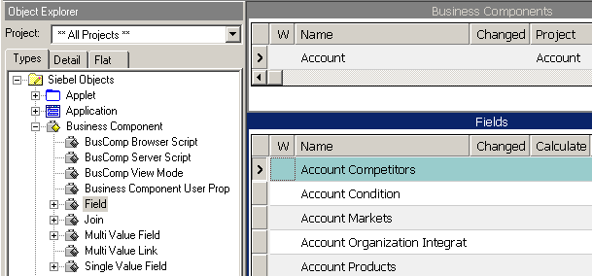
Viewing Parent/Child Object Definitions
Select object types and definitions alternately to examine child object definitions
Use the
Types tab
1. Expand the parent object type (BC) in the OE
2. Select the parent object definition in the OBLE
3. Select the desired child object type (Field) in the OE
4. View child object definitions for the selected parent definition in the lower pane of the OBLE

Slide 12
Additional Navigation Techniques
0/3
Hyperlinks
Back and Forward Buttons
Bookmarks
Notes:
This slide introduces three additional techniques to assist users when navigating in Siebel Tools.
This is a structuring slide. Do not teach the steps or concepts here, because the following slides cover them in detail.

Slide 13
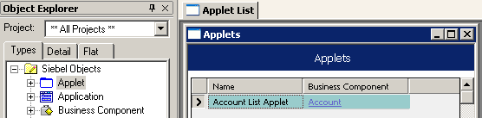
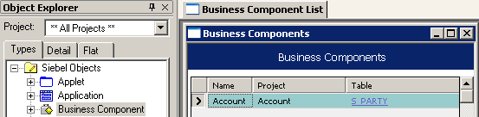
Hyperlinks
1/3
Drill down on a hyperlink to navigate to that object definition
  For example, applet to business component
  For example, business component to table
Underlined in blue
Notes:
A number of properties have drilldowns (hyperlinks) enabled to allow users to navigate easily from one object definition to a related one. Consider demonstrating this feature by selecting an applet and drilling down on the Business Component property and then drilling down on the Table property.

Slide 14
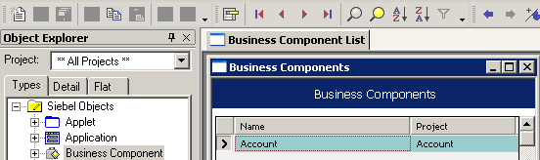
Back and Forward Buttons
2/3
Use the Back button to return to the object definition last examined
Use the Forward button to return to the current object definition
Notes:
The Back and Forward buttons are another feature designed to make navigating easier. Use caution when demonstrating this, because you may not always return to the exact previously selected object definition.
Note the recommendation in the student note to use the bookmark feature to help with navigation. Bookmarks are discussed in greater detail on the next slide.

Slide 15
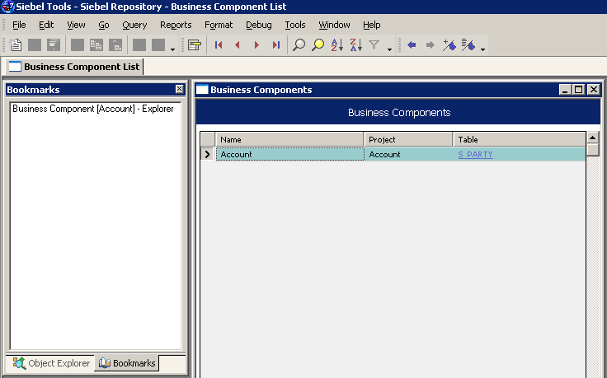
Bookmarks
3/3
Use bookmarks to navigate directly to a specific object definition
Add a new bookmark
Display or hide bookmark window
Select desired bookmark from bookmarks window
Notes:
Bookmarks function like predefined queries and provide a very easy and quick way to get any specific object definition. Users can choose to leave the Bookmarks window open all the time (it can either be docked or free-floating), or they can close it and bring it up whenever they need by clicking the Display Bookmark icon.

Slide 16
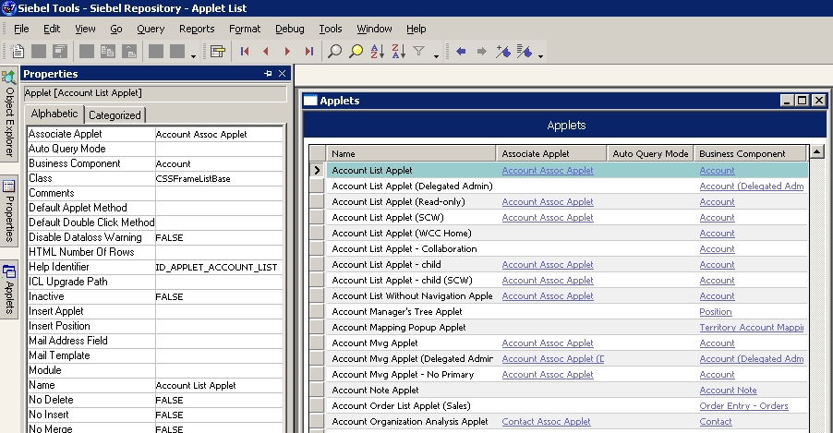
Window Navigation
Use dockable windows and tabs for frequently-accessed tools such as the Properties window
Undock windows to resize and place
Window tabs
Autohide
Minimize, maximize, close
Autohide docking windows
Notes:
Bookmarks function like predefined queries and provide a very easy and quick way to get any specific object definition. Users can choose to leave the Bookmarks window open all the time (it can either be docked or free-floating), or they can close it and bring it up whenever they need by clicking the Display Bookmark icon.

Slide 17
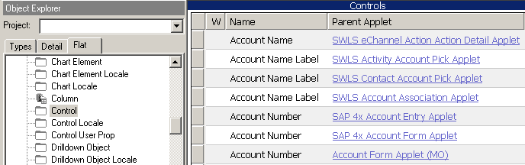
Object Explorer: Flat Tab
Removes all hierarchy and shows all object types in a single list
Helps developers:
  Find a child object with an unknown parent
  See how object definitions and properties are typically used
Select any object type in the OE
Parent object definition
displayed (parent applet for the control)
Notes:
Use the flat tab to show all object types in a single list irrespective of hierarchy. The slide gives a couple of cases where this is very helpful. We do not mention the Detail tab anymore since we never use it. If students ask about it, explain that it interweaves the object definitions for a given object with the object types in the hierarchy, but that it is not a particularly useful representation, especially given the size of the current repository.
Detail Tab: If you select the Detail tab of the Object Explorer and expand an object type, all the objects of that type appear in the Object Explorer. If you select an object type in the Detail tab, the Object List Editor displays all the objects of that type.

Slide 18
Module Highlights
Siebel Tools is a declarative configuration tool
Object definitions consist of a set of properties with assigned values
  Are created from a template called an object type
The Object Explorer (OE) lists object types
Object definitions appear in the Object List Editor (OBLE)
Properties Window displays the object definition selected in the OBLE
Flat tab removes all hierarchy and shows all object types in a single list
Notes:
Review Question: What is the difference between an object type and object definition?
Review Question: Where do you find each in Siebel Tools?
Review Question: Where are two places you can examine or edit object definitions?
Answer: The Object List Editor and the Properties window

Slide 19
Lab
In the lab you will:
  Use Siebel Tools to examine object definitions in the Siebel repository
  Tools navigation convention used in the labs
  Select Business Component :: Account | Field :: Account Role
Parent Record in OBLE
Child Record in OBLE
Parent Object Type in OE
Child Object Type in OE
Notes:
See lab instructions for details.
Labs and Troubleshooting: It takes a while for students to become comfortable with navigating from the OE to the OBLE and back to find a parent or child object definition. Make sure they understand the concept and also the notation (shown on the slide) that we use in the configuration labs.

