Slide 1

Module 16: The Siebel Data Model
0/5
Siebel 8.0 Essentials
Notes:
Time: Lecture: 35 to 40 minutes; Lab: 30 – 35 minutes
Intent: To introduce the Siebel data model, which defines the database schema.
Flow: The Siebel data model; tables; primary keys; types of tables; columns; user key; index; foreign keys; intersection tables; and extension tables.
Key Terms:
Tables
Columns
Primary Key
ROW_ID
Seven Prominent Data Tables
Column Properties
System Columns
User Keys
Indexes
1:M Relationships
Foreign Key Table Columns
M:M Relationships
1:1 Extension Table
1:M Extension Table

Slide 2
Module Objectives
After completing this module you should be able to:
  Describe the purpose of the Siebel Data Model
  Describe the role of primary and foreign keys, indexes, and user keys
  Identify prominent tables in the Siebel Data Model
Why you need to know:
  Enables you to understand how data is accessed in existing Siebel applications
  Enables you to understand how to map your business logic to the Siebel Data Model
  Enables you to configure the Data layer as necessary for your implementation
Notes:
Each objective and “why you need to know” should be stated aloud.

Slide 3
The Siebel Data Model
Defines how the data used by Siebel applications is stored in a standard third-party relational database
  Specifies the tables and relationships
Is designed to support the data requirements across Siebel applications
Field
Business
Component
Business
Object
Defines business logic
Defines data storage organization (makes up the data model)
Column
Table
Notes:
This slide explains what we mean by the data model. The Siebel Data Model is the as-delivered database schema installed as part of the database server configuration.
The data model is the predefined table and column structure into which the Siebel application will store your CRM data. You can modify the data model by extending a table or creating additional tables. However, the Siebel recommended best practice is to thoroughly examine the data model before making changes so that you do not reinvent the wheel; many, many data relationships have already been created for you. This module will explain how to investigate the Siebel Data Model.
Data Model for Vertical Applications The Siebel Data Model has been extended for some industry applications to incorporate additional tables and columns specific to the industry application.

Slide 4
Siebel Data
Is organized and stored in normalized tables in a relational database
  Each table has multiple columns storing atomic data (single-value, cannot be logically further sub-divided)
  The data schema is organized to eliminate repeated storage of data
Table
S_PROD_INT
ROW_ID
NAME
PART_NUM
UOM_CD
Columns (store single values only)
Notes:
This slide introduces the idea that Siebel data is stored in normalized tables. Normalized data means that a data value—for example, a phone number—is stored in only one location in the database, eliminating duplicate data and streamlining data maintenance.
For example, we may want to include the account phone number in the contact business component and all the contacts at that account will display the same phone number. However, we do not want to store that phone number in each individual contact record. Rather, we choose to store it in one place in the account record.
Point out the diagram notation for tables in this course.
Note: in this case, “normalized” refers to the basic, underlying database schema. While there may be some denormalization designed into the schema to address performance issues, such as in intersection and index tables, the general database schema is normalized. For example, Siebel does not store large amounts of account data in an opportunity record, or contact data in an account record. Rather, separate entities exist in the schema, with PK/FK used between entities to establish relationships.

Slide 5
Primary Key (PK)
Is a column that uniquely identifies each row in a table
  ROW_ID serves as the primary key for Siebel tables
S_PROD_INT
Primary key
ROW_ID
NAME
PART_NUM
UOM_CD
Notes:
The slide highlights the role that ROW_ID plays in the Siebel Data Model. Note: Every table must have a primary key.
Since the module has not yet covered the different types of tables and columns, do not try to explain the exceptions to the class at this point.
Consider drawing a diagram on the board to illustrate what some sample data would look like in a table with the ROW_ID filled in. The important point is that in a relational database, a data record is retrieved by its reference key, or primary key. In Siebel applications that key is always stored in the ROW_ID column of any data table.
Note: There are a small number of data tables (fewer than 10) for which another column is designated as the primary key (for example, the LANG_CD column in the S_LANG table). However, this fact adds unnecessary complication to the slide since almost all tables use ROW_ID.

Slide 6
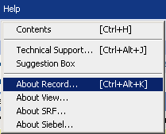
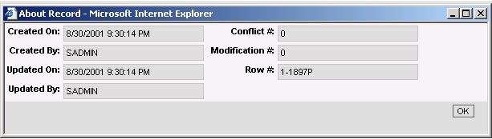
ROW_ID
Is a column in every table
  Contains a Siebel application-generated identifier that is unique across all tables and mobile users
Is managed by Siebel applications and must not be modified by users
Is viewed by right-clicking the record or navigating to Help > About Record
Notes:
This slide conveys the idea that the ROW_ID must be unique. It is generated by a Siebel-proprietary algorithm that ensures uniqueness across all tables, and not just a single table. Stress to the class that users must never edit or create ROW_IDs directly.
A caveat: In most cases ROW_ID is unique not only within a table, but across most tables. There are some exceptions. ROW_ID in _X tables are the same as in the parent table. ROW_ID is not unique for one-to-one extension tables in general. For example, S_PARTY, S_CONTACT, S_USER, S_EMP_PER share ROW_ID's. Be aware of this, but do not mention it here since they do not know what an _X table is.
The graphic illustrates how to access record data, such as Row number, by selecting Help > About Record.

Slide 7
Understanding the Data Model
0/6
Tables
Columns
User Keys
Indexes
Relationships Between Tables
Extension Tables
Notes:
This is a structuring slide. Do not teach the steps or concepts here because the following slides cover them in detail. Provide a high-level description of what will be discussed

Slide 8
Tables
1/6
Approximately 3,000 tables in the database
Three major types: Data, Interface, and Repository
Data
Interface
Repository
S_PROD_INT
EIM_PROD_INT
S_TABLE
ROW_ID
UOM_CD
ROW_ID
ALIAS
NAME
PART_NUM
NAME
DESC_TEXT
ROW_ID
TYPE
NAME
PART_NUM
UOM_CD
This module is focused on data tables
Notes:
This slide explains that there are many tables in the data model and that they fall into three major types that are of interest to us. Be aware that there are some other table types. Do not teach the various table types here; wait for the following slides.

Slide 9
Data Tables
1/6
Store the user data
  Business data
  Administrative data
  Seed data
Are populated and updated by:
  Users through the Siebel applications
  Server processes such as: Enterprise Integration Manager (EIM) and Assignment Manager
Have names prefixed with S_
Are documented in the Siebel Data Model Reference
Notes:
This slide explains data tables. Consider giving a quick demo of each type:
Seed Data: data in S_LST_OF_VAL
Administrative Data: Responsibilities in S_RESP, Price Lists in S_PRI_LST
Business Data: defer to the next slide
The Data Model Reference is not provided automatically with the product. Students should talk to their sales representatives on how best to obtain this document.
Note: example administrative data objects include Employee, Division, List of Values, Position, Responsibility
Note: The default Siebel application contains some built-in seed data, such as organization, division, position, responsibility, and employee records. You can use this seed data for training or testing, or as templates for the real data that you enter. For more information on seed data, including descriptions of seed data records, see Security Guide for Siebel Business Applications.

Slide 10
Seven Prominent Data Tables
1/6
Store data for the major business entities
Opportunity
Service Request
Contact
S_OPTY
S_SRV_REQ
S_CONTACT
ROW_ID
LAST_NAME
FST_NAME
ROW_ID
MID_NAME
SR_NUM
DESC_TEXT
ASGN_DT
ROW_ID
LAST_UPD
NAME
BDGT_AMT
PROG_NAME
STG_NAME
Asset
Account
Activity
Internal Product
S_ASSET
S_ORG_EXT
S_EVT_ACT
S_PROD_INT
ROW_ID
NAME
ASSET_NUM
SERIAL_NUM
MFG_DT
ROW_ID
DESC_TEXT
DEPT_NUM
DIVISION
EMP_COUNT
ROW_ID
ACTIVITY_UID
TODO_CD
PROJ_ID
OPTY_ID
ROW_ID
NAME
PART_NUM
ORDER_CST
PROD_CD
Notes:
This slide shows the tables for some of the major business entities. Point out that students need to know the names of these important tables.
Customer or Business data includes objects that contain data specific to your business enviroment. Example objects include Account, Competitor, Contact, Forecast Series, Household, Marketing Event/Activity, Opportunity, Order, Partner, Product Defect, Project, Quote, Service Request, User List

Slide 11
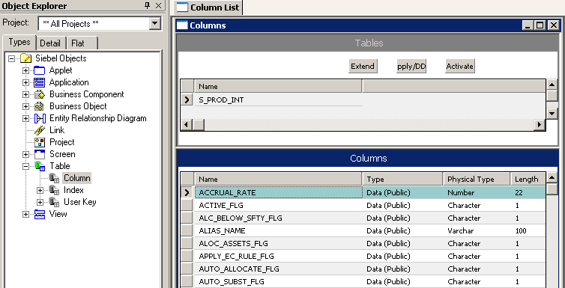
Columns
2/6
Each table has multiple columns to store user and system data
  Defined by Column child object definitions
Columns determine the data that can be stored in that table
Notes:
This slide introduces the concept of columns and how to examine columns for a given table.

Slide 12
Column Properties
2/6
Determine size and type of data that can be stored in column
Limit proposed modifications to a standard application
Do not edit existing properties
Identifies data type and size
Notes:
This slide identifies a set of significant properties for columns. They should not be edited for existing tables and columns, but we will need to define them when we create new columns and tables.
Make a clear statement to the DBAs (database administrators) in the room about how changes to the database schema are made only through Tools, and never using SQL directly against the database.

Slide 13
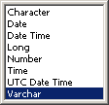
Data Type and Length Properties
2/6
Physical Type identifies the type of data to be stored
Length determines the maximum size
Notes:
Physical Type (Physical Type Name). Identifies the data type of the column in the database.
The following data types are supported:
Character. Used for fixed-length text. Also used for Boolean columns, which are character columns with a length of 1. By default, you cannot have char greater than 1. The default setting can be changed: Set the preference in View > Options > Database.
NOTE: Defining a Column as a Char when the data being stored in the column is variable in length will cause the data to be padded with blank spaces in the database. It is recommend that you use the varchar data type for all but Boolean columns implemented as CHAR(1).
Long. Long text. You can store approximately 16K worth of data in long columns.
Varchar. Variable-length text. Used for memo-type fields and to store row-ID and foreign key values. Used for most alphanumeric columns in the Siebel data model including ROW_ID, foreign key, LOV, and other free-form text columns.
Number. Any numeric data. Typical numeric columns in Siebel applications are 22,7 for general-purpose numbers, and 10,0 for integers. Data of this type is limited to 16 digits without a decimal point or 15 digits before a decimal
point.
UTC Date Time. Time is saved in Greenwich mean time.
Date. Date values only, without time.
Date Time. Combined date and time values in the same column.
Time. Time values only, without the date.

Slide 14
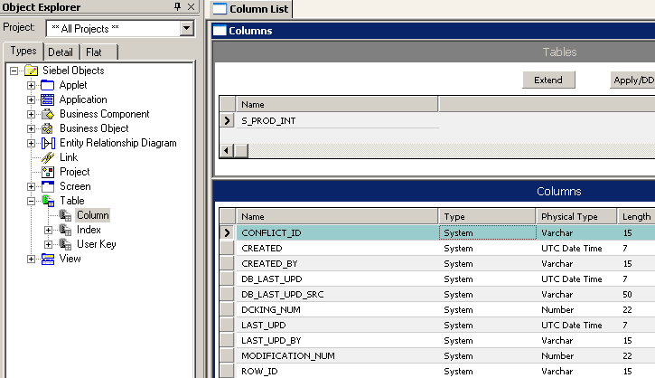
System Columns
2/6
Exist for all tables to store system data
Are maintained by Siebel applications and tasks
System columns
Notes:
System columns appear in all tables in Siebel applications, although the same set of system columns does not appear in every table. You can use the data in system columns for various purposes; for example, the ROW_ID column in tables is used in the construction of “joins”, covered later in this training.
Generally you should not modify the data in system columns.
This is a good place for a demo: Show About Record in the application, and the System Column query in Tools.

Slide 15
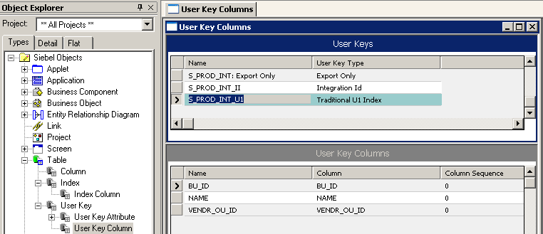
User Keys
3/6
Are used to determine the uniqueness of records when entering, importing, or integrating data
Are predefined and cannot be changed
Column Combination provides a unique value
All columns in user key may not be required
Notes:
A user key specifies columns that must contain unique sets of values. In industry, the user key is also sometimes called a compound key or composite key.
A user key is designated by the name of its parent table with an _Un suffix, such as S_PROD_INT_U1.
Each user key has User Key Column child objects that specify the table columns that must have unique values, for example BU_ID, NAME, and VENDR_OU_ID in the S_PROD_INT_U1 user key.
This slide introduces the user key which specifies that one or more columns must contain a unique set of values. Again be aware that not all columns in a user key are required columns. That means that users can enter records with null values in those columns. Different databases treat nulls differently. SQL Anywhere views each null as different and unique. It may allow apparent duplicate records (with a null in user key column) to be entered.
This is a good place for a diagram showing the User Key columns on a common table with sample data written in. (S_ORG_EXT is an easy one; it uses Name, Location, and Org.) Explain how a user key has to be a unique combination of values, not a unique value individually. A record with the combination of values IBM-TX-North American Org is not the same as a record for IBM-Tokyo-Asia Pacific Org; some values are the same, but the combination is unique. This is how a Siebel application does duplicate checking. If another record for IBM-Tokyo-Asia Pacific Org. is entered, the user will be notified that a record with those values already exists.

Slide 16
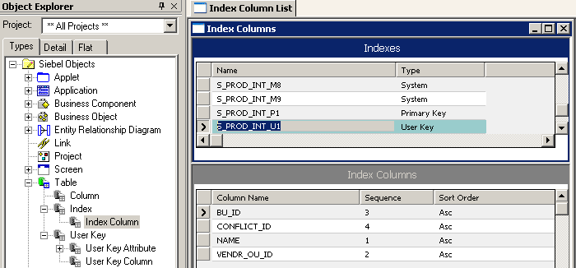
Indexes
4/6
Are a separate data structure that stores a data value for a column and a pointer to the corresponding row
  Used to retrieve and sort data rapidly
Are predefined by Siebel as a set of standard indexes
_P index based on primary key
_U index based on user key
Sequence affects sort order
Notes:
An index object definition is a logical representations of physical index in the underlying database management system. Siebel applications include a set of standard indexes and are named with a prefix of S_.
You cannot modify or delete standard indexes; however, if an index would benefit your implementation, you can create custom indexes.
Indexes are important data structures that allow efficient access to rows in a database table. Understanding indexes will be very important for performance considerations as the index sequence will effect the speed of the sort order. This is because the index sequence represents the relative order in which columns will be sorted.
The Index Column object type has the following important properties:
Column Name. The name of the column object definition to include in this index object definition.
Sequence. The integer value that indicates the order of the column in the index relative to other columns. The Sequence property must be populated even when only one column is present.
Sort Order. The sort order for the index column. Its value can be either Asc (ascending) or Desc (descending).

Slide 17
Relationships Between Tables
5/6
Siebel tables have many predefined relationships to support the as-delivered application
  1:M – one-to-many
  M:M – many-to-many
Product Line
Asset
S_PROD_LN
S_PROD_INT
S_ASSET
ROW_ID
PROD_CD
NAME
DESC_TEXT
ROW_ID
NAME
ASSET_NUM
SERIAL_NUM
ROW_ID
MFG_DT
NAME
PART_NUM
ORDER_CST
M:M relationship
1:M relationship
Notes:
This is a transition slide to change the focus from individual tables to relationships between tables. Mention that the data model captures relationships as well as the individual tables.

Slide 18
1:M Relationships
5/6
Are captured using foreign key (FK) table columns in the table on the many side of the relationship
FK column on many side of the relationship references PK column on one side
Foreign key column for 1:M
Product : Asset relationship
S_PROD_INT
S_ASSET
NAME
PROD_CD
ROW_ID
PART_NUM
ORDER_CST
ROW_ID
NAME
ASSET_NUM
SERIAL_NUM
PROD_ID
PK
FK
Notes:
This slide reminds students where a foreign key for a 1:M relationship can be found and shows a simple example.
Explain that an asset is simply a specific instance or occurrence of a particular product. It makes sense that an asset belongs to one and only one product, while a given product can have multiple assets associated with it.
Demo: Consider also drawing a diagram that shows each table with one or more rows of records. Then show the PK value for one record in the FK column for another record, to re-emphasize the point. The next slide will present how you discover the column name for any column that stores a foreign key in Tools; a diagram is a good way to keep the concept simple.

Slide 19
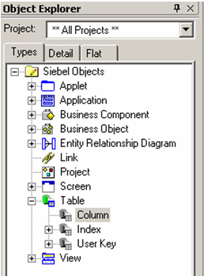
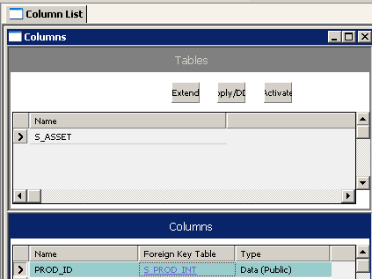
Foreign Key Table Columns
5/6
Are columns in a table that refer to the primary key column of a related (parent) table
  Many are named with suffix _ID
Are maintained by Siebel applications and tasks to ensure referential integrity and should never be updated directly via SQL
Foreign key column
Foreign key table
Notes:
Here you can see how the conceptual diagram in the previous slide is represented in Tools. Foreign Key Table property in S_ASSET maps to its parent S_PROD_INT. It identifies the PROD_ID column in S_ASSET as the FK column.
This slide reminds student what a foreign key is and explains that they are stored in Foreign Key Table columns. Stress that Siebel applications use these columns to manage referential integrity and they should never be updated directly with SQL.
Be prepared to explain foreign keys in basic terms in case you have students unfamiliar with this concept. A diagram works best.

Slide 20
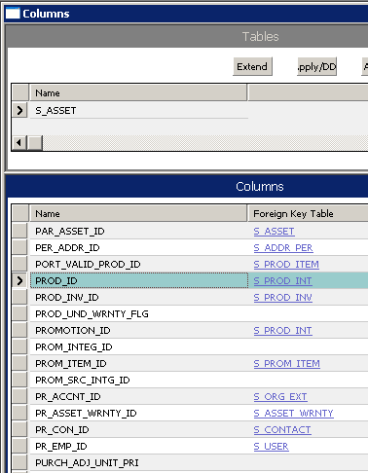
Finding Foreign Keys for 1:M Relationships
5/6
Inspect the Foreign Key Table property in a Column object definition to determine the column that serves as the FK
S_PROD_INT
S_ASSET
NAME
PROD_CD
ROW_ID
PART_NUM
ORDER_CST
NAME
ROW_ID
ASSET_NUM
SERIAL_NUM
PROD_ID
FK
column
Parent
table
PK
FK
Notes:
This slide shows how to find a foreign key for a specific relationship.
This is a critical point to make for any developers in the class, because this is how they determine what data relationships already exist.
This is a good place for a demo: Show the query in Tools that finds the column used to store a foreign key. (Remember that the students are still very new to Tools.) Point out that the table name is in the top applet, and the lower applet displays all the columns in that table. Then run your demo query in the Foreign Key Table property. The critical part of this demo is to explain that the column name returned by the query is the name of the column in the table you have selected in the top applet that will store the foreign key to the table listed in the Foreign Key Table property.
Remind the class that when they perform this query in Tools, what they are looking for is the name of the table to which the foreign key points.
Caution: the lower list applet shows the results of a query ("IS NOT NULL" for Foreign Key Table column). Some students might misinterpret the fact that all columns shown have a FKT value.

Slide 21
M:M Relationships
5/6
Are captured using foreign key columns in a third table called the intersection table
Product : Product Line intersection table
S_PROD_LN
S_PROD_INT
ROW_ID
NAME
DESC_TEXT
ROW_ID
NAME
PART_NUM
S_PROD_LN_PROD
UOM_CD
PK
ROW_ID
PK
PROD_LN_ID
PROD_ID
FK
FK
Notes:
This slide reminds students that these foreign keys are located in another table called the intersection table.
Explain why its necessary to resolve M:M relationships with an intersection table.
Note: the suffix on S_PROD_INT could cause some to confuse it with “INTersection”. In this case, _INT refers to “INTernal”; not INTersection.

Slide 22
1:1 Extension Table
6/6
Is a special table that has a 1:1 relationship with a base table
  Foreign key for the relationship:
    Is located in the extension table
    Is named PAR_ROW_ID
Provides additional columns for business components referencing the base table
  A base and extension table can be considered as a single logical table
Base Table
Extension Table
S_PROD_INT
S_PROD_INT_X
NAME
ROW_ID
PART_NUM
UOM_CD
ROW_ID
PAR_ROW_ID
ATTRIB_39
PK
FK
Notes:
Oracle provides a set of preconfigured extension tables that are set aside for customer use. These tables are known as static extension tables. Static extension tables include generic columns (ATTRIB_) that you can use to store custom attributes. Static extension tables are already part of the data model, so using them does not require updating the physical database.
Overall, extension tables provide flexibility for both Siebel Engineering and customer use. They also support multiple business components referencing the S_PARTY table (discussed in a later module).
Extension tables provide additional columns that you can use to store custom attributes. Extension tables have either an implicit 1:1 or a 1:M relationship with a given base table.
Rows in the extension table have one-to-one relationships with corresponding rows in the base table. They are basically an extension of the base table record.
Note: Its important to discuss extension tables at this point in the class because a basic understanding of what they are is required to the upcoming business component modules.
Also, its important students know the Siebel data model is flexible and robust, and that this flexibility is, in part, accomplished via these extension tables.

Slide 23
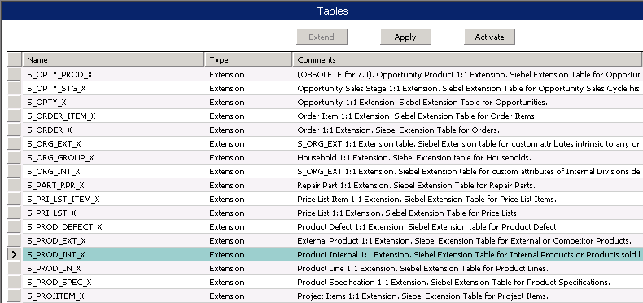
Standard 1:1 Extension Tables
6/6
Prebuilt for many major tables
  Have the name of the base table with suffix _X
Contain 40-plus generic columns of varying types
  Store data for new business component fields that are in addition to those mapped to the base table
Notes:
The static 1:1 extension table has a predefined 1:1 relationship with a base table that allows you to use the additional columns in the extension table for new functionality without making alterations to the base table or modify the database schema. When using static 1:1 extension tables, you do not need to create a new business component object because these tables are already implicitly defined as “joins”, which will be covered later in this training.
1:1 Static extension tables have a suffix of _X in the name, such as S_PROD_INT_X. Columns in these tables are named ATTRIB_nn, where nn is a value from 01 to 47. You can add additional extension columns if needed.
Not all columns in standard extension tables are available to use because Siebel applications use some of the columns. Extension columns used by standard Siebel applications should be treated as data columns in base tables.that is, they should not be modified or deleted.

Slide 24
1:M Extension Table
6/6
Is a special table for storing child data related to an existing parent table
Allows you to track entities that do not exist in the as-delivered Siebel applications
S_ASSET
S_ASSET_XM
TYPE
ROW_ID
PAR_ROW_ID
NAME
ROW_ID
ATTRIB_01
NAME
ASSET_NUM
SERIAL_NUM
PROD_ID
PK
FK
Notes:
There are more than 20 predefined tables that have one-to-many relationships with base tables.
These tables have the suffix _XM. They have generic columns that you can use to store additional data. They allow you to track entities that do not exist in standard Siebel applications and have a 1:M relationship to an existing base table. Because the extension tables themselves are already part of the data model, you do not need to modify the database schema.
You can store data for multiple business components in an _XM table.
The names of 1:M extension tables are appended with the suffix _XM.
In a 1:M extension table, there can be multiple rows for a single row in the base table.
Like 1:1 extension tables, 1:M extension tables have a set of generic columns (ATTRIB_xx) that you can use to store custom attributes.
However, unlike 1:1 extension tables, 1:M extension tables have a Type property value of Data (Public) rather than Extension.
Extension tables allow a new BC to be created as a child to an existing, out of the box BC.

Slide 25
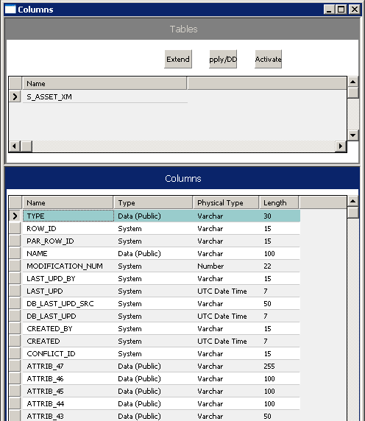
Standard 1:M Extension Tables
6/6
Are prebuilt for many tables
Have the name of the main table appended with _XM
TYPE defines data classification
PAR_ROW_ID stores FK to ROW_ID in main table
NAME stores name of child entity
ATTRIBs are predefined with varying types
Notes:
Type Column: The TYPE column is used to group records in the _XM table. You configure each business component to retrieve only the rows of a given type.
Demo: Show students how to find the right extension table: find the base table for the parent business component, then verify that an _XM table exists for it. Show the various types of ATTRIB columns available.
No fully-defined business component in the standard Siebel applications uses the _XM tables as its base. Two are defined (Countries Deployed and Languages Deployed), but they are not complete. They have no fields based on the ATTRIB columns. So if you want to do a more detailed demonstration in the classroom, you may have to do a little bit of work in advance.

Slide 26
Module Highlights
Siebel Data Model defines how data is stored in a third-party relational database
A primary key (PK) is a column that uniquely identifies each table row
ROW_ID is a column in every table
  Contains a Siebel application-generated unique identifier
User keys specify the columns used to determine uniqueness of records when entering, importing, or integrating data
Foreign Key Table columns are columns in a table that refer to the PK column of a related table
1:1, 1:M, and M:M relationships are predefined within the model
Notes:
The most important point a student should hear about the data model is that there are ways to investigate what has been defined by the Siebel application and that they should always investigate first before making changes.
Review Question: What are some important pieces or elements of the data model?
Answer: Table, Column, User Key, Index, and so forth
Review Question: What are some types of tables?
Review Question: What data is stored in each type?
Review Question: How are relationships represented in the Siebel Data Model?
Answer: Through the use of foreign keys

Slide 27
Lab
In the lab you will:
  Examine tables, columns, indexes, and user keys that make up the Siebel Data Model
  Determine the form of relationships between tables in the Siebel Data Model
Notes:
See lab instructions for details.

