Slide 1

Module 17: Siebel Business Components
0/5
Siebel 8.0 Essentials
Notes:
Time: Lecture: 30 – 40 minutes; lab: 15 – 20 minutes
Intent: To explain what business components are in detail and how a single-value field maps to a column in a base table, a column in a related joined table, or a column in an extension table. The focus here is on understanding rather than being able to create new business components.
Flow: Business components; mapping to base tables; mapping to joined tables; and mapping to extension tables. (The sequential order is important, because we need to introduce the idea of a join first before we can talk about implicit joins.)
Key Terms:
Entity-Relationship Diagrams (ERD)
Application Architecture
Business Component Reuse
Base Table
Joined Tables
Join Definition
Join Specification Definition
Extension Tables
Implicit Joins
Field Data Type

Slide 2
Module Objectives
After completing this module you should be able to:
  Define a business component
  Describe how business component fields at the business object layer are mapped to columns at the data layer
  Describe how base and joined tables are used as a part of this mapping
Why you need to know:
  The business component is a fundamental object in the Siebel Application Architecture
Notes:
Each objective and “why you need to know” should be stated aloud.

Slide 3
Application Architecture: Business Components
Provide a way to group data according to business logic
Are referenced by applets
Specify access to tables (read, write, and update)
Are used by business objects to provide data to views
Siebel Application Architecture
UI
Layer
List Column
or Control
Applet
View
Screen
Application
Business
Layer
Field
Business
Component
Business
Object
1 or many
Data
Layer
Column
Table
References
Notes:
Here’s our 10 box diagram again, with a focus on business components. The business component not only provides a way to group data according to business logic, which we’ll explain in a moment, but is the data source for applets. As discussed earlier, any given applet references one and only one business component.
Business components also manipulate data in the tables in the data layer. Any given field in a business component references one column in a table at the data layer.

Slide 4
Business Component
A business component (BC) is a person, place, thing, or event about which data must be stored
  Represents a fundamental business entity
Provides the foundation for controlling how data is selected, inserted, and updated in underlying tables
Opportunity
Opportunity
Quote
Product
Contact
= Business Component

Slide 5
Business Component Continued
Arranges data from one or more tables into a logical grouping
Consists primarily of fields and joins
  Each field references a single column in a table
Is not a table
  Does not store data
  Stores metadata: data about data
BC
Opportunity
Name
Description
Decision Level
Sales Stage
Sales Stage Phase
S_OPTY
S_OPTY_X
S_STG
Field
ROW_ID
NAME
DESC_TEXT
CURCY_CD
ROW_ID
NAME
PHASE_CD
PAR_ROW_ID
ATTRIB_39
STG_ORDER
ROW_ID
ATTRIB_01
ATTRIB_09
Base Table
Joined Tables
Notes:
Most Business Components get their data from a combination of base tables and joined tables. When thinking about how mapping occurs across layers, most of our time is spent working with tables.
Base Tables
Every business component, except virtual business components, has one base table assigned to it. The base table typically provides the most important columns that populate fields in the business component (for non-party business components).
Joined Tables
In addition to including data from base tables, business components can include data from joined tables, covered later in this module.

Slide 6
Business Component Reuse
A business component can be:
  Defined once in terms of a logical collection of columns from one or more tables
  Then used in many different business object contexts
Opportunity
Contact BC appears as master in Contact BO
Opportunity
Contact
Contact
Quote
Product
Contact
Quote
Product
Account
Contact BC appears as child in Opportunity BO
Notes:
This slide mentions that a BC (once defined in terms of a collection of data form multiple tables) can be reused in multiple different contexts. It only needs to be defined once.
In the example on the left, the Account BO has a BC called Contact, which is a child of the Account parent BC. In the example on the right, Contact is now being used as the parent in the Contact business object. The implication of the parent/child relationship within the BO will become clear when we cover business objects later during this training.

Slide 7
Base Table
Contains the main columns for the business component
Every business component references only one base table
Many BC fields are mapped to base table columns
Fields referencing base tables are editable in the UI
Opportunity
Name
Description
Decision Level
Sales Stage
Sales Stage Phase
S_OPTY
Base table
Mapping Example
Field:
Description
Business
Component:
Opportunity
ROW_ID
NAME
DESC_TEXT
CURCY_CD
Column:
DESC_TEXT
Table:
S_OPTY
Notes:
Fields in the business component map directly to columns in the base table.
Business components do not need to include all of the columns in the base table, although typically it will include most of them. In particular, system columns in the base table such as ROW_ID, CREATED_BY and LAST_UPD_BY are automatically represented in the business component.
Fields from the base table are usually easily recognizable in the UI because they are typically editable by the user.
Mapping Example: The mapping example illustrates how the Opportunity BC maps to its base table, S_OPTY: the BC only has one base table. S_OPTY contains multiple columns, such as DESC_TEXT. The Opportunity BC field called Description maps directly to the DESC_TEXT column in the S_OPTY table.
Creating BCs: For most off-the-shelf applications, its not necessary for you to create new business components and do the mapping because Siebel has already done a lot of this work for you. However, even with off-the-shelf applications, a certain amount of re-configuring various components in the software architecture may be necessary to meet your specific data generation and display requirements.
DEMO: navigate to Table: S_OPTY | Column. Scroll through the list of columns. Run a query on Type for System. Pick out a few system columns and describe their usage. Pick out a few easily understood sample columns, such as BDGT_AMT or ASGN_DT. Explain that Siebel has done most of the work necessary to meet the needs of most applications; that’s why S_OPTY has so many columns: to populate the fields in any given business component across a variety of applications.
Note: For brevity, the slide states relationships definitively. For example, “contains the main columns for the business component”, rather than “typically contains the main columns for the business component”. This is true in most cases. However, there are occasional exceptions.

Slide 8
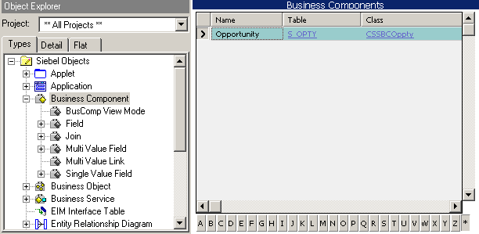
Business Component Table Property
Each business component contains a table property that specifies the base table
Base table
Notes:
Now let’s take a closer look at how business components are structured.
As we have seen in the 10 box diagram, any given business component references one, and only one, base table.

Slide 9
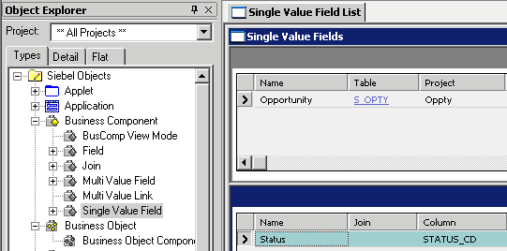
Fields That Map to a Base Table
Column property maps to a column in the base table
  Join property is blank
Base table
“Status” field references base table
Join is blank
Notes:
In this example we’re looking at the opportunity BC, and we’re looking at a field called “Current Status” in that BC. The Current Status field maps to the base table for opportunity, which is S_OPTY.
The type property corresponds to the Physical Type of the associated column.
The power of Siebel Tools is that it forces adherence to the Siebel Application Architecture. For example, its not possible in Tools to assign a screen or view to a business component. That relationship is achieved through the relevent intermediary applets and business objects.
DEMONSTRATION: demonstrate the creation of a new BC field. Show students how the dialog appears when tabbing into the Column property.

Slide 10
Explicit Join
Is a join that brings in data from tables other than the base table to meet the business component’s data display requirements
  Most fields referencing explicitly joined tables are read-only in the applet
Includes a join definition and a join specification
BC field references the join definition
Opportunity
Name
Description
Sales Stage
Base table
S_OPTY
S_STG
Joined table
ROW_ID
DESC_TEXT
NAME
NAME
CURCY_CD
ROW_ID
PHASE_CD
STG_ORDER
Notes:
What if the base table doesn’t contain all data required by the BC? In these cases, data in joined tables is brought into the BC so it can be displayed together in a single applet. In this example, sales state and close data data is brought in from the S_STG joined table.
To create this join, a Join “object definition” is used to establish a relationship between a business component and a table that is not its base table. This relationship allows the business component to use columns from the other table.
The end-user cannot edit data from an explicitly joined table. You can recognize data from an explicitly joined table by the gray background in the applet, which indicates it is not editable.
Exception Regarding Editable Fields
(only address this if students ask the question) Implicit joins to extension tables admit modification of joined fields.

Slide 11
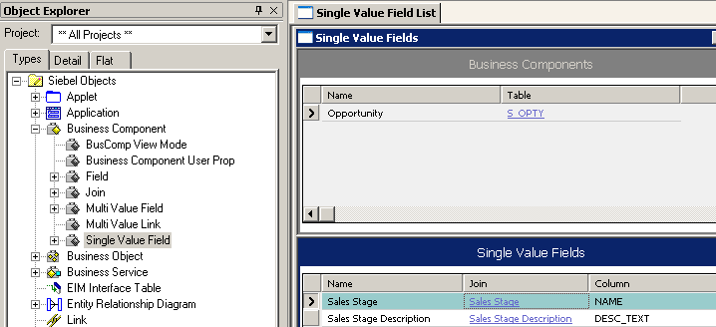
Fields That Map to a Joined Table
Join property specifies the join object definition being referenced
Column property maps to a column in the joined table
The S_STG column, “NAME,” contains sales stage data
Sales Stage field maps to Sales Stage join
Name of join that maps to S_STG table
Notes:
How does it appear in Tools when mapping to a joined table? In this example, the business component is “Opportunity” again. Single Value Field lists all SVFs in the Opportunity business component.
The joined table being referenced is S_STG: Sales Stage is the value for the Join property. This join, in turn, has S_STG as its table, as we’ll see on the next slide. The column in S_STG that contains the source data for the “Sales Stage” single value field is NAME. Its specified under the “Column” property.

Slide 12
Joining Data from Joined Tables
Returns only one row from the joined table
There is a 1:1 or 1:M relationship from the joined table to the BC
Relationship is established using a FK column on the base table to join to the PK column on the joined table
FK column on base table
PK column on joined table
S_OPTY
S_STG
ROW_ID
DESC_TEXT
NAME
NAME
CURCY_CD
CURR_STG_ID
ROW_ID
PHASE_CD
STG_ORDER
Base Table
Joined Table
FK
PK
Notes:
The join uses a foreign key in the business component to obtain rows on a one-to one basis from the joined table, even though the two tables do not necessarily have a one-to-one relationship:
For every record in the business component there can be a corresponding row in the joined table. However, not every record in the base table will have a record in the joined table.
Note: every record in the business component corresponds to a row in the base table.
A table can be a joined table only if there is a 1:1 or 1:M relationship between the joined table and the base table. This means that the joined table has at most one related record per row in the base table.

Slide 13
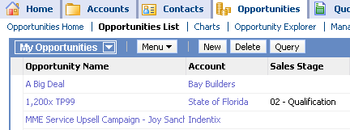
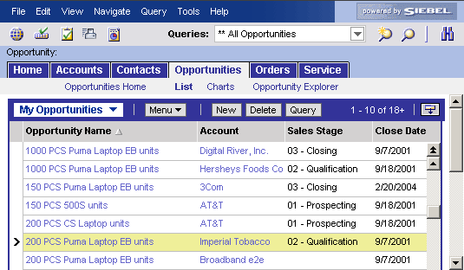
Displaying Fields from Joined Tables
The UI layer specifies how information joined at the business layer will be displayed
From Base Table
From Joined Table
Opportunity List Applet
UI Layer
Business Layer
Opportunity BC
Data Layer
S_OPTY
S_STG
Notes:
Referencing in the business layer is then displayed in the UI.
This screen capture shows the Opportunity List Applet that exposes the Sales Stage field. A join brings the field into the Opportunities business component and the Opportunity List Applet displays the data in the user interface.
Note: the important message to get across here, for this architecture module, is that the BC assembles data from the data layer into a structure that fits the business logic requirements. It provides that data to applets for display at the presentation layer. This join example details how the BC fulfills its role in the architecture.

Slide 14
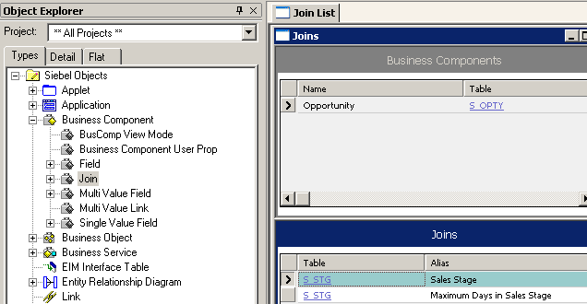

Join Definition
Specifies the joined table from which to retrieve data
  Is a child object of the business component
Defaults the alias property to the name of the joined table
  Modify alias when there is more than one join to same table
Alias of join
Joined table
Notes:
Here we can view the join referenced on the previous slide. Sales Stage is the join (under Alias property), and S_STG is the joined table (under Table property).
A join definition is a child object definition of the business component that declares what the joined table is.
Note the Alias property is really the name of the join definition. In most cases it simply defaults to the name of the joined table. The slide mentions two exceptions to that: 1) when you join back to yourself to capture a parent child relationship; and 2) when there is more than one join to the same joined table (multiple relationships). In these cases, an alias is necessary to ensure a unique mapping for each join. For example, if you have two joins to the same table, you can’t use the same name for both joins. Therefore, the alias was created to allow you to provide a unique name for each join, even in those cases where both have the same value in the Table property. In the slide, there are multiple references to S_STG, one for the Sales Stage join, and one for the Sales Stage Description join.

Slide 15
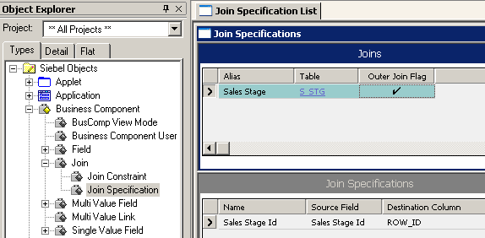
Join Specification
Specifies how to retrieve the related row from the joined table
  Based on the foreign and primary keys used to relate the base and joined tables
Opportunity
Name
Description
Sales Stage Id
S_OPTY
S_STG
Foreign Key field
Primary key column
ROW_ID
CURCY_CD
NAME
DESC_TEXT
CURR_STG_ID
ROW_ID
NAME
PHASE_CD
STG_ORDER
FK
PK
Notes:
The next construct is the join specification, which specifies how to retrieve the related record from the joined table. You might ask the class what type of information is needed – primary and foreign keys for the records. And that’s what makes up the join specification. It is actually based on the foreign key field in the business component and the primary key column in the joined table (ROW_ID).
The source field is in fact mapped to the foreign key column in the base table. The base table stores the row ID of the single record from the joined table. This row ID is stored in the foreign key column on the base table. This field needs to be exposed in the business component prior to creating the join specification. This field will have no value for the join, as it exists on the base table.

Slide 16
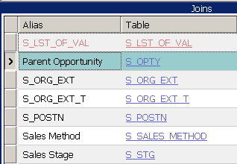
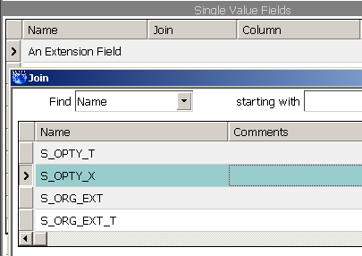
Implicit Joins
Base tables are automatically joined to their extension tables
  Known as implicit joins
  Make extension table rows available to the BC
  An explicit join to describe the relationship is not needed
Come pre-configured as part of the Siebel object architecture
  Name of an implicit join is always the name of the _X table
Do not appear as Join object definitions
Do appear in the picklist for the Join property in an SVF
S_OPTY_X Appears Here
S_OPTY_X does appear here
S_OPTY_X does not appear here
Notes:
Implicit joins exist as part of the off-the-shelf Siebel object architecture. They are not explicitly defined using Siebel Tools and, therefore, do not appear as object definitions.
Implicit joins exist for 1:1 extension tables and relevant intersection tables.
Underlying a 1:1 extension table’s relationship with the base table and business component is a set of hidden relationships called an implicit join. The implicit join makes the extension table rows available on a 1:1 basis to the business component that uses the extension table.
Implicit joins allow data to be updated in columns, whereas joins defined as object definitions do not. Joins defined as object definitions only allow data to be displayed.
Join Name: Implicit joins usually use the table name as the Join Alias. The name of the implicit join is the same name as the extension table. When a field in the business component is based on a column in the extension table, the Column property of the Field object is set to the name of the column, and the Join property is set to the name of the extension table. For example, the Industry field in the Contact business component has a Column property value of ATTRIB_48 and a Join property value of S_CONTACT_X.
(POSSIBLE DEMO)
The Id field is a system field in the business component. It represents the ROW_ID column in the base table, and it can be used in joins involving extension tables and other joined tables.
PAR_ROW_ID stands for parent row ID. Every extension table has this column, and every extension table row has a value there. It is used as a foreign key to the base table that is extended by the extension table.
Note: Extension tables of S_PARTY, such as S_ORG_EXT, S_CONTACT, S_POSTN, and S_USER. These implicit joins are used to map data to party business components. For example, if you were to add a field to the Account business component and then select the Join property, you would see several implicit joins that do not appear in the Join definition list displayed in the OBLE, including joins with an alias of S_ORG_EXT and S_USERs. Party business components will be covered in more detail, later in this course.

Slide 17
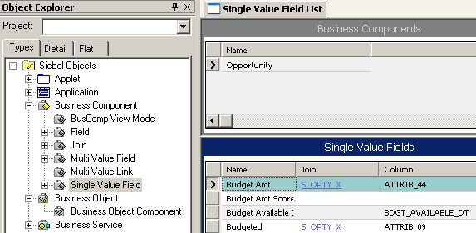
Fields That Map to an Extension Table
Join property specifies the extension table being referenced
Column property references a column in the extension table
Field is editable in the UI
The S_OPTY_X column, “ATTRIB_44,” contains budget amount data
The Budget Amt field references the S_OPTY_X table
Notes:
This slide illustrates how fields map to a column in an extension table. The main work here is to find an appropriate column in the extension table. Some business components come delivered with fields that map to columns in an extension table. Consequently, developers need to first verify that the column is not already used in another business component.
Note: to get this display, an *_X query was run on the field join property. All fields in the Opportunity business component are displayed.

Slide 18
Module Highlights
A BC is a person, place, thing, or event about which data is stored
A BC can be defined once then re-used by different BOs
Each BC references a single base table
A BC can include data from joined tables
A join definition specifies joined table
A join specification specifies how to access joined table via PK/FK
An extension table extends data in the BC
Fields on extension tables use implicit joins
Notes:
Review Question: What types of tables typically provide the main columns to a business component?
Answer: Base tables.
Review Question: What is the requirement for a table to serve as a joined table?
Answer: It must have a 1:1 or 1:M relationship with the base table, and there must be a foreign key column in the base table that points to the joined table.

