Slide 1

Module 19: Siebel Business Objects
0/5
Siebel 8.0 Essentials
Notes:
Time: Lecture: 20 - 30 minutes; lab: 10 – 15 minutes
Intent: To explain business objects and links.
Flow: Business objects and links; 1:M and M:M links; and grandchild business components.
Key Terms: <List terms the instructor should be familiar with in order to teach this module>
Business Objects
link property
Link Definition
1:M Link
M:M Link
Intersection Table
Grandchild Business Components

Slide 2
Module Objectives
After completing this module you should be able to:
  Describe how business objects focus data presented in the UI based on context
  Describe how views reference business objects
  Describe how links are used to relate parent business components to child business components
Why you need to know:
  Business objects enable you to configure your company’s business logic
Notes:
Each objective and “why you need to know” should be stated aloud.

Slide 3
Application Architecture: Business Objects (BO)
Provide a way to organize BCs into major areas according to your business logic requirements
Provide context to views
Siebel Application Architecture
UI
Layer
List Column
or Control
Applet
View
Screen
Application
Business
Layer
Field
Business
Component
Business
Object
1 or many
Data
Layer
Column
Table
References
Notes:
Recall that business objects are used to focus data presented in views depending on the context in which the data is accessed, and that any given view references one, and only one business object. Business objects also organize business components into a major business area, such as Accounts, Opportunities, Contacts and Actions.
In this module we’ll explore how business objects are used to focus data displayed in views and how they are used to group business components around a specific business focus, such as accounts, opportunities, contacts, etc.

Slide 4
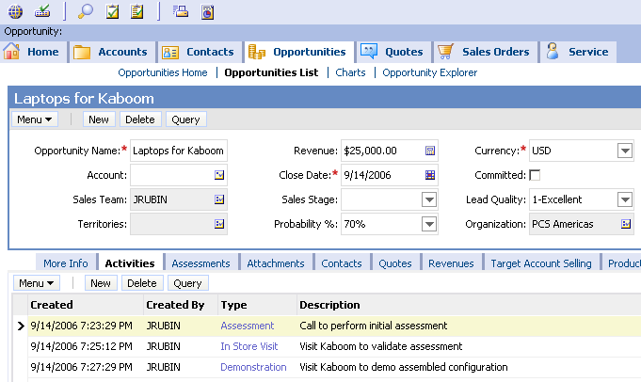
Business Challenge
Business components provide a way to group data according to business logic, but they do not address the need for context
  For example, the opportunity BC defines how to retrieve opportunity data, but not related activity data
How is it that the Activities view shows only activities related to the Kaboom opportunity?
?
Notes:
In our sample database there are many, many activity records. We wouldn’t want to display them all in this view, so what mechanism does Siebel use to limit records displayed to fit the context in which they’re being viewed?
For example, the Opportunities business component tells the application how to retrieve account information, but does not tell the application how to retrieve associated contact information.

Slide 5
Business Solution: Business Objects Provide Focus
Business objects contain relationships used to access records from a child business component
  Identifies records to display depending on context in which they are viewed
  Ensures that only records related to parent BCs are returned from queries
Activities pertaining to Kaboom opportunity, and only Kaboom, are displayed
Notes:
The context here is the Laptops for Kaboom opportunity, and only those activities associated with Kaboom are displayed in the Opportunity Activity List Applet . In this module, we’ll explore how business objects are able to focus data based on the context in which its viewed.

Slide 6
Business Objects
Are a collection of related business components that represent a major area of the business
  Contain parent and child business components
  Relate parent and child components via links
  Links focus records displayed based on the context in which they are viewed
Provide a container for grouping business components
Provide context for views
Opportunity
Business Object
Link focuses data in view
Opportunity
Children BCs provide data related to parent
Parent BC provides most data; data is specific to the BO
Action
Product
Source
Notes:
Container: The business object provides a way to group business components into an area that represents a major part of the business, such as opportunities, assets, contacts, industries, or service requests.
Parent/Child: Every business object has at least one parent business component and one or more children business components that display data related to the parent. The Parent business component contains most of the data required by the business object. For example, the Opportunity BC contains fields that hold data like opportunity name, revenue, etc.
Child business components contain additional data that may be required in the display. For example, a user who drills from the Opportunity List Applet to the Contact form will see individual contact records associated with the Opportunity they drilled on. They’re called child business components because the records displayed are directly related to the parent.
Link: As we’ll see in a moment, its how the link is specified that determines the focusing mechanism. Links can be used to impose referential integrity between parent BC and child BC tables by ensuring records in these coupled tables are consistent. For referential integrity to hold, any FK field in a table can contain only values from the parent table's PK. For instance, deleting a record that contains a value referred to by a FK in another table would break referential integrity. Links enforce referential integrity by ensuring foreign key rows are deleted or by ensuring an error message is returned, and by causing the delete not to occur. Later in this module, we’ll see how referential integrity is enforced via links that establish a PK/FK relationship between parent/child tables.
Links are not child objects of the BO. They are shown in the diagram as existing within the BO to reinforce their central role the architecture of the BO. We’ll see in a moment how the link is referenced by the Business Object Component, which is a child object of the BO.
Instructor Note: the one exception to the rule that every business object as at least one parent BC and one or more child BCs is with screen home pages, in which several unrelated BC's appear with no links to each other. It is not necessary to discuss this exception at this point, and it is at your discretion to do so.
(CONTINUED ON NEXT PAGE)

Slide 7
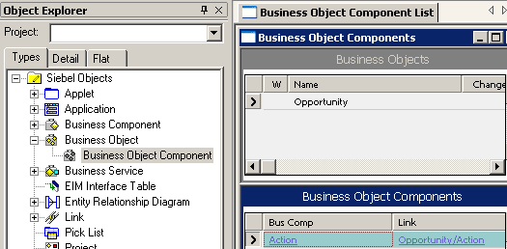
Business Object Component
Contains Link and BusComp properties that relate the parent and child business components to each other
Link relates parent to child
Child BC
Parent BC
Notes:
The Business Object Component is a child object of the Business Object. Typically, each business object component defines one parent-child relationship within the parent business object.
The BusComp property identifies the child business component. The link is specified via the Link Property. In this example, the Opportunity business component is the parent, and Action is the child.
(CONTINUED FROM PREVIOUS PAGE)
QUICK DEMO: navigate to the Opportunity list applet. Drilldown on an account and select Contact. Describe how all the contact records are directly related to the parent business component that contains information for the list applet, Opportunity.

Slide 8

Link Definition
Identifies the PK/FK relationship
  Identifies which records to retrieve from the child business component
  Identifies the foreign keys to populate when new child records are created
Is used with both 1:M and M:M relationships between parent and child data
Opportunity
Link Definition
Opportunity
Action
Product
Source
Notes:
A link is used to identify a one-to-many (or parent-child) relationship between two business components. The Link object type makes parent-child views possible.
In some cases, one record of the parent business component, such as in a form applet, displays with many child business component records, such as in a list applet. Typically this appears in the UI with the form applet above and the list applet below.
In other cases, usually with M:M relationships, child BC data may be displayed as a column or columns in a list applet, which we’ll see later in this module.
Note: If a link is not specified, all child records are displayed in the applet.

Slide 9
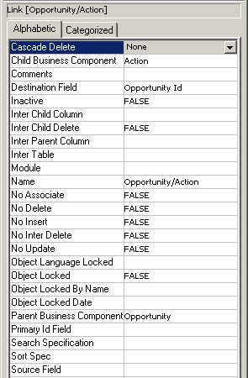
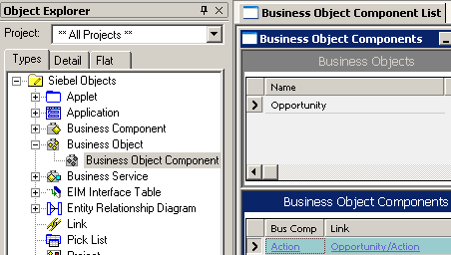
1:M Link
Used for 1:M relationship
between parent and
child business components
FK field in child BC
Link Definition
Defaults to parent BC/child BC
PK field in parent BC
(defaults to ROW_ID if blank)
Notes:
We use the 1:M link when there is a 1:M relationship between the parent and child business components.
This slide illustrates how a 1:M (one-to-many) link is configured.
Link. The Link object definition specifies a parent/child relationship between two business components. It identifies:
the foreign key field in the child.
the parent and child business components involved in the link
And the primary key field in the parent
Destination Field: contains a foreign key that refers to the primary key in the child business component. The link is used to locate all records in the child business component that have a value in the FK field that match the value in the parent’s PK field. The child business component is therefore known as the destination, because that is where you need to go to retrieve all the matching records.
Source Field: contains the PK field for the parent BC. This field usually defaults to ROW_ID for the parent BC. If its blank, its value is actually ROW_ID and it points to the parent.
Name: contains the name of the link that appears in the link definition. It defaults to the form: [parent]/[child]

Slide 10
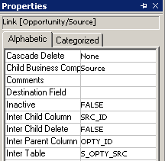

M:M Link
Used for M:M relationship between parent and child business components
Uses an intersection table to resolve the link
Intersection table with FK columns
Notes:
This slide illustrates how a M:M (many-to-many) link is configured. One easy way to identify a M:M relationship is to view the values of the “Inter” properties: Inter Child Column, Inter Child Delete, Inter Parent Column and Inter Table. If these properties have values, it indicates the presence of an intersection table used to resolve the M:M relationship. Since there are two foreign keys in the intersection table, and none in the business components, we do not specify the source and destination fields. Instead, we specify the name of the intersection table and the columns that hold the foreign keys.
Note: We can find which column holds the appropriate foreign key by looking at the Foreign Key Table property of the column (in Table > Column).

Slide 11
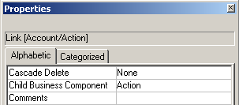
Cascade Delete Property
The Cascade Delete property of a link specifies whether child records of a 1:M relationship are deleted when the parent record is deleted
  None: Neither deletes nor clears the foreign key column
  Clear: Does not delete, but clears the foreign key column
  Delete: If a parent record is deleted, all child records are deleted
Notes:
This is a property in a link that determines what happens to a child record when a parent record is deleted. It is relevant for 1:M links only.
The Cascade Delete property determines whether a child record is deleted when the parent record is deleted.
■ None. No records are deleted and the foreign key column is not cleared. This is the default setting.
■ Clear. The foreign key reference is removed if the master record is deleted, but the detail records remain in place. However, the value in the foreign key column is cleared. This is most appropriate for child values that might be shared with other parent records.

Slide 12
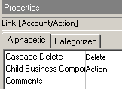
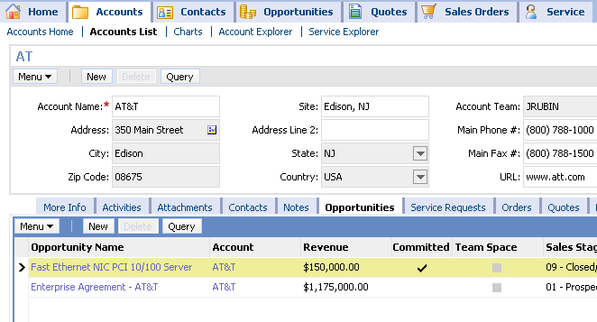
Cascade Delete Property Continued
Determined by your business logic
  Should all activities be deleted if parent contact is deleted?
  Should all child opportunities be deleted if the parent account is deleted?
Deletion cascades
Notes:
■ Delete. The detail records are deleted along with the master. This is most useful when attempting to avoid orphaned child records for values stored on _XM tables where the only related record is the parent record.
Do not use DELETE if the child business component in this link is also a detail business component in another link. In this case, use CLEAR instead.
Note: Cascade Delete is not available for many-to-many links. With a many-to-many link, Siebel applications will automatically delete the intersection record but will leave the child record intact, as it may have other parents.
Note: When you delete a record which is pointed to by foreign keys of other tables, the references to it may or may not be deleted. If those references are not deleted, the user is left with row IDs which point to nonexistent records. In the case of multi-value groups, sometimes these foreign keys will be converted to say “No Match Row Id.”

Slide 13
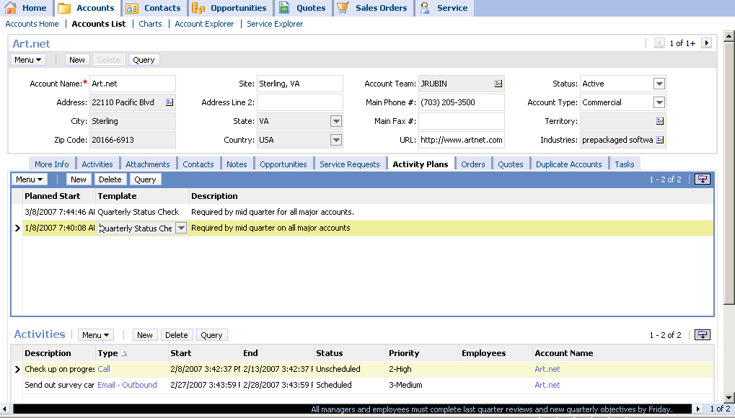
Grandchild Business Components
Business objects may include grandchild business components
Used in parent-child-grandchild views
Parent BC: Account
Activity plans for Art.net
Child BC: Activity Plan
Activities for selected Art.net activity plan
Grandchild BC:
Activity Plan
Action
Notes:
It is possible to have more than one generation of records displayed in a Siebel view. In the example shown, an account has one or more activity plans and each activity plan has one or more of its own activities. You can verify this by demonstrating this view and showing what happens when you move from activity plan record to activity plan record. You may have to create some sample records yourself to demonstrate this.
A parent-child-grandchild view uses three applets to display parent, child, and grandchild data in a single view. The records displayed in the grandchild applet are related directly to the selected record in the child applet, and not to the selected record in the parent applet.

Slide 14
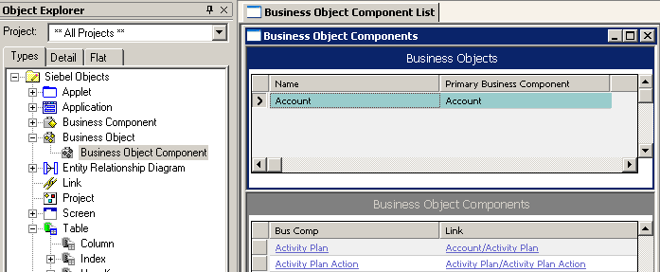
Links for Grandchild Data
Specify how the grandchild and child business component are related
  Used to retrieve grandchild records on parent-child-grandchild views
Parent/Child
Child/Grandchild
Notes:
This slide shows how the links are set to bring grandchild business components into a business object. Note that the grandchild business component uses a child/grandchild link.

Slide 15
Module Highlights
Business objects
  Provide a way to group BCs according to business logic
  Provide context to views
  Contain parent and child BCs associated via links
Links provide a way to focus records based on context
Links relate parent and child BCs
Link definitions specify which records to retrieve from child BCs
A 1:M link is used for a 1:M relationship between parent and child BCs
A M:M link is used for a M:M relationship between parent and child BCs
  A M:M link uses an intersection table to resolve the link
BOs may include grandchild BCs
Notes:
Review Question: What is a business object?
Answer: A collection of business components and the relationships between them. Stress the importance of the relationships.
Review Question: What differentiates 1:M links from M:M links?
Answer: M:M links require an intersection table.

