Slide 1

Module 20: Configuration Strategy
0/5
Siebel 8.0 Essentials
Notes:
Time: Lecture: 15 – 20 minutes; labs: no labs
Intent: To explain the basic principles for configuring a Siebel application. This is the first of several modules in the Configuration section of the course that explains how to change the standard (as-delivered) application.
Flow: Configuring the UI layer; configuring the Business layer; configuring the Data Objects layer; a way to approach the configuration process
Key Terms:
Tailoring
Configuration Strategy
Development Environment

Slide 2
Module Objectives
After completing this module you should be able to:
  List the critical elements of the Siebel configuration strategy
Why you need to know:
  Following a reasonable configuration strategy can expedite your configuration efforts and make your configured application robust and upgradeable
Notes:
Each objective and “why you need to know” should be stated aloud.

Slide 3
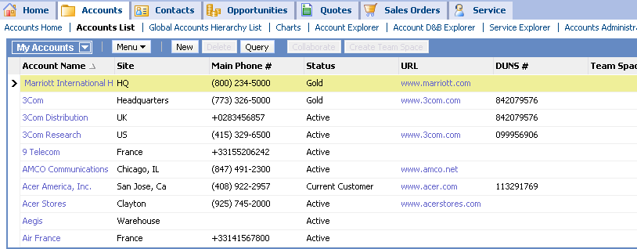
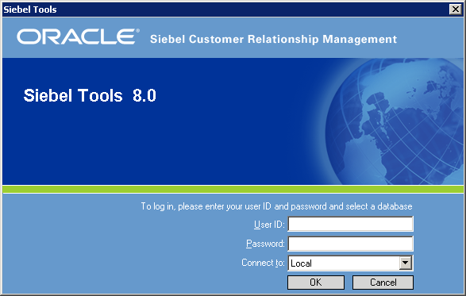
Configuring a Siebel Application
Configuring is the process of using Siebel Tools to modify an as-delivered Siebel application to meet business needs
Object definitions are edited and created
  Developers do not modify code in siebel.exe
  Developers do not write SQL directly
Object Manager
SRF
Repository Data
Siebel Repository File
Notes:
Set the scene for the module by explaining what is meant by “configuration” in Siebel terms.
The term “configuration” describes the process of changing any of the objects in the as-delivered application, be it the UI, the business logic, or the data objects.

Slide 4
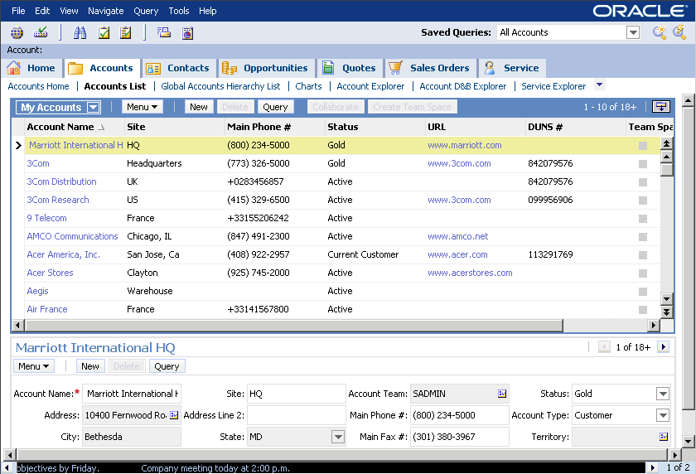
Siebel Applications
Siebel as-delivered applications include a predefined set of screens, views, lists, forms, and their associated templates
A predefined view
Notes:
Remind students that customers get a as-delivered application, with a standard set of views, screens, and so on. The as-delivered application is what they start with.
The screenshot illustrates the look-and-feel of the UI, which students have already seen.

Slide 5
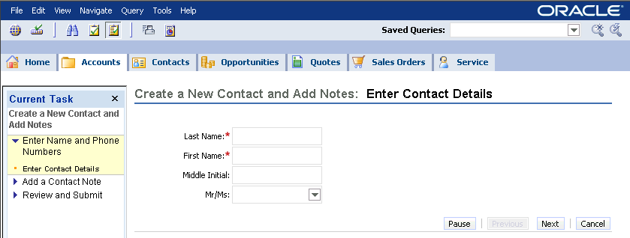
Tailoring the Logical User Interface
Developers tailor the as-delivered Siebel screens, views, lists, and forms to better support users’ business needs
A tailored view
Notes:
The job of a developer at the UI level is to modify the appearance of the application, so that it better reflects the business needs of the company and the users.
In the Logical UI, you can modify the layouts of the applets, views, screens, and applications (for example: which fields appear in what order in an applet, which applets appear in what order in a view, and so forth).
Modifying templates is a change to the physical user interface, not the logical user interface, and is handled in the customer’s HTML editor of choice, not in Tools. This is discussed in more detail later in the class.

Slide 6
Tailoring the Physical User Interface
Use the existing physical UI files whenever possible
When necessary, copy existing files and modify as needed
Use an HTML or a text editor to modify layout
Use a text editor to modify colors, fonts, etc.
  Siebel template files
  Cascading style sheets
  Image files
UI files
Object Manager
Use a graphics program to add your organization’s images
.cfg
SRF
Database Server
Configuration File
Siebel Repository File
Notes:
Siebel applications are also specified by a set of physical UI files that specify how the logical UI will be physically rendered in a browser. Developers should use the existing swe templates, CSSs, and image files, to the extent possible. Reducing customization of object definitions reducing not only development work but on-going maintenance, as well.

Slide 7
Siebel Business Entities
Siebel as-delivered applications utilize a set of Siebel business components that implement the defined business logic
Account
Service Request
Contact
Action
Product
Notes:
In the as-delivered application, business logic is represented as a set of defined relationships between the supplied business components.
You might remind students how we explored some of those business entities and logic in earlier modules.

Slide 8
Tailoring the Business Logic
Developers also tailor the application by modifying the definitions of the business components to implement the business logic appropriate to the users’ organization
Account
Add fields
Modify form of the relationship
Service Request
Contact
Action
Modify properties of existing fields
Product
Notes:
Configuration can take place at the Business Layer by changing elements associated with the business entities to better represent the business logic of the organization. For example, you might add another field to support data not currently represented, or change a relationship from M:M to 1:M.
The names of the business components do not change. For example, suppose a company uses the term “Customer” instead of “Account.” You would change the applets, views, and screen text to say “Customer” instead of “Account”, but the application still uses the Account business component. (Changing the name of the BC would involve a massive project of tracking down everything that referred to that BC by name and changing it, and would not be an effective use of time or resources.)

Slide 9
Extending the Data Layer
Siebel as-delivered applications contain a large, predefined set of database tables
Developers can tailor the application by extending the set of database tables
  Recommendation is to perform this in a limited and controlled manner
Use existing extension tables to store additional attributes, or…
… create custom tables on a very limited basis
CX_OPTY
S_OPTY
S_OPTY_X
ROW_ID
LAST_NAME
FST_NAME
MID_NAME
ROW_ID
LAST_NAME
FST_NAME
MID_NAME
ROW_ID
CREATED
CREATED_BY
CURCY_CD
ROW_ID
ATTRIB_44
Notes:
This slide is done differently to capture the idea that developers are not expected to do much configuration at the Data layer. Hence, we use terms like “extending” the Data layer in a limited and controlled manner.
The as-delivered application comes with a predefined data model, that is, a standard set of tables. You can configure the application at the Data Objects layer by adding columns to tables, or by adding new tables to extend the functionality of the data model.
Note that Siebel Systems supplies predefined extension tables. Customers can also create their own extension tables. Also note that there are possible consequences when you extend the data model; for example, it can affect EIM data imports.
Extension tables and columns and their usage in Siebel applications are discussed in upcoming modules.

Slide 10
Configuration Strategy
Make minimal changes to the as-delivered application
Use existing object definitions in the as-delivered repository whenever possible
  Ensures that a new configuration can be upgraded
  with minimal effort
Modify definitions as required, rather than creating new ones
  Creating new object definitions can lead to redundant configuration and increase the maintenance effort
Notes:
The next two slides highlight a sensible approach to configuration.

Slide 11
Configuration Strategy Continued
Do not delete, make inactive, or rename seemingly unused object definitions
  Other object definitions might reference them
  Deleting does not save memory, storage space, or improve performance
Use existing template files
  Modify only when changes are essential
  Modifying a template for one view or applet can have unexpected consequences if another view or applet uses the same template
Notes:
The next two slides highlight a sensible approach to configuration.

Slide 12
Configuration Strategy Continued
Plan your configuration project from the top down
  First, determine UI and application functionality
  Then, determine what changes are necessary at the Business layer to implement UI functionality
  Finally, determine what changes are necessary at the Data layer to implement Business layer changes
    Keep changes to a minimum
Determine UI Functionality
Determine Required Business Layer Changes
Determine Required Data Layer Changes
Notes:
This slide presents more on basic configuration principles.
The points here can be a little confusing. You can definitely work in more than one layer at a time. The point is that you should make any given modification at as high a level in the architecture as possible (much configuration only requires modification of the UI), but make the lowest level modifications first.
For example, if you have to make a modification at the Business Object Level, you make the Business Object–level modification first, and then modify the UI level to display it properly.
Similarly, if you find that you absolutely must extend the Data layer, do that first. Then configure the Business Object layer to use the extensions. Finally, display the extensions in the UI.

Slide 13
Configuration Strategy Continued
Make changes from the bottom up
  First, edit Data layer definitions, if necessary
  Then, edit Business layer definitions, as required
  Finally, edit or create the templates and UI layer definitions to display the data correctly
Edit or Create UI Layer Templates and Definitions
Edit Business Layer Definitions, as Required
Edit Data Layer Definitions, if Necessary
Notes:
This slide presents more on basic configuration principles.
The points here can be a little confusing. You can definitely work in more than one layer at a time. The point is that you should make any given modification at as high a level in the architecture as possible (much configuration only requires modification of the UI), but make the lowest level modifications first.
For example, if you have to make a modification at the Business Object Level, you make the Business Object–level modification first, and then modify the UI level to display it properly.
Similarly, if you find that you absolutely must extend the Data layer, do that first. Then configure the Business Object layer to use the extensions. Finally, display the extensions in the UI.

Slide 14


Create a Separate Development Environment
To isolate the development effort from the enterprise’s production database, set up a development environment
Each developer or group can work on a different aspect of the development effort
  Use Siebel-supplied mechanisms to separate the development effort into projects
Test all customization and extensions thoroughly before deploying to end users
Server Machine
Developer Workstation
Developer Workstation
Developer Workstation
Notes:
This slide provides an overview of the general idea of a development environment, which is discussed in detail in the slides to follow.
The slide also introduces the idea of separate configurators working in isolation to implement and then test changes in a local repository, and then propagate those changes to the server in a controlled manner. That is the “development environment.”

Slide 15
Develop on the Local Repository
Always make changes to the object definitions in the local repository
  Cannot undo or back out changes when made directly on the server
  Changes made directly on the server are immediately available to other developers
    Incomplete changes on the server cause problems
Use Siebel-supplied mechanisms to copy definitions between server and local databases
Server Machine
Developer Workstation
Server repository
Local
repository
Notes:
By working in an isolated development environment, the developer avoids any disruption of mission-critical applications and deploys the upgrade to users when it is fully functional.
“Siebel-supplied mechanisms…” include the check-in and check-out processes, and the use of archive files (.sif).

Slide 16
Module Highlights
Configuring is the process of using Siebel Tools to modify an as-delivered Siebel application
Recommended configuration strategy:
  Tailor existing logical UI, physical UI, and business entities to minimize development and support effort
  Do not delete, make inactive or rename unused object definitions
  Use existing template files
Plan configuration project from the top down, make changes from the bottom up
Development and production environments are separate
  Enables developer or group to work independently
  Enables developer to test customizations before deploying
Notes:
Review Question: When would developers working on a Siebel configuration modify the code in siebel.exe?
Answer: They wouldn’t.

