Slide 1

Module 21: The Configuration Process
0/5
Siebel 8.0 Essentials
Notes:
Time: Lecture: 15 - 20 minutes; labs: 65 – 95 minutes
Intent: To explain the basic principles for configuring a Siebel application. This is the first of several modules in the Configuration section of the course that explains how to change the standard (as-delivered) application.
Flow: setting up the development environment; and creating individual developers (configurators) who would make the changes to the application.
Key Terms:
Development Environment
Local Repository
Siebel Remote
Generate DB
Extract DB
Initialize DB
Populate DB
sse_data.dbf
User Login
Local Database Template
ODBC

Slide 2
Module Objectives
After completing this module you should be able to:
  Describe the development environment architecture
  Set up the development environment
Why you need to know:
  Being able to set up the development environment is critical to carrying out a successful configuration
Notes:
Each objective and “why you need to know” should be stated aloud.

Slide 3

The Development Environment
Siebel Remote is used to establish a local development environment
Siebel Developer Web Client provides full Siebel application functionality in a local environment
  Accesses a local DB containing a subset of the server database
  Synchronizes with the server database, as necessary
  Implements a development and testing environment for individual developers
Enterprise
Server
CFG
Siebel Server
Developer Web Client
Local
CFG
Server
SRF
Synchronization Manager
Object Manager
Local
SRF
Server
Database
Siebel File System
Local
Database
Local
SFS
Notes:
Siebel Remote uses a local database to store changes made via the remote device, and that database is periodically updated with the server database. Siebel uses the same method to implement a development environment. The developer’s work is saved to a local database where changes are isolated from the server, then periodically updated with the server database in a controlled manner. This provides the developer an environment where the part of the database being developed can be manipulated off-line from the larger development community.
Note: synchronization in the development environment can be performed on an “as needed” basis. For example, if the developer starts a new project working in an area she previously did not have access, SADMIN must provide view access to the new areas. The developer can then synchronize with the server to gain access, as necessary.

Slide 4
Procedure for Setting Up the Development Environment
0/8
Enable the Development Environment
Create the Developer
Create a User Login
Generate the Local Database Template
Extract User Data
Modify and Verify Configuration Settings
Initialize Local Database
Extract Repository Data
Notes:
This is a structuring slide. Do not teach the steps or concepts here because the following slides cover them in detail. Provide a high-level description of what will be discussed.

Slide 5
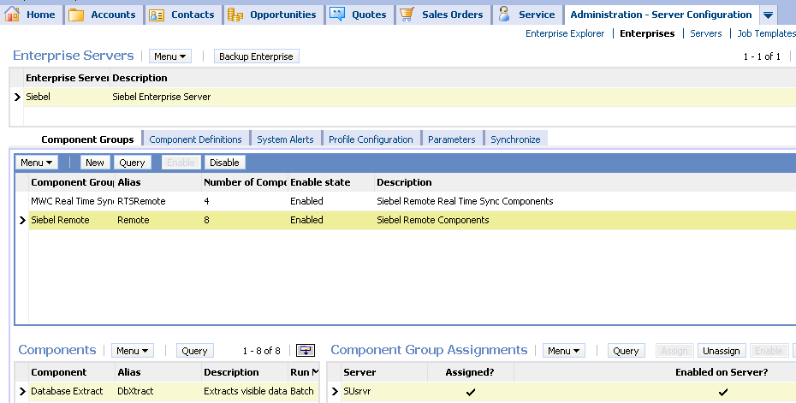
Enable the Development Environment
1/8
Enable the Siebel Remote component group to enable development using a local database
  After enabling a component group, do not forget to restart the Siebel Server and synchronize components
Enable Siebel Remote
Notes:
There are several simple administrative steps that must be taken to enable the development environment.The first is synchronize then to enable Siebel Remote.
One of the changes for 8.0 is that the Enable on Server option must be checked.

Slide 6
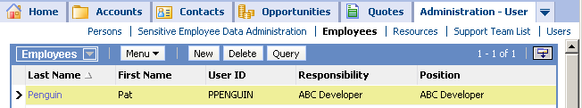
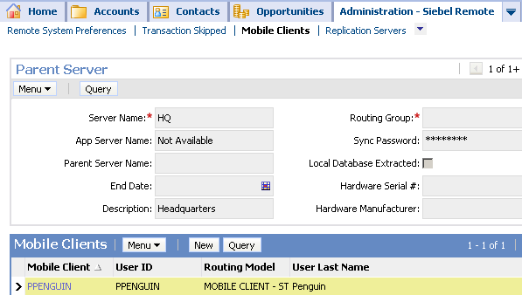
Create the Developer
2/8
Add the developer as an employee
Associate a position and responsibility
Register the developer as a mobile client
Add employee record
Register mobile client
Notes:
Students have already created employees when they set up the company structure in the Security section. The only new thing here is the mobile client. PPENGUIN is the login used for the developer user in the course. The developer user is created as a mobile client because they need to use a local database.
In the lab, students create a new ABC Developer responsibility with repository views. The responsibility provides a way to control access by assigning a set of views associated with a job role. In general, you probably want to limit the views a developer can access. You can control access for developers by creating a new responsibility that contains only those views required by the developer and then associating it to the developer’s user record.
Since the developer environment uses Siebel remote, each developer must be setup as a remote client. One value you’ll set is Routing Models, which are used to reduce the amount of data replicated to mobile users. Reducing data replication can reduce synchronization and transaction times for some users. For a majority of mobile users, the MOBILE CLIENT - STANDARD, MOBILE CLIENT - EXTRACT ONLY, or Executive Management routing model is adequate. Before you deploy Siebel Remote with any of the other specialized routing models, it is strongly recommended that you discuss this with a Siebel technical resource.

Slide 7
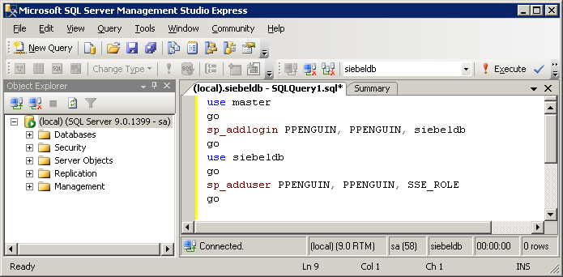
Create a User Login
3/8
If necessary, create a corresponding database login using RDBMS tools and the grantusr.sql script as a template
Example:
Screen shot from Microsoft SQL Server Management Studio Express copyright © Microsoft Corporation
Notes:
There must be a corresponding database account for the user. This is an activity typically performed by a database administrator.
The grantuser.sql script, which resides in
C:\SUsea\dbsrvr\ <database server type>,
contains the syntax for creating a database user in the respective RDBMS.
The screenshot includes a sample from the grantusr.sql script. The format of the commands are specific to the server database. This sample shows MS SQL Server syntax (the RDBMS used in the labs).

Slide 8

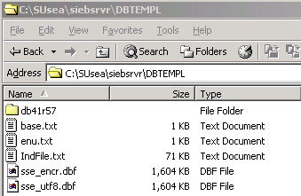
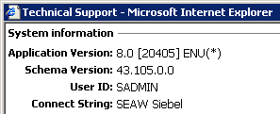
Generate the Local Database Template
4/8
Run the Generate New Database server task to generate a local database template
  Snapshot of the current version of the database schema (tables, columns, indexes, and so forth)
Notes:
The Generate New Database server task creates a series of files that capture the current database’s structure (schema), at that point in time. Therefore, the developer user has a representation of the same tables and columns contained in the server database on their local database. Note that the output of this server task is placed under a directory called DBTEMPL on the server machine.
Students have seen how to run server tasks in prior modules. This is the first real application. Notice that the template is specific to a given version of the database schema.
If columns are added, a new template needs to be created. The template here is for SQL Anywhere, but one can also be generated for MS SQL Server. This would be defined in the Client Db Type parameter in the Generate New Database task. The task is discussed in more detail in the modules on Siebel Remote.

Slide 9
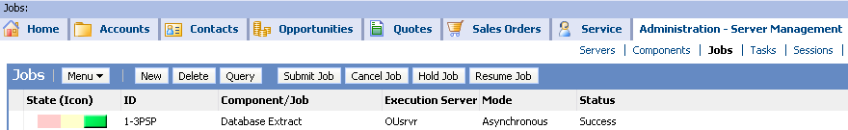
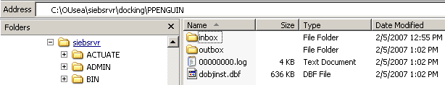
Extract User Data
5/8
Run the Database Extract server task to extract user data
  Generates compressed data files
    Stored on the server
  User data is extracted for the user(s) specified in the job parameters
Data is extracted to the specified mobile user’s directory
Notes:
Database Extract retrieves from the server database the user visible data for a specific mobile client, and packages the data into compressed files. When you initialize the database, this data is then used to populate the local database with user data (not repository data). Database Extract uses the schema represented in files from the Generate New Database task, which should be run immediately before extracting user data.
Ensure you enter the full name for the mobile client, such as PPENGUIN. When using Client Name during database extract, Siebel Remote searches for the “node” name, which is identified by the full mobile client name. If you fail to enter the full name, as specified in Siebel Remote > Mobile Clients, you will receive an “Unable to find node in database” error.

Slide 10
Modify Configuration Settings
6/8
Modify configuration information for Siebel Tools in ..\tools\BIN\<Language Code>\tools.cfg
  For example, ..\tools\BIN\ENU\tools.cfg
Modify configuration information for Siebel Developer Web Client in ..\client\BIN\<Language Code>\<application>.cfg
  For example, ..\client\BIN\ENU\uagent.cfg for the Siebel Call Center Developer Web client
Both configuration files hold critical information to ensure proper behavior of local executables:
  Native client connection information for the local database
  ODBC connection for the server
  ODBC connection for the local database
  Location of the local Siebel file system
Notes:
When you initialize the local database you create a database called sse_data.dbf on the developer’s local machine, and then populate it with data visible to the user. Because you want to perform configuration tasks using this database, you need the repository data. This data does not come from Database Extract. Database Extract is done for all mobile users, but repository information is specific to developers. Therefore, developers use Siebel Tools to connect to the server using ODBC, and copy the repository data into the local database.
You need to verify/update the ODBC data source for Tools, connecting to the server. The Siebel Server installation program automatically creates an ODBC system data source name (DSN) that it uses to connect to the Siebel Database Server.
This setting ensures ODBC is directed to the database you are about to initialize. In the lab, you will create an ABC application on Penguin’s local machine. If this setting is configured incorrectly, ODBC will not be able to locate the database, and you will receive an invalid user/password error any time you attempt to access the ABC application.

Slide 11
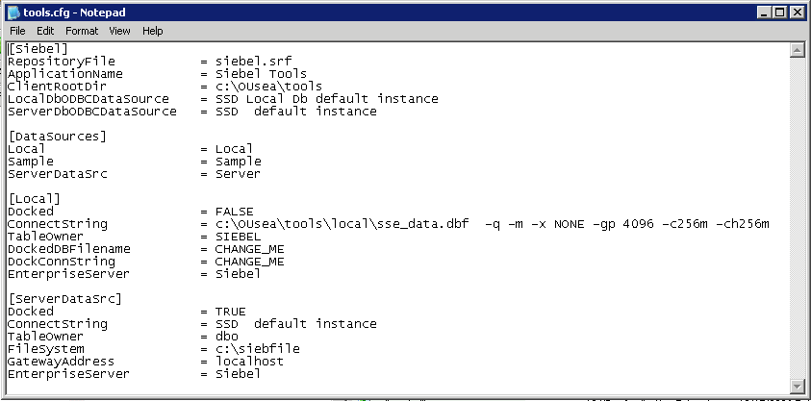
Example Configuration Settings
6/8
Example: tools.cfg (edited for length)
Overall configuration: Name of SRF file, application name, root directory, and ODBC connections to local and server databases for testing connectivity
Available data sources. Add more if needed.
Local connection information, including native connect string. Note absolute path. Modify if local database is in a different location.
Server connection information
Notes:
When you initialize the local database you create a database called sse_data.dbf on the developer’s local machine, and then populate it with data visible to the user. Because you want to perform configuration tasks using this database, you need the repository data. This data does not come from Database Extract. Database Extract is done for all mobile users, but repository information is specific to developers. Therefore, developers use Siebel Tools to connect to the server using ODBC, and copy the repository data into the local database.
You need to verify/update the ODBC data source for Tools, connecting to the server. The Siebel Server installation program automatically creates an ODBC system data source name (DSN) that it uses to connect to the Siebel Database Server.
This setting ensures ODBC is directed to the database you are about to initialize. In the lab, you will create an ABC application on Penguin’s local machine. If this setting is configured incorrectly, ODBC will not be able to locate the database, and you will receive an invalid user/password error any time you attempt to access the ABC application.

Slide 12
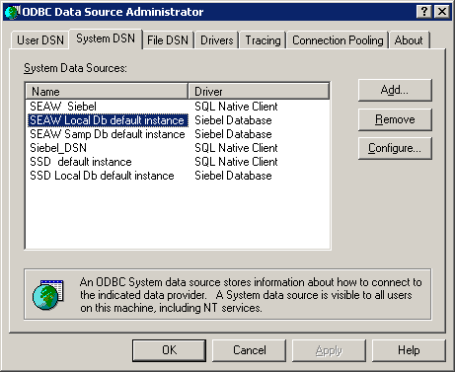
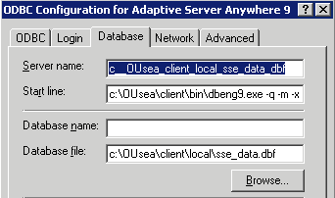
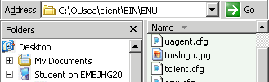

Verify Web Client ODBC Connections
6/8
Ensure that the Web Client ODBC connection references the local database
  The database file parameter of SEAW Local Db default instance must match ConnectString in [Local] section of uagent.cfg
  ConnectString must point to local DB: \client\LOCAL\sse_data.dbf
Web Client connection. . .
. . .must match
Must point to local DB
Notes:
When you initialize the local database you create a database called sse_data.dbf on the developer’s local machine, and then populate it with data visible to the user. Because you want to perform configuration tasks using this database, you need the repository data. This data does not come from Database Extract. Database Extract is done for all mobile users, but repository information is specific to developers. Therefore, developers use Siebel Tools to connect to the server using ODBC, and copy the repository data into the local database.
You need to verify/update the ODBC data source for Tools, connecting to the server. The Siebel Server installation program automatically creates an ODBC system data source name (DSN) that it uses to connect to the Siebel Database Server.
This setting ensures ODBC is directed to the database you are about to initialize. In the lab, you will create an ABC application on Penguin’s local machine. If this setting is configured incorrectly, ODBC will not be able to locate the database, and you will receive an invalid user/password error any time you attempt to access the ABC application.

Slide 13
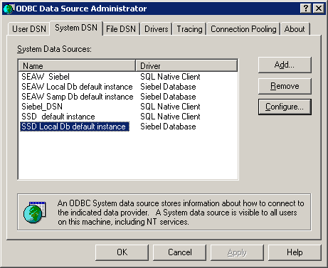
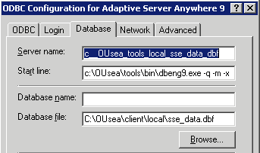
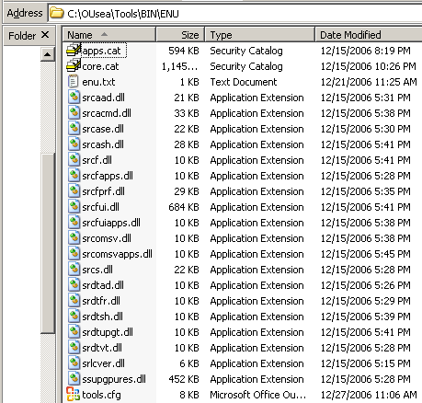

Verify Tools ODBC Connections
6/8
Ensure that the Tools ODBC connection references the local DB
  The database file parameter of SSD Local Db default instance must match ConnectString in [Local] section of tools.cfg
Tools connection. . .
. . .must match
Notes:
In addition to the web client, Siebel Tools also uses ODBC as its connection method to sse_data.dbf. In ODBC Data Source Administrator, the Tools connection appears as SSD Local Db default instance.
You need to verify that Tools is correctly configured to connect to the server and local databases. When logging into the local database you connect directly to the connect string specified in the [Local] section of the .cfg file. When you are logged into a local database, the Mobile Web Client is allowed to synchronize. This synchronization takes place on the Siebel Server designated in the .cfg file.
The connect string specified in Tools.cfg can be verified by viewing the Technical Support dialog in the Tools application.
As illustrated in the slide, the database file to which the Adaptive Server Anywhere executable is directed must match Tools’ connect string.

Slide 14
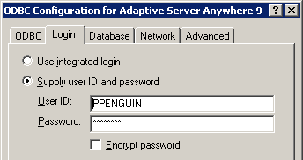
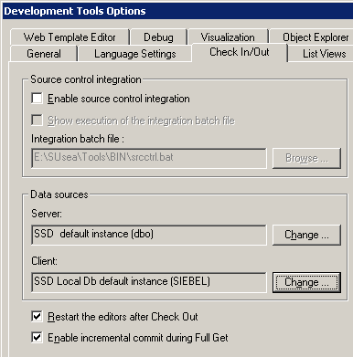
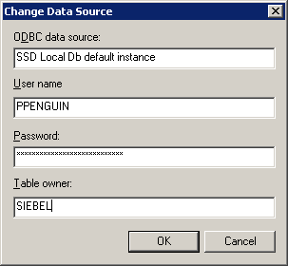
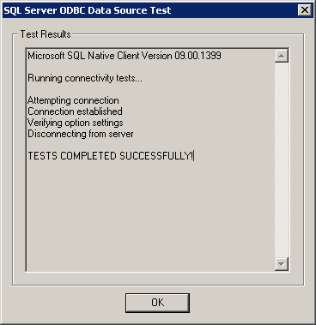
Test Tools ODBC Login
6/8
Check user IDs and passwords, and then test the connection
1. Check
2. Test
Notes:
To ensure the ODBC connection, you can use the Test Data Source option that appears at the end of a series of configuration screens in ODBC Data Source Administrator. The test will establish a connection, verify option settings, then disconnect from the server.

Slide 15
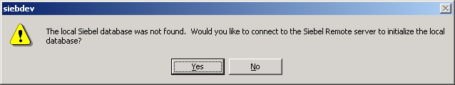
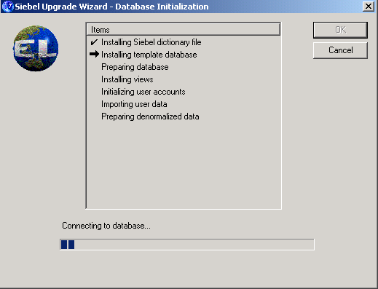
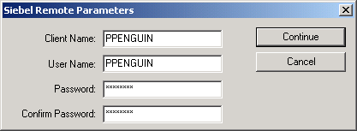
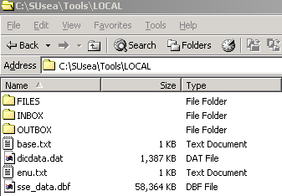
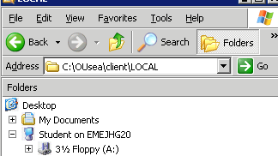
Initialize Local Database
7/8
Local database is initialized upon first login to client
  Creates local database (sse_data.dbf) from template
  Populates local database with data from compressed files
Local db
Notes:
You can initialize the database by launching tools or the web client. Either way, the Siebel Remote Parameters dialog will display. Database initialization creates a database by the name of sse_data.dbf, and then populates it with the data visible to the user. The local client connects to the Siebel Server to pull down the database schema and data files to create a new local database. Again, this is covered in detail later in the Siebel Remote modules.
In the lab, you will initialize the sse_data.dbf SQL Anywhere local database using Siebel Remote. In this step, you’ll use an Upgrade Wizard to perform the initialization. During database schema upgrades, new and changed objects are identified by comparing the current physical schema with the new virtual schema. Based on this comparison, Upgrade Wizard adds new objects and alters existing objects. Upgrade Wizard first applies the new local database (including a new schema) to the remote user's machine. Next, Upgrade Wizard applies any server transactions downloaded during synchronization.
Possible Demo: in the lab, you will perform an important verification step. If the configuration is incorrect, Tools may still open but be mapped to a database other than the local sse_data.dbf database. You must be able to log in as PPENGUIN connected to the local sse_data.dbf database in order to continue with the labs.

Slide 16
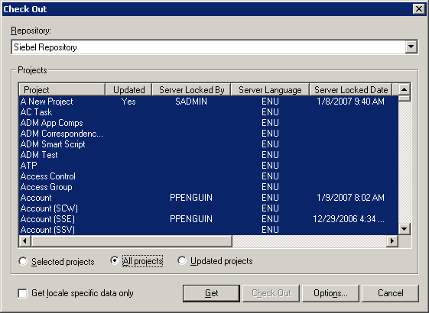
Extract Repository Data
8/8
Perform a Get to extract repository data
  Copies all objects from the server repository to the local repository
  Must be performed before compiling
    SRF must be based on the full set of Siebel objects
“Get” all projects to extract repository data
Notes:
Next, you Ppopulate the local database with object definitions from the repository. Since you want to perform configuration tasks using this database, you need the repository data. This data does not come from Database Extract, which is performed for all mobile users. Developers require repository information that is specific to development tasks. Developers use Siebel Tools to connect to the server using ODBC and copy the repository data into the local database.

Slide 17
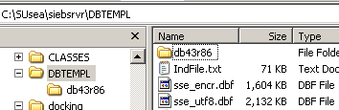
The Big Picture
Steps to create a usable local database
Server
Template provides schema
3. Use templates to initialize local DB and populate user data
1. Generate DB template
Client
Compressed files provide user data
Local Database
2. Extract user data
Server database provides repository data
Server Database
Repository Data
4. Extract repository data
Notes:
This slide brings together the previous several slides into a single image that illustrates the four steps required to create a usable local database.
This slide illustrates:
1. The template and compressed files are generated on the server first.
2. The Extract task extracts user data. User data is extracted from siebeldb.mdf.
3. Repository data is extracted from the server database by peforming a full Get.
4. The local database is created and populated with user and repository data using the template files and compressed user and repository data files stored on the server.

Slide 18

Additional Developers
For each additional developer:
  Create the developer
  Create a user login
  Extract the local database
  Initialize the local database
  Verify login and data sources
Server Machine
Developer Workstation
Developer Workstation
Developer Workstation
Server
Local
Local
Local
Notes:
This slide summarizes the work that must be done for each additional developer.
Each developer should have his or her own machine, and needs to undergo the same process steps described. The result is each developer has their own local databases and an exact copy of all the definitions that reside in the server repository.

Slide 19
Module Highlights
Siebel Remote is used to establish a local development environment
An individual developer uses Siebel Developer Web Client to develop and test custom configurations
Create the development environment by:
  Installing Siebel Tools on the client
  Enabling Siebel Remote on the server
  Creating a developer, login, and remote user on the server
  Generating, extracting, and initializing a local database
  Verifying login and data sources
Notes:
Review Question: When would developers working on a Siebel configuration modify the code in siebel.exe?
Answer: They wouldn’t.
Review Question: Why should you set up a separate development environment for configuration?
Answer: To isolate the development effort from the enterprise’s production database. Also acceptable: To allow developers to work independently on different aspects of the development effort; to test customizations and extensions thoroughly prior to deployment.

Slide 20
Lab
In the lab you will:
  Set up an employee as a developer
  Extract a local database for the developer
  Populate the developer’s local database with user and repository data

