Slide 1

Module 22: Managing Object Definitions
0/5
Siebel 8.0 Essentials
Notes:
Time: Lecture: 30 - 40 minutes; lab: 30 – 40 minutes
Intent: To define projects and how developers use them to manage work in a multi-developer environment. The major activities that students learn involve moving object definitions between a central repository on the server and the local development repository.
Flow: Defining projects, checking out and getting projects, checking projects in, and locking projects locally.
Key Terms:
Projects
Server Repository
Local Repository
Check-in and Check-out
Get
Extract All Repository Tables
Project Differences
Locking Projects

Slide 2
Module Objectives
After completing this module you should be able to:
  Explain the role of projects
  Manage object definitions using Check Out and Check In
  Lock projects locally
Why you need to know:
  Checking projects in and out are critical tasks that enable multiple developers to work together on a configuration effort
Notes:
Each objective and “why you need to know” should be stated aloud.

Slide 3
Projects
Are named sets of object definitions in a repository
  Only one version of a project exists in a repository at a time
Are a mechanism to organize object definitions so that a single developer can exclusively work on them as a group
Project
Account (SSE)
Applets
Screen
Account List Applet
Accounts Screen
Account Entry Applet
Views
Account List View
Manager’s Account List View
All Account List View
Account Profile View
Object definition with Project property = Account (SSE)
Notes:
This slide defines a project as a named group of object definitions. The slide illustrates the concept by showing select object definitions from three projects. Make the class aware that this is just a sample of projects and definitions. You might also note that projects are not necessarily based on object type.
You can think of a project as simply a container for one or more object definitions. When a developer takes ownership of a project, they edit its contents. (This is done by locking the project, which students will see later.) Other developers will not be able to edit those object definitions while someone has ownership of the project and its contents (that is, the project is locked).

Slide 4
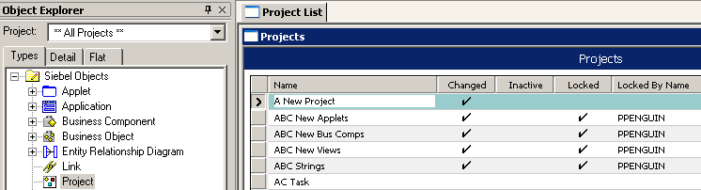
Existing and New Projects
The as-delivered Siebel application contains a large number of existing projects
New projects are created by:
  Selecting the Project object type, and
  Creating a new record in the Object List Editor
Notes:
A newly-installed repository has lots of projects, and you can easily create new ones. Note that a Siebel application does not allow you to delete a project once it is created.
A standard Siebel application comes with a large number of existing projects. Because Siebel is a prebuilt application, it has prebuilt object definitions. These are contained in predefined projects. The project name typically indicates the contents of the project. For example, object definitions pertaining to the account functional area would appear in the Account project. Siebel-delivered projects without suffixes usually contain Business Object layer definitions that span multiple Siebel applications, while those with suffixes contain definitions specific to the application. For example, Account would typically contain the Account BC and the Account BO, while Account (SSE) would typically hold UI definitions such as the Account List Applet. The suffixes are acronyms for the different applications. Common suffixes you will see are: SSE for Siebel Sales Enterprise, SSV for Siebel Service Enterprise, TAS for Target Account Selling, and FS for Field Service.
Possible demo: Show students Account and then Account (SSE) to illustrate which types of object definitions reside in which project and the different suffixes.
Projects are an object definition in their own right, but project definitions do not have a Project property. Note that when you are looking at the project object definitions in the OBLE (as shown) you cannot execute a Tools > Lock Project. You lock a project here by clicking the Lock property check box.

Slide 5
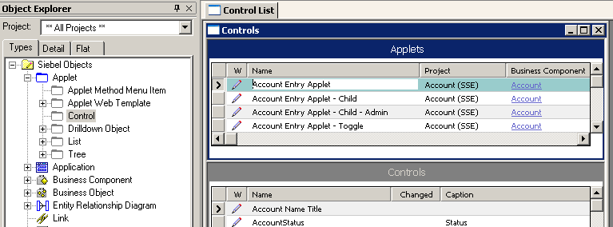
Assigning Object Definitions to Projects
Every object definition must belong to one, and only one, project
  Either a Siebel-supplied project, or
  A user-created project
A top-level object definition has a Project property
  Child object definitions belong to the parent’s project
Child belongs to parent’s project. It does not have a project property.
Notes:
An object definition can be assigned to one and only one project. You can select a project only for a top-level object definition; all its child definitions automatically belong to the parent project.

Slide 6
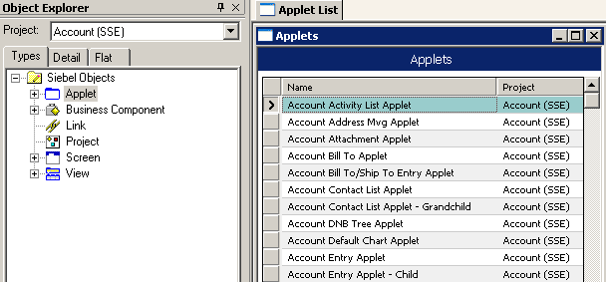
Viewing Object Definitions by Project
View object definitions in a project using the Project drop-down list
  Displays object types for which there are object definitions in the selected project
  Select **All Projects** at the top of list to see all projects
1. Select project
2. Select object type
3. Object Type with project property = Account (SSE) displayed
Notes:
The OE has a drop-down list at its top that allows you to select a specific project. When you do so, the OE shows only object types for which there are object definitions in that project.
To select all projects in Siebel 7.7, you pick **All Projects** from the Project drop-down list.

Slide 7


Repositories
Master copy of repository resides on server database
  Stores tested object definitions for entire development team
Each developer has repository copy on local developer (client) workstation
  Developers perform all editing on their local repository
Server Machine
Developer Workstation
Developer Workstation
Developer Workstation
Server
Local
Notes:
This slide reminds students that they must work on a local database.

Slide 8
Copying Projects
Check In and Check Out safely manage concurrent use by multiple developers
Object definitions in one or more projects can be copied:
  From the server to the local developer repository (Use Get or Check Out to retrieve definitions)
  From the local developer repository to the server (Check In)
Overwrites the version in the destination repository
1. Developer uses Get, Check Out
2. Developer modifies objects
Project
Server
Local
3. Developer uses Check In
Notes:
This slide introduces the idea that you can copy projects (the smallest unit that can be copied) back and forth. Do not get into details about Get, Check In, and Check Out at this point.

Slide 9
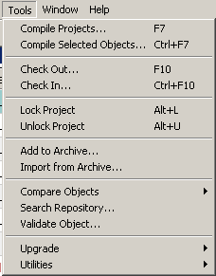
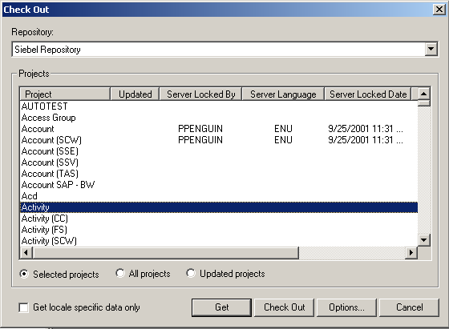
Getting Projects
Get populates a local database with a copy of projects from the server repository
Use Get to bring object definitions modified by other developers to your local database
Use Get with All Projects selected to populate a newly-initialized local database
Notes:
This slide explains what students did in a previous lab (select Check Out from the Tools menu and then select Get from Check Out window), when they set up the developer environment. Now mention that Get can be used to refresh the local repository whenever there is an updated project on the server.
Note that Get populates all the projects. Also, no locks are placed on the server.

Slide 10
Check Out
Click Check Out to copy projects from the server repository to the local repository
  The project’s Allow Object Locking property must be disabled
Notes:
Check Out and Check In provides a way to control the output of multiple developers working in the same repository. It allows you to check out objects from the server and download them to your local repository for editing. When you check out a project, all objects associated with that project are locked on the server. This prevents other developers from checking them out and avoids conflicts that could result from multiple developers working on the same objects simultaneously. When you check the project back into the server, the lock is removed, and the project and its associated objects are available for other developers to check out.
You can't check out a project if Allow Object Locked flag is set to Y. As of Siebel 8, out of the box functionality has Allow Object Locking set to Y for all projects. If a customer desires to checkout an entire repository, it will be necessary to disable object locking for all projects. The only easy way to do this is to run an SQL: UPDATE S_PROJECT SET OBJ_LOCKED_FLG = 'N'. This changes the flag on the server DB, but the flag still appears on the client's local copy. CAUTION: customers who run SQL in this fashion may not be supported.

Slide 11
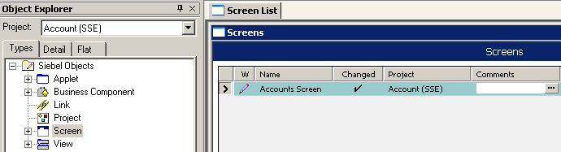
Check Out Continued
Use Check Out in order to edit object definitions in a project
  Copies all object definitions in project on server to local database
    Local copy of project is overwritten by server version
  Locks project on server repository
    Prevents other developers from modifying that project
  Locks the project in the local repository
    Permits developer to make changes to object definitions in that project
Pencil indicates “writable”
Property is editable
Notes:
In order to edit an object definition, you must have it locked. A Check Out process copies over the object definitions from the server to the local repository. It locks the project on the server so that no other developers can modify the definitions it contains. It locks it locally so that you can modify the definitions it contains.
In Tools, projects that have been checked out are indicated in the W property with a pencil icon.

Slide 12
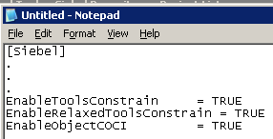
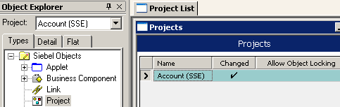
Check Out Objects
Allows for checking out individual objects
  Quicker than checking out entire projects
To enable object-level Check Out
  Enable object-level Check Out in the [Siebel] section of tools.cfg
    Ensure ToolsConstrain parameters = TRUE
    Add EnableObjectCOCI=TRUE
  Log in to Tools as SADMIN to the server database and enable the project’s Allow Object Locking property
1. Enable object-level Check Out in tools.cfg
2. Log in as SADMIN to server, then enable Allow Object Locking
Notes:
For each project you can specify whether or not developers are allowed to check out and check in individual objects within the project. To allow developers to check out and check in objects, you set the project's Allow Object Locking property to TRUE. To modify the Allow Object Locking property, you must login to Tools as SADMIN to the server database.
Note: in some pre-GA releases, in order to enable object-level check-out, the following must also be inserted into the Siebel section of tools.cfg:
EnableRelaxedToolsConstrain = TRUE

Slide 13
Canceling Check Out
Discards changes made to checked-out project if:
  Changes are no longer required
  Local project has become corrupted
To cancel a Check Out of a project:
  Check out the project from the server again
    Replaces modified object definitions in local repository with original version from server repository
    Repeating Check Out is permitted for person who last checked out project
  Then check in the project to unlock the project on both the local and server repositories
Notes:
This is not a formal operation with its own menu item, but it is a common operation in most version control systems. To cancel a check out, you need to check out the project again (since you already have the project locked) to undo all the changes on local repository and check the project back in. Click Cancel when you no longer want the changes you made to the object definition on your local repository.

Slide 14
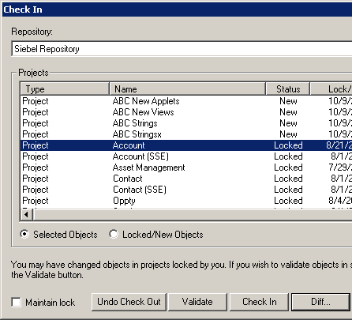
Undo Check Out
Use Undo Check Out to release lock on a project on the server without checking in edited object definitions
  Makes the original project available to another developer
  Can be followed by Get to restore original definitions in local DB
    Alternate way to cancel
    Check Out
Undo Check Out:
  Releases lock on server
  Retains lock on local
  database
    Developer can continue to
    modify object definitions but
    will not be able to check
    them in to the server
Cannot publish definitions
Notes:
One example usage:
- Perform an Undo Checkout followed by a Get.
- Routinely do a Get daily on changed projects to keep the local database up to date with other developer’s work.
This is done for the following reasons.
- Perform the Undo Check Out right before the daily Get. This way, not much time is added to the developer’s day waiting for the Get to complete.
- Provides a fallback if work is accidentally overwritten by checking out the wrong project. For instance if the Account and Account (SSE) projects are both locked it would be a simple mistake of the mouse to overwrite the wrong project.

Slide 15
Check In
Is used when object definitions in the project have been edited and tested
  Copies object definitions from local repository to server repository
  Replaces versions of checked out object definitions with new versions and unlocks projects
    Can also check in object definitions in newly created projects
  Releases locks on both server and local copies of project
    Maintain Lock leaves project locked for further local modification by current developer
Notes:
Check In returns the edited object definitions to the server and normally unlocks the projects on both repositories.
Check in work that has been tested to update the object definitions on the server. This process releases the locks both on the local database and on the server database. To check in the new object definitions but keep ownership of the project, perform a Check In with Maintain Lock. This will not release the locks, so you may continue to modify the object definitions.

Slide 16
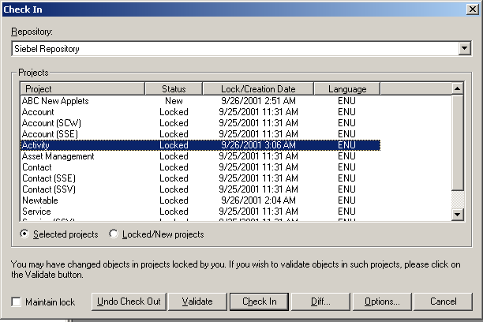
Check In Continued
Click Check In to copy projects and objects from the local repository to the server repository
Notes:
This slide shows how to do a check in. This is a screenshot showing the menu options and the Check In dialog box. The “Maintain lock” option mentioned on the previous slide is the check box on the bottom left. You can check in those individual projects you select, or choose to check in all projects you have locked or that are new.

Slide 17
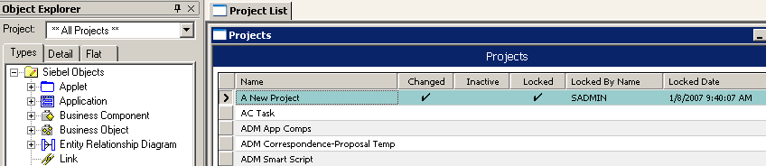
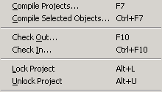
Locking Projects
You can directly lock and unlock projects in the current repository (local or server)
Click to set Locked property directly…
Or Select Tools > Lock Project
Notes:
This slide introduces the idea that you can lock a project directly. These are the two methods. There are ramifications to using each of these methods, and they are discussed in the following slides.

Slide 18
Locking Projects Locally
Allows developer to make and test modifications locally
Prevents developer from checking changes into server repository
  However, locking does not prevent other developers from checking out and modifying a project
Consider when:
  Prototyping your ideas without preventing other developers from checking out the project
  Intending to discard (rather than save) your work
Server Machine
Developer Workstation
Developer Workstation
Developer Workstation
Server
Local
Notes:
The slide shows situations when it is OK to do this. Remind students that if they do this, they will not be able to copy the modified object definitions to the server.

Slide 19

Do Not Lock Projects on the Server
Oracle recommends that developers never directly lock projects on the server
  Prevents the developer from undoing changes and restoring original definitions
  Allows other developers to get object definitions in an incomplete, inconsistent, and untested state
Always use Check Out and modify the object definitions locally
Server Machine
Developer Workstation
Developer Workstation
Developer Workstation
Server
Local
Notes:
This slide has an important main message. Locking projects on the server is not a good idea. Even a single developer should not do it, because you lose the ability to roll back.
Locking projects directly on the server is potentially a very dangerous activity because any errors you make here are being applied to the master copy of the repository. Other developers using this repository would be accessing those errors. For this reason Siebel Systems, Inc. does not recommend doing this. To recover, you would need to use some backup of the repository to restore it to a consistent state prior to the errors.

Slide 20
Module Highlights
Projects organize object definitions so a developer can work on them exclusively
The as-delivered application contains many projects
Every object definition must belong to one, and only one, project
Developer edits a copy of master repository residing on local client
Check Out and Check In are used to modify object definitions
  Project locking ensures only one developer can modify a given object
Notes:
Review Question: What is a project?
Answer: Projects are named sets of object definitions in a repository. They are used to organize object definitions so that a single developer can exclusively work on them as a group.
Review Question: What are some ways to lock a project?
Answer: Check out the project to lock it in the server and local repository. Perform a Check In with Maintain Lock. This does not release the locks, so you may continue to modify the object definitions.

Slide 21
Lab
In the lab you will:
  Explore how projects work in Siebel Tools
  Check out a project from the server

