Slide 1

Module 23: Editing and Compiling Object Definitions
0/5
Siebel 8.0 Essentials
Notes:
Time: Lecture: 35 minutes; labs: 70 – 80 minutes
Intent: To discuss the operations that you can perform on object definitions: editing, verifying, compiling, and archiving.
Flow: Editing object definitions, validating object definitions, archiving object definitions, comparing object definitions, compiling object definitions, and testing a configuration.
Key Terms:
Changed Flag
Validating Object Definitions
Exporting Object Definitions
Export to Archive File
Archive Recommendations
Exporting Projects
Importing Object Definitions
Import Conflicts
Compare Objects
Source Code Control Integration
Backing Up the Development Database
Compiling
Uagent.cfg
Rapid Unit Testing

Slide 2
Module Objectives
After completing this module you should be able to:
  Create new and edit existing object definitions
  Validate edited object definitions
  Archive object definitions and projects
  Back up the local database
  Compile object definitions into a repository file
Why you need to know:
  These are fundamental activities that occur during all configuration efforts
Notes:
Each objective and “why you need to know” should be stated aloud.

Slide 3
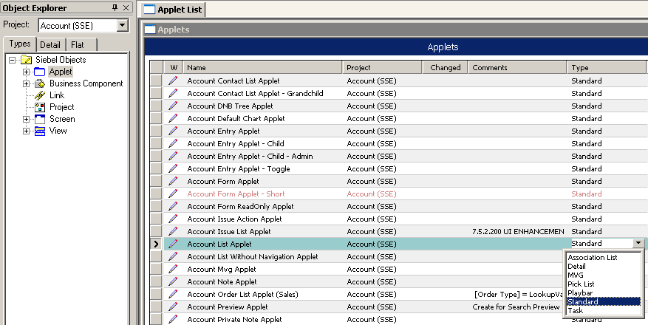
Editing Object Definitions
Use the Object Explorer and Object List Editor to edit object definitions
  Ensure that the project has been locked
Type in a value, or. . .
. . .select a value
Pencil indicates object is locked and editable
Notes:
You can edit object definitions directly in the list editor. Remind students that they need to have the project locked before they can make any changes. You can type in values or use any picklist provided to select values. An alternative to this method is to use the Property window from Views > Windows > Properties Window to enter or edit values. Note that the Project and Changed properties are not available if you use the Property window.

Slide 4
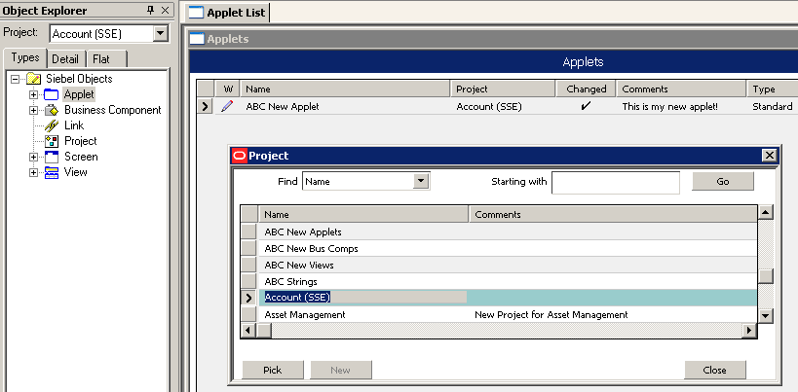
Creating a New Object Definition
Select the desired object type in the Object Explorer
Create a new record in the Object List Editor
1. Enter a unique name
2. Select a project from
the picklist
3. Assign values to the remaining properties, as necessary
Only locked projects are available for object creation
Notes:
You can create a new object definition using the list editor. If it is a top-level object, then it needs to be assigned to a locked project

Slide 5
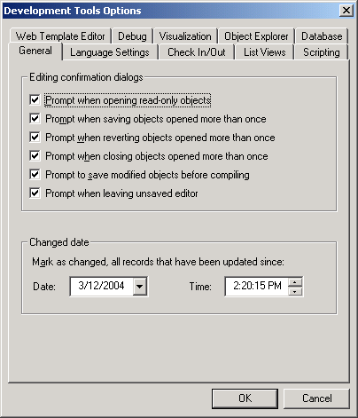
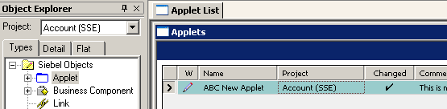
Changed Flag
Indicates records that have been modified since the changed date
Is set whenever a record is edited
Is cleared by resetting the changed date value
Notes:
The Changed flag tracks all object definitions that have been edited. It does not matter if you undo the edit later, as the Changed flag will still be set. (Tools does not keep track of prior values once the record is committed.) To clear the Changed flag, reset the changed date as shown on the slide.
You can see which object definitions have been modified since a specified Date and Time. Select View > Options > General tab to set Date and Time settings. A check mark appears in the Changed property if that object definition has changed since the Date and Time selected. The Changed flag does not indicate which property has changed; it only acts as an indicator that something about this object definition has changed. You will not know what values have been changed using this mechanism.
Tip: When you set the Date and Time, take an Archive of the object(s) or project(s) before you change them. You then have a backup of the object definitions before you start to modify them. If you need to know what you changed since that time, pull up the archive file and explore the differences in the property values.

Slide 6
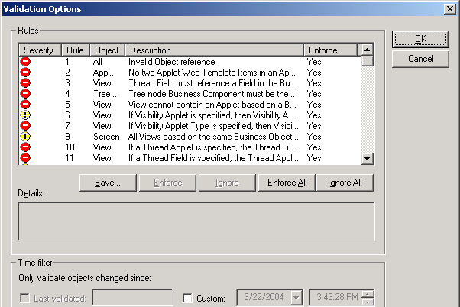
Validating Object Definitions
Determines the correctness of selected object definitions in the repository
  Includes all child object definitions for the selected parent definitions
Is based on a set of Siebel-defined rules
Error
Warning
User can enable or disable a Siebel-defined rule
Notes:
This slide introduces the fact that you can validate an object definition against 180 or so syntactic rules. Validating an object definition compares the object definition to a set of rules for that object type. If the object definition does not satisfy the rule, an error or a warning is reported.
This screen shot shows validation options; here we can see the 180 or so rules and whether or not they are errors or warnings. For example, rule 22 states that a business component should have at least one required field. If the business component you are validating does not have one field specified as required, then this is flagged to you when you select the Start option in the Validate window (this window is shown on next slide).
You can also decide whether or not to enforce or ignore a particular rule when performing the validation of the object definition.

Slide 7
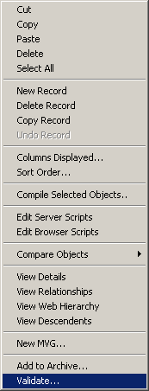
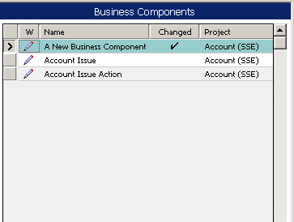
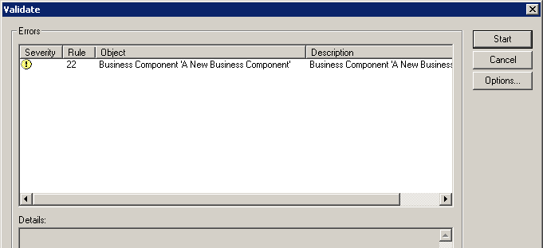
Validating Object Definitions Continued
Select the object definition to validate
Right-click and select Validate
Click Start in the Validate dialog box
Violations appear in Errors list
Click to access the Validate Options dialog box
Notes:
This slide shows how to validate.

Slide 8
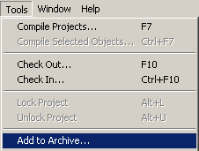
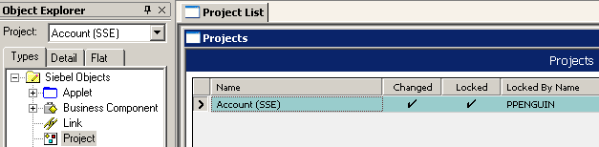
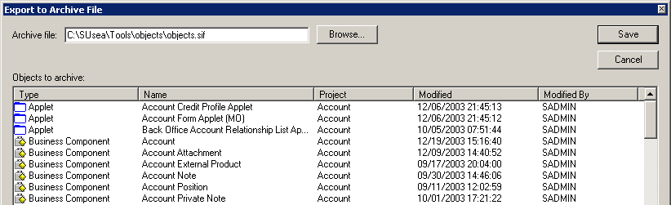
Archiving Projects
Projects can be archived to .sif files
  Select the project (or projects) to be archived
  Select Tools > Add to Archive
  Select an existing (or create a new) archive file
  Click Save in the Export to Archive File dialog box
Notes:
Projects can also be archived. All the object definitions contained in that project are archived.

Slide 9
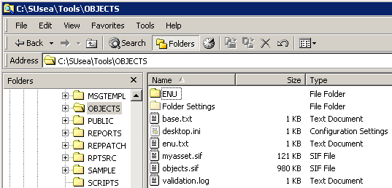
Archive Files
Contain projects exported from a repository
  Available for importing into other repositories
Have .sif extension by default
Are used to share projects among developers
Are used to back up projects
Can be version-controlled using source code control systems
Archive file
Notes:
This slide explains archive files and how they can be used. Point out to students that it is a useful way to back up the changes to the projects that you are working on.
Archive files are a mechanism of exporting projects from a repository. The file extension is .sif. They can be used to back up projects or to move projects from one repository to another.

Slide 10
Archive Recommendations
Archive the entire project
Do not archive individual objects
  Could result with inconsistent object definitions
  Difficult to recover from a partial or incomplete archive
  Will only save a few minutes per day compared to archiving the project
Archive at appropriate intervals
  Prior to implementing a large amount of work
  After testing a section of work
  Several times per day during heavy development
Notes:
This slide explains archive files and how they can be used. Point out to students that it is a useful way to back up the changes to the projects that you are working on.
Archive files are a mechanism of exporting projects from a repository. The file extension is .sif. They can be used to back up projects or to move projects from one repository to another.
Note: individual objects can be archived, but its not recommended. If you wish to present the procedure for archiving objects, here it is:
Top-level object definitions can be exported to an archive file
Includes all child object definitions for selected parent definition
To export object definitions
Select the object definition or definitions
Select Tools > Add to Archive
Select an existing (or create a new) archive file
Click Save in the Export to Archive File window

Slide 11
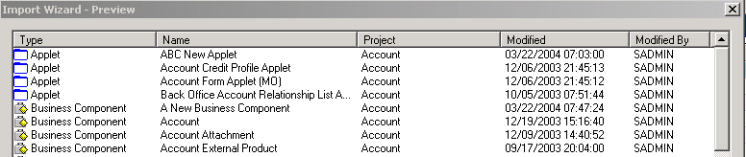
Importing Object Definitions
Object definitions in an archive file can be imported into the local repository on the developer workstation
  Appear in the current active repository
To import object definitions
  Select Tools > Import from Archive
  Select the archive file
  Indicate how to resolve conflicting object definitions
Notes:
This slide explains how to import object definitions from an archive by using Tools > Import from Archive. You will see the object definitions contained inside the archive file. Details of the object definitions include the object type, the object definition name, the project, and who and when it was modified. You cannot select individual object definitions to import from that file. Use the conflict resolution options to specify what to do with object definitions that exist in the repository and in the file. The next slide will discuss this.
This is important to know in case students need to recover from an archive file to catch up during the configuration labs.

Slide 12
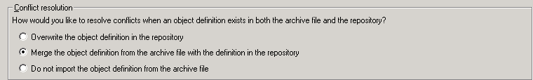
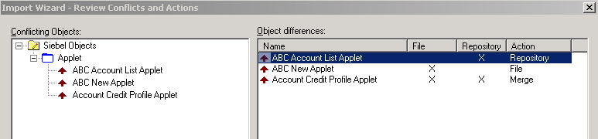

Resolve Import Conflicts
Set the default conflict resolution
Adjust individual resolutions by right-clicking them in the “Object differences” list
Notes:
This slide explains how to deal with conflicts between definitions in the archive and those already in the repository. You can set a default strategy (overwrite, merge, or ignore) and then adjust them on an individual basis. Merge is recommended since it preserves user changes already made to the repository while adding in definitions and properties from the archive. Students need to understand the importing process because they will be doing it in an upcoming lab. Conflict resolution specifies what Siebel Tools should do if the same object definition is found in the file and in the local repository.
“Overwrite the object definition in the repository” deletes the version in the target repository and its children, and replaces them with the definition(s) from the archive file.
“Merge the object definitions from the archive file with the definition in the repository” replaces those properties that are different with the ones coming from the file being imported. It adds new child object definitions to the target if they are not already present.
“Do not import the object definition from the archive” does not change object definitions in the target repository.
When you select Next, you will see which objects conflict in the next dialog box.

Slide 13
Compare Objects
Displays differences between the selected object definition and another one:
  In the current local repository
  In an archive file
  In the repository on the server
Allows developers to identify differences while comparing objects
  Delete individual child object definitions
  Copy individual child object definitions in either direction
Notes:
A feature in Siebel Tools is the ability to compare two objects and observe the differences between them. An object definition in a repository can be compared against an object definition in in the same repository (for example, you made a copy and do not recall all the changes that have been made). An object definition can also be compared against an object definition in an archive file, or in some other repository.

Slide 14
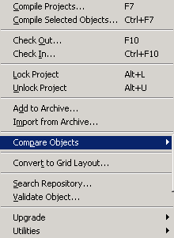

Compare Objects Continued
To compare an object definition to one in an archive or repository:
  Select the object definition to be compared
  Select Tools > Compare Objects
  Select type of comparison
  Select the archive or repository
Notes:
This slide shows how to invoke an object comparison.

Slide 15
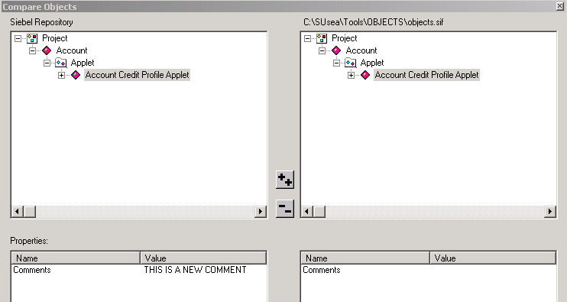

Compare Objects Continued
Examine the differences in the Compare Objects window
Definitions with difference highlighted
Differences displayed
Notes:
The differences will be highlighted in the Compare Objects window. The display uses colored icons to indicate whether two definitions are the same or different. The lower two panes show the property values that differ.

Slide 16
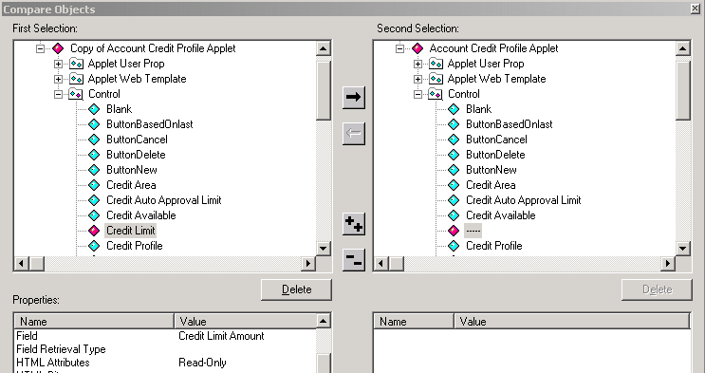
Compare Objects Continued
To compare two object definitions in the developer repository
  Select two object definitions to be compared (by SHIFT-clicking)
  Select Tools > Compare Objects > Selected
Modifying definitions is supported
Copy selected control
Delete selected control
Notes:
A nice feature is that you can do some editing of the object definitions. You can delete or copy fields in either direction (depending upon the locked status of each object definition).

Slide 17
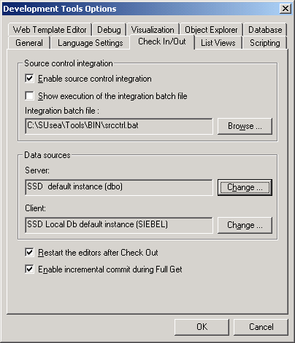
Source Code Control Integration
Automate integration with source code control for repository data
Creates archive when project is checked in
Check archive into code management system
ODBC to server and local databases
Notes:
This slide briefly mentions that you can add archives to a source code control system for version management. The Siebel application does not version control repositories directly.
Optionally, you can integrate your check out/check in mechanism in Siebel Tools with a third-party source control system such as Microsoft SourceSafe. When source control integration is enabled, each time a project is checked in to the server repository, an archive file containing all the object definitions in the project is also checked into the source control system. As a result, successive versions of the project are maintained in the source control system.

Slide 18
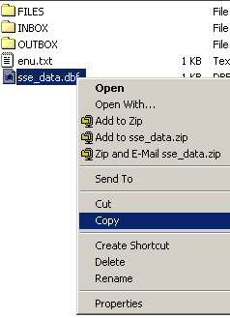
Backing Up the Development Database
Is achieved by copying the local database file (.dbf)
  Backs up the entire database
Windows copy/paste
Notes:
This slide shows the options available to back up local work.
Use Archive files to keep backups of object definitions
Check the definitions back into the server database
Copy the local database file itself to get a backup of the entire database

Slide 19
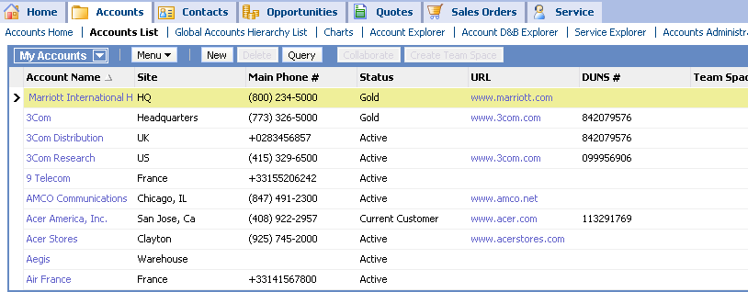
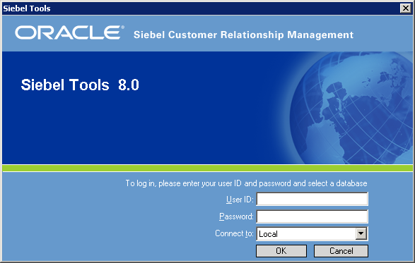
Compiling
Compile to produce an .srf file to test the configuration
  Reads object definitions from repository and creates a flat file representation to be accessed by siebel.exe at run time
Compile into .srf file located in the objects directory of the client application
Configured application
Compiling
Object Manager
SRF
Repository Data
Siebel Repository File
Notes:
This slide reminds students about the concept of compiling. This graphic has appeared in the course a couple of times before. Stress that you compile into a .srf file in the client installation directory (not the Tools directory), even if you are using the same database.
To test the application, a repository file (.srf) needs to be compiled from within Tools. A repository file is a compressed, binary, read-only file that contains the configured object definitions that reside in the repository. A single repository file can contain the definitions for one or more applications. This file is used by the Siebel executable to read the object definitions that determine the application’s behavior. The repository definitions are held in this format for faster access.

Slide 20
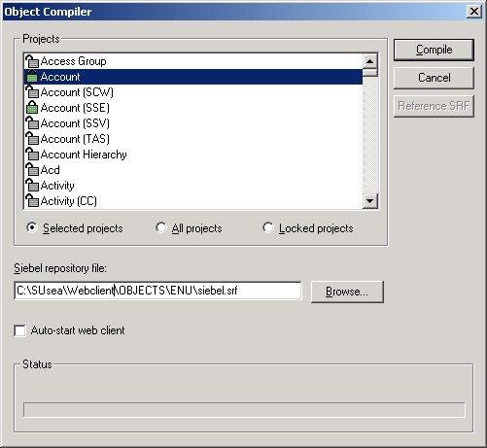
Compile Projects
When starting and at milestones
  Use Compile All Projects to generate a new .srf file
Compile only selected projects or locked projects for
incremental compile
Back up the .srf file
prior to full compile
To compile projects:
  Select Tools > Compile
  Projects
  Select project or projects
Compile into the client directory
Notes:
One choice is to compile projects. Typically you do an “all projects” compile when you start development, and at major milestones to ensure you have a clean .srf file. Otherwise, you will typically do incremental compiles of selected projects or all locked projects. Doing the latter ensures that you compile all definitions that you have edited. Another point to note is that when you get projects to update the local versions of those projects, you need to recompile those projects as well to include them into the .srf. Compiling locked projects will not make that happen.
Note: The other choice is to compile individual object definitions. Although it can be quicker when projects are large, compiling individual objects can be problematic (see earlier slide).

Slide 21
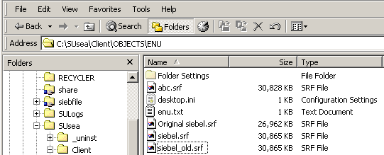
Backing Up the Configuration File
Copy the .srf file to create backups
  Create an initial backup copy before starting development
  Create additional backups after major milestones
Rename the copies and compile into siebel.srf
  Using the original siebel.srf name for development eliminates the need to edit .cfg files to point to a renamed .srf
Compile into siebel.srf
Original .srf
Copy .srf file after major milestones to create backups
Notes:
Typically you compile into a new .srf file (not the one delivered).

Slide 22
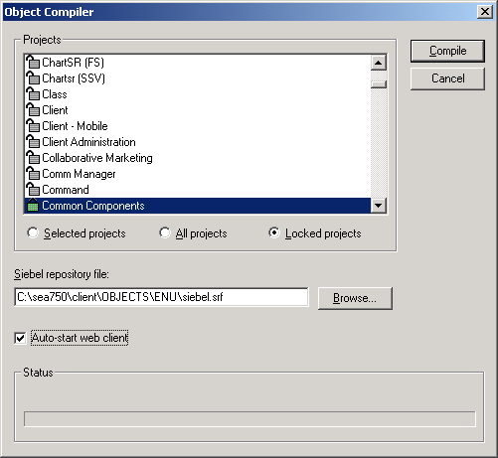

Rapid Unit Testing
Run-time behavior when user compiles SRF
  If Web client is running:
    At end of the compile, the browser window refreshes
    The user is brought back to the view that was displayed before the compile
  If Developer Web Client is not running:
    If user checked auto-start, Web client is started using debug setting
Allows developers to test changes in a local instance of the Developer Web Client
Notes:
This slide identifies the two types of run-time behavior when a user compiles the SRF.
If the Web client is running, at the end of the compile the browser window refreshes and the user is brought back to the view displayed immediately before the compile, in the newly-compiled version.
If the Web client is not running, there are two possible outcomes.
If the user checked the "auto-start Web client" check box, the Web client is started using the debug setting and the user is brought to the standard application home page.
If the user did not check the auto-start check box, nothing happens.
Note: client must be installed on the same machine.

Slide 23
Module Highlights
Object definitions can be created and edited once the project is locked
Validation determines correctness of object definitions
Developer can generate archives that contain exported projects
  Share projects for back-up and version-control
  Export projects to and import from archive
  Highlight import conflicts and project differences
Compile to produce the .srf used to test a configuration
Compiling:
  Reads object definitions from repository tables
  Creates a flat file (.srf) accessed by the Siebel application at run time
Rapid Unit Testing allows developers to test changes using the Developer Web Client
Notes:
Review Question: What do you need to do first before you can edit an object definition?
Answer: Lock it.
Review Question: What does the Change Flag indicate?
Answer: It indicates records that have been modified since the Changed Date.
Review Question: What does compiling do?
Answer: Compiling produces an .srf file which reads object definitions from the repository and creates a flat file representation to be accessed by siebel.exe at run time.

Slide 24
Lab
In the lab you will:
  Practice editing and validating object definitions in Siebel Tools
  Explore the use of diff and archive options in Siebel Tools
  Compile an .srf file

