Slide 1

Module 24: UI Layer Configuration: Web Templates
0/5
Siebel 8.0 Essentials
Notes:
Time: Lecture: 35-45 minutes; labs: 30 minutes
Intent: To present the types of configuration that can be done to application, screen, and view object definitions.
Flow: Specify the Application object. Configure menus and screen tabs. Add views to screens. Configure where views will appear in the Siebel application. Create views using the wizard. Register and assign views to responsibilities.
Key Terms:
Siebel Web Template Files
Siebel Tags
WEBTEMPL
Cascading Style Sheet
PUBLIC\enu\FILES
Web Template Placeholders
Web Template Explorer
swe tag
Web Template Object Definition
Form Applet Web Templates
List Applet Web Templates
View Web Templates
Web Page Web Templates
Registering
Associating
Binding
Web Template Items

Slide 2
Module Objectives
After completing this module you will be able to:
  Describe the role of Siebel Web template files
  Describe the role of Siebel tags in template files
  List the types of templates
  Describe how to register, associate, and bind a template file
Why you need to know
  Understanding template structure and how to register, associate, and bind template files is necessary in order to customize the look and feel of your Siebel application
Notes:
Each objective and “why you need to know” should be stated aloud.

Slide 3
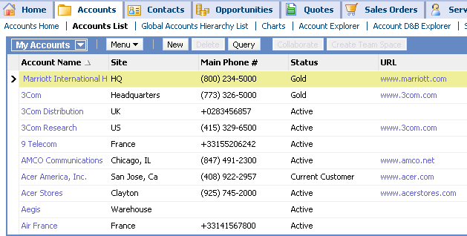
Tailoring the Physical User Interface (UI)
Is performed by editing template files and cascading style sheets
Use an HTML or a text editor to modify layouts
Use a text editor to modify colors, fonts, etc.
  Siebel template files
  Cascading style sheets
  Image files
UI files
Object Manager
.cfg
SRF
Database Server
Configuration File
Siebel Repository File
Notes:
Siebel applications are also specified by a set of physical UI files that specify how the logical UI will be physically rendered in a browser. These files are not composed of object definitions and are the main focus of this module.

Slide 4
Siebel Web Template Files
Are HTML files that specify how to render the views for a Siebel application in the user’s browser
Specify the formatting and layout of:
  Graphic and text elements
  User data
Consist of standard HTML tags and Siebel-specific swe: tags
Standard HTML tag
<table width="100%" class="banner" cellpadding='0'
cellspacing='0' border='0'>
<tr>
<td><img src="images/spacer.gif" height="29"
width="10"></td>
<td><swe:menu type="Default" width="275" height="29" bgcolor="#ccccff" fgcolor="#000000" /></td>
HTML table tag
Siebel tag
Notes:
This module explores the Siebel web template file.
A Siebel web template is a file that contains markup tags (HTML, WML, XML, and so on) interspersed with Siebel tags (prefixed by .swe.). Siebel Web templates define the layout and formatting of the user interface (such as views, applets, and controls). Web browsers require HTML to define the layout and formatting of a page.
In this graphic you can see example HTML in a template file as well as an example Siebel tag.
This course does not teach or explain HTML; if you are familiar with HTML you will likely recognize the text displayed. If not, you will still understand the material in this module.
Note: Do not try to teach the class HTML. Instead, explain that HTML is a “browser-independent” markup language that indicates how text and graphics are to be rendered in the browser.

Slide 5
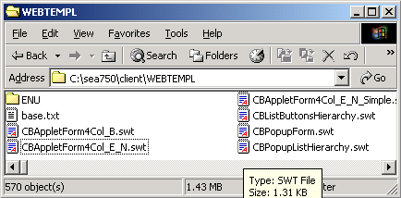
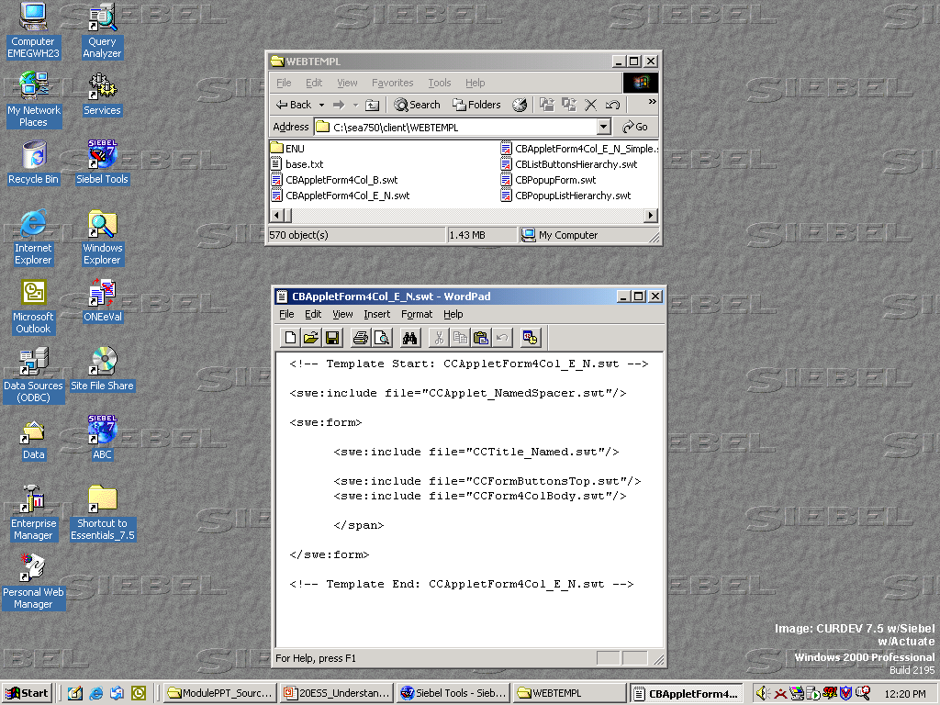
Siebel Web Template Files Continued
Are stored as separate files outside the Siebel repository
  Located in the WEBTEMPL directory in a Siebel installation
  Have an .swt extension
Are edited using text or HTML editor of your choice
Can include other template files via swe:include tag
Reference Cascading Style Sheet files (.css)
Siebel tag to include another Siebel template file
Notes:
The template files themselves are located in the WEBTEMPL directory. They can be edited with your favorite HTML or text editor.
In this course, you will examine the contents of selected template files and make a small number of changes.
Important: this course is not intended to teach you how to create new or edit existing template files.

Slide 6
Siebel Tags
Are special tags inserted into template files
  They specify how objects defined in the repository should be laid out and formatted in HTML for display in the user’s Web browser
Control layout repetitively through iteration
Serve as placeholders for Siebel-specific content
<swe:for-each-screen>
<swe:screenlink state="Active"><td id="swe:this.Id" …………
<img src="images/tb1_mid_1.gif"><img src="images/tb1_opn_1_d.gif"
align="absmiddle" width="5" height="19" alt="">
<swe:this property= FormattedHtml">&nbsp;<swe:screenname/>
&nbsp;</swe:this><img src="images/tb1_cls_1_d.gif"
align="absmiddle" width="5" height="19" alt=""></td>
</swe:screenlink>
… … … … … … … …
</swe:for-each-screen>
Siebel tag to iterate over all screens
Siebel tag to insert the name of the screen
Notes:
Siebel tags are a special library of Siebel-developed tags that allow information from the Siebel repository to be embedded in the HTML that is being generated for display. Siebel tags can be identified by their swe: prefix.
This graphic shows two types of Siebel tags: one tag that iterates (it executes repetitively) for all the screens, and another tag that inserts the name of the screens. This fragment comes from the template file responsible for rendering screen tabs.

Slide 7
Cascading Style Sheets
Can be modified to define global parameters
  Fonts, foreground and background colors, and so forth
Style sheets:
  Are located in PUBLIC\enu\FILES directory in a Siebel installation
  Can be modified by customers
Edit style sheet files to achieve the desired look and style for your implementation
  Backup the current .css files
  Edit .css files with your
  preferred HTML editor
From main.css
/*globalMenu Definitions*/
/*----------------------*/
TR.globalMenu, TD.globalMenu,
TD.globalMenu A,
TD.globalMenu A:visited,
TD.globalMenu A:hover
{ font-size: 8pt;
color:#000000;
background-color: #ccccff;
font-weight:normal; }
Adjust fonts
Adjust colors
Notes:
The look and feel of user interface elements are controlled by cascading style sheets. Cascading style sheets contain classes that define elements such as color schemes and fonts.
The example in the slide illustrates how template files can include style sheets which allow for easy specification of system UI parameters within and across multiple applications.
By storing style-related information in cascading style sheets rather than .SWT templates, you can increase the modularity and consistency of your applications and the ease with which the .SWT templates can be modified and reused.
Since style-related information stored in cascading style sheets is rendered slightly differently in different browsers, you should test the results in both browsers unless your users are restricted to one or the other.
Style sheets are located in the PUBLIC\enu\FILES directories.
Note: editing CSS is beyond the scope of the course since it's an industry standard.

Slide 8
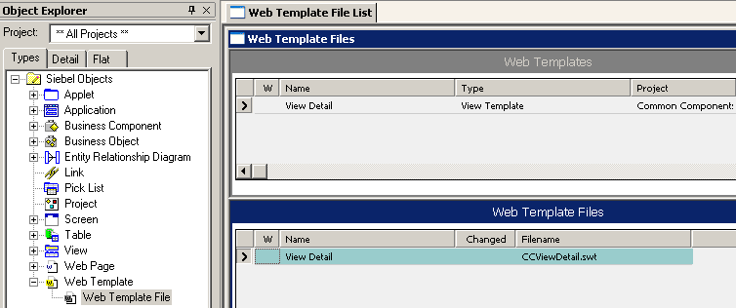
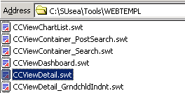
Web Template Object Definition
Is a layer of abstraction between a UI object definition (View, Applet, or Web Page) and the file itself
UI object definitions reference Web Template object definitions
References an HTML Web template file
Changes are propagated to all objects that reference the file
Notes:
The Web Template object definition is a layer of abstraction between a UI object definition (View, Applet or Web Page) and the file itself. UI object definitions reference the Web template object definition, which references the file name.
If you choose to modify or create a Web template file, you can change the reference to the filename in a single place, the Web Template object definition, and the change will be propagated to all the UI object definitions that reference it.
You should not create or modify Web template files in employee applications unless there is a significant ROI benefit. You may choose to modify Web template files in you applications to incorporate the look and feel of your existing corporate Web site.

Slide 9
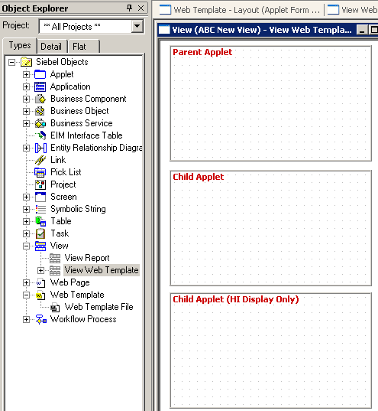
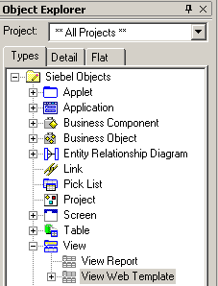
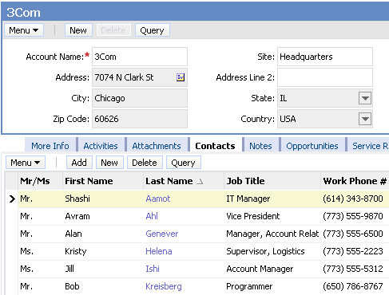

Web Template Placeholders
Contain placeholders for Siebel logical UI definitions
Definitions map to Siebel Web templates
Placeholder
Notes:
Siebel web templates are filled with data and user interface elements by associating views, applets, controls, and other objects defined in Siebel Tools.
Each view, applet, or control, is mapped to a placeholder in the template. For example, you may have a View object with three applets, such as ABC New View. You associate a View Template with the view, and map each applet to a placeholder in that template.
The example in the slide shows a form applet being bound to the Parent Applet placeholder, and a list applet being bound to the Child Applet placeholder. This is the standard layout for a detail view.
Unmapped placeholders are ignored at run time.
An important feature of Siebel Web Templates is that they can be shared between many objects in the repository. Because a template has only placeholders, any number of repository objects can be mapped to a specific placeholder. This allows you to propagate style or structural changes to numerous user interface elements by changing only one template.

Slide 10
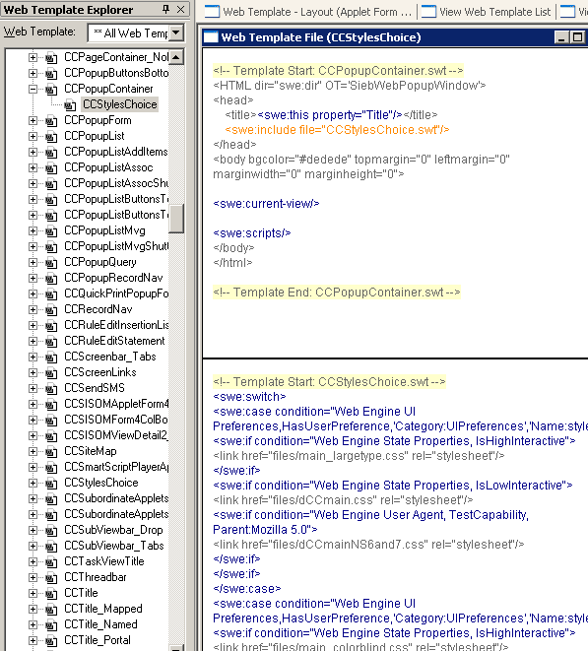
Web Template Explorer
Is used in Tools to:
  Identify template files included in a template file
  Examine the contents of a template file
  Invoke an editor to modify the template file
Highlights Siebel-supplied tags for easy viewing
Navigate to View > Windows > Web Templates Window
Filter
swe tag highlighted
Parent template
Child template
Notes:
Siebel Tools has a template browser that allows you to examine the contents of template files without having to open them directly. It functions very similarly to the OE and the OBLE.
The explorer pane shows the hierarchy of templates and the panes show the contents of the parent and child templates selected in a split view. In the example screen print, CCPopupContainer is the parent and CCStylesChoice is the child.
The Web Template drop-down list in the Web Template Explorer window lets you filter the templates that are shown in the Web Template Explorer window. You can edit a template file by right-clicking in the HTML code window for that template.
This is an example of Tools functioning as an IDE (integrated development environment). You can edit the HTML directly from within Tools without having to leave the Tools application.

Slide 11
Types of Web Templates
0/4
Form Applet Web Templates
List Applet Web Templates
View Web Templates
Web Page Web Templates
Notes:
This is a structuring slide. Do not teach the steps or concepts here because the following slides cover them in detail. This group of slides will discuss four principle Web template types, and the information will be used in subsequent modules and labs.

Slide 12
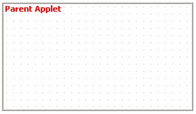
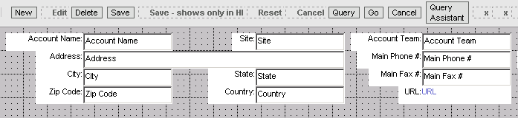
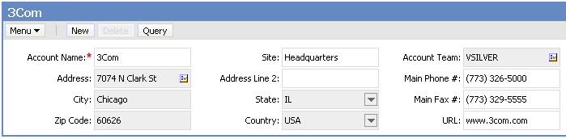
Form Applet Web Templates
1/4
Define the layout of form applets
  Placeholder provides starting point for building applet
  Tools’ Web Layout Editor assists you in setting template file parameters
Account Entry applet uses Applet Form Grid Layout
Web Layout Editor
Tools
Object Manager uses template to build applet
UI
Notes:
Here we see an example of a web template being used to define the UI. Note that, when developing in Tools, the developer starts with the blank placeholder discussed earlier, then builds the applet by using the Web Layout Editor.
Form applet Web templates are used to display controls such as buttons, labels and textboxes.
Grid Layout applet Web templates, Siebel tags, and other features in the Web Layout Editor allow you to modify form layout without having to directly modify the underlying applet Web templates.
The form applet Web template is called Applet Form Grid Layout. This template does not contain explicit placeholders, but is laid out in a grid. Each point on the grid may be addressed by an applet Web template item, which gives greater flexibility to the layout of controls.

Slide 13
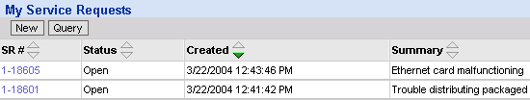
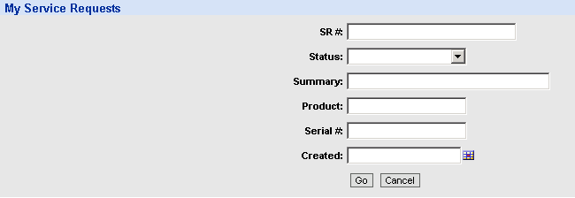
List Applet Web Templates
2/4
Define the layout of a list applet
  Standard Interactivity list applets use Base and Edit modes
Base Mode
A read-only
list of data with buttons for editing
Edit Mode
An editable form for querying
and data entry
Notes:
Standard Interactivity clients require two modes: Base mode and Edit mode.
Base Mode is read-only and used for displaying but not editing data. Views appear by default in Base mode.
Edit mode is used editing an existing record.
Standard interactivity clients use base mode to display a list of data in an applet. List applets in base mode are read only. If a user attempts to create, edit, or query data in a base mode list applet, the applet will be displayed in edit mode.
Edit mode typically appears as an editable form. This context is familiar to Web users. When users fill out data in the editable form and click OK (or Save), the list applet reappears in base mode with the updated record or query results displayed.
In many cases, you can forego read-only forms (Base mode) and use persistently editable forms because task activities are often data editing and input. This type of form improves usability because users can enter data without first having to click an edit button and then wait for the form to appear in edit mode.

Slide 14
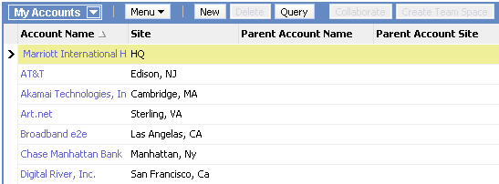
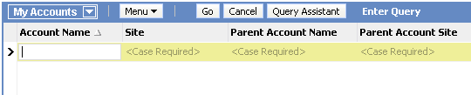
List Applet Web Templates Continued
2/4
High Interactivity clients use EditList mode
EditList Mode
An editable list of data
EditList mode supports
querying and data entry
directly in the list
Notes:
High interactivity clients use a single mode, EditList, to display a list of data in an applet. List applets in EditList mode display data in an editable list. If a user tries to create, edit, or query data in an EditList mode list applet, they will be able to do so in the current applet context.

Slide 15
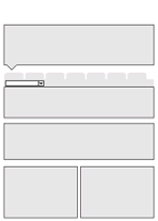
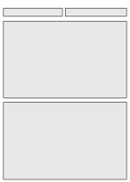
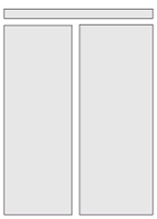
View Web Templates
3/4
Define the layout of a view
  Common view templates include:
View Detail (Parent with Pointer)
View Basic
View 50 50
Notes:
Recall that a view is a collection of applets displayed on a screen at the same time. It consists of a single window displaying related form and list applets.
View Web templates contain placeholders for applets.
They are associated with a view through the View Web Template object definition.
A view template primarily contains placeholders for applets as specified by the <swe:applet> tag.
The Siebel application uses many different view Web templates. View Basic, View Detail (Parent with Pointer) and View 50/50, are some common examples.

Slide 16
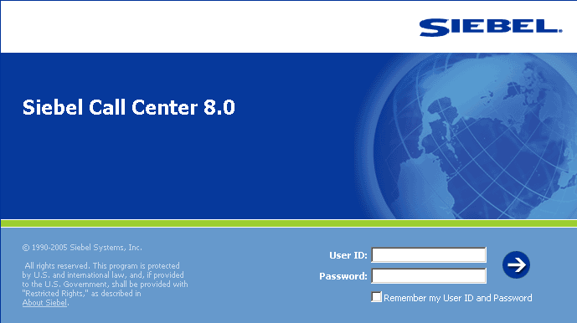
Web Page Web Templates
4/4
Define the layout of Web pages such as:
  Login Page
  Error Page
  Container Page
The Login Web template
defines the layout of the
Login page
Notes:
Web page Web templates are used by the Web Page object type. Some examples are given on this slide.
The application is associated with a set of templates through properties in the Application object definition. A few example properties include Container Web Page, Error Web Page and Login Web Page. Each property identifies a template to use to fit a given circumstance, such as logging in.
Web Page web templates are not discussed in detail in this class.

Slide 17
Using Template Files
Requires three types of relationships:
  Registering creates an object definition in the repository
  Associating identifies the Web template used to render an applet or view
  Binding fastens a control to a specific position on the page or an applet to a view
View Example
Applets
View
Associating
Binding
(View) Web template
Registering
Applet placeholders
(View)
Template
file
swt
Notes:
The diagram illustrates the three relationships for a view. In this case, each view is composed of one or more applets; however, each view references only one web template:
- The (View) Web template is registered with the (View) Template file.
- The View is associated with the (View) Web template
- The Applets are bound to Applet placeholders.
An applet requires the same three relationships. However, in applets, controls are bound to control placeholders.
Registering: The first relationship is that of registering. Registering is nothing more than creating an object definition in the repository that points to the actual physical template file.
You can think of the repository as a book in which a record of the object definitions are kept, and registering is the act of adding a record to that book.
Why is this important? Because we can localize in one, and only one, object definition the reference to the actual physical template file used.
Associating: Associating identifies the Web template (and indirectly the template file) used to render a view or applet.

Slide 18
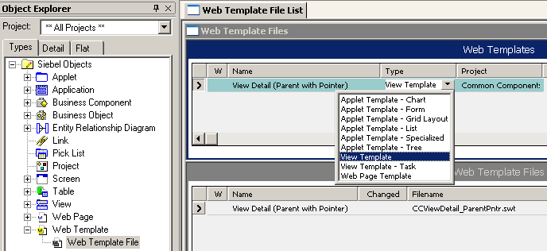
Registering a Template File
Creates a Web Template object definition to define the logical name for the template
Creates a Web Template File object definition to reference the actual physical file
Logical name in repository for template
Type of Web template
Actual name of the physical template file
Notes:
This slide shows how to register a new template file. Given the large number of template files provided by Siebel Systems, it is unlikely that you will need to create a new one yourself.
Notice that a given template can have multiple template files registered for it. This might allow for registering both an HTML and a WML template file (although the repository currently doesn’t show any such examples).

Slide 19
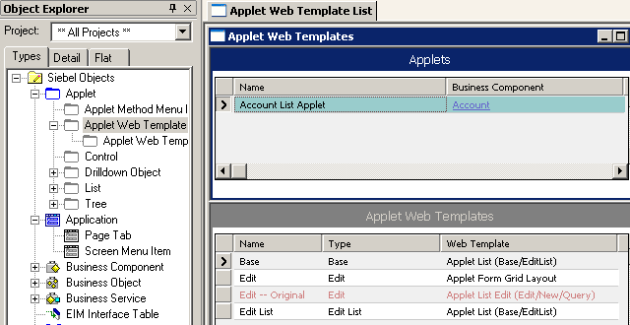

Associating an Applet with Its Template
Creates an Applet Web Template object definition to specify the associated Web template
  Different applet modes can reference different Web templates
Applet template used to render applet for mode
Mode for the applet
Notes:
This slide shows how to associate an applet with its templates. In this case, there are three web templates associated with the Account List Applet, one for each mode being used with this applet:
- For Base mode, the Applet List (Base/EditList) web template is associated with the Account List Applet.
- For Edit mode, the Applet For Grid Layout web template is associated with the Account List Applet.
- For Edit List mode, the Applet List (Base/EditList) web template is associated with the Account List Applet.

Slide 20
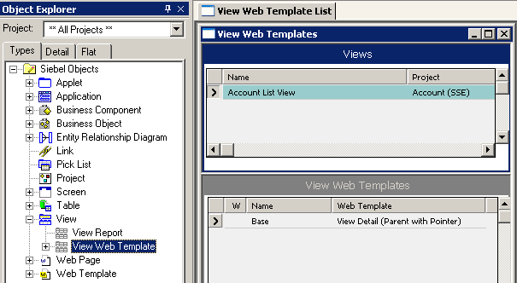
Associating a View with Its Template
Creates a View Web Template object definition to specify the associated Web template
  Each view references a single view Web template
Web template used to render view
Notes:
This slide shows how to associate a view with its template. In this case, the Account List View references the View Detail (Parent with Pointer) web template. In most cases, the record is given the name Base, since editing is not typically performed on views.
Note that applets use multiple templates, for editing, querying, and so forth. A view uses only one template.

Slide 21
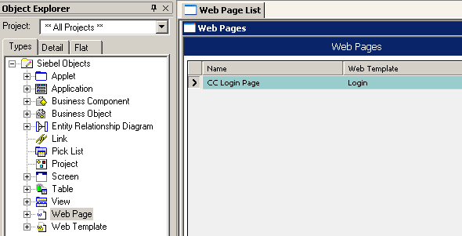
Associating a Web Page with Its Template
Creates a Web Page object definition and sets the Web Template property
Web page template used to render Web page
Notes:
This slide shows how to associate a Web page with its Web template. This is done by setting the Web Template property in the Web Page object definition. In this example, the Login Web Template is associated with the CC Login Page web page.

Slide 22
Binding
Maps the components of an applet or view to placeholders in the corresponding template file
Information is specified in the repository
  View Web Template Item
  Applet Web Template Item
  Web Page Item
  Results in the corresponding element being displayed at run time
Binding Controls to Applets
Binding Applets to Views
Controls/Lists
Applet
Applets
View
Binding
Binding
(Applet) Web template
(View) Web template
Control placeholders
(Applet)
Template
file
Applet placeholders
(View)
Template
file
Notes:
Binding controls to applets is the act of fastening or securing a control to a specific position on the page.
Binding applets to views is the act of fastening or securing an applet to a view.
In either case, placeholders reside within a template file.
You can think of binding as the process of associating the parts that make an applet (that is, controls) with the pieces in the corresponding template file (the control placeholders). This is shown in the left half of the diagram. The analogous situation exists for views and their parts (applets).
One other difference is that Applets reference one or more web templates, while Views reference only one web template.
Binding Information: Binding information is stored in the repository in a variety of object definitions. These bindings are accessed at run time to identify the repository items to be inserted into the generated HTML.

Slide 23
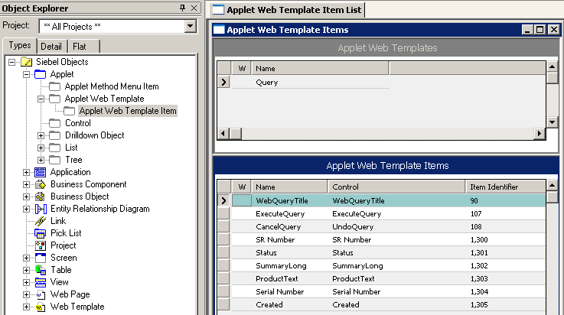
Applet Web Template Items
Are created by the binding process
  Item Identifier is the “id” attribute value in the swe:control tag
Are used at run time by the Siebel Web Engine to identify the controls that make up an applet
<swe:for-each count="6" startValue="1300" iteratorName="currentId">
<swe:control id="swe:currentId" hintMapType="FormItem">
Notes:
The Web Template Items window displays the components that make up the applet. In this case, those components are controls, and each control has its own record.
The Applet Web Template Item identifies the control bound to a specific swe tag. The Item Identifier is the ID number of the swe tag itself.
The Item Identifier specifies a unique numeric identifier for each control, generated in the layout editor. The value is used in the markup language tag that specifies the corresponding control in a template, binding the control to a specific position on the page.
Note: the web template items displayed in the screen print are child objects of the Account Service Request List Applet (eService).

Slide 24
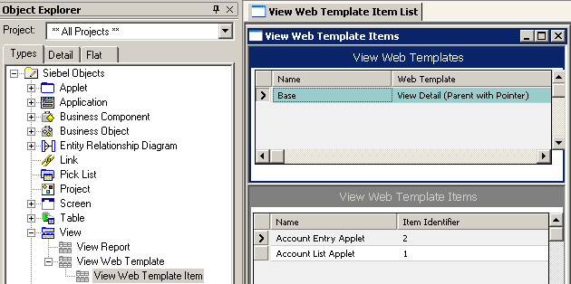
View Web Template Items
Are created by the binding process
  Item Identifier is the “id” attribute value in the swe:applet tag
Are used at run time by the Siebel Web Engine to identify the applets that make up a view
<swe:applet hintMapType="Applet" id="1" hintText="Parent Applet"
Notes:
The View Web Template Item identifies the applet bound to a specific applet swe tag. The Item Identifier is the ID number of the swe tag itself.
The Item Identifier is a unique numeric identifier for each applet. The value is used in the markup language tag that specifies the corresponding applet in the view web template, binding the applet to the view.
Note: the view web template items displayed in the screen print are child objects of the Account List View.

Slide 25
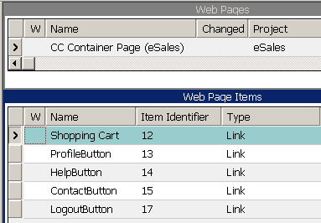
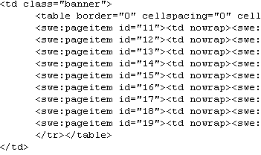
Web Page Items
Identify the links and buttons appearing on a Siebel Web page
  Item Identifier is the “id” attribute value in the swe:pageitem tag
Are used at run time by the Siebel Web Engine to position the links and buttons
Notes:
The Web Page Item identifies the “thing” (link, button, and so forth) bound to a specific swe tag. The Item Identifier is the ID number of the swe tag itself.

Slide 26
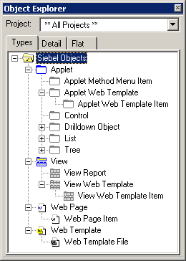
Summary of Object Definitions
Registering, associating, and binding adds object definitions to the repository
3. Specifies how the components of an applet, view, or container page are mapped
Associating
Binding
2. Identifies the logical template used to render an applet, view, or container page
1. Identifies the physical template file
Registering
Notes:
This slide shows the various new object definitions introduced in this module.
Associating is accomplished via web templates or web page:
- Applet Web Template
- View Web Template
- Web Page
Binding is accomplished via web template item or web template file:
- Applet Web Template Item
- View Web Template Item
- Web Page Item

Slide 27
Module Highlights
Siebel Web Template Files are HTML files that specify how to render views for a Siebel application in a user’s browser
  Can include other template files
  Can reference CSS files
Siebel Tags are a Siebel-developed library of tags in Web template files processed at run time
CSSs can be modified to define global parameters such as fonts and colors
The four Web Template types are Form Applet, List Applet, View, and Web Page
Template files require three types of relationships: Associate, Register, and Bind
Notes:
Review Question: What is the primary role of Web templates?
Answer: They provide placeholders for logical UI definition within Siebel Tools.
Review Question: What are four major types of Web templates?
Answer: Form Applet, List Applet, View, and Web Page Web templates.

Slide 28
Lab
In the lab you will:
  Examine Web templates

