Slide 1

Module 25: UI Layer Configuration: Applets
0/5
Siebel 8.0 Essentials
Notes:
Time: Lecture: 35-45 minutes; labs: 40 – 50 minutes
Intent: To learn how to create and modify list and form applets
Flow: Describe list and form applets. Build a list applet using the wizard. Use the Web layout editor to modify a list applet. Discuss symbolic strings. Build a form applet using the wizard. Use the Grid Layout Editor.
Key Terms:
Primary Applet Types
List Applet wizard
List Applet Wizard Inputs
List Applet Wizard Outputs
upgrade behavior
Edit mode
Base
EditList
Edit/New/Query
Web Layout Editor
Applet Web Templates
List Column Definitions
Symbolic Strings
String Conversion Utility
Form Applet Wizard
Grid Layout Editor
Web Controls Toolbar
Applet Properties
Preview

Slide 2
Module Objectives
After completing this module you should be able to:
  Create and modify a list applet
  Create and modify a form applet
Why you need to know:
  You may want to display new data in the UI
Notes:
Each objective and “why you need to know” should be stated aloud.

Slide 3
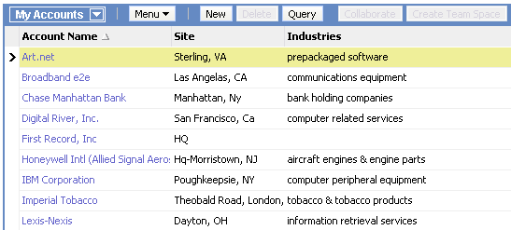
Primary Applet Types: List Applet
Displays one or more records simultaneously in a list
Fields for one record are displayed in a single row
Typically displays fewer fields than a form applet due to width of monitor
Supports drilldown to other views through hyperlinked fields
Notes:
This is a review; students should be familiar with these concepts by now.

Slide 4
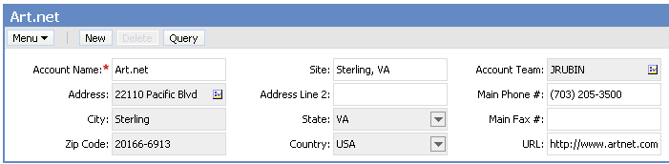
Primary Applet Types: Form Applet
Displays a single record
Fields for the record are displayed in a grid or form
Can show more fields at once than a list applet
Notes:
This is a review; students should be familiar with these concepts by now.

Slide 5
Creating a List Applet
Follow these steps to create a new list applet …
…Or use the List Applet Wizard
  Automates these steps
  Generally the preferred method
  Ensures that object definitions and properties are created
  Ensures that steps are not omitted
  Increases developer productivity
  Speeds project completion
1. Create new applet object definition
2. Associate applet template with object definition
3. Bind controls and list columns to template
Highly recommended
Notes:
This is a positioning slide. The process of creating a list applet is covered in detail in the following slides.
Emphasize the value of using the wizard to create a List Applet which prompts the user for required information and auto-populates the remaining parameters which Tools requires.

Slide 6
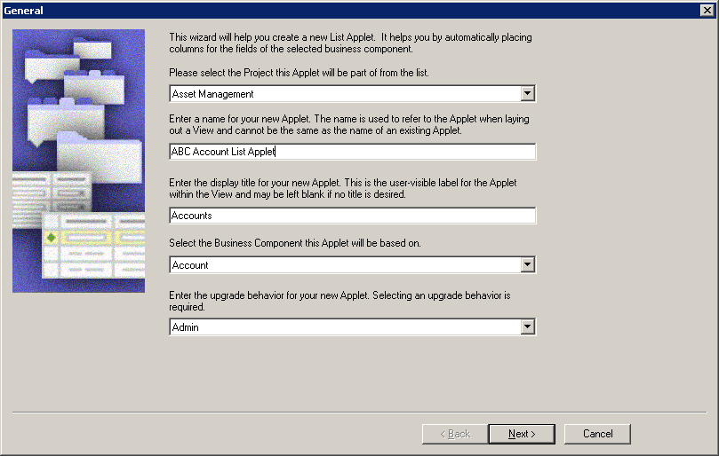
List Applet Wizard
Use the List Applet Wizard to create a new applet
  Select File > New Object, select the Applets tab, select List Applet, and then click OK
Wizard
Notes:
This is an overview of the List Applet wizard, including some advantages to using it.

Slide 7
List Applet Wizard Inputs
The List Applet Wizard requires the following inputs:
  Project the new applet will be part of
  Applet name and display title
  Business component the applet will reference
  The upgrade behavior
    Admin, Non-preservable, Preservable
  The Web templates that will be used for each mode
    Base and EditList mode are commonly built using Applet List (Base/EditList)
    Edit mode is commonly built using Applet List Edit (Edit/New/Query)
  The business component fields that will appear in the Web layout
  Additional controls that will be added to the applet
    By default, all of the standard buttons are selected
Notes:
Demo: Wizard dialog: General: Remind students of the relationship between BCs and applets. Later modules will discuss BCs in more detail. This screen of the wizard solicits the necessary data from the user to create a new list applet object definition.
Point out that only locked projects are available. Point out the pre-defaulted values for the applet name and title.
Wizard dialog: Web Layout – General. Two good techniques for selecting a template:
Find an existing applet with a layout similar to what you want, and use Siebel Tools to find out what template it uses.
Select Web Templates in the OE, click a likely-looking template name, right-click, and select View Web Layout.
Do this before you start the wizard.
Click the Show All Templates option on and off to demonstrate the difference.
Wizard dialog: Web Layout – Fields. This wizard screen solicits data to create and associate the correct list column and applet Web template item object definitions with the applet object definition. Point out that you might want to add fields, and then selectively remove them using the Web Layout Editor. This way you can have different fields appear in different modes of the same applet.
Wizard dialog: Web Layout – Fields, dialog #2 (controls). Customers will select all controls in almost all cases. New controls may be added to the Model HTML Controls applet if a customer creates a custom button or other control. If a customer elects not to use a piece of standard functionality, such as the Query Assistant, the control should not be removed in the wizard, but from the applet Web template. This makes it easier to add the functionality back to the applet in a later phase.
Wizard dialog: Finish. This wizard screen only gives details of the applet object, not the list columns and controls. If you need to review them, use the Back button.

Slide 8
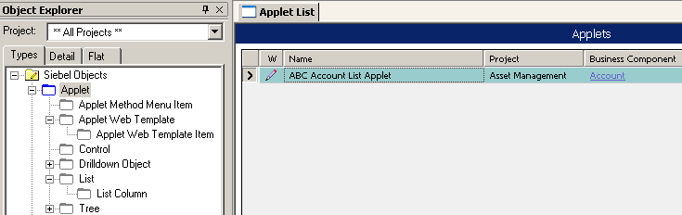
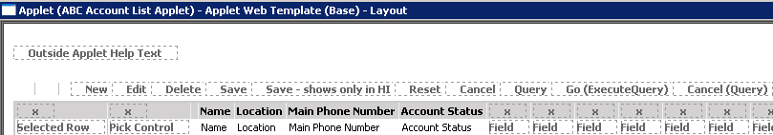
List Applet Wizard Outputs
Creates required object definitions for controls, lists, and list columns
Associates applet Web templates to the applet
Binds list columns to templates
  Appear as applet Web template items
Invokes the Web Layout Editor
New applet object definition created
List Web Layout Editor invoked
Notes:
This is a list of the various things the list applet wizard does after you click the Finish button. Note that the very last thing it does is to start the Web Layout Editor.
Upgrade Behavior Property
If you are upgrading from Siebel 7.x or later, you can choose Incorporate Custom Layout (ICL) when performing a repository merge. An ICL merge handles customer-modified screens, views, and applets differently than other repository objects.
As of Siebel 7.7, an object property called Upgrade Behavior determines whether a UI object is preservable:
■ If this property is set to Preserve then the UI object is eligible for ICL handling.
■ If this property is set to Non-Preservable, then the UI object is not eligible for ICL handling for upgrades to the currently shipping release.
■ If this property is set to ADMIN, then the UI object is never eligible for ICL handling.
The Upgrade Behavior property is defined on Screen, View, and Applet.
At each release, Oracle sets the value of Upgrade Behavior for UI objects. Do not change these values. For more information, see Siebel Database Upgrade Guide Version 8.0.

Slide 9
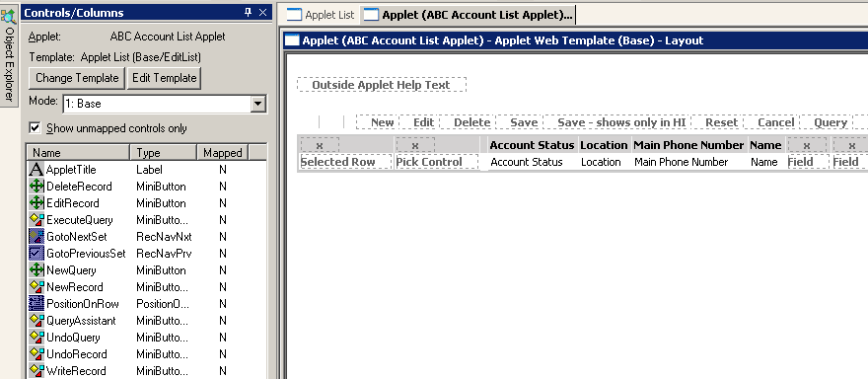
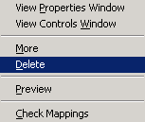
Web Layout Editor
Is used to add, remove, and reorder applet Web template items
  Placeholders correspond to item identifiers of applet Web template items
Can be invoked from the right-click menu
1. Select the mode
2. Drag and drop
items from the Controls/Columns window
Select and right-click to delete controls that you have added

Slide 10
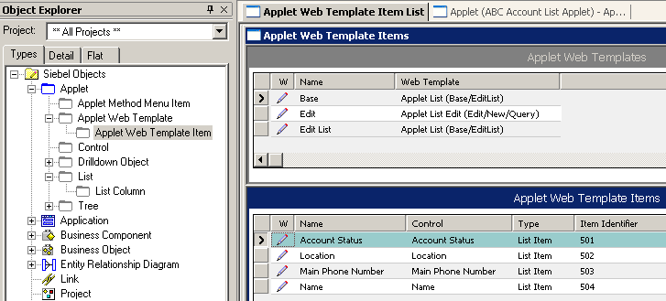
Applet Web Templates
Specify which template is used when the applet is displayed in a given mode
Contains Applet Web Template items
  The controls or list columns that have been bound to the template
  The item identifier that describes where in the applet the controls or list columns should appear
Specifies which template to use
Specifies where list column will appear

Slide 11
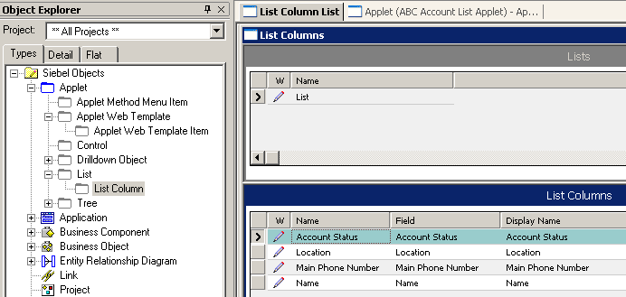
List Column Definitions
Specify:
  The field that is displayed
  The display name that appears at the top of the list column
    May reference a symbolic string
Notes:
With the exception of symbolic strings, the Display Name property is read only and can be updated in one of two ways: by setting the Display Name – String Override, or by selecting the Display Name – String Reference from the picklist. The next three slides give detail on symbolic strings.

Slide 12
Symbolic Strings
Ensure that the same name appears exactly the same way throughout the application
Define it once, reference it anywhere
Provide a way to manage updates, globally
Are used by user interface objects such as:
  Labels
  List columns
  Applet titles
Are stored in the repository containing words and phrases used in UI definitions
  Global Dictionary contains many commonly used terms
  Symbolic String Locale object type allows language translation
Notes:
The symbolic strings model centralizes all strings, both English and all other languages, which exist in the repository into one object type: Symbolic Strings. Translatable text strings are defined once and then referred to by multiple user interface objects. Having a centralized mechanism for storing and managing repository text strings:
■ Reduces redundancy because many objects can reference one symbolic string
■ Results in a more consistent user interface
■ Simplifies maintenance because you only have to maintain one string for a given word
■ Simplifies translation by eliminating duplicated translations of the same word
■ Reduces translation costs
Demonstrate the Symbolic String object type in Tools. Show that there is a record for each text value that appears in the user interface. Show that there are occasionally duplicate values for commonly used strings.

Slide 13
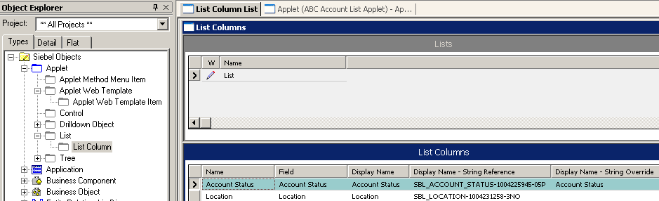

Using Symbolic Strings
String reference:
  Refers to symbolic string object definitions
  Is selected from a picklist
  Refers to the name of the symbolic string
String override:
  Used for exceptions when strings are infrequently displayed
  Can be converted to symbolic strings using a Siebel-supplied string conversion utility
Reference to object in repository
Notes:
Text properties are read only. Developers can select a symbolic string for a text property by selecting “<property name> - String Reference.” For example, Display Name is read-only, but Display Name – String Reference has a picklist from which developers can select the appropriate symbolic string.
In cases where a symbolic string for the desired text value does not exist, developers can either create a new symbolic string or type in a value for text properties in a property called “<property name> - String Override.” For example, in this case the Display Name is read-only, but Display Name – String Override can be edited.
Both will be demonstrated in the labs.

Slide 14
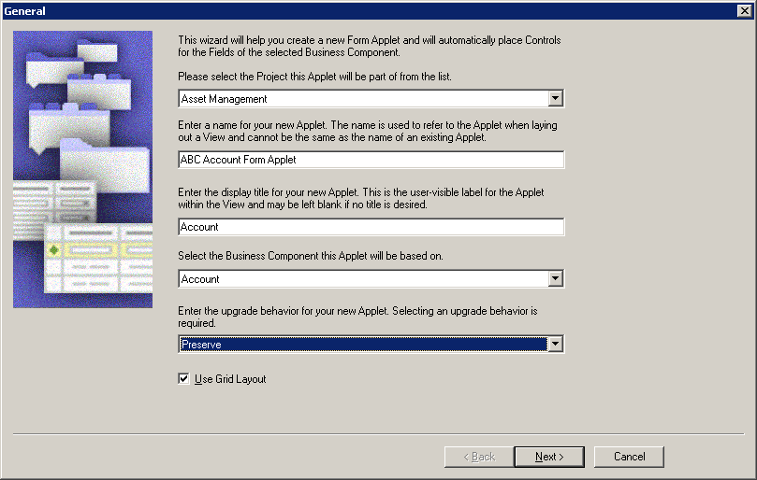
Form Applet Wizard
Use the Form Applet Wizard to create a new form applet
  Select File > New Object, select the Applets tab, select Form Applet, and then click OK

Slide 15
Form Applet Wizard Inputs
The Form Applet Wizard requires the following inputs:
  Project that the new applet will be part of
  Applet name and display title
  Business component that the applet will reference
  Upgrade behavior
    Admin, Non-preservable, Preservable
  Modes to use
    Edit mode is required for all clients
      Uses the Applet Form Grid Layout template
    Base mode is required for Standard Interactivity clients only
  Business component fields to appear in Web layout
    Creates controls and binds them to applet Web templates
  Additional controls to be added to applet
    By default, all standard buttons are selected
Notes:
This wizard screen solicits data to create the basic form applet object definition. The Applet wizard is highly robust and ensures the applet is created, associated, and bound without errors.
Demo: Demo the Form Applet wizard as you step through these slides.
Wizard Dialog: Web Layout – Forms
Form Applets typically use the Applet Form Grid Layout template. This allows greater functionality in editing, formatting, and sizing of controls.
Form Applets are typically configured for Edit Mode only. To configure an applet for Base Mode, you may check the box in the wizard. Customer applications occasionally display form applets in base mode.

Slide 16
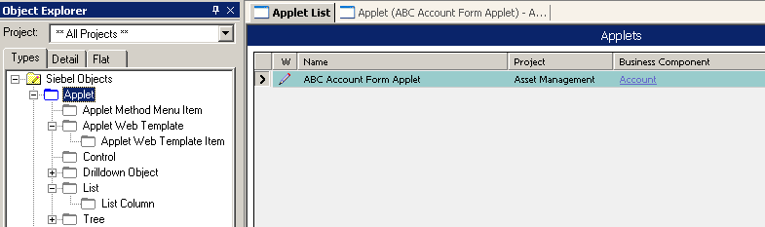
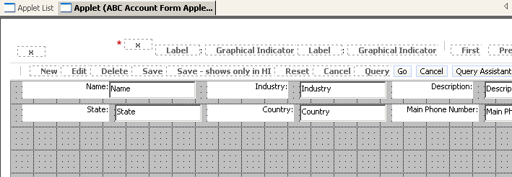
Form Applet Wizard Outputs
The Form Applet Wizard
  Creates required object definitions for Controls
  Associates applet Web templates to the applet
  Binds columns to templates
    Appear as applet Web template items
  Invokes the Grid Layout Editor
New applet object definition created
Grid Layout Editor invoked
Notes:
This is a list of the various things the applet wizard does after you click the Finish button. Note that the very last thing it does is to start the Web Layout Editor.

Slide 17
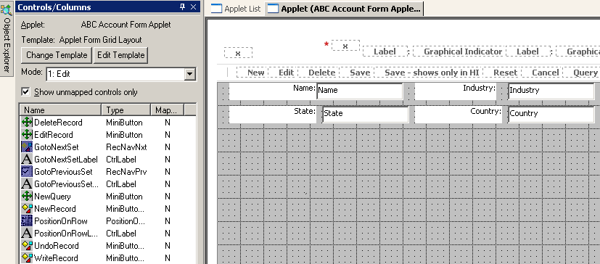
Grid Layout Editor
Is used to:
  Create new control object definitions
  Bind controls to the Web template
  Resize controls
  Reposition controls
Grid Layout Editor
Notes:
The Grid Layout Editor is used to lay out form applets. The next several slides describe features of the Grid Layout Editor.

Slide 18
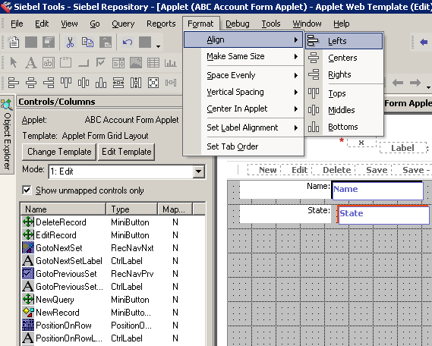
Grid Layout Editor Continued
Allows drag-and-drop layout editing
Supports formatting options such as:
  Align controls
  Make same
  size
  Horizontal
  spacing
  Vertical
  spacing
Format menu. . .
. . .arranges selected controls
Notes:
Demonstrate these functions by moving an existing control, or dragging a new control from the toolbar, onto a form applet, manually resizing it, then using Make Same Size, Align – Bottoms, and Align – Lefts to resize and reposition the control.
The students use each of these functions in the labs.

Slide 19
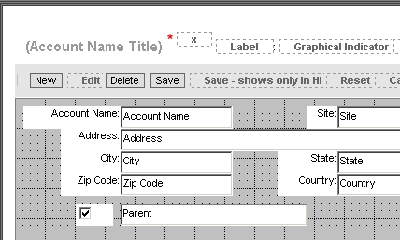
Web Controls Toolbar
Supports drag-and-drop creation of controls
Contains icons for:
  Text controls
  Check boxes
  Labels
HTML text
HTML label
Notes:
The Web Controls toolbar should be displayed automatically when the Grid Layout Editor is open. If it is not, it can be displayed by selecting View > Toolbars > Web Controls Toolbar.
Developers may choose to drag and drop controls from the toolbar to the grid layout editor, or create controls manually in Applet :: <Applet Name> | Controls.
If controls are created manually, both a label control and text box control will be available in the Controls/Columns window of the Grid Layout Editor.

Slide 20
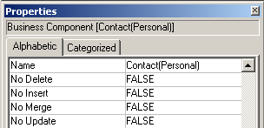
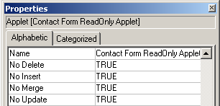
Properties for Editing
No Delete, No Insert, No Merge, No Update are set to restrict the behavior of the applet
  Can also be set at the business component level
  Most restrictive settings are always used
Business Component
Applet
Affects all applets referencing this BC, or. . .
. . .can be customized for each applet
Notes:
Recall that every Applet references one, and only one, business component. Also, many applets can reference a single business component. This is illustrated in the application architecture diagram in the student guide.
We usually choose to restrict editing at the applet level instead of the business component level. Then you can create special views that allow designated users with the right responsibilities to edit the records.
Possible Demo:
Log in to Siebel Sales as SADMIN connected to the Sample database.
Select Category > Contact Categories.
Select Help > About View to show that the read-only Contact Applet is based on the Contact business component.
Select Contacts > Contacts List > All Contacts.
Select Help > About View to show that the list applet here is based on the same business component.
Explain the implication of setting properties at the business component level; doing this affects both these applets and all others based on this business component.
Note: picklists and links also have these properties. However, they are not addressed here since this module is focused on applets.
Search Specification: If the value in the Search Specification property in an Applet object definition is nonblank, the set of records provided to an applet is restricted. The search specification contains the names of one or more fields in the business component and various operators, combined to create a conditional expression. Records in which the value of the conditional expression evaluates to TRUE are provided to the applet for display; those records in which the expression evaluates to FALSE are excluded.
Search specifications on child applets are not executed when the child applet is based on the same business component as the parent applet. When that is not the case, search specifications on child applets are executed. They are amended with a WHERE clause that keeps the search specification in context with the parent applet.

Slide 21

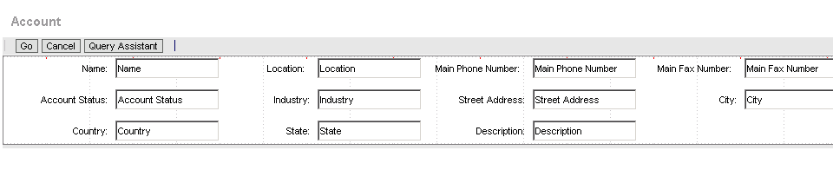
Preview the Applet
Right-click and select Preview to see how the applet appears
  When finished, right-click and deselect Preview to return to the Grid Layout Editor
Right-click to preview the applet
Notes:
New users may inadvertently close the grid layout editor instead of leaving preview mode by deselecting Preview from the right-click menu.
Demonstrate Preview, and how to exit preview.

Slide 22
Module Highlights
List applets:
  Display records simultaneously in a list
  Contain fields for one record displayed in a single row
Form applets display a single record and contain fields for the record in a grid or form
Applet wizards ensure object definitions are created and steps are not omitted
Web Layout Editor is used to add, remove, and reorder Web template items
List column definitions specify field displayed and display name
Symbolic strings ensure that the same name appears exactly the same way throughout the application
Notes:
Review Question: What’s the best way to create a list applet?
Answer: Use the List Applet wizard.
Review Question: How can one invoke a wizard?
Answer: Select File > New Object and select the appropriate wizard.
Review Question: What template is usually used by form applets?
Answer: The Applet Form Grid Layout template

Slide 23
Lab
In the lab you will:
  Modify a form applet using the Grid Layout Editor
  Create a new list applet using the wizard

