Slide 1

Module 26: UI Layer Configuration: Applications, Screens, and Views
0/5
Siebel 8.0 Essentials
Notes:
Time: Lecture: 35 - 40 minutes; Labs: 30 minutes
Intent: <What is the instructional goal of the module>
Flow: < Describe at a high level the overall flow of the module>.
Key Terms:
Applications
Container Page
Application-Level Menus
Screen Tabs
Screens
Aggregate View
Aggregate Category
Detail View
Detail Category
Screen View Properties
Viewbar Text
Menu Text
Sequence Editor
View and Applet Web Templates
View Template
View Wizard
Web Layout Editor
Web Template Items
Register and Assign View

Slide 2
Module Objectives
After completing this module you should be able to:
  Tailor applications
  Configure how a view is accessed on a screen
  Change the order of screen views for a screen
  Create and administer a view
  Associate a view with a template
Why you need to know:
  Enables you to modify the user interface
Notes:
Each objective and “why you need to know” should be stated aloud.

Slide 3
Logical User Interface
Specifies the layout of the Siebel application
Consists of:
  Applications, screens, views, applets, controls/list columns
This module focuses on views, screens, and applications
Siebel Application Architecture
UI
Layer
List Column
or Control
Applet
View
Screen
Application
Business
Layer
Field
Business
Component
Business
Object
Focus of this module
1 or many
Data
Layer
Column
Table
References
Notes:
This is a review of the UI layer of the object model.

Slide 4
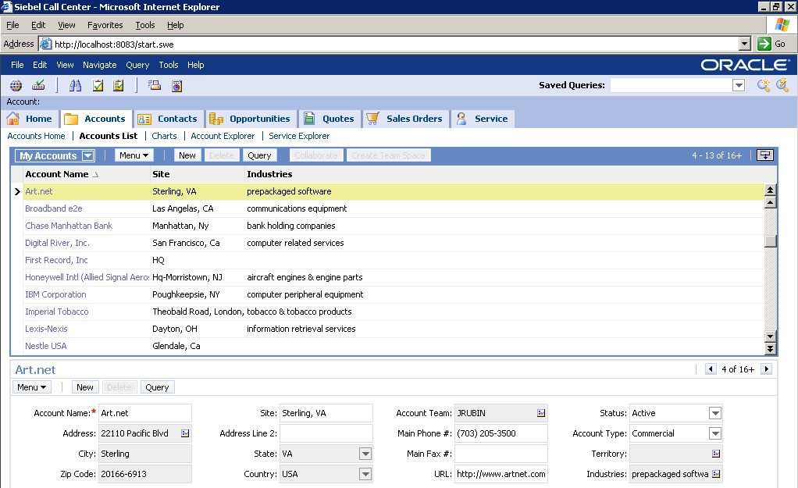
Applications
Are collections of screens through which users can navigate
Use a container page to display the Siebel Web page
Specify the application-level menus
Application-level menus
Container page
Notes:
The container page will be discussed in more detail in the next two slides.

Slide 5
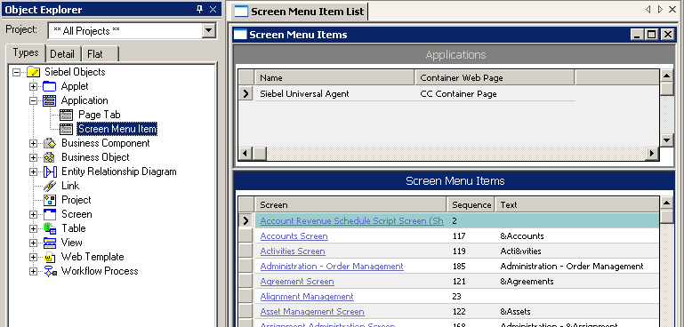

The Container Page
Is a Web page that displays the menus, toolbars, screen tabs, and views that appear in the application
Is specified in the Application object definition
One container page per application
Container Web page specifies the container page
Notes:
The container page is a Web page that displays the menus, toolbars, screen tabs, and views that appear in the application.
The overall purpose of the page container is to provide a structure for the overall application. There is one page container per application, but views can be flagged indicating they should not use the container page (for example, the login page cannot use the page container).

Slide 6
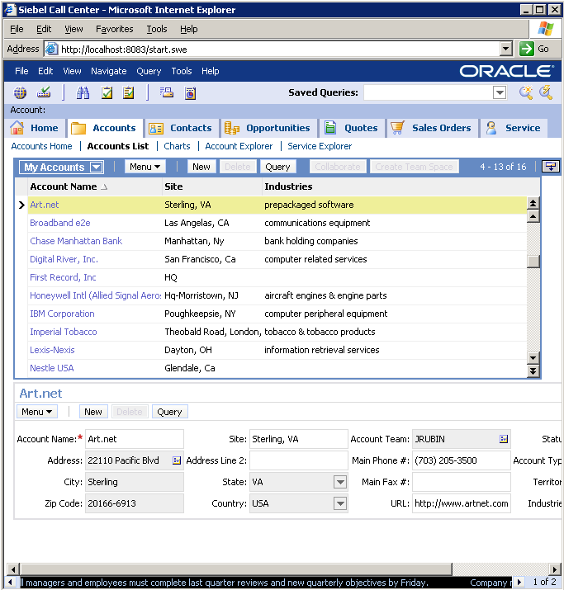
Container Page Example: Employee Application
Container page specifies application layout
Application-level menu
Toolbar
Screen tabs
Link bar
View
Message bar
Notes:
The container page for an employee application should be familiar to the students, as they have been using Siebel Call Center throughout the course.
The callouts highlight items that will be discussed in more detail in the rest of the module.
Note: this slide illustrates navigation elements, such as menus, toolbars, tabs, link bars, views and tickers. Siebel objects compose the parts used in these navigation elements. For example, screen tabs reference screen objects, while the link bar references aggregate categories.

Slide 7
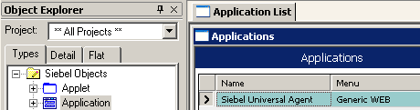
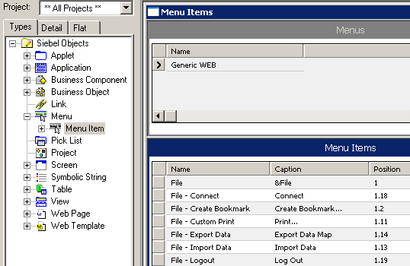
Application-Level Menus
Are specified in the Menu object type
Application uses Generic WEB menu…
…which contains…
…a list of menu items
Caption specifies text displayed
Position specifies order of appearance
Notes:
The example describes how to specify the caption and order of appearance of menu items using Siebel Tools.
The Siebel Universal Agent application uses the Generic WEB menu. The Generic WEB menu contains a list of menu items with captions and positions specified via Menu Item properties.

Slide 8
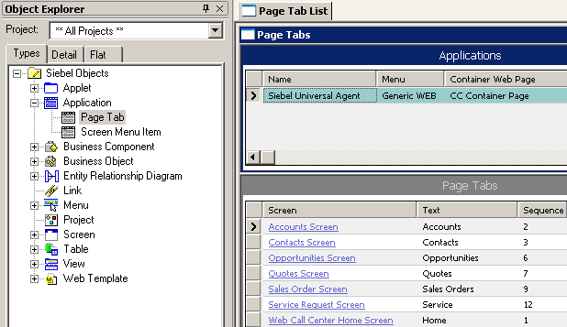
Screen Tabs
Contain links to screens
Are defined as page tabs
  Child object of the application
Specifies text that appears on the page bar
Specifies default page tab order appearance in screenbar
Notes:
The example describes how to specify screen tabs using Siebel Tools.
Screen is the screen you want to expose through a page tab.
Page Tabs are child objects of the Application object type. They appear as the first-level navigation in the user interface, allowing users to click the tab to go to the associated screen.
Sequence Specifies the order of the page tabs for an application.
Text is the string that appears in screen tabs in the user interface. You can add HTML tags in this property to modify the text style that is rendered in the user interface. For page tabs, this works when running applications in standard interactivity mode. It does not work for applications running in high interactivity mode.
Translatable text string values are entered using symbolic string references or by entering values in a string override field. To add HTML tags to modify text strings, you must either create a new symbolic string that includes the HTML tags or enter the values in the string-override field.

Slide 9
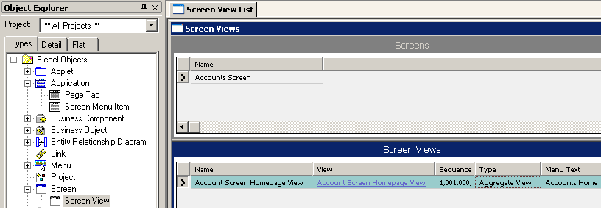
Screens
Have a child object type called Screen View that specifies the views and categories that appear in the screen
  Sequence property specifies where the view appears in the screen
  Menu Text property defines the text that appears in Site Map
  Type property defines the type of view within the screen
    Four types: Aggregate category, aggregate view, detail category, and detail view
Specifies where the view appears in the screen
Specifies the type of view for this definition
Notes:
Note that Sequence and Type are properties of the Screen View object definition. This example screen has a type of Aggregate View. Next, we’ll take a look at the various view types, then look at how they are sequenced to appear in a specified order in the application.

Slide 10
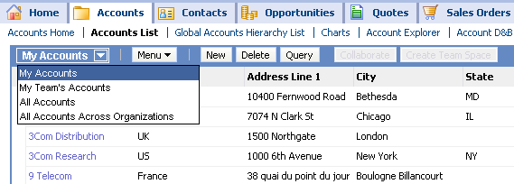
Type Property for Screen View
An aggregate category is a container for a set of views accessible via a link in the linkbar
  May also contain subcategories
An aggregate view is a container for a set of views accessible via the visibility filter drop-down list, a link in the link bar, or the Home Page
Aggregate category
Aggregate views
Notes:
The Screen View object type has a property called Type which defines the type of screen view. Screen views are either actual views or are groupings of views or categories. The Type (in addition to the Parent Category property and applet visibility rules if relevant) generally defines where the view or category is displayed at runtime.
Aggregate Category is a group of views which may contain aggregate views, detail views, and detail categories. Aggregate categories are not views, but are groups of views to which the user can navigate. They appear as links in the link bar.
For example, in the screen print, when you select the Accounts List aggregate category from the link bar, you are navigated to a group of views, including aggregate views such as My Accounts, My Team’s Accounts, and All Accounts.
An Aggregate View is a group of views that appear in the visibility dropdown filter, in the link bar along with aggregate categories, or as screen home pages, such as the Accounts Home page. In the screen print, there are four aggregate views shown: My Accounts, My Team’s Accounts, All Accounts, and All Accounts Across Organizations.

Slide 11
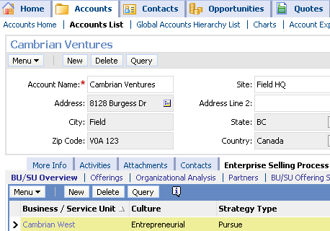
Type Property for Screen View Continued
A detail category is a container for a set of detail views
  Each view is represented as a tab on the view tab bar
  Used to provide an additional layer of navigation
A detail view is a single view that displays data in a list or form that can be queried and edited
Aggregate category
Detail category. . .
. . .displays detail view tabs
Detail view
Notes:
Detail Category, a group of detail views, is used to provide an additional layer of navigation when using an application that contains data which necessitates another level categorization that might be difficult to implement with Aggregate Category and Detail Category alone. In the screen print, Enterprise Selling Process is an example of a detail category. The Detail Category, appearing only ocassionaly, appears in the view bar as a single link. When you click on Enterprise Selling Process, a separate link bar is displayed that contains tabs for all the views in the Enterprise Selling Process detail category.
Detail View is a single view that displays data in a list or form. It is the only Screen View Type that actually displays data and, therefore, the only type that allows data entry. All other types exist to assist user navigation. The detail view shown in the screen print is called ESP (for Enterprise Selling Process) Business Service Unit Overview View. It is represented via the list applet at the bottom.

Slide 12
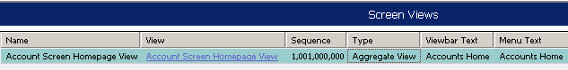
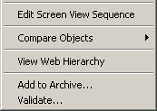
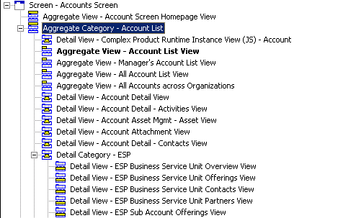

Sequence Editor
Assists in defining where view appears in the application
  Updates the sequence property of the screen view object definition
  Lists four screen view types in hierarchy
Right-click to invoke editor
Right-click to edit
sequence
Notes:
The Screen View Sequence Editor sets the sequence property for screen views. It indents the screen views for Aggregate Categories, Aggregate Views, Detail Views, and Detail Categories to help the developer visualize where they will appear.
The sequence editor is used to determine the placement of the screen view in the appropriate UI element. The higher the position of the view or category, the further left in the link bar or view bar (or higher in the visibility filter drop-down list) the link to the view or category will appear.
Sequence property: The Sequence property displays a numerical code to indicate the sequence of a Screen View in the hierarchy. This field is updated when you open the Screen View Editor, make changes, and then choose File > Save. In the Object List Editor, you can sort on the Sequence column to see the hierarchy that will be displayed at run time. If there is a null value for the Sequence property, SWE will render that Screen View as the last item in the sequence.
If you do not define the sequence of screen views, the Siebel Web Engine will order them alphabetically.

Slide 13
View
Consists of one or more applets
References a business object that defines the relationships between data in the view
Is associated with a Web template that defines its layout
Notes:
Views are containers for applets. The rest of the module will focus on creating and administering views.

Slide 14
View and Templates
Views use templates to organize data layout
Form Applet Web Template
Container Page Template
Control
placeholders
Menu
Branding
Toolbars
Screen Tabs
View Web Template
List Applet Web Template
View
Web Template
Tree Applet Web Template
Applet placeholder
Ticker
Notes:
The web templates can be used to organize and simplify how applications are created. Form, list and tree applets can be thought of as placeholders for the controls that appear on the container page. View templates can be thought of as placeholders for the various applets. And the view template itself specifies a significant portions of the container page view.

Slide 15
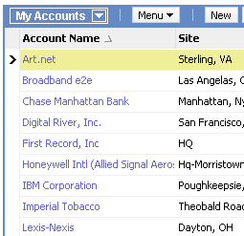
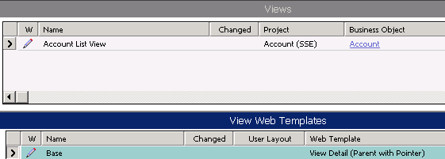
Selecting a View Template
Find an existing view that has desired layout
Examine the View Web Template object definition to determine the view template to use
The Account list view…
…uses the View Detail (Parent with Pointer) template
Notes:
The Account List View uses the View Detail (Parent with Pointer) template that will be used in the following slides.
Recall that a view is a collection of applets displayed on a screen at the same time. It consists of a single window displaying related data forms and lists (applets). The user can select the current (active) view from either the Screenbar (the default view for that screen), the second-level Visibility picklist, a thirdlevel tab, the fourth level Category-view picklist, the thread bar, the history list, history forward and back buttons, or by a drilldown from another view.
Access to particular views is determined by the four navigational constructs in the physical UI. View Templates are associated with a view through the View Web Template object definition. A view template primarily contains placeholders for applets as specified by the <swe:applet> tag. As we discussed in the template module, the mapping of specific applets to these placeholders is done visually through the View Layout Editor.

Slide 16
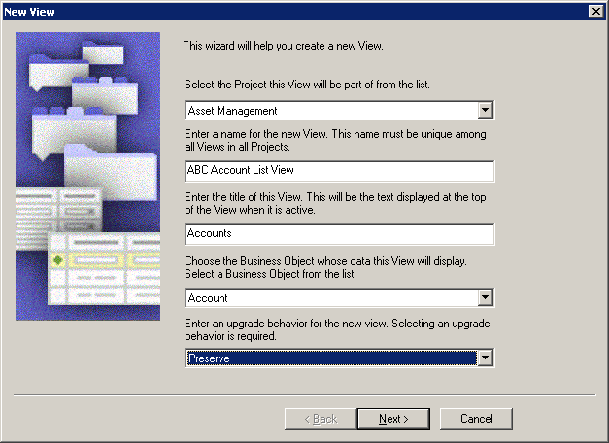
View Wizard
Use the View Wizard to create a new view
  Select File > New Object, select View, and then click OK
Wizard
Notes:
In this course, we will be configuring a lot through wizards instead of building the definitions directly. Using wizards is much easier and more foolproof (reducing the risk of errors).

Slide 17
View Wizard Inputs
The View Wizard requires the following inputs:
  Project that the new view will be part of
  View name and display title
  Business object that the view will reference
  The upgrade behavior
    Admin, Non-preservable, Preservable
  The Web templates that will be used
  The applets that make up the view
    These applets will appear in the Web layout
Notes:
Demo:
This wizard dialog and the following two dialogs in the wizard (New view and View Web Layout – Select Template) are similar to the applet wizard we have recently discussed.
Dialog: Web Layout - Applets
Select an applet in the Available Applets list and click the right arrow to move it to the Selected Applets list. Selected applets will appear in the view, and the order in the list determines the order in which they are added to the view. Use the arrows to move applets up and down in the Selected Applets list.
Dialog: Finish
Check your settings before submitting.

Slide 18
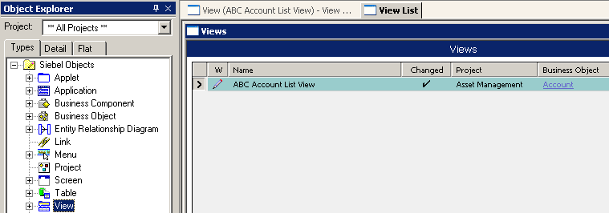
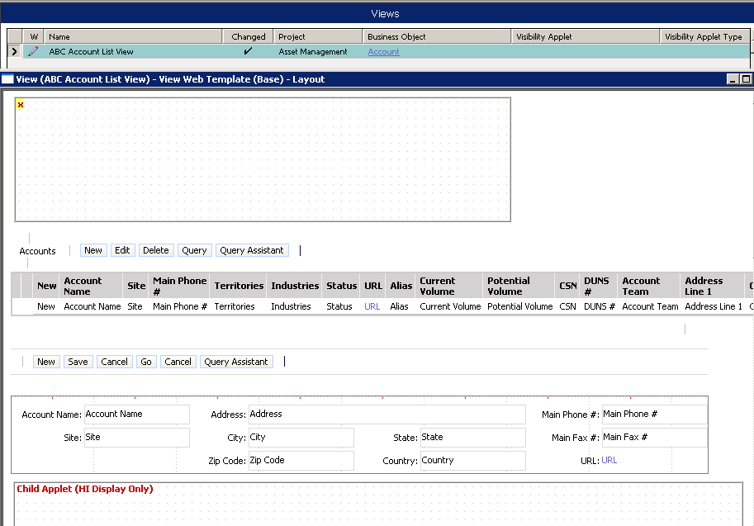
View Wizard Outputs
The View Wizard:
  Creates a view object
  References view to a business object
  Associates Web templates to the view
  Invokes the Web Layout Editor
Creates view
References business object
Invokes Web Layout Editor
Notes:
This is a list of the various things the wizard does after you click the Finish button. Note that the very last thing it does is to start the Web Layout Editor.

Slide 19
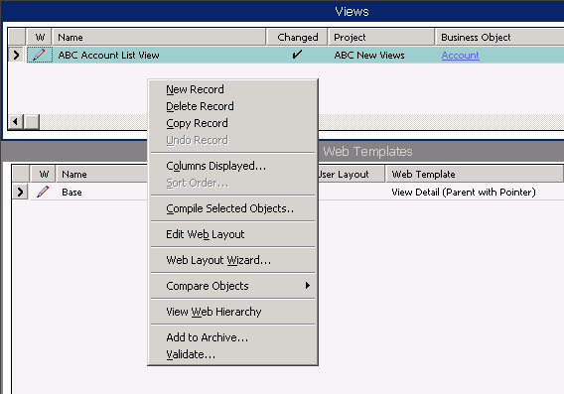
Web Layout Editor
Is launched by the View Wizard
Can be launched by right-clicking a view definition in the OBLE
Right-click and select Edit Web Layout
Notes:
The students have already used a Web Layout Editor for list and form applets, so this should be a familiar concept.

Slide 20
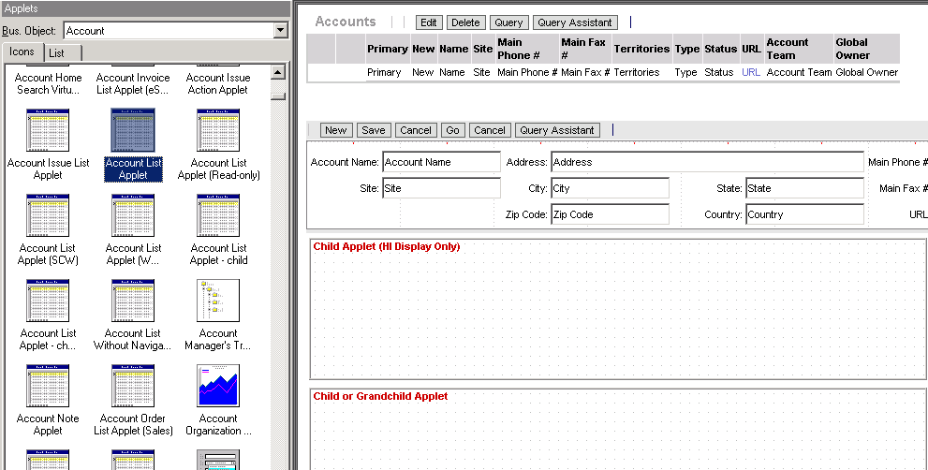
Web Layout Editor Continued
Displays the current layout of the view
Applet window shows the applets available for display within the view
  Constrained by the view’s business object property
1. Drag applet from Applet window
2. Drop onto applet placeholder
Notes:
The Applets window contains applets based on the business object of the view.
If a new applet does not appear in the applets window, it is possible that the applet uses a business component that is not part of the business object for the view. It is also possible that the Applets window has cached the list of available applets. To refresh the cache, select the Bus Object drop-down at the top of the Applets window and select another business object. The window should refresh. Open the list again and select the appropriate business object. The window should refresh with a list of all applets for the selected business object.

Slide 21
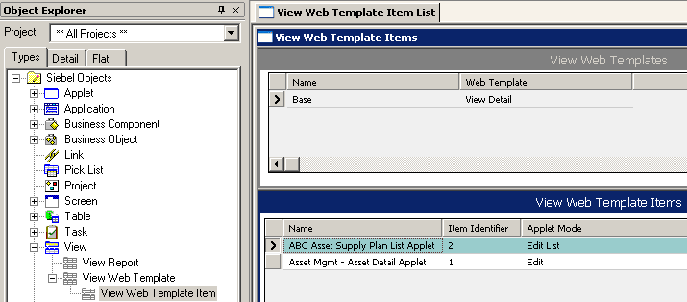
View Web Template Items
Are applets that have been bound to a view
  Item identifier specifies where they are to appear
    Used in the markup language tag that specifies corresponding control in a template
Binds a control to specific position on Web page
Notes:
The Applet Web Template Item child object type (of Applet Web Template) defines the mappings between controls and list columns to placeholders in the Web template file.
Name. Name of the object definition, generally the same as the Control property.
Item Identifier: specifies a unique numeric identifier for each control, generated in the layout editor. The value is used in the markup language tag that specifies the corresponding
control in a template, binding the control to a specific position on the page.
Applet Mode:specifies the mode in which the applet will appear. For high interactivity applications, form applets should be displayed in Edit mode, and list applets in EditList mode.

Slide 22
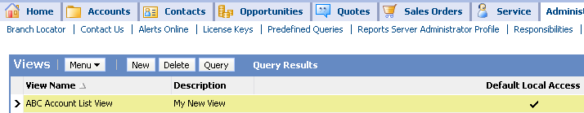

Register and Assign View
Views must be administered in the client to make them available to users
  Navigate to Administration - Application > Views in the client application to register the view
    Copy and paste the view name from the object definition in Tools to the view record
  Navigate to Administration - Application > Responsibilities to assign the view to one or more responsibilities
    Assign the view to developers for unit testing and to users for system testing and production
3. Clear the cache
1. Register the view
2. Assign the view
Notes:
Registering a view creates a database record to which Responsibilities can refer. Responsibilities do not reference views in the repository or the .srf file directly, but instead reference views that appear in this list.
Assigning a view to a responsibility makes the view visible to users that share that responsibility. If a view has not been registered, it cannot be added to a responsibility. If a view has not been added to the developer’s responsibility, they will not be able to unit test the view.
Be sure to remember to clear the cache after assigning the view.

Slide 23
Module Highlights
Applications are groups of screens through which users navigate
Screens are containers for views
  Screen views come in four types: aggregate view, aggregate category, detail category, and detail view
Views:
  Consist of one or more applets
  Reference a BO that defines the relationships between data in the view
  Are associated with a Web template that defines their layout
Notes:
Review Question: Which object specifies a container page?
Answer: The application
Review Question: What types of screen views may appear in the link bar?
Answer: Aggregate categories and aggregate views

Slide 24
Lab
In the lab you will:
  Create a view
  Add the view to a screen using a specified view navigation mechanism
  Administer the new view

