Slide 1

Module 27: UI Layer Configuration: Drilldowns
0/5
Siebel 8.0 Essentials
Notes:
Time: Lecture: 25 minutes; labs: 45 minutes
Intent: To teach students how to create and configure some of the navigational aids in Siebel applications.
Flow: The modules begins with a basic discussion of drilldown navigation, and then proceeds to examine static drilldowns for the same and for different business components. Next, the topic on dynamic drilldowns is explored focusing on configuration and discussion of the thread bar.
Key Terms
Dynamic drilldown
Dynamic toggling
Static drilldown
Static toggling
Thread applet
Thread field
Threadbar (tag)
Togglebar (tag)

Slide 2
Module Objectives
After completing this module you should be able to:
  Configure drilldown to a related view
  Enable the thread bar
Why you need to know:
  Enables you to add drilldowns to assist users with navigation
  Enables you to activate the thread bar to assist users
Notes:
Each objective and “why you need to know” should be stated aloud.

Slide 3
Navigation Using Drilldown
You can configure list columns or controls for drilldown
  When the user clicks the hyperlinked value, the application navigates to another view
You can configure drilldown as static or dynamic
  Static: Clicking the hyperlink always navigates to the same target view
  Dynamic: Clicking the hyperlink navigates to a target view determined by values shown in the current view
Notes:
This is a positioning slide for concepts regarding drilldown. The next series of slides will show how drilldowns appear inside the application and how to implement them using Siebel Tools.
A drilldown (you may also hear the term “view drilldown”) is like a hyperlink on a Web page. The user clicks a field in the record and is taken to another view. Static drilldowns are called “static” because you always arrive at the same destination view, no matter what the value is of the field that was clicked. Dynamic views are “dynamic” because the value of the field determines which of a possible number of potential destination views the user sees next.
Diagram idea: It might be useful here to draw a simple representation of static versus dynamic on the board so students can have it to refer to as you go through the slides.
Static: Draw views A and B on the board, with fields F1, F2, and F3 in view A. Draw an arrow from F1 to view B to represent the user drilling down on F1 and being taken to view B.
Dynamic: Draw views A, B, C, and D on the board, with fields F1, and F2 in view A. Draw an arrow with two “tails” from F1 and F2 to view B, to show that if certain values appear in F2, drilling down on F1 takes the user to view B. Draw another arrow with two “tails” from F1 and F2 to view C to represent another conditional drilldown. Finally, draw a simple arrow from F1 to view D, showing the default drilldown if no other conditions are met.

Slide 4

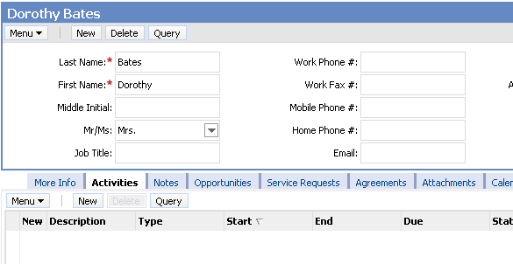
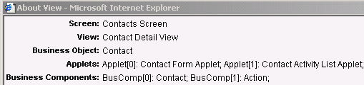
Static Drilldown: Same Business Component
Drill down to another view, keeping the business component (BC) context
Contact record in Visible Contacts list view
Same contact record in Contact Detail view
Notes:
This slide defines static drilldown within the same business component. Note that static drilldown within the same business component is most frequently seen in the list applet of a More Info view.
The screen shot shows a static view drilldown implemented in the Contact list applet (on the left). Point out that the contact of the record is maintained. The drilldown was configured on the Last Name field, not the First Name field, and the drilldown action navigates to a view where the information is based on the same business component as the business component from which we are drilling down.
Follow these steps to demo static drilldown:
1. Log in to Siebel Call Center as SADMIN connecting to the sample database.
2. Select Contacts > My Contacts and use the Last Name field (same as the screen shot). Point out that the drilldown field can be identified by the blue color on the hyperlinked text. Also, point out that when you hold the mouse pointer over the field, it will display a blue underline and the mouse pointer changes to a hand. Show how clicking takes you to a different view.
This module shows three different ways to configure drilldown, from least complex to most complex. Make sure students are clear on each before moving on to the next. In each case, the definitions shown in Siebel Tools match the example shown in the application, so you can move back and forth between slides and the demo to clarify the point if necessary.

Slide 5
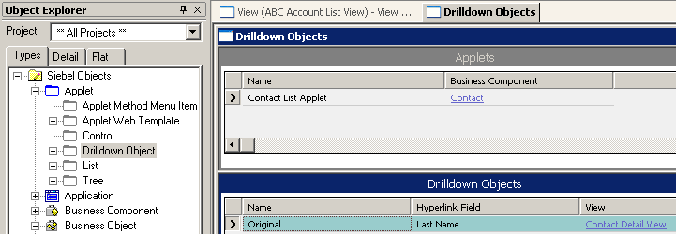
Configuring Drilldown Within Same Business Component
Create a new drilldown object
  Set the Hyperlink Field and View properties to enable static drilldown
  Drilldown object is child of an applet object
Specifies the BC field to be highlighted for drilldown
Specifies the target view
Notes:
This slide shows how to configure the definition for a static drilldown within the same business component. The screenshot shows how the drilldown illustrated on the previous slide is configured.

Slide 6

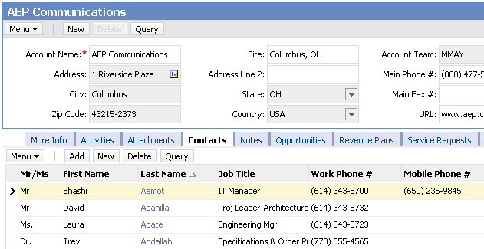
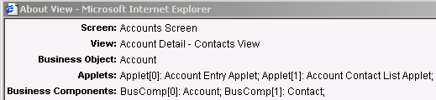
Static Drilldown: Different Business Component
Drill down to another view, changing the business component context
The account field of the contact record in the Contacts list view
Related account record in the Account Detail - Contacts view
Notes:
This slide defines static drilldown to a different business component. Make sure students understand that whether a drilldown is static or dynamic is a different issue from whether or not the same or different business components are involved.
In the screenshot, our starting context is on the Contact List Applet inside the Visible Contact List view. Then, we drill down to the Account Form Applet inside the Account Detail - Contacts view. So our context has moved from the Contact business component to the Account business component.
Show this drilldown to students to illustrate the point. Select Contacts from the screen tab and then drill down on the Account field to navigate to the Account Detail-Contacts view.

Slide 7
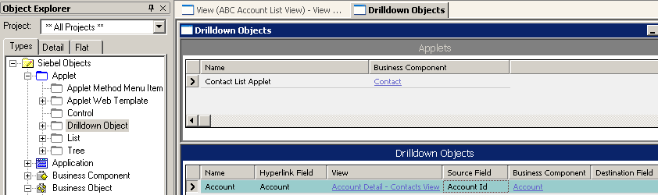
Configuring Drilldown to Different Business Component
Create a new drilldown object for the applet
  Set Hyperlink field and View properties as before
  Set Business Component, Source Field, and Destination Field properties to enable drilldown to a view based on a different parent record
BC in target view
Foreign Key field in record pointing to target BC
Primary Key field in target BC
(default is ROW_ID)
Notes:
This slide shows the extra properties we need to set in order to configure the definition for a static drilldown to a different business component. The screenshot shows how the drilldown illustrated on the previous slide is configured.
Note that we have to specify:
1. The business component to which we are navigating.
2. The name of the foreign key field in that source business component that will match the primary key field in the target business component.
This allows the application to correctly retain the context of the record from which the user navigates.

Slide 8
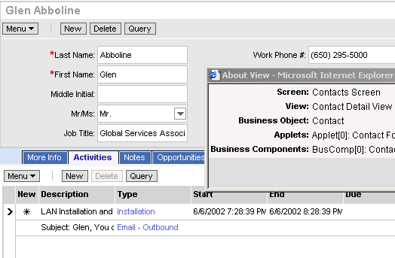
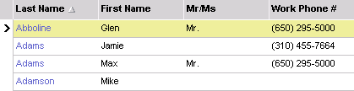
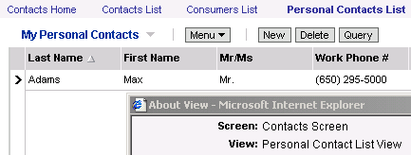
Dynamic Drilldown
Enables drilldown to multiple views from the same hyperlink field, depending on value of a field in the active record of the list
For business contacts, go to the Contact Detail view
For personal contacts, go to the Personal Contact List view
Notes:
This slide defines dynamic drilldown. Note that dynamic drilldown is generally to a different business component.
Dynamic drilldown navigates the user to multiple views from the same hyperlink field as illustrated in the screenshot.

Slide 9
Matching Conditions
Identify one or more matching conditions to trigger drilling down to a specific target view
  For example:
Determine the order to check the matching conditions
  Conditions can involve different fields
  Multiple matches could occur for a given record
Personal
Contact?
Personal Contact Detail View
Y
N
Contact Detail View
Notes:
This slide lists some items of business logic the developer should determine before configuring a dynamic drilldown. The developer must specify the conditions to navigate to a particular target view.

Slide 10
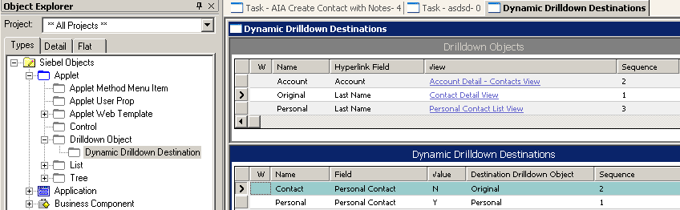
Configuring Dynamic Drilldown
Create the drilldown objects for each view
  Multiple drilldown objects with same hyperlink but different views
Set sequence number to determine where to look for dynamic drilldown destinations
  The drilldown object with the lowest sequence number is checked for dynamic drilldown destination child object definitions
The Original drilldown object has the lower sequence number, so it is checked for dynamic drilldown destinations
The Original and Personal drilldown objects have the same Hyperlink field but different views
Notes:
This slide shows how to configure the definition for a dynamic drilldown. The screenshot shows how the drilldown illustrated two slides previously is configured.
First, you configure a drilldown object for each destination view. These create the set of possible places to go. Each drilldown object also has a sequence number. The conditions that dictate which view is drilled down to are specified in the dynamic drilldown destination (DDD). This is a child object of the drilldown object. You must configure this for the drilldown object with the lowest sequence number, and the best practice is to configure it for all.
The sequence number also enables “priority” for a drilldown object—if the user double-clicks in a row with one or more drilldowns configured, the application navigates based on the drilldown with the lowest sequence number.

Slide 11
Configuring Dynamic Drilldown Continued
Create a dynamic drilldown destination definition for each condition
  Each condition specifies a destination drilldown object to use
  Recommended practice: Create a default dynamic drilldown destination to specify a desired view if there are no matches
    If no default is configured, navigates to the view specified by the parent drilldown object
Contact Detail view is default
Separate definition for each destination
Field to check
Value to check for
Destination
Order in which to check
Notes:
This is a checklist of general principles for configuring a dynamic drilldown without unwanted results.
Where do you want users to navigate to when there is no matching condition? The default should always be the last item to check in the sequence, and should have no matching condition. If no default is defined, and no matching condition is met by a given record, the drilldown does nothing (that is, the user continues to see the current view).
Configure a drilldown object that navigates to your target view (that is, set these properties to define the required target/destination view at which users should arrive).
Each target view must be specified in a drilldown object (DO) definition. Each condition (Dynamic Drilldown Destination (DDD) should point back up to a drilldown object.
If no default drilldown object has been set, and all matching conditions fail, the hyperlink still appears, but it will not navigate to another view. It is a recommended practice to set a default drilldown object to avoid this confusion.

Slide 12
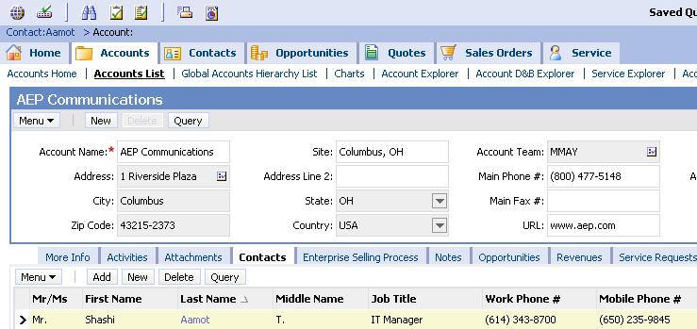
Thread Bar
Tracks previous business object (view) and active record
Updates whenever the user navigates to a different business object
Provides hyperlinks to previous views
  Allows user to backtrack easily
Hyperlink to prior active record in the thread
Notes:
Thread bars track the user’s navigation through views.
Note bullet two: The thread bar updates (that is, adds another view to the thread bar) when the user navigates to a new view in another business object.
Use the following demo:
Navigate to My Contacts by selecting the Contacts screen tab.
Drill down on the Last Name field and point out that there is no update to the thread bar because we are still in the same business object.
Click the Back arrow, then drill down on the Account field for the same contact record. Point out that the thread bar is now updated with the Last Name of the contact record we drilled down from.
Now drill down on the Last Name field of the last contact shown in the Contact list applet. This takes us to the Contact Activity view, and the thread bar is updated again.

Slide 13

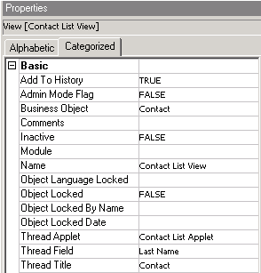
Thread Properties
Specifies the text that appears in the thread bar
Thread title
Thread field
Specifies the record to “remember” in the hyperlink
Thread Title property specifies prior business object in hyperlink; if not entered, application uses Title property
Notes:
This slide shows how the thread applet and thread field definitions relate to the appearance and behavior of the thread bar.
Note that while drilldown is configured on a field of an applet, thread bar properties are configured on a view.

Slide 14
Module Highlights
List columns or controls can be configured for drilldown
Drilldowns can be static or dynamic
  Static drilldowns always navigate the user to the same target view
  Dynamic drilldowns navigate the user to a target view determined by the values shown in the current view
  Static drilldowns can be configured to drill down to the same business component or to a different business component
Thread bar allows user to easily backtrack
  Configured in Tools
Notes:
Review Question: What are the three kinds of drilldown?
Answer: Static drilldown within the same business component, static drilldown to another business component, and dynamic drilldown
Review Question: Drilldown is configured on what type of object?
Answer: On a column of a list applet
Review Question: On what type of object is the thread bar configured?
Answer: On a view object

Slide 15
Lab
In the lab you will:
  Create and configure dynamic drilldowns
  Enable and configure thread support

