Slide 1

Module 28: Business Layer Configuration: Joins
0/5
Siebel 8.0 Essentials
Notes:
Time: Lecture: 35 to 45 minutes; lab: 45 minutes
Intent: To discuss the procedure for creating explicit joins when party data is not involved as well as when party data is involved.
Flow: How joins are used to bring data into business components, bringing party data into a non-party business component, and bringing party data into a party business component.
Key Terms:
Join Definition
Join Specification
Single Value Field
Mapping a Field job aid
Join Diagram Template
Alias
foreign key column
primary key column
Destination Column
Source Field
Outer Join Flag
Bringing Party Data into a Standard Business Component
PAR_ROW_ID
Bringing Party Data into a Party Business Component
INTRODUCTION: At this point, you have specified web templates, applets, screens, views and drilldowns. In subsequent modules, you will configure existing BCs and create a new BC. The labs in those modules will bring together many of the elements you’ve studied thus far in this configuration section. However, before moving on to BCs, there is one more important topic to cover, and that is the procedure to create joins. This is what will be covered in this module.

Slide 2
Module Objectives
After completing this module you should be able to:
  Create a join that brings data from a standard table into a standard business component
  Create a join that brings data from a party table into a standard business component
  Create a join that brings data from a party table into another party business component
Why you need to know:
  Enables you to configure your company’s business logic
Notes:
Each objective and “why you need to know” should be stated aloud.

Slide 3
Joined Tables Review
Business components can include data from related joined tables
  Brings in data as needed to meet the business component’s data requirements
    For display in applets
    For use in processing by the business component
Opportunity
Name
Description
Sales Stage
S_OPTY
S_STG
Base table
Joined table
ROW_ID
NAME
DESC_TEXT
CURCY_CD
ROW_ID
NAME
PHASE_CD
STG_ORDER
Notes:
This is a review slide from a previous module. Recall that we use explicit joins in cases where the BC’s base table doesn’t contain all the data required by for display in the UI. In this example, the Opportunity business component references sales stage and close data in the S_STG joined table.
To create this join, a Join Definition is used to establish a relationship between S_OPTY and the S_STG table. This relationship allows the business component to use columns from S_STG.

Slide 4
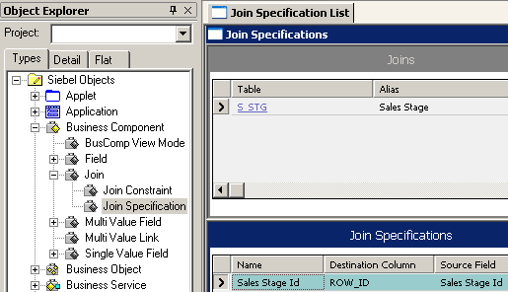
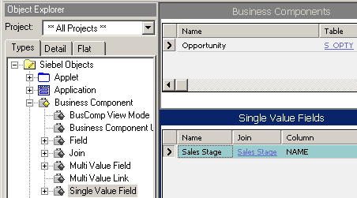
Three Definitions Are Used to Implement a Join Review
Join definition specifies the joined table
Join specification specifies the FK and PK used to relate the base and joined tables
Single-value field (SVF) references the join object definition
1. Join definition
2. Join specification
3. Single-value field
Notes:
This is a review slide. Note the following:
The join definition specifies the joined table from which to retrieve data. In this case, S_STG. The alias property is the name of the join, Sales Stage.
The join specification specifies the foreign and primary keys used to relate the base and joined tables. The Destination Column references the primary key in the joined table, usually ROW_ID, and the Source Field references the column in the base table that is the foreign key to the joined table.
Note: quickly review slides from the Business Component module (module 17). Start with slide 13 to quickly review how the join brings data into a BC (the FK CURR_STG_ID has a direct relationship with the PK, ROW_ID – that is, their values match, and a unique relationship is created between the two tables for each row), then skip to slide 16 to quickly review how the join sets up this relationship.)
The SVF references the Join object definition via its Join property. It references the joined table column via the Column property.
Note: this slide is not intended to describe the procedure for creating a join. Rather, it illustrates the parts that must be present in to create the join and bring the joined data into the BC.

Slide 5
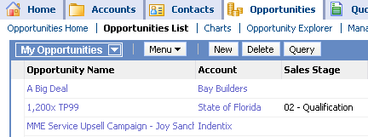
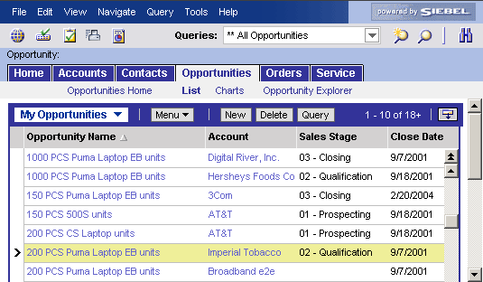
Join Example
Will bring Sales Stage data from S_STG into the Opportunity BC
  S_OPTY is the base table, S_STG is the joined table
From S_OPTY
From S_STG
Notes:
This screen capture shows the Opportunity List Applet that exposes the Sales Stage and Close date fields. A join brings these fields into the Opportunities business component and the Opportunity List Applet displays the data in the user interface.
In the subsequent slides in this module, we will explore what’s required to build a join that brings together the data required to render information displayed in this screen shot.

Slide 6
Building a Join
0/6
1. Locate the Data Source
2. Examine Existing Joins
3. Diagram the Join
4. Create the Join Definition
5. Create the Join Specification
6. Map the Single Value Field(s)
Notes:
This is a structuring slide for <insert what will be discussed>. Do not teach the steps or concepts here because the following slides cover them in detail. Provide a high level description of what will be discussed.

Slide 7
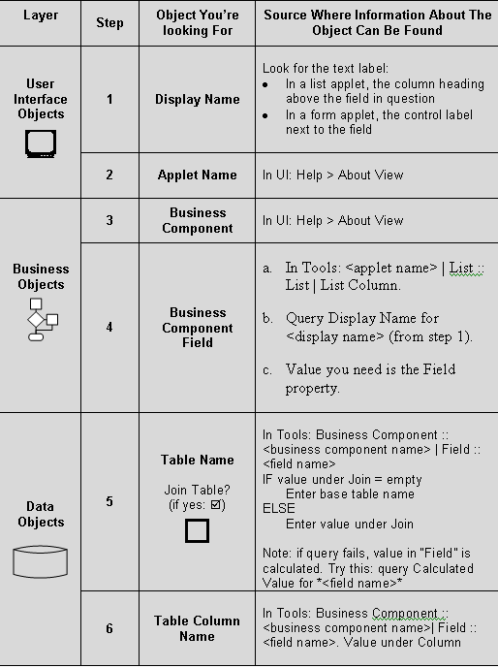
1. Locate the Data Source
1/6
Identify potential data sources
  Peruse application for data that you seek
    The required data could exist in another business component
Once you find the data in the UI, identify the specific table and column where the data resides
  Trace down from the UI element to the table column
    For assistance, use the job
    aid from the Business Component lab
Identify table and column that contains data you seek
Notes:
The job aid is from a lab in the business components module. Note: the job aid helps you find the data source, not any existing joins.
Lab Scenario
In the lab, you will perform the procedure for creating the join, but the data source is provided for you. To give some context to the lab, I’ll demo locating the data source here.
In the lab for this module, you will need to display the original order number for a piece of equipment and, if available, the purchase order number given by the customer.
Identify Order #:
In the UI, go to Site Map > Sales Orders > List.
In the form applet, locate the Order # field. Make a note of the caption (Order #)
In About View, make a note of the applet: Order Entry – Order Form Applet; and the business component: Order Entry – Orders.
In Tools, we’ll
- display the Order Entry – Order Form Applet
- Select the Control object type (child of the applet)
- Search for Order # caption property
View its Field property to identify the BC field, Order Number.
Select the Order Entry – Orders BC
Select the Order Number SVF
View the join and column properties. Here we can see that the column is ORDER_NUM; however, the join property is blank, so we can infer that the table is the base table, S_ORDER. To verify, we’ll drill down on the BC’s base table property to verify ORDER_NUM is indeed a column in S_ORDER.
We now know the business component, the base table, table we need to join to, and the column in that table that holds the data,
Identify Purchase Order #: this field can be viewed by accessing the More Info view tab after drilling down on an order number from the list. The rest of the procedure is similar to they way Order # was identified.

Slide 8
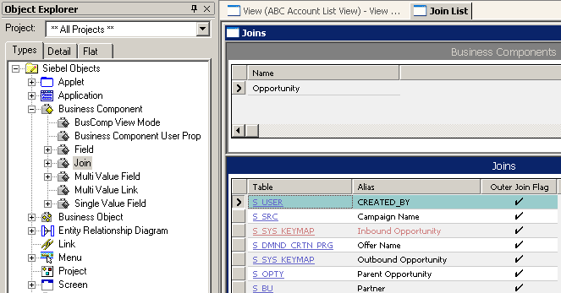
2. Examine Existing Joins
2/6
Determine if a join already exists
  Peruse existing joins for joins that might be candidates
  Oracle has already provided many commonly-used joins
If a join exists that meets data display requirements, use it
Otherwise, create a new join
Examine alias for candidates
Notes:
Before creating a join, peruse existing joins for the business component to determine if there is a join that suits your needs.
Since we don’t want to demo the lab for you, I’ll go back to our earlier sales stage scenario.
The alias may provide some clues as to whether the data it joins suits the data display requirements for the business component. For the sake of demonstrating this concept, assume that the screen print displays all the joins for this BC. I don’t see an Alias that indicates there is a join that brings in sales stage data into this BC, so I can conclude there is probably not an existing join I can use.

Slide 9
3. Diagram the Join
3/6
The Join Diagram template simplifies join creation
  Gather information first, then create the join
Indicate each of the numbered items
Join Diagram Worksheet
1. Business component
Business Component: Opportunity
Single Value Field: Sales Stage Id
7. Single-value field
2. Base table
S_OPTY
S_STG
3. Joined table
4. Joined table column
ROW_ID
CURR_STG_ID
ROW_ID
NAME
6. Primary key column
5. Foreign key column
Base Table
FK
PK
Joined Table
Notes:
There is one more step I’d recommend you perform before creating the join, particularly when you new to the task. The Join Diagram Worksheet in this slide is a structure you can use to assist you in gathering the information you need to build a join. You will use this worksheet in the lab for this module. The red items in the worksheet indicate the information you need to gather.
DESCRIPTION (you will perform these steps in the lab):
We’ve already determined the first four elements when we identified the data source:
Business Component – The BC referenced by the APPLET that will display the data. (see data source job aid)
Base Table – it’s the base table for the BC. (see data source job aid)
Joined Table name. This is the table you determined via the job aid that contains the data you seek. (see data source job aid)
Joined Table Column. The column you determined contains the data you seek, also determined with the job aid. (see data source job aid)
Foreign Key Column. You haven’t identified yet. Its the name of the column in the base table that serves as the foreign key to the joined table. In Tools you select the BC’s base table (S_OPTY), select the Column object type, then query the Foreign Key Table property for the name of the joined table, in this case S_STG. The result in this case is CURR_STG_ID.
Primary Key Column. To determine the name of the column in the joined table that serves as the primary key, you select the joined table, in this case S_STG, then Query for Primary Key = TRUE.
SFV. Next, you need to determine if there is an SVF in the BC that references the FK column, in this case CURR_STG_ID. To do this, select the SVF, e.g., Opportunity :: Single Value Field, then query the Column property for the FK column, in this case CURR_STG_ID. If there is a reference, the NAME property in the Single Value Field’s window of the OBLE will populate. In this case, its Sales Stage Id. The join property appears empty because CURR_STG_ID is in the base table. Recall that when the join is in the base table, the join property appears blank.

Slide 10
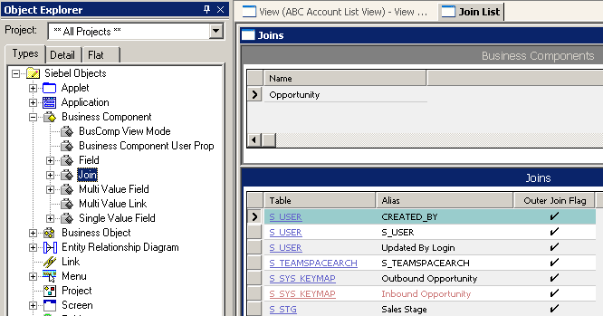
4. Create the Join Definition
4/6
Table property specifies joined table
Alias property is the name of join definition
  Alias always defaults to the joined table’s name
    Displayed in ALL CAPS
  Additional aliases for self-joins or multiple joins to the same table are specified by the developer
    Recommended practice is to use Initial Caps
Name of join
Default alias value: joined table name
Joined table
Notes:
Now you are ready for data entry in Tools. Once in Tools, the first step is to create the Join Definition.
Recall that the join definition is a child object definition of the business component.
Here we have the Table property, which contains the name of the joined table, and the Alias property, which is the name you give to the join.
When you create a new join definition, you first specify the joined table name. Upon tabbing out of the Table property, the Alias property will automatically populate with the value in the table property.
It specifies the joined table. In this case, the joined table is S_STG.
It is important that the Alias property of the join be distinct even though the destination table is the same across several joins. We recommend you do not use the table name as the Alias name, even though this is common in the standard repository. This is because implicit joins will use the table name as the Alias to make sure that the explicit join name is not used instead. To make sure that no conflict exists, you should always give the join a distinct and custom alias name.
By convention, when specifying the Alias property for a join definition you are creating, the Alias is stated in Init Caps, such as, Updated By Login. There is nothing to stop you from using all caps. However, by following the convention, it simplifies development and maintenance in that you can readily distinguish between an alias whose property mirrors a table name versus an Alias property that describes the data being joined..
As soon as you save the record, the value in the Alias property is added to the pick list you use to specify the join for a SVF.
Note: to simplify presentation of the procedure to create a join, optional items, like the outer join flag, are covered after presentation of the base procedure, later in this module.
CONTINUED ON SUBSEQUENT PAGE

Slide 11
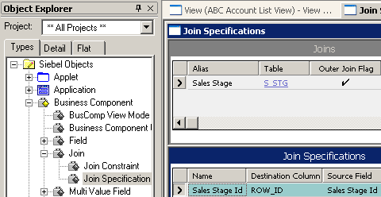
5. Create the Join Specification
5/6
Specify foreign key field of the base business component in the Source Field property
Specify primary key column of the joined table in the Destination Column property
Base Table
Joined Table
S_OPTY
S_STG
ROW_ID
CURR_STG_ID
ROW_ID
NAME
FK
PK
Notes:
After you create the join definition, create the join specification.
As is illustrated in the Join Diagram Worksheet on the previous slide, the Source Field identifies the foreign key column in the base table that references the PK of the joined table.
Likewise, the Destination Column property identifies the primary key in the joined table.
For Name, use the value in Source Field. There is an upgrade utility that depends on this naming convention.
CONTINUED FROM PREVIOUS PAGE: Multiple Joins (only if a student asks): it is common for a BC to have more than one join with the same destination table. In the example shown, the Opportunity BC has three joins to S_USER table: CREATED_BY, S_USER and Updated by Login. By examining references within the joins and their related SVFs, we find that each retrieves the same data: the user ID (e.g., PPENGUIN). However, each SVF uses them differently. CREATED_BY is used by list columns in numerous applets to track, via user ID, the user who created a new record. The S_USER join is used to track who is the Primary designation for a sales rep via the Primary Sales Rep Login field. Finally, Updated By Login is used in the list columns of numerous applets to keep track of which user updated a given record. It appears here that [engineering] could have accomplished this with a single join. For you, the student, it is best to use an existing join if it meets your purposes.

Slide 12
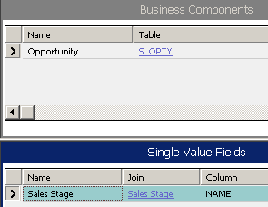
6. Map the Single Value Field(s)
6/6
Specify business component field name, the joined table, and column name of the joined table
  SVF specifies the data you seek
  The join determines how you access that data
Data you need
Base Table
Joined Table
S_OPTY
S_STG
ROW_ID
CURR_STG_ID
ROW_ID
NAME
How to get the data
FK
PK
BC SVF field name
Sales Stage join references S_STG joined table
Sales Stage SVF references NAME column in joined table
Notes:
At this point, the join is created. It stands on its own, and any SVF can reference it.
If there is NOT an SVF in the BC that references the column in the joined table that contains the data, you need to create a SVF that does (or point an existing field to the join definition and the column).
Name Property. In this example, Sales Stage is simply the name of the SVF.
Join Property. In this example, Sales Stage it is the Alias Name we discussed earlier when configuring the Join definition. In Tools, you simply select the join from a pick list.
Column Property. is the column in the joined table that contains the data you seek. In this case, Sales Stage field is referencing the NAME column of S_STG table via its column property.
Together, the Join property and Column property identify the table and column and how to access it.
DEMO (time permitting):
1. Create Join Definition
Table: S_STG (tab out; alias will default, change it)
Alias: My Join Definition
2. Create Join Specification
Source Field: Sales Stage Id (will reference FK column in base)
Name: cut & paste Sales Stage Id from Source Field
3. Create SVF
Name: My New Field
Join: My Join Definition
Column: NAME. Notice how the columns in the pop-up list are all limited to columns in the joined to table, S_STG. If you remove the join, then bring up the pop-up for columns again, now only base table columns appear. It thinks that, since no join is specified, that columns from S_OPTY should be used]
When doing this demo, point out how the pick list populates at various points in the procedure. Verify this by comparing items in the pick list against the parent object, such as the columns in S_STG.

Slide 13
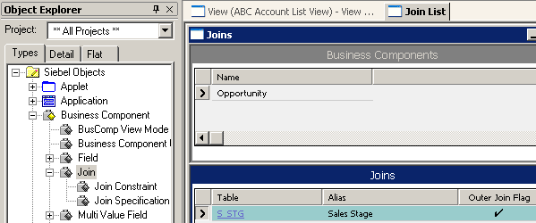
Outer Join Flag
An option in the join definition
Set Outer Join Flag to TRUE to return all records from the base table, even when there is no related row in the joined table
Outer joins will affect performance
  Do not enable outer join if there is always a related row in the joined table
Outer join enabled
Notes:
The Join definition also has a property called Outer Join Flag. You use an outer join to return all records from the base table even when there is no match in the joined table.
If the outer join flag is not checked, an inner join is used. Anyone recall what an inner join does? An inner join essentially finds the intersection between two tables. It finds all the records from table A with matching records from table B. If no match is found, the record from A is not included in the results.
However, outer joins have a performance impact; you should only use outer join when you know that there may not be a related row in the joined table. If the relationship always exists, then don’t set the outer join flag.
Note: should a student ask, a Join Constraint is a constant-valued search specification applied to a column during an outer join. Its main properties are Destination Column, which is the column on which the constraint will be applied, Name, which is the name of the constraint, and Value, which is a non-null constant value or constant function, such as LoginId(), PostionId(), and DivisionId(). The join constrain is an optional configuration, and beyond the scope to cover in detail in Siebel Essentials.
.

Slide 14
Outer Join Flag Continued
When Outer Join Flag is TRUE (checked), a left outer join is used
  All records in source table are displayed
    Even if there is no related record in the target table
  Records with no related record in target table display target values as null
S_OPTY
ROW_ID | NAME | DESC_TEXT | CURR_STG_ID
001 | 200 PCS CS Laptop units | AT&T | 105
002 | 200 PCS Puma Laptop EB | Imperial Tobacco | 106
003 | 200 PCS Puma Laptop EB | Broadband e2e | NULL
S_STG
ROW_ID | NAME | PHASE_CD
101 | 03 - Closing | 9/7/2001
102 | 05 – Won | 9/18/2001
103 | 07 - Selected | 2/20/2004
104 | 06 – Short List | 9/18/2001
105 | 01 - Prospecting | 9/18/2001
106 | 02 - Qualification | 9/7/2001
FK
PK
All records displayed from source
No corresponding record for Broadband e2e
Notes:
If you do use outer join, here are two key points:
S_OPTY foreign key references S_STG primary key
With outer join, all records from base table are displayed. In the example, the business need is to display Broadband e2e, even if its corresponding record in S_STG is null (you wouldn’t want to exclude Broadband e2e as an opportunity just because the sale stage hasn’t been administered)
With inner join, only those records in S_OPTY that have a corresponding record in S_STG are displayed.
Your business needs determine when to use outer join. In this example, if you are an end-user viewing opportunities, you probably want all opportunities to display, regardless of whether a sales stage has been assigned or not.
Here’s how the SQL might appear for outer join:
SELECT *
FROM s_opty
LEFT OUTER JOIN
s_stg
ON s_opty.curr_stg_id = s_stg.row_id
The SQL reads as:
SELECT all records from S_OPTY (the base table for opportunity BC)
LEFT OUTER JOIN: limits results to those matches with the "left" table, S_OPTY. This means that if the ON clause matches 0 records in the right table, S_STG, a row in the result will still be returned, but with NULL values for each column from S_STG.
Note: the SQL statement is provided here solely as a learning aid. In general, you will not code SQL with Siebel.

Slide 15
Joins and Party Business Data
0/3
Joins and Party Business Components
Bringing Party Data into a Standard Business Component
Bringing Party Data into a Party Business Component
Notes:
This is a structuring slide for <insert what will be discussed>. Do not teach the steps or concepts here because the following slides cover them in detail. Provide a high level description of what will be discussed.

Slide 16
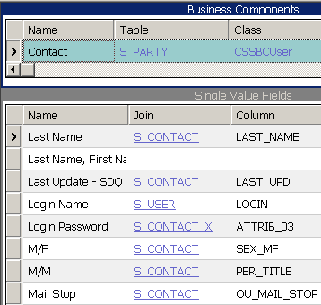
Joins and Party Business Components Review
1/3
Party Business Components have S_PARTY as the base table, but store main data in S_PARTY extension tables
An implicit join is used to reference fields from extension tables
  Used when relationship between tables is known
  Appears in Join property on SFV
  Does not appear as Join object definition
Main columns use implicit join to S_CONTACT
Contact
First Name
Last Name
Birth Date
S_PARTY
S_CONTACT
ROW_ID
NAME
PARTY_TYPE_CD
PARTY_UID
ROW_ID
FST_NAME
LAFST_NAME
BIRTH_DT
PAR_ROW_ID
PK
FK
Base Table
Extension Table
Notes:
All party BCs use S_PARTY as their base table but store no real user data in it. Data is stored in the many S_PARTY extension tables.
Since they are extension tables, they use implicit joins. Recall from the BC module that implicit joins, predefined as part of the Siebel architecture, are used to reference fields in extension tables, and do not appear as Join object definitions.
Possible Demo: in Tools, sort the SVF object definitions ascending on the Join property for SVFs in the Contact BC. Scroll through all the joins named S_CONTACT. Emphasize that S_CONTACT is the Contact party BC’s main extension table, and that all these S_CONTACT implicit joins are used to bring in the main party data. Then, show all the explicit Join object definitions for the Contact BC. Point out that there are no (or maybe one) S_CONTACT join definitions.

Slide 17
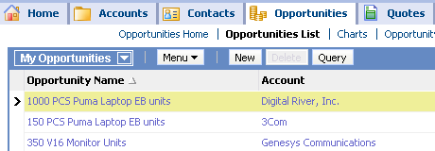
Bringing Party Data into a Standard Business Component
2/3
Example: Bringing account data into the Opportunity business component for display in an Opportunity applet
Opportunity
Name
Description
Account
Data from an S_PARTY extension table
Standard business component
Notes:
Scenario: This slide illustrates a situation where we’re bringing account data from S_ORG_EXT, a party extension table, into the opportunity business component, a standard BC.
On the next slide, we’ll consider what’s involved to configure this via Tools.

Slide 18
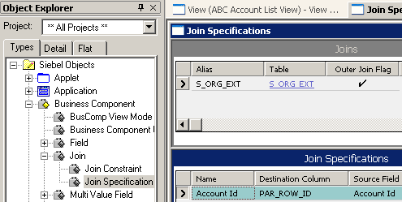
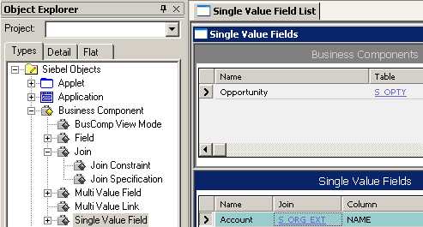
Three Definitions Bring Party Data into a Standard BC
2/3
The Join definition specifies which S_PARTY extension table to use
The Join specification specifies to use PAR_ROW_ID
The SVF is the desired column from the joined extension table
1. Join definition
2. Join specification
3. Single-value field
Notes:
Party data is brought into a standard business component the same way as non-party data is brought into a standard business component. The fact that S_ORG_EXT is an extension table of S_PARTY doesn’t really matter.
What is different, is the Join Specification, in that it references PAR_ROW_ID rather than ROW_ID. We’ll examine this more thoroughly on the next slide.
SVF is used in the same way as when joining standard BCs.
Join Definition and Specification establish FK/PK
This slide illustrates how the SVF that references a join definition is really independent of the join definition and join specification. Once the join is defined via the join definition and join specification, any field can reference that explicit join via the field’s Join property.
In this example, Account Id is the source field that references the FK column in the base table. However, Account is the SVF that references the S_ORG_EXT join. While the Column property for the Account SVF is NAME, and it contains the data we seek.

Slide 19

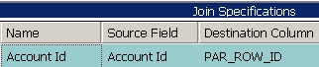
Join Specification with Party: Similar to Standard But
2/3
Destination references PAR_ROW_ID, not ROW_ID
Keys reference base to extension to join, rather than base to join
Typically references PAR_ROW_ID
Standard
Typically references ROW_ID
Party
S_OPTY
S_STG
S_OPTY
S_ORG_EXT
S_PARTY
ROW_ID
ROW_ID
ROW_ID
CURR_STG_ID
PR_DEPT_OU_ID
NAME
ROW_ID
PAR_ROW_ID
NAME
ROW_ID
Data resides in _EXT
FK
FK
PK
FK
PK
FK
PK
001
001
001
Oppty Base Table
Joined Table
Oppty Base Table
Joined /
Extension Table
Party Base Table
Notes:
Here we have a side-by-side comparison.
In the example, Party side:
The value in the Source Field property is Account Id, and just like with standard data, it references a FK column, PR_DEPT_OU_ID, in the base table, S_OPTY. It doesn’t contain data, just a numeric FK (like 001), which references. . .
PAR_ROW_ID in S_ORG_EXT, an extension table of S_PARTY, and its foreign key PAR_ROW_ID column references. . .
The primary key in S_PARTY. All this referencing is necessary to ensure the integrity of a single account record across these tables. Everything references back to that master record in S_PARTY for a given account, such as the Permian China account record.
The Destination Column property references the extension table FK column, PAR_ROW_ID.
The Column property in the SVF (not shown here) is set to NAME to reference the NAME column in the joined table, S_ORG_EXT.
Destination Column
PAR_ROW_ID is used instead of ROW_ID because we are really interested in the primary key of the entire account record. You may notice that ROW_ID in an extension table, in this case S_ORG_EXT, is set equal to ROW_ID of the base table, S_PARTY. Hence setting the destination column to ROW_ID could work. However, this is done by convention and there is no guarantee this will continue in future releases. That’s why its best to reference PAR_ROW_ID, guaranteeing a given account record is referenced accurately across the tables.
The diagram illustrates this for a single record: the value is 001 for all FK and PK columns, ensuring data for a given record.

Slide 20
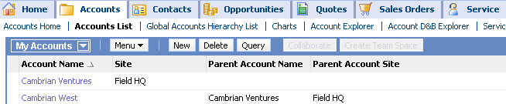
Bringing Party Data into a Party Business Component
3/3
Example: Bringing parent account data into the Account BC for display in an Account applet
  A join in a BC that refers back to data in that same BC
This Account references top account
Account
Name
Location
Parent Account Name
Parent Account Location
Notes:
Here’s another example: bringing party data into a party BC. The slide illustrates a case where one record in the Accounts List, Permian China, is referencing data in another record in the same Accounts List, Permian Tech, China’s parent account.
This case is described as a join that “refers back to itself”; that is, data in one record in a BC refers to data in another record in that same BC via a join.
In this case, we are bringing parent account data into the account business component from S_ORG_EXT.
Recall that with party business components, the data resides in the extension table, not the base table, S_PARTY. Therefore, in order to display data from the extension table, you must create an explicit join to it, even if the extension you are joining to is the main data table for the BC, such as S_ORG_EXT for the account BC.
In this example, the implicit join, called S_ORG_EXT, establishes a FK/PK relationship between S_PARTY and S_ORG_EXT. It is used by a SVF called Name, which has its Column property set to NAME, the column in S_ORG_EXT that contains the account name. It is used to display records in the Account Name list column.
To bring over the parent account data, the implicit join is not going to work because you need to reference a different FK/PK relationship that brings back only those records where there is a relationship between the parent and child records.
In this example, there is an explicit join called Parent Account that establishes that FK/PK relationship between account records within S_ORG_EXT. The SVF that references that explicit join, Parent Account Id, has PAR_OU_ID as its Column property, which has a pointer to the parent account name.

Slide 21
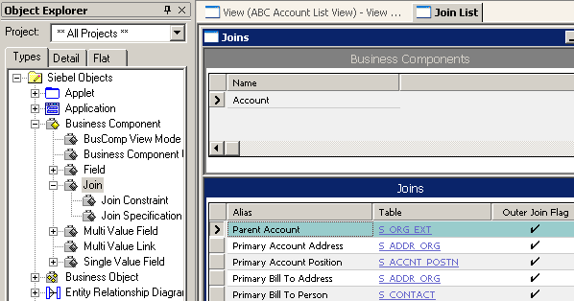
Join Definition, Bringing Party Data into a Party BC
3/3
Must use an explicit join to an extension table based on the appropriate foreign keys
  The alias must be different from those used by implicit joins in this BC
Must not use an existing implicit join to that extension table
Since an implicit join to S_ORG_EXT already exists. . .
. . .an explicit join must be used, and it must have an alias
Notes:
Since this is party data, as just discussed, there is an implicit S_ORG_EXT join, but that is not the join you should use. As mentioned earlier, you should use an explicit join to S_ORG_EXT.

Slide 22
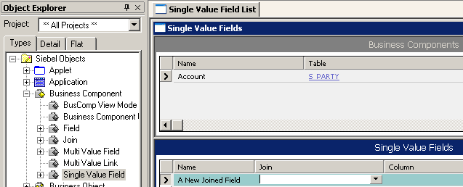
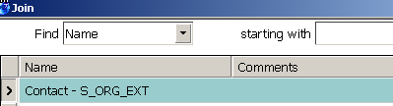
Map Field to Column in Party Table
3/3
Select the appropriate explicit join
  Do not use an implicit join to the table
Select the desired column in the joined table
Set the appropriate type (DTYPE_TEXT, etc.)
Select the explicit join instead of S_ORG_EXT
Notes:
The SVF is where you select the explicit join and specify the column in the joined table.

Slide 23
Module Highlights
BCs can include data from related joined tables
Join definitions and join specifications define how to access joined table data
Single-value fields reference the join definition and define the field to access in the joined table
To create a join:
  Locate the data source, examine existing joins, diagram the join, create the join definition, create the join specification, and define the SVF
Joins that involve party data are similar to standard data; however, when bringing party data into:
    A non-party BC, create a join specification based on PAR_ROW_ID
    A party BC, use the appropriate explicit join
Notes:
Review Questions
Question: What characterizes a party business component?
Answer: It has S_PARTY as the base table but stores main
data in one or more of its extension tables.
The subject of performance may come up. Students might ask about the performance impact of all the extra joins in the party business components. The answer is yes, there can be some impact on performance. But many of these business components already have multiple joins to begin with. In addition, Siebel Engineering tries to make sure that the joins they create do not have an unacceptable negative impact. A great deal of work goes into ensuring good performance. Make sure you point out the benefits of the party business components’ capacity to create a much more flexible way of allowing access to data (which will be discussed later in the course).

Slide 24
Lab
In the lab you will:
  Examine references when a join is not present as well as when a join is present
  Create a join that brings in data from joined table and display it in the UI
Notes:
See lab instructions for details.
Instructor may want to do the lab along with the students if there are students who have no prior experience with Siebel. For more advanced students who may be looking to display the full name of the person that last updated the record, they will want to create a calculated filed with “First Mid Last”.

