Slide 1

Module 29: Business Layer Configuration: Existing Business Components and Fields
0/5
Siebel 8.0 Essentials
Notes:
Time: Lecture: 35 - 45 minutes; labs: 20 – 30 minutes
Intent: To teach students how to edit the properties of business components and fields to capture business logic.
Flow: The module opens with a discussion of business components and their relationship to declarative configuration. Several business component properties are discussed, followed by an extended discussion of business component field properties specification via declarative configuration.
Key Terms:
Owner Delete
Search Specification
Sort Specification
BusComp View Mode
Required Property
Read Only Property
Validation Property
Pre Default Value Property
Post Default Value Property
Calculated Value Property
User Property, Field Read Only Field
User Property, Parent Read Only Field
User Property, Inner Join Extension Table

Slide 2
Module Objectives
After completing this module you should be able to:
  Edit business component properties to capture business logic
  Describe business component view modes
  Edit field properties to capture business logic
  Specify business component and field user properties
Why you need to know:
  Editing the properties of business components and fields helps you to more accurately and fully capture your business logic
Notes:
Each objective and “why you need to know” should be stated aloud.

Slide 3
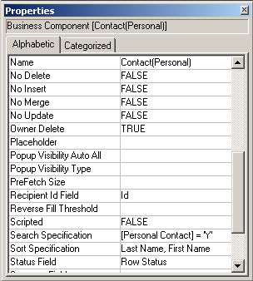
Business Component Properties
Capture business logic
Include:
  Properties for editing
    No Delete
    No Insert
    No Merge
    No Update
  Owner Delete
  Search Specification
  Sort Specification
Notes:
This is a structuring slide. It provides an overview that highlights some important business component properties that are discussed in detail in this module. Do not teach the points listed.

Slide 4
Business Component Properties
0/4
Properties for Editing
Owner Delete Property
Search Specification Property
Sort Specification Property
Notes:
This is a structuring slide for <insert what will be discussed>. Do not teach the steps or concepts here because the following slides cover them in detail. Provide a high level description of what will be discussed.

Slide 5
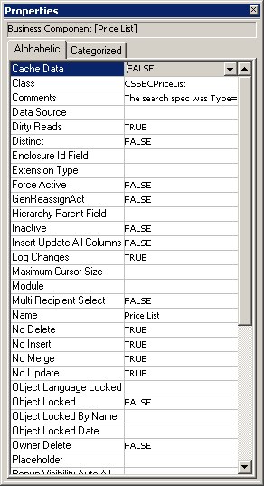
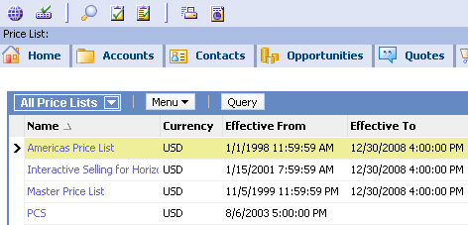
Properties for Editing
1/4
Set editing properties at the business component level to prevent deleting, inserting, merging, and updating records in all applets
Example: To maintain record continuity, users cannot delete or change price lists once they have been created
Notes:
The editing properties determine what operations are allowed on the business component records themselves.
Follow these steps to demo this:
Start Siebel Tools.
Select Business Component :: Price List.
Review the editing properties.

Slide 6
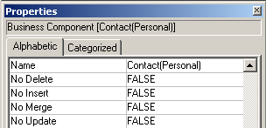
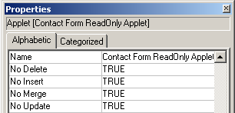
Properties for Editing Continued
1/4
These properties also appear on applets
  Most restrictive settings are always used
  Set these properties to FALSE at the business component level so you can make exceptions at the applet level
Business Component
Applet
Affects all applets referencing this BC, or. . .
. . .can be customized for each applet
Notes:
We usually choose to restrict editing at the applet level instead of the business component level. Then you can create special views that allow designated users with the right responsibilities to edit the records.
Follow these steps to demo this:
Log in to Siebel Sales as SADMIN connected to the Sample database.
Select Category > Contact Categories.
Select Help > About View to show that the read-only Contact Applet is based on the Contact business component.
Select Contacts > Contacts List > All Contacts.
Select Help > About View to show that the list applet here is based on the same business component.
Explain the implication of setting properties at the business component level; doing this affects both these applets and all others based on this business component.
Note: picklists and links also have these properties. However, they are not addressed here since this module is focused on BCs. We include the applet here because of the affect of specifying these properties at the BC level vs. the applet level.

Slide 7
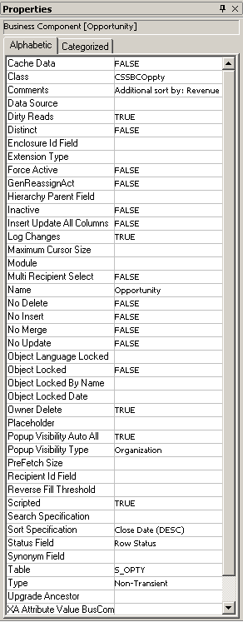
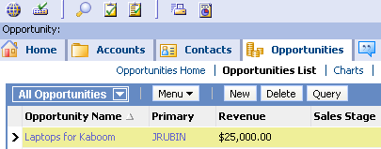
Owner Delete Property
2/4
Set the Owner Delete property to TRUE to enable only the owner of a record to delete it
  The primary on a team-based business component is the owner of the record
JRUBIN is primary owner; only JRUBIN can delete
Notes:
A TRUE or FALSE value in Owner Delete establishes the deletion rights of the user to the business component. The owner of a record in a business component set up for team visibility mode (non-blank Visibility MVLink and Visibility Emp MVField properties) is the primary position on the sales team. The owner when set up for position-based personal visibility is the position in the field pointed to by the Position
Visibility Field property. When a view is designated for Admin mode, the Owner Delete protection is disabled, and anyone having access to the view can delete any record.
If TRUE — Only the owner (under personal or team visibility) can delete the record. If FALSE — Anyone can delete the record.
Question: If Owner Delete is set to TRUE and No Delete is also set to TRUE, can the owner delete records?
Answer: No

Slide 8
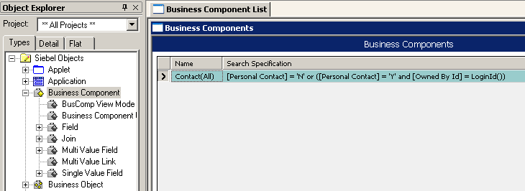
Search Specification Property
3/4
Specifies records to be retrieved by the business component
  Typically used when there are multiple business components based on the same table
BC field
Conditional statement
Notes:
The Search Specification property in a business component, applet, link, or picklist selectively retrieves rows from the underlying table that meet the criterion specified in the property. The search specification is the basis for the WHERE clause in the resulting SQL statement. It acts like a predefined query controlling the data that is visible in the applet.
An index should be present that supports the search specification. Otherwise the RDBMS engine might scan through all rows in the table rather than only those to be returned by the query. This should be a single index which contains all the columns referenced by fields in the search specification.

Slide 9
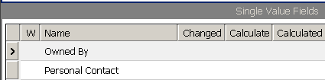
Search Specification Expression
3/4
Consists of field names, constants, functions, logical operators, and comparison operators
Example: For a given user, Contact(All) retrieves:
  All contacts where the Personal Contact flag is “N”
  All personal contacts belonging to the user
Field name in [ ]. . .
Operator
. . .must match exactly
Logical operator
Function
Notes:
This slide shows the search specification for the Contact(All) business component. It is actually two specifications, joined with an OR.
The first search specification returns all contact records where the Personal Contact flag is set to “N” (they are not personal contacts).
The second returns all contact records where the Personal Contact flag is set to ‘Y’ (the contact is a personal contact) and the owner of the record matches the login ID (it is a personal contact for the current user).
Because the two specifications are combined using OR, any record that meets either specification is returned.

Slide 10
Search Specification Considerations
3/4
Appear on business component properties and applet properties
  Search specifications are part of the WHERE clause for all applets that display this business component
    Predefined queries may also contribute to the WHERE clause
  Search specifications on the applet are combined with search specifications on the business component with an AND in the resulting SQL statement
Avoid mutually exclusive search specifications
  Avoid competing search specifications that preclude record display
UI
Layer
List Column
or Control
Applet
View
Screen
Application
Business
Layer
Field
Business
Component
Business
Object
Notes:
An applet search specification cannot be used to override the search specification of the underlying business component, if the business component has one. Rather than overriding the business component’s search specification, the applet’s search specification is appended to that of the business component. Search specifications should appear in the business component or the applets that use it, but not both.
You can set a search specification at the applet level as well the business component level.
Position determines which records you have access to.
Personalization rules also control the records you see based on certain criteria. For example, if it is Groundhog Day, you might see only the price lists with the Groundhog Day specials included.
The property text is limited to 255 characters for Sort Specification, Search Specification, and Validation properties.
Search specifications are part of the WHERE clause for all applets that display this business component.
Applet, position, and personalization criteria can also become part of the WHERE clause, as well as predefined queries (PDQs).
All of these are connected together with AND. Therefore, if any of these create mutually exclusive criteria, then no records can be displayed.
Single versus double quotes in the search specification for a business component: 77% of the time we use single quotes. The ratio stays about the same regardless of whether we are quoting a single character or multiple ones.

Slide 11
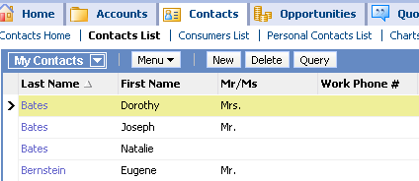
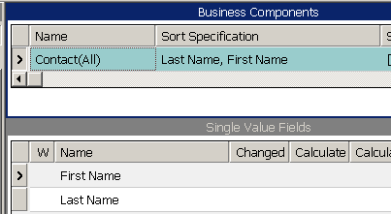
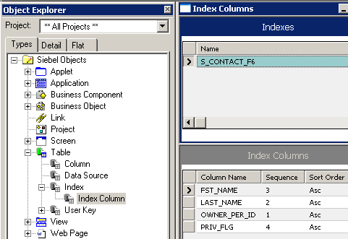
Sort Specification Property
4/4
Determines the sort order of the retrieved records
  Use (DESC) or (DESCENDING) to sort that field in reverse order
  Cannot be set at the applet level
To sort by last name, then first name. . .
. . .configure a sort specification
Must match exactly
Ensure that an index exists to support the sort specification
Notes:
The Sort Specification property of a BC orders the records retrieved by a query, and serves as the basis for the ORDER BY parameter in the SQL statement issued. The value of the Sort Specification property is the name of a field or list of fields that must be child objects of the BC. It sorts the records returned to an applet associated with this BC.
Example: The Sort Specification of the Account BC is “Name, Location.” This causes account records to be sorted by account name. Where multiple records have the same account name, they are sorted within Name by location. Observe the following syntax considerations:
Use commas to separate field names in a sort specification.
To indicate that a field in the list sorts in descending order, include
(DESCENDING) or (DESC) after the field name, as in “Start Date
(DESCENDING).” If you do not specify a sort order, ascending order is used.
Do not enclose the field name in square brackets, like this: [Account
Name]. Brackets are accepted in search specifications, but not sort
specifications.
The Sort Specification expression must be 255 characters or less.
If the Sort Specification value is blank, the Siebel application returns
records in the order in which they occur in the table.
When a check box field is included in a sort specification, three values are sorted: Y, N, and NULL. If the sorting is in descending order, the order is NULL, Y, and N.
When a multi-value field is included in a sort specification expression in a BC, the sorting is on the initial value of the multi-value field. This makes sense only if the multi-value group uses a primary foreign key.
A sort specification that includes a multi-value field in the expression does not sort the records in the underlying multi-value group. Instead, you create a sort specification in the detail BC of the multi-value link to do this.
Finally, examine the Column Name property of the various indexes in the table on which the search will be performed. If an index does not exist, there could be a severe, negative on performance when the search is executed.

Slide 12
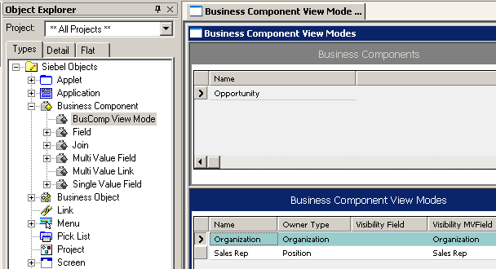
BusComp View Mode
Specifies that the BC is subject to Access Control
  Owner Type property identifies the Access Control mechanism that limits records a user can access
BCs may have multiple access mechanisms
  Allows records to be associated with different owner types
  Supports multiple view modes
Identifies the Access Control mechanism
BC field used to specify visibility
Notes:
BusComp View Modes must be configured for visibility if they are to be displayed in views such as My, My Team’s and All views discussed in the Access Control modules.
The BusComp View Mode child object definition specifies the type of access control via its Owner Type property, for example, Person, Position, or Organization, and the field containing the owning person, position, or organization, as specified via the .
Owner Type determines how a user is associated with a record. This property can have the following values: Personal, the user’s person record; Position, the user’s position; Organization, the organizaiton the user belongs to, as determined by the organization to which the user’s current position belongs; membership in an access Group that has access to particular catalogs and categories.
If the Access Control field is single-valued, the field name is specified in the Visibility Field property. If the Access Control field is multi-valued, the field name is specified in the Visibility MVField, and the multi-value link used by the Visibility MVField is specified in the Visibility MVLink property (not shown in the screen print).
For more information, consult the Security Guide for eBusiness Applications.
Note: in general, customers should not modify BusComp View Mode properties. However, the customer may need to understand the pre-configured visibility behavior, which is determined by perusing BusComp View Mode.

Slide 13
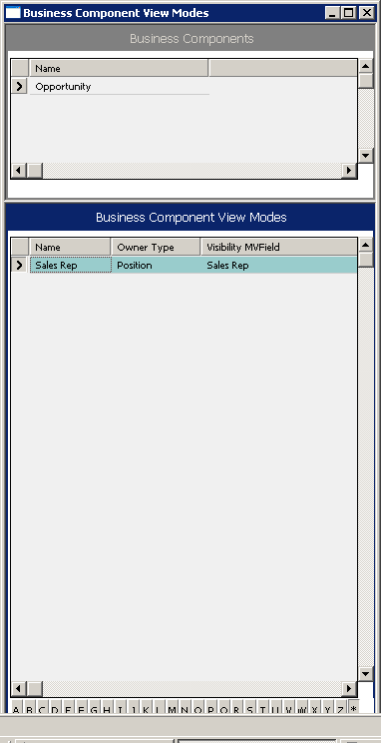
BusComp View Mode, Example
The Opportunity business component has a position-based BusComp View mode
  Invoked when user navigates to the My Opportunities or My Team’s Opportunities view
Visibility MVField property is set to Sales Rep, so application reads list of positions from Sales Rep MVF to determine record visibility
  The My Opportunities view shows records with the user’s current position listed in the Sales Rep MVF
  The My Team’s Opportunities view shows records where user’s direct or indirect reports are primaries on the Sales Rep MVF
For each record, the application compares the user’s current position to positions in Sales Rep MVF
Person- or position-based BusComp View modes are invoked by My views
Notes:
The value in Visibility MVField is compared against the corresponding value for the user, as specified in the Owner Type property, to determine whether the user is associated with a record. If they are associated, the user gets access to the record.
For example, in the screen print, the Opportunities business component’s Sales Rep view mode determines whether the user is associated with the record by
1. Specifying Position as the owner type for this BC view mode.
2. Using the Sales Rep MVF to specify visiblity. Note that Sales Rep has a display name of Sales Team. It is the position that is being compared; not the user. That’s why it is important to view the pick list in this example, not just the form applet since the form applet only displays the User ID.
3. Comparing the values specified via Owner Type against the values specified via Visibility MVField.
4. If the values match, the record is displayed.
DEMO:
In Tools, show the various choices in the Owner Type drop down list. The point here is that Owner Type can be either a Person, Position, Organization, Group, or Catalog Category.
In the Visibility MVField, show how all MVFs in the BC are possible choices.
Illustrate this relationship: navigate to Administration > Group > Positions to show how Rubin’s position is administered.
Navigate to Opportunities List. Select the Sales Team MVF to show how Positions are used to determine who can be selected to be part of this team and, therefore, has access.

Slide 14
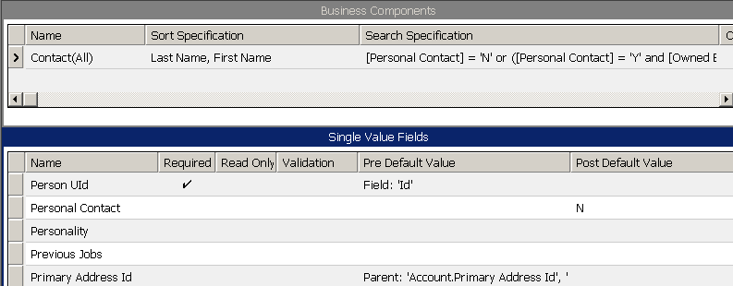
Field Properties
Customize fields by editing property values
Setting field properties at the business component level sets them across all applets that reference the business component
  Each applet references one, and only one, business component
Properties set at the business component level affect all applets that reference the business component
Notes:
This is a positioning slide. The following properties are handled in depth in the next few slides.
Required
Read Only
Validation
Pre Default Value
Post Default Value
Calculated fields are also discussed in this module, and use the properties “Calculated” and “Calculated Value.”

Slide 15
Business Component Field Properties
0/4
Required and Read Only
Validation
Default Values
Calculated Fields
Notes:
This is a structuring slide for <insert what will be discussed>. Do not teach the steps or concepts here because the following slides cover them in detail. Provide a high level description of what will be discussed.

Slide 16
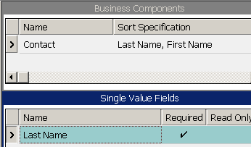
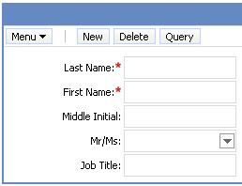
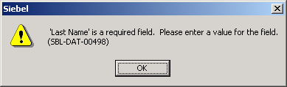
Required and Read Only Properties
1/4
Setting Required to TRUE prevents user from leaving field blank
Setting Read Only to TRUE prevents user from editing the value
2. Required field marked with asterisk
1. Contacts require last names
3. Attempting to save without last name causes error message
Notes:
Required Property
This property ensures that a user must provide a value for the field before the record can be saved. On the other hand, if the field has a pre-default value, as shown on slide 18, the user can simply accept the default.
Discuss the implications of making this field required at the Business Component level, for example:
Any control based on this field in any applet will now require a value.
Also, if you were to import data into the application through the Business Objects layer (for example, using EAI or a programmatic interface), then you would have to ensure that the record had a value for this field, otherwise the record would be rejected.
Read Only Property
This property prevents users from editing the field, regardless of the applet. If you want the user to be able to enter a value for this field when creating a new record, do not set this property to True.
Controls and List Columns can also be set to Read Only. This property can be used to make the field to be read-only in one applet, but editable in another. Discuss the implications of making a field read-only at the Business Component level as opposed to the Applet level.

Slide 17
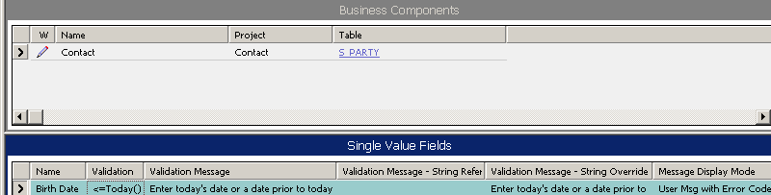
Validation Property
2/4
Checks the rule when a record is saved to ensure that the field data is valid
Message is customizable
Can refer only to business component fields in the same record
Birth date must be
prior to the current date
Text displayed when validation fails
Specify existing string in SRF. . .
. . .or enter a custom message
Option to include system error message
Notes:
This property defines a condition that must be TRUE for the user to be able to exit the field. If it is not, the application automatically generates a message for the user.
A field’s Validation property restricts the values for a field or ensures the correctness of data entered for a single-value field. Validation is not supported for MVFs.
The property text is limited to 255 characters for Sort Specification, Search Specification, and Validation properties.
With Siebel 8.0, messages for field validation are customizable, with three new validation properties: Validation Message displays, in clear text, the message you configure in the Validation Message - String Reference or Validation Message - String Override field.
In the Message Display Mode user property, you can select the display mode you want to use for the error message:
■ User Msg. Displays only the error message you provide.
■ User Msg with Error Code Only. Displays the error message you provide along with the system error code.
■ User Msg with Error Code/Msg. Displays the error message you provide, along with the system error code and system error message.

Slide 18
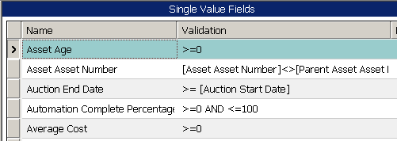
Validation Property Continued
2/4
Rules are expressed as a combination of logical operators, constants, field names, and predefined functions
Constant
Field name
Operator
Logical operator
Notes:
This slide illustrates examples of what can appear in a validation expression. Note that the expression can refer to other fields in the same business component. It can also refer to fields in the parent business component as long as the parent business component is part of the current view.

Slide 19
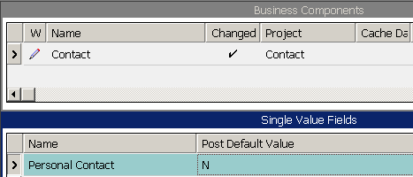
Default Values for Fields
3/4
Pre Default Value
  Automatically assigns a value to a field for a new record
Post Default Value
  Assigns a value to a field, if not entered by the user, before the record is inserted into the database
Example: If the user does not designate a contact as personal, the system assumes it is not personal, and sets it to N
Notes:
The Pre Default property defines a value that is automatically assigned to the field when a new record is created.
Pre Default values are common in a number of situations. For example, they can be used to fill in fields that are used to distinguish between records for different business components that use the same table. For example, the Contact(Personal) business component uses the same tables and columns as a number of other business components including Contact, Contact(All), and Contact(Purchasing Manager). However, it pre-defaults the “Personal Contact” field to ‘Y,’ which differentiates it from other contact-type business components.
Pre Default values can be used to automatically fill in parent-related fields when creating a record in the child business component in a detail view. They are also used when there is a field with an obvious value, like a date field.
Follow these steps to demo this:
1. Navigate to the Service Request List applet.
2. Add a new SR. Note that the SR Number, Priority, and Status fields are automatically given a value. These fields have had a Pre Default value set at the field level in Siebel Tools.
The Post Default property defines a value that is assigned to a field when a user saves a record but has not provided a value for that field.
Follow these steps to demo this:
1. Navigate to the Opportunity-Quote view.
2. Add a new quote but do not put a value in the Name field.
3. Save the record. Note that the quote Name field now has a value. This was added when you saved the record; a post-default value was set at the field level for this to occur.
Note: before leaving this section on BC field properties, note that Force Case is another property that can be specified. Its very straightforward, so a separate slide is not warranted. Suffice to say Force Case defines the case for a field value. Valid values are:
UPPER
LOWER
FIRSTUPPER

Slide 20
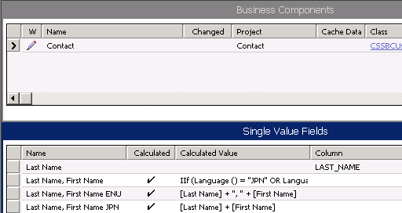
Calculated Fields
4/4
Derive their value from values in other fields in the same record of the business component in which the calculated field resides
Cannot be stored in the database; therefore, there is no associated column
To enable, set Calculated property to TRUE (checked)
Column property
is empty because
calculated fields are not
stored in the database
Notes:
This slide explains what a calculated field is.
A calculated field is one whose value is derived from some formula involving other fields. You do not enter data into a calculated field; the system automatically determines the correct value.
The calculated flag must be set to TRUE.
A calculated field in Siebel Tools is implemented by the specification of a Calculated Value property value in a Field object definition. The Calculated Value property specifies an expression for calculating the value of a field. The syntax for the Calculated Value or Validation property is the same as the QBE syntax, with different but overlapping functions. The comparison, logical AND, and logical OR operators are valid for these properties.

Slide 21
Restrictions on Calculated Fields
4/4
Calculated fields are read-only
System does not validate values of calculated fields
Sorting on calculated fields is not supported
Querying on calculated fields is supported
  Performance depends upon whether functions in the query expression can be incorporated into the SQL statement
Notes:
Calculated fields have the following rules and restrictions:
Calculated fields do not support updates (even simple
expressions like [Field]), unless specialized business
components override SqlSetFieldValue.
Calculated fields cannot be stored in columns.
Validation criteria on calculated fields is ignored.
Queries on calculated fields are always supported.
Sorting on calculated fields is never supported.
Calculated fields are not stored in tables.
When a query is performed on a calculated field, the action taken by the Siebel application (and thus the resulting performance) depends on which functions are used within the calculation. Functions that can be incorporated directly into the WHERE clause in the SQL statement are incorporated. Functions that cannot be directly incorporated, such as If() and Lookup(), result in testing each record in the business component to determine which records to display to the user, at a considerable performance cost.

Slide 22
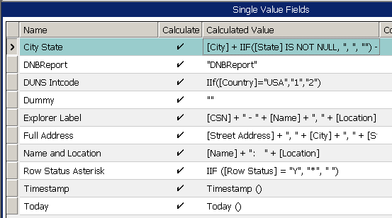
Calculated Value Property
4/4
Is an expression built from:
  Field names in the same business component
  Field names from the parent business component
    Current BC must have the child in a detail view
  Standard functions
  String, numeric, and logical operators
System functions
Notes:
This slide explains what can appear in an expression for a calculated value. The syntax for the Calculated Value or Validation property is the same as the QBE syntax, with different but overlapping functions. The comparison, logical AND, and logical OR operators are valid for these properties.

Slide 23
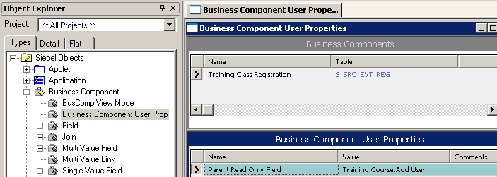
User Properties
Are object definitions added as children to an applet, business component, control, field, or list column
Used to configure specialized behavior beyond what is configured in the parent object definition's properties
Each user property contains its own conditional logic
  Can implement specific, custom IF/THEN logic
  Many use their own unique syntax
Can be used as a declarative alternative to scripting
A wide variety of user properties exist, such as:
  BC Read Only Field, Field Read Only Field, and On Field Update Set
Notes:
User properties are object definitions that are added as children to an applet, business component, control, field, or list column to configure specialized behavior beyond what is configured in the parent object definition’s properties.
For more information about declarative alternatives, I recommend the Web-based training course, “Declarative Alternatives to Siebel Scripting,” available from Siebel University.
Note: There are a large number of user properties, each with its own specialized behavior. Many have unique snytax and logic. For additional information, reference Siebel Developer’s Reference.

Slide 24
BC User Property Scenario
Business challenge
  Based on values the end user enters at run time, dynamically disallow updates to record
Business solution
  Use the BC Read Only Field user property
    Allows you to specify a field on the business component that determines whether individual records are read-only
  Example: Shipped orders cannot accept changes to order entry line item records in an existing order
    Order has shipped, and it is too late to add more line items to the order
Order Entry - Line Items
BC Read Only Flag
Field that flags whether record is read-only
Y
Read-only
N
Order Entry - Line Items
Target BC
Writable
Notes:
Very often a record should not be changed based on a value in a field entered by the user. Usually a PreWriteRecord event is scripted to check the value in a specific field, and will reject the writing of that record if an offending value is found.
As a declarative alternative to this scripting, a proactive method of preventing changes to a record is to use the Business Component Read Only Field business component user property. A typical scenario is to disallow the editing of a record when its Status field is in a certain state, for example, "Shipped.“ If the order has already been shipped, edits to the Order Entry - Line Items business component would be in violation of an established business rule. Enforcement of this rule would involve creating a calculated field called BC Read Only Flag, for example, on the Order Entry - Line Items business component and entering an expression such as: If the Status field is "Shipped", "Y". Otherwise, "N".
This allows the field to be referenced in another expression.

Slide 25
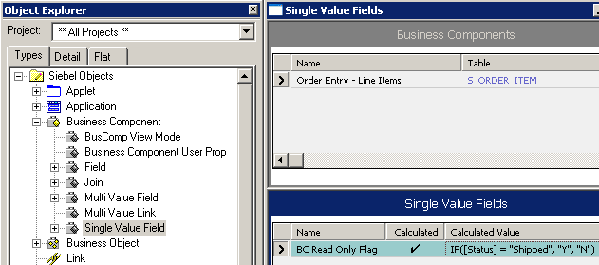
User Property, BC Read Only Field Example
Create a calculated field on the Order Entry – Line Items business component whose value is either Y or N
  BC Read Only Field user property requires an input value of Y or N, so create a calculated field whose values are limited to those two values
For this example, create a calculated field named BC Read Only Flag with the expression: IF([Status] = "Shipped", "Y", "N")
  This sets the value of the calculated field to Y if the status is shipped, N otherwise
BC Read Only Flag SVF has a value of Y if the status of the item is shipped, N otherwise
Notes:
1. Create a calculated field called BC Ready Only Flag. In the example shown, the calculation reads: If the Status field = “Shipped”, then the value of this BC Ready Only Flag field is “Y”; otherwise, the value is “N”.
2. Create a new Business Component User Property called BC Ready Only Field. Set the Value for this User Property to the name of the calculated field you just created.
Note: The Value for the BC Read Only Field user property must be the name of a field on the business component. When the value of the field specified in this user property is TRUE, the current record is read-only.
The Siebel application knows that at run time, a field in the business component, the one specified in the Value property of this business component user property (BC Read Only Flag in this case) determines if the record is read-only. If BC Read Only Flag contains a TRUE value, then the record is read-only; if it contains a FALSE value, the record is not read-only.

Slide 26
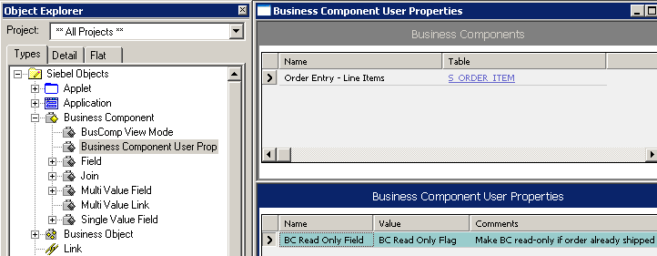
User Property, BC Read Only Field Example Continued
Add the BC Read Only Field user property
  Set the Value property to BC Read Only Flag
    Value is the name of the calculated field on the BC
  When the value of this field is “Y”, the current record is read-only
Create User Property which references the calculated field
Notes:
1. Create a calculated field called BC Ready Only Flag. In the example shown, the calculation reads: If the Status field = “Shipped”, then the value of this BC Ready Only Flag field is “Y”; otherwise, the value is “N”.
2. Create a new Business Component User Property called BC Ready Only Field. Set the Value for this User Property to the name of the calculated field you just created.
Note: The Value for the BC Read Only Field user property must be the name of a field on the business component. When the value of the field specified in this user property is TRUE, the current record is read-only.
The Siebel application knows that at run time, a field in the business component, the one specified in the Value property of this business component user property (BC Read Only Flag in this case) determines if the record is read-only. If BC Read Only Flag contains a TRUE value, then the record is read-only; if it contains a FALSE value, the record is not read-only.

Slide 27
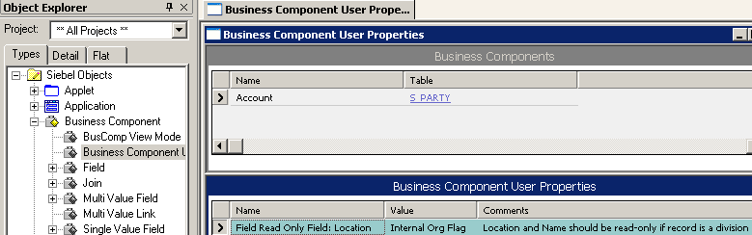
User Property, Field Read Only Field
Sets a specific field in a business component to be read-only
  Field Read Only Field: Location sets Location field as the target of a conditional statement
  Value is the name of a field that contains a Boolean value
At run-time, if condition is met, field is set to read only
This condition affects. . .
Location is ready only
S_ORG_EXT
INT_ORG_FLG
. . .this target field. . .
ROW_ID | INT_ORG_FLG
1 | Y
Y
N
. . .depending on the Boolean value in this field
Location is not read only
Notes:
Field Read Only Field is another User Property we can examine.
The name of the Field Read Only Field user property must specify the name of a field (fieldname) in the business component. The value of Field Read Only Field is typically a second field, which is Boolean. When the field specified by the value evaluates to TRUE, the field specified by fieldname in the current record is set to read-only.
For example, if Field Read Only Field: Location has a value of Internal Org Flag, then the Location field is set to read-only when Internal Org Flag is TRUE.
BC Read Only Field performs in a similar way: This user property allows you to specify a field on the business component that determines whether individual records are read-only. When the value of the field specified in this user property is TRUE, the current record is read-only. With Field Ready Only Field, only the field becomes read-only, not the entire record.

Slide 28
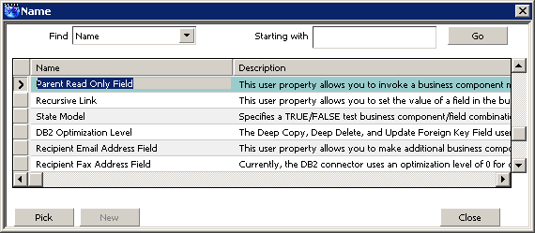
Adding a User Property
Is done via a picklist in the Name property in the Business Component User Properties window
  Only those user properties allowed for parent BC are displayed
Displays user properties allowed for this BC
Notes:
A picklist in the name property in Bus Comp User displays the user properties supported for the parent.

Slide 29
Module Highlights
BC properties are set to control behavior:
  Editing properties, Owner Delete, Search Specification, and Sort Specification
BC field properties are set to control behavior:
  Required, Read Only, Validation, Pre and Post Default, and Force Case
BusComp View Mode specifies BC is subject to access control
Calculated fields derive their value from other fields in the same record of the BC in which the calculated field resides
User Properties have their own specialized logic that can be added to a BC
  Declarative alternative to scripting
Notes:
Review Question: If you give the same field a pre-default value and a post-default value, will the post-default value ever be used for anything?
Answer: Yes, if the user creating the record deletes the pre-default value but does not give it a new value, the post-default value will be automatically filled in.

Slide 30
Lab
In the lab you will:
  Incorporate business logic into the application by configuring properties of business components and fields

