Slide 1

Module 30: Business Layer Configuration: New Business Components and Fields
0/5
Siebel 8.0 Essentials
Notes:
Time: Lecture: 30- 35 minutes; lab: 60 – 75 minutes
Intent: To teach students how to create new business components and add them to existing business objects.
Flow: The module by posing a business problem, and then presenting the solution of creating a business component using a 1:M extension table. The structure of 1:M extension tables is discussed followed by a discussion of creating a new business component, and adding it to a business object.
Key Terms:
Standard 1:M extensions table (*_XM)
TYPE column
TYPE field

Slide 2
Module Objectives
After completing this module you should be able to:
  Create a new business component (BC)
  Add a business component to a business object
Why you need to know:
  Enables you to incorporate additional business entities that do not correspond to business components in a standard Siebel application
  Enables you to tailor your business logic
Notes:
Each objective and “why you need to know” should be stated aloud.

Slide 3
Business Challenge
Siebel-provided business components capture most commonly-used business entities, but they do not cover every possibility
Example: Sales organizations might record personal data about contacts, such as:
  What colleges the contact attended
    Name of college, years attended, major field of study, sports played, honors received, and so on
  The contact’s favorite restaurants
    Name and location, price range, type of cuisine, and so on
To capture this kind of information may require:
  Multiple fields to capture the details
  1:M or M:M relationship to the parent
Notes:
This slide is an overview and expands on the “why you need to know” statement on slide 2. It also reviews some details of how business components are implemented and how they relate to a parent business object.

Slide 4
Business Solution: Create New Business Components
To capture this sort of information, create new business components
  For example, create college and restaurant child BCs of the Contact parent BC
Used to add entities specific to your organization that are not in the Siebel repository
You can base these business components on tables supplied by Oracle
  Standard
  Extension
  1:M
  M:M
Notes:
Relate the bullet points to the example on the bottom of the slide. Point out that both child business components will be based on the same standard 1:M extension table, in this case, S_CONTACT_XM.

Slide 5
Scenario: 1:M Relationship With Existing Table
Example: Create Colleges Attended and Favorite Restaurants business components for sales organization
Colleges Attended and Favorite Restaurants have a 1:M relationship with Contact
  Requires two business components, Colleges Attended and Favorite Restaurants
    One for Contact : Colleges Attended
    One for Contact : Favorite Restaurants
When creating a BC with a 1:M relationship with the parent business component, consider using a 1:M extension table
Colleges Attended
Contact
Favorite
Restaurants
Notes:
Relate the bullet points to the example on the bottom of the slide. Point out that both child business components will be based on the same standard 1:M extension table, in this case, S_CONTACT_XM.

Slide 6
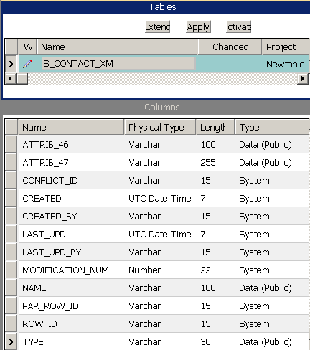
Review: Standard 1:M Extension Tables
Predefined in the repository for many business components
Have name of parent table appended with _XM
Contains many predefined ATTRIB columns of varying type
NAME column stores the name of the child entity
PAR_ROW_ID column stores foreign key to ROW_ID in main table
TYPE column identifies the child business component
Notes:
Show students how to find the right extension table: Find the base table for the parent business component, then verify that an _XM table exists for it. Show the various types of ATTRIB columns available.
No fully-defined business component in the standard Siebel applications uses the _XM tables as its base. Two are defined (Countries Deployed and Languages Deployed), but they are not complete. They have no fields based on the ATTRIB columns. So if you want to do a more detailed demonstration in the classroom, you may have to do a little bit of work in advance.

Slide 7
User Key
TYPE, PAR_ROW_ID, and NAME serve as a user key for the table
  These three columns are required
    Must provide values for all three columns when creating a new record
  Combined value of the three columns must be unique
S_CONTACT_XM
User Key
ROW_ID
TYPE
PAR_ROW_ID
NAME
Notes:
Point out that, while TYPE and PAR_ROW_ID are the base for required fields, they should not be displayed to the user, but set by the system. TYPE should be pre-defaulted. PAR_ROW_ID will be set by the link to the parent business object.

Slide 8
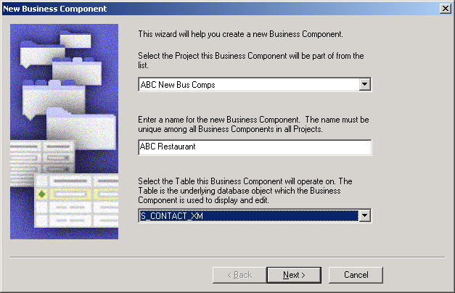
Business Component Wizard
Use the Business Component Wizard to create a new business component
  Select File > New Object, select BusComp, and then click OK
Wizard

Slide 9
Business Component Wizard Inputs
The Business Component Wizard requires the following inputs:
  Project new business component will be part of
  Business component name
    Must be unique among all business components in all projects
  The business component’s table name
  Fields that will be part of this BC
    Selected in the wizard by specifying Table Column, then entering a field name
      Specify TYPE column and relate it to Type field
      Specify PAR_ROW_ID column and relate it to Id field
      Specify NAME column and relate it to Name field
      Use ATTRIB_ columns for additional data
    Columns are limited to the table you select in wizard
    Use a separate column for each field
Establishes User Key
Notes:
Demo:
Walk through the process of creating a new business component.
Dialog box: New Business Component
Use the example of creating the XYZ College business component using the Business Component wizard. Show the first screen of the wizard (business component = Contact, name = XYZ College, table = S_CONTACT_XM). Don’t press Next yet.
Dialog box: Single Value Fields
Click Next and demonstrate the Single Value Fields screen of the wizard. Use ATTRIB_01 for the location of the college, ATTRIB_02 for notes, ATTRIB_03 for team name, and ATTRIB_08 as a flag for a four-year college.
Don’t forget to set Name, Type, and Parent Id.
Click Finish. The business component appears in the OBLE. Select Single Value Field in the OE to show that the SVFs have been created. Change the type of the four-year flag to Boolean. Set the predefault for Type to “College.”
Note: the 10 box diagram is included in the student guide for student’s quick reference: a business component references tables, which are composed of columns. A business component is composed of fields, which also reference those columns. When using this wizard, students interact with all these objects at some level.

Slide 10
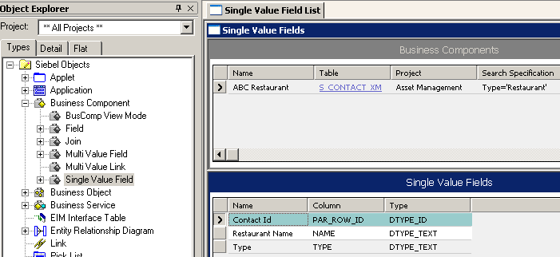

Business Component Wizard Outputs
The Business Component Wizard:
  Creates a business component object and its child object definitions
  Creates fields and relates them to table columns
    Aside from what you specify in the wizard, uses default field and table values; for example, Owner Delete is set to FALSE
Creates new fields and relates them to columns
Creates the business component object definition
Notes:
This is a list of the various things the business component wizard does after you click the Finish button.

Slide 11
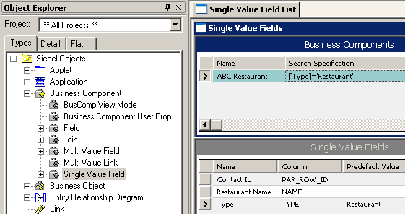
Set the Pre-Default Value
Automatically assigns a value to a field for a new record
  For extension tables, set Predefault Value property of the Type field to the value used in the BC search specification
  Can be used to ensure that the user key is populated
Matches the value in the Search Specification
Ensures that all new records have a type of “Restaurant”
Notes:
The Predefault Value property is discussed in more detail in the previous module, but here we see it put to use. Also, note that you can ensure the user key is populated by specifying a predefault value for each and every field in that user key.

Slide 12
Set Search Specification
Manually set the search specification to match the unique TYPE value for the business component
  Specifies the records to be retrieved by the business component
Typically used with extension tables
  Supports the case where multiple BCs are based on the same extension table
Search retrieves only records with a Type of “Restaurant”
Notes:
Search Specification was discussed in the previous module, here we see a specific example of this property’s usage.
In this example, when the ABC Restaurant BC is used, only records that have a Type that = “Restaurant” will be retrieved.
Search Specification is particularly useful when you have an extension table that is referenced by more than one BC. Each of those BCs may have its own data display requirements. However, since several BCs use the same extension table, all data in that extension table will most likely not be specific to just one BC. Therefore, you can use Search Specification to limit the records retrieved based on the BC that is retrieving them. For example, lets say that in addition to ABC Restaurant BC, you also have ABC Amusement Park BC. Both BCs use S_CONTACT_XM to store their specific data. The Search Specification for ABC Amusement Park could be set to [Type]=‘Amusement’, and hence retrieve only the records it needs.
Search specifications can affect performance negatively, particularly when you include:
- Fields based on joins
- The operators NOT or OR; they can force the database to execute a full table scan
- Calculated fields

Slide 13
Multiple Business Components
You can use one table to map multiple user-defined child business components
Each BC has a unique TYPE value
  Stored in the TYPE column of the table
Each BC retrieves only those rows with its TYPE value
Specify properties on business components and fields
  Search Specification
  Pre Default Value
Colleges
Attended
S_CONTACT_XM
Type = College
NAME
ROW_ID
TYPE
PAR_ROW_ID
Favorite
Restaurants
Type = Restaurant
Notes:
In an actual scenario, at this point the second business component must be created.
Point out that the same ATTRIB columns can be used in different extension business components, because the TYPE search spec guarantees that a given row will only be used for one business component. Therefore, there will be no confusion. For example, if you are defining “Colleges” and “Restaurants” as extensions of Contact, you can use ATTRIB_03 of S_CONTACT_XM to store both the street addresses of restaurants and the names of college teams.

Slide 14
Post-Creation Tasks
0/3
1. Relate Child and Parent BCs
2. Reference Business Component in Business Object
3. Enable Display Data in UI
Notes:
This is a structuring slide for <insert what will be discussed>. Do not teach the steps or concepts here because the following slides cover them in detail. Provide a high level description of what will be discussed.

Slide 15
Relate Child and Parent BCs
1/3
For each child/parent relationship, associate the newly configured child business component to the parent:
  Create a link definition to relate child and parent records
Parent
Contact
Contact/Favorite Restaurants Link
Contact/Colleges Attended Link
Favorite
Restaurants
Colleges
Attended
Child
Child
Notes:
This slide is a positioning slide for the next two slides.

Slide 16
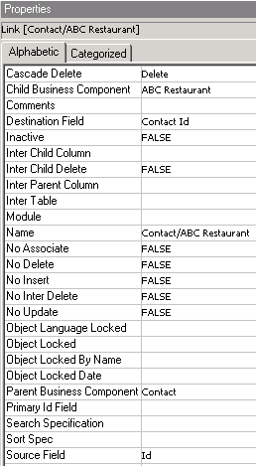
Relate Child and Parent BCs Continued
1/3
Create a separate link for each child/parent relationship
  In our scenario, Contact/Favorite Restaurants and Contact/Colleges Attended
Link creation is same as with any standard BC
This will be the link you specify in the business object
Child is Restaurant
Parent is Contact
Notes:
Assuming you created XYZ College, create a link with these values: Project = Contact, Parent business component = Contact, Child business component = XYZ College, Source Field = Id, Destination Field = Parent Id.
Recall that the Source Field maps to the Primary Key of the parent, which is always the ROW_ID column in the parent’s base table.

Slide 17
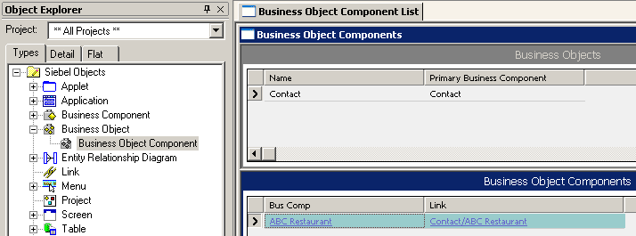
Reference Business Component in Business Object
2/3
Create a Business Object Component definition for each new business component
  The business object defined for the parent is the one to use
  The business component is the child you just created
  Set the Link property
Parent BC
Child BC
Link you just created
Notes:
Add XYZ College as a Business Object Component to Contact. Do not forget to set the Link property.

Slide 18
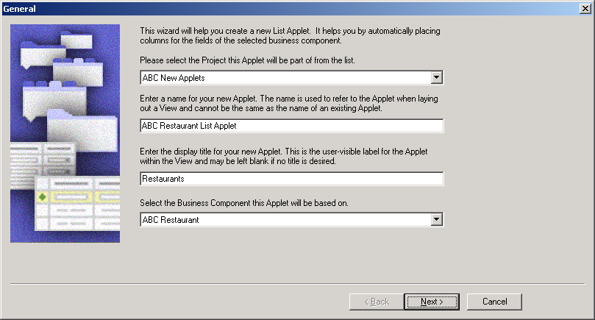
Enable Display Data in UI
3/3
Build applets and views as required to display data from the business component
  To prevent users from changing the value, do not display the Type field
List Applet Wizard
Notes:
This slide is a review. Users will not see the business component until it has been displayed on an applet, the applet has been displayed on a view, and the view has been administered in the application.
If you have done the other demos up to this point, and you have time, create a simple applet and view to display XYZ College.

Slide 19
Creating a Standalone Business Component
May be necessary when your company's business logic requires a new table be added to the database
  In most cases, Siebel's extensive database should meet most of your needs. There could be exceptions.
To create a standalone BC:
  Create a new table to hold BC data
  Add appropriate columns to this table
  Create a new BC and add BC fields
  Create a new Business Object and reference the BC in this BO
  Enable data display in the UI
  Standalone BCs are based on standalone tables and have no relationships to other BCs or tables
Notes:
The scenario just covered in this training, 1:M with an existing table, is just one possible scenario for the need to create a new business component. It may also be necessary to create a “standalone” business component, where this new BC has its own, new base table.
This slide highlights the steps required for such a scenario.
You can still use the BC wizard to perform some of these tasks. However, you’ll have to create a new table prior to running the wizard.
The first two steps are addressed in the Extending the Siebel Database module of Siebel Essentials (a few modules later in this configuation section).

Slide 20
Module Highlights
Create a new BC as child of an existing BC to capture new information
When possible, use predefined _XM tables to store data
Use the BC Wizard to create a new BC
When using extension tables, use one extension table to map to multiple child BCs
  Each BC has a unique TYPE value
  Specify properties on BC and fields
    Include required fields, such as Type and NAME
Create a link definition to associate new child BCs with parent
Add new BC to a BO, then create applets and views to display data
Create a standalone BC, when necessary
Notes:
Review Question: How can many business components use the same _XM table?
Answer: By giving each business component a unique code, which is stored in the Type field (a required field in all _XM tables) and set as a predefault value in the business component, multiple business components can use the same _XM table.
Review Question: In a 1:M link, what are the Source Id and Destination Id properties?
Answer: They provide data that implements the 1:M relationship between the parent and child business components.
The Source Id property contains the name of a field in the parent business component that contains a unique identifier (key)—typically, Id.
The Destination Id property contains the name of a field in the child business component that contains a value matching the value of the field in the parent business component (identified in the Source Id property).

Slide 21
Lab
In the lab you will:
  Create and display a new business component based on a 1:M extension table

